Slide 1
Decoupled Software Pipelining
Fuyao Zhao
Mark Hahnenberg

Slide 2
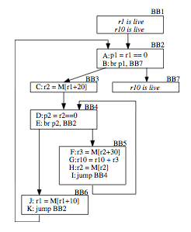
Problem
Automatically extract general thread-level parallelism from loop bodies.
Other constraints:
LLVM compiler framework
No custom hardware support

Slide 3
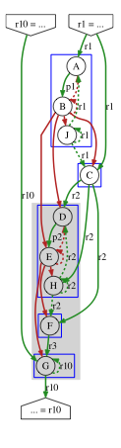

Dependence Analysis
Analyze the dependences in the program and build a graph, find SCCs, coalesce into a DAG
Dependence types:
Data
True
Anti
Output
Control
Normal
Loop iteration

Slide 4
Thread Partitioning and Code Splitting
Partition the DAG into separate threads
Copy instructions from the partition into separate, newly created functions
Initialize threads with new loop functions
Main thread waits for auxiliary threads to finish

Slide 5
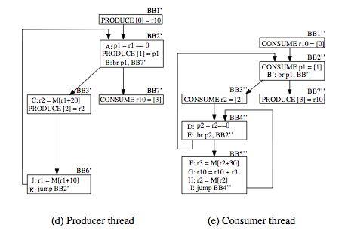
Synchronization Insertion
At points where dependences need to be communicated between threads
Insert a produce in the producer thread
Insert a consume in the consumer thread

Slide 6
Runtime Support
Built an external library in C
Fixed-size thread-safe queues
Block on pop if queue is empty
Block on push if queue is full
Functions callable from LLVM (for produce and consume)
Original program
Compiled by LLVM
DSWP optimized program
Linked against
simple_sync lib
executable

Slide 7
Results

Slide 8
Future Work
More testing and benchmarks
Persist threads between loop bodies
Improved thread synchronization cost model

