Slide 1
Decoupled Software Pipelining
Fuyao Zhao
Mark Hahnenberg
Repository: http://code.google.com/p/15745-project-dswp/

Slide 2
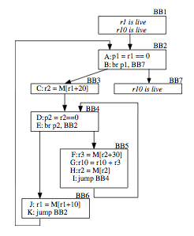
Problem
Automatically extract general thread-level parallelism from loop bodies.
Other constraints:
LLVM compiler framework
No custom hardware support

Slide 3
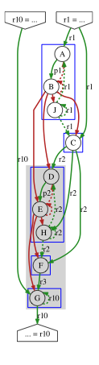

Dependence Analysis
Analyze the dependences in the program and build a graph, find SCCs, coalesce into a DAG
Dependence types:
Register
Data
True
Anti
Output
Control
Normal
Loop iteration

Slide 4
Thread Partitioning and Code Splitting
Partition the DAG into separate threads
Minimize the total execution time
NP-Complete
Using heuristic try to balance each thread
Code Splitting
Copy instructions from the partition into separate, newly created functions
Initialize threads with new loop functions
Main thread waits for auxiliary threads to finish

Slide 5
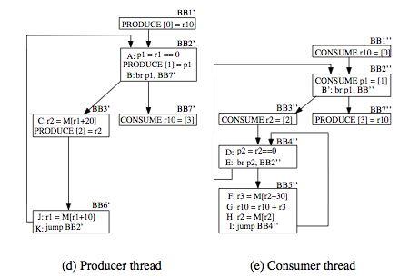
Synchronization and Runtime Support
For each dependency Insert a produce/consume in the producer/consume thread
Built an external library in C
Fixed-size thread-safe queues
Block on pop if queue is empty
Block on push if queue is full
Functions callable from LLVM (for produce and consume)

Slide 6
Architecture
SCC and DAG builder
Dependency Analyzer
Original program
Compiled
Thread Partitioner
LLVM DSWP Loop Pass
DSWP optimized program
Loop Splitter
Linked
Synchronization
simple_sync lib
Debug Support
Runtime support
executable

Slide 7
Results & Analysis
Haven't run the optimizer on large program
On a simple program that calculate sum from 1 to 10000, it is much slower than original one
Why?
Run on un-optimized code gives an “unrealistic” opportunity for parallelization
Overhead of communication

Slide 8
Future Work
Improve the implementation, more testing and benchmarks
Better dependency analysis, better alias analysis
Formulation for synchronization cost based thread partition model, and better heuristic
Reduce the runtime overload (1. Persist threads between loop bodies. 2. Profiling)

