Slide 1





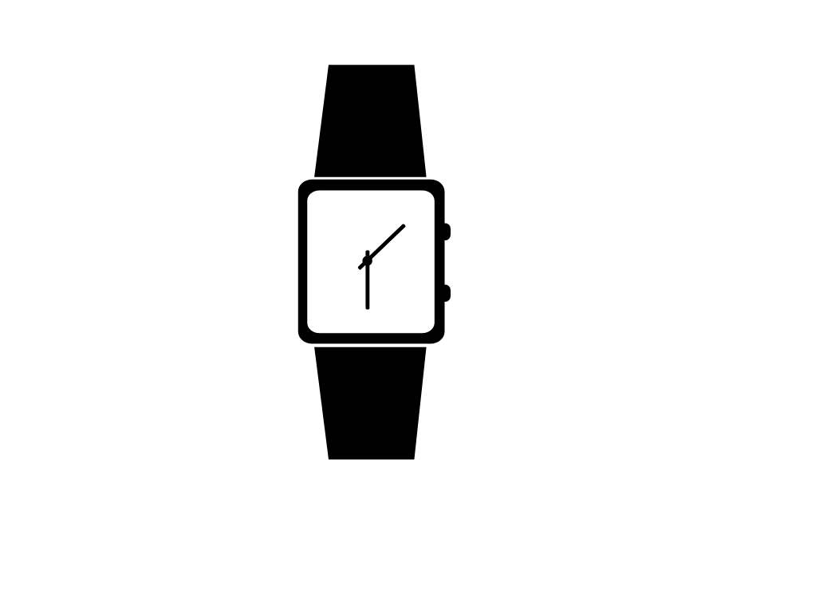

Flow of Information Lemelson MIT
SD Card
Collects patient data if no cellular connection is available
Emergency Medical Services
Patient profile uploaded to web app and accessed via RFID
Reusable data collection device
Program
Sensors
Imbedded RFID
App 1 web app (pre-upload)
Patient profile: uploaded images and videos, patient data
*EMS can add additional info to patient profile via the web app
RFID identified when patient is admitted into hospital
Patient profile loaded into “App 2”
*RFID sent to EMS and hospitals via radiowaves
Hospital
Doctor and nurse smart-device
Access to app 2
Alert system based on patient norms
1.
2.
*Doctors and nurses have additional app 2 settings i.e. the alert system and patient data
1.
2.
3.
4.
5.
App 2 interfaces to app 1
Triaged patients
*Triage nurses are able to change the triage order based on their knowledge

Slide 3



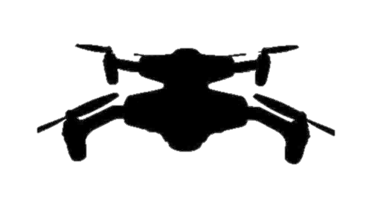

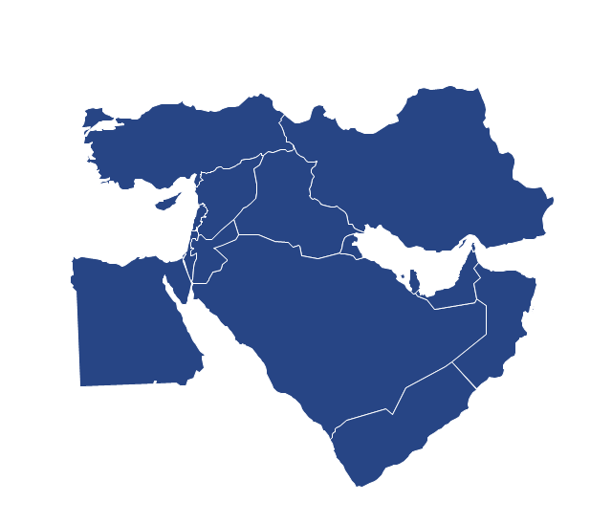


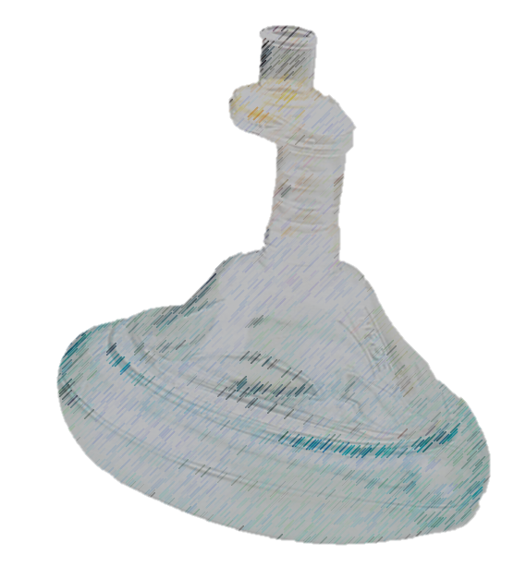


Advanced Response Medical Emergency System 1 (ARMES)
SD Card
Records vitals history if no cellular connection is available and communication node is down
Reusable data collection device
Sensors – vitals collection
Imbedded RFID – ID
App 1 web app (post-upload)
Host's patient profile
Maps route/destination from BFT informed decision support
Recommends drone medical supply delivery
Connection Type
App 1 web app (pre-upload)
Patient profile: uploaded images and videos, location, patient data
Supply Drone
Acts like a radio repeater
Drops off medical supplies if needed
Wireless patient scale
Wireless patient scale
Wired patient scale
Wireless vehicle or building scale
Wireless city scale
Wireless city scale
Emergency Medical Services
Accesses patient profile through RFID
Determines drone medical supply delivery
Communicates with patient or EMS
MTF
RFID
Identifies when patient is admitted into MTF
Patient profile loaded into “App 2”
Patient Status
Ground
Transport
Medical treatment facility (MTF)
Central Hub
*EMS can add additional info to patient profile via the web app
Doctor and nurse smart-device
Accesses app 2
Receives patient data alerts and updates
App 2
Interfaces to app 1 and triages patients based on patient profile
1.
1
1.
2
1.
3
1.
4

Slide 4
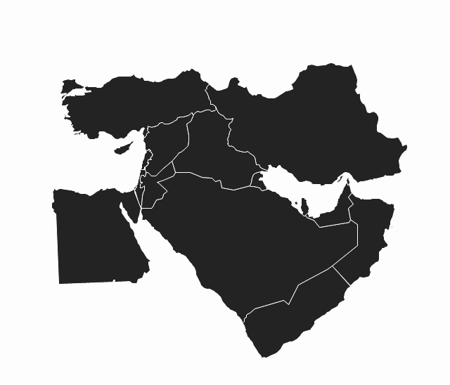


Flow of information when smartphone is avalible on ground
Vitals and location data sent to a smartphone
Smartphone recieves data and stores it in a patient profile
Additional images and videos are added to the patient profle
Patient profile is sent to the drone which routes the data to the app 1 server
App 1 server stores the patient profile
EMS access the the patient profile
EMS cellular communications are sent to the drone which routes the data to the smartphone
EMS determines if drone should drop medical supply delivery
2. 3.
5.
1.
4.
4.
7.
6.
7. 8.

Slide 5
Flow of information when smartphone is not avalible on ground
Communication node sends vital and location data to drone which routes the data to the app 1 server
App 1 server stores the patient profile
EMS accesses the the patient profile
If necessary, EMS communicates with patient or ground medic through an internal RF reciever embedded in the vitals collection device
EMS determines if drone should drop medical supply delivery
2.
1.
1.
5.
4.
3.

Slide 6
1.
1.
Flow of information when smartphone is not avalible on ground and communication node is down
Communication node sends vital and location data to a local memory card
On scene, EMS uploads vital and location data to app 1 server
App 1 server stores the patient profile
EMS acceses the patient profile
3.
2.
2.
Comminication node – core node in the vitals collection device that collects and communicates vitals data
4.

Slide 7
Flow of information when MTF is tracking incoming patients and doctors and nurses have access to smartphones
MTF accesses and downloads incoming patient profiles
App 2 server stores patient profiles
App 2 triages and tags incoming and current patients
Doctors and nurses subscribe to specific patients
Doctors and nurses view the triaged list of their patients or access individual patient profiles
1.
2.
5.
3.
1.
4.
1
1.
2
1.
3
1.
4

Slide 8
Flow of information when MTF is tracking incoming patients and doctors and nurses not not have access to smartphones
MTF accesses and downloads incoming patient profiles
App 2 server stores patient profiles
App 2 triages and tags incoming and current patients
Monitor displays triaged list of patients and doctors or nurses can look at individual patient profiles if necessary
1.
2.
3. 4.
1.
1
1.
2
1.
3
1.
4

Slide 9
Flow of Information when EMS arrives at MTF and patient profile is already on the App 2 server
App 1 server alerts MTF when patient is 15 minutes away
EMS arrives on scene and RFID alerts App 2 to change patients status from being in-transport to in-MTF
1.
2.

Slide 10
Flow of Information when EMS arrives at MTF and patient profile is not already on the App 2 server
EMS arrives on scene and RFID alerts App 2 to upload patient profile to App 2 server
MTF accesses and downloads incoming patient profiles
2.
1.

Slide 11
ARMES
1.
1
1.
2
1.
3
1.
4

Slide 12


Medical hands-free Unified Broadcast System (MEDHUB) Interfacing
MEDHUB Capabilities
Dosage calculations
Automated medical documentation
Patient ETA to medical treatment facility
ARMES Interfacing Capabilities
Patient profile considering data collected from MEDHUB (vitals) and ARMES (vitals, location, images, videos)
Patient triage considering vitals collected by MEDHUB
Patient subscription application for nurses and doctors
Alternative communication routes
Pocket mask and integrated sensor data in addition to vitals collected by MEDHUB
Trauma, Triage, Treatment, and Training Decision Support (4TDS) Interfacing
4TDS Capabilities
Identification of shock type through machine learning
ARMES Interfacing Capabilities
Patient triage considering shock type
Patient profile listing shock type
Blue Forces Tracker (BFT) Interfacing
BFT Capabilities
Unit location and movement tracking
Enermy forces tracking
Battlefield conditions
ARMES Interfacing Capabilities
Route identification considering enemy force location and the locations of MFTs
Medical supply drop recommendation considering location of enemy forces

Slide 13
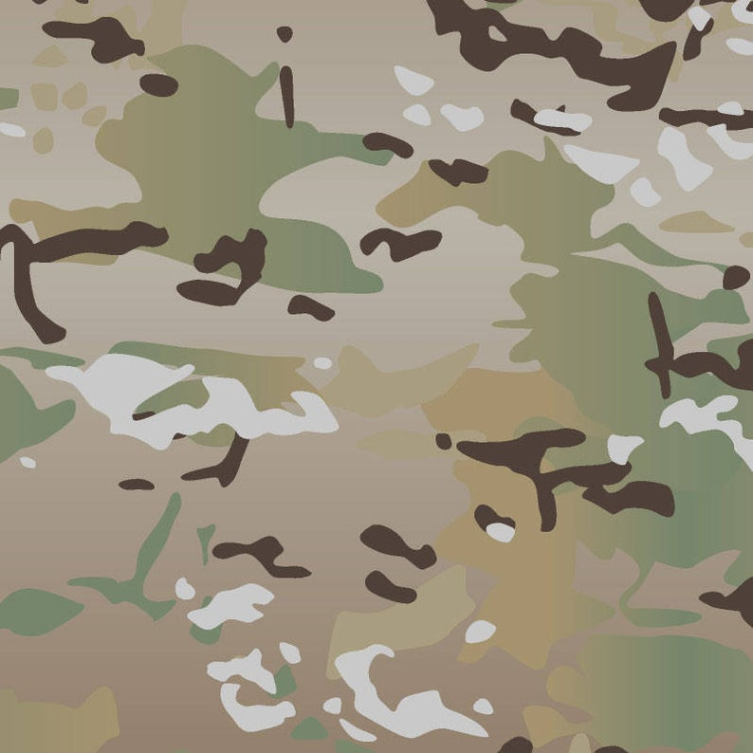
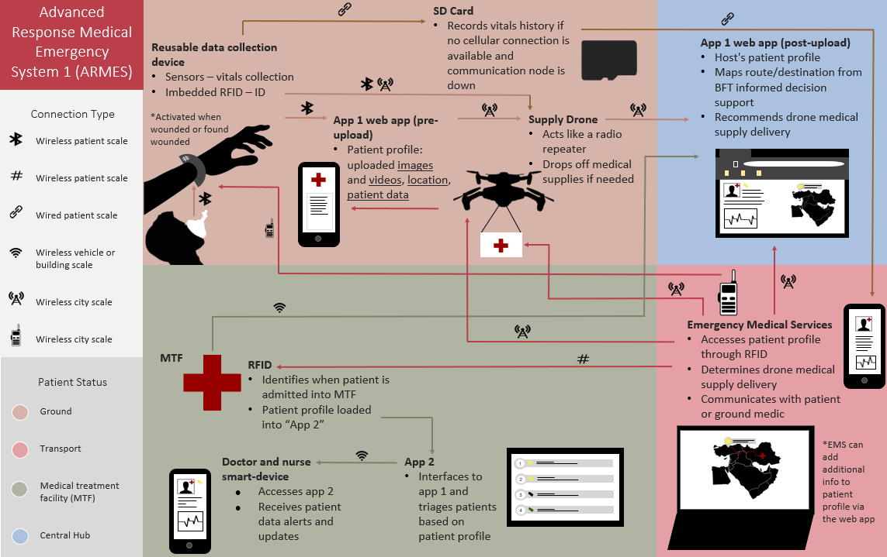
Time is Tissue
Problem
Pre-MTF phase of care is the 1st link in the chain of survival for those injured in combat and represents the next frontier for making further significant improvements in battlefield trauma care. [MD14]
The medics/surgeons only get a snapshot of data, instead of understanding what has been happening, being able to see the patient, the wounds, the presentation of the patients' symptoms.
Current State
In 2021 Hatzfeld [HHM+21] identified the top ten needs for en route combat casualty care, including:
1. medical documentation,
2. clinical decision support,
3. patient monitoring,
5. transfer of care,
7. transport timing following damage control
resuscitation or surgery.
“Technology needs for en route care must support interoperability of medical information, equipment, and supplies across the global military health system in addition to adjusting to a dynamic transport environment.“ [HHM+21]
End State / Impact
ARMES system supports interoperability of medical information from point of injury through every level of chain of custody.
ARMES Algorithm performs matching and constraint-based optimization to facilitate patient movement in a dynamic transport environment.

Slide 15

Automated Vitals Emergency Medical System (AVEMS)
Advanced Response Medical Emergency System (ARMES)
Vitals can also be routed through military vehicles if available
App 2 Data Processing and Subscription
Hosts patient profile (instantaneous + historical)
Maps route/destination from BFT informed decision support
Recommends drone medical supply delivery
Triages patients
Sequences patients
Performs other data processing if necessary
SD Card
Records vitals history backing up all other communication links
Nett Warrior
4TDS
APPRAISE
Connection Type
App 1 Field Medic app
Patient(s) profile: uploaded images and videos, location, vitals, and PCR/ DD1380
Wireless patient scale
Wireless patient scale
Wired patient scale
Wireless vehicle or building scale
Wireless city scale
Wireless city scale
BFT
Data pooling device
Sensors – vitals collection
Imbedded NFC or RFID – ID label
Supply Drone
Drops off medical supplies if needed
Collects and sends images and videos of patient
Routes patient updates
1.
1
1.
2
1.
3
1.
4
MEDHUB, ViSi Mobile, or other vitals collection devices
EMS
Patient Status
Ground
Transport
Medical treatment facility (MTF)
Central Hub
MEDHUB
Hospital

Slide 16
Advanced Response Medical Emergency System (ARMES)
Advanced Response Medical Emergency System (ARMES)
App 2 (central server) Data Processing and Subscription
Hosts patient profile (instantaneous + historical)
Maps route/destination to the patient and to the ideal hospital given the patient’s condition
Recommends drone medical supply delivery
Triages patients
Sequences patients
Performs other data processing if necessary
SD Card
Records vitals history backing up all other communication links
Connection Type
App 1 Field Medic app
Patient(s) profile: uploaded images and videos, location, vitals, and PCR
Wireless patient scale
Wireless patient scale
Wired patient scale
Wireless vehicle or building scale
Wireless city scale
Wireless city scale
Data pooling device(s)
Sensors – vitals collection
Supply Drone
Drops off medical supplies if needed
Collects and sends images and videos of patient
Routes patient updates
1.
1
1.
2
1.
3
1.
4
EMS
Patient Status
Ground
Transport
Medical treatment facility (MTF)
Central Hub
Hospital

Slide 17
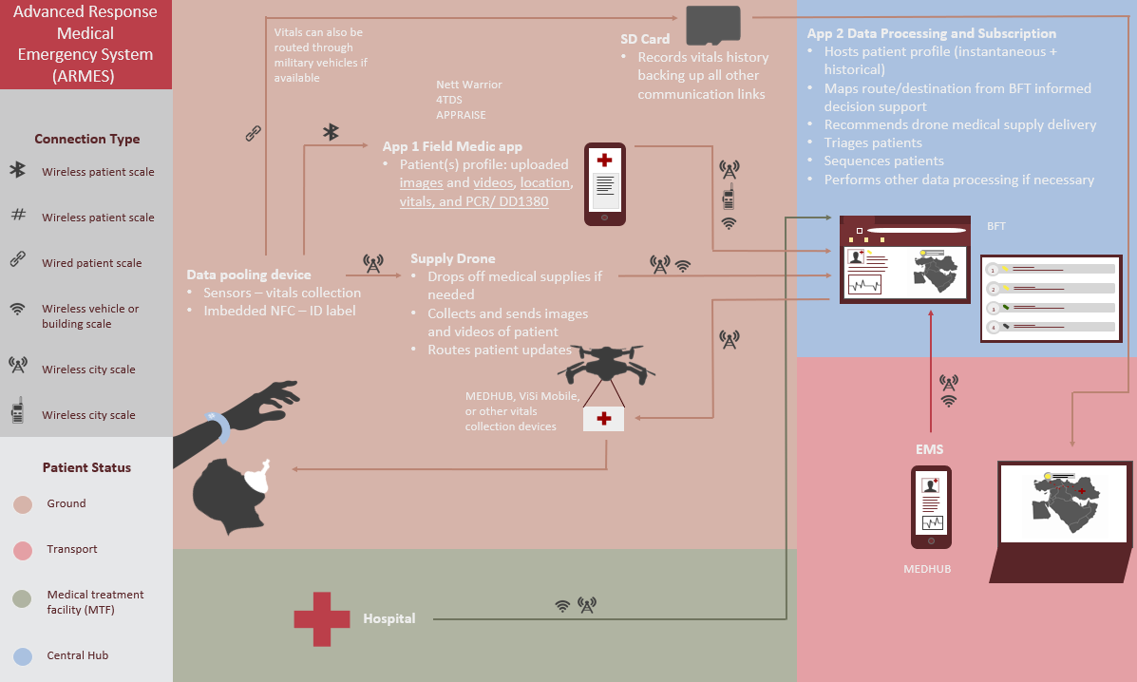
Time is Tissue
Problem
Pre-MTF phase of care is the 1st link in the chain of survival for those injured in combat and represents the next frontier for making further significant improvements in battlefield trauma care. [MD14]
The medics/surgeons only get a snapshot of data, instead of understanding what has been happening, being able to see the patient, the wounds, the presentation of the patients' symptoms.
Current State
In 2021 Hatzfeld [HHM+21] identified the top ten needs for en route combat casualty care, including:
Medical documentation,
Clinical decision support,
Patient monitoring,
Transfer of care,
Transport timing following damage control resuscitation or surgery,
Part of intelligent tasking,
Part of commander’s risk assessment tool,
“Technology needs for en route care must support interoperability of medical information, equipment, and supplies across the global military health system in addition to adjusting to a dynamic transport environment.“ [HHM+21]
End State / Impact
ARMES system supports interoperability of medical information from point of injury through every level of chain of custody
ARMES Algorithm performs matching and constraint-based optimization to facilitate patient movement in a dynamic transport environment.

Slide 18
Ground
Transport
Medical treatment facility (MTF)
Central Hub
Other
Inputs
Outputs
*numbers correlate to the end route combat casualty care needs that are addressed according to [HHM+21]
Medical Hands-free Unified Broadcast System (MEDHUB)
Wireless Vital Signs Monitor (WVSM)
Other military-developed biosensors/ future medical tech
Blue Forces Tracker (BFT)
Nett Warrior (NW) / ViSi Mobile / Automated Processing of the Physiologic Registry for Assessment of Injury Severity (APPRAISE)
Trauma, Triage, Treatment, and Training Decision Support (4TDS)
1. 3. 4. Patient profile
ARMES
Future data processing schemes
2. BFT and patient profile informed medical supply drop recommendation
7. Commanders risk assessment tool
2. Patient triage list and map
6. Personalized information subscription
2. Patient sequence list
6. Intelligent tasking
4. Near Field Communication (NFC)
5. BFT informed route identification

Slide 19
Tactical Field Care
TACEVAC
Next Level Care
Definitive Care
Done
Emerging Tech
(sense vitals, detect status, record) Nett Warrior / Automated Processing of the Physiologic Registry for Assessment of Injury Severity APPRAISE / ViSi mobile
(detect status) Trauma, Triage, Treatment, and Training Decision Support 4TDS
(detect status, sense vitals, record, report) Wireless Vitals Signs Monitor WVSM
(treat) Surgery using night vision, Tatrctimes 2017
Current Tech
Done
Emerging Tech
(sense vitals, record, report) MEDHUB
(detect status, sense vitals, record, report) WVSM
Done
Emerging Tech
(detect status, sense vitals, record, report) WVSM
Done
Emerging Tech
Gaps
Gaps
Gaps
Gaps
Areas of Research / Development
Detect Status
Sense Vitals
Record
Report
Treat

Slide 20
Patient
Ambulance Problem
Field Hospital
Commander
Done
Emerging Tech
Current Tech
(treat) Individual first aid kit (IFAK)
Done
Intelligent tasking
Done
Intelligent tasking
Done
Commander risk assessment tool
Intelligent tasking
Gaps
Ambulance problem with dynamic field hospital location
Gaps
Gaps
Commander risk assessment tool
Intelligent tasking
Gaps
Help patient be own medic
Areas of Research / Development
Detect Status
Sense Vitals
Record
Report
Treat

Slide 21
Key players in Military Medical Technology
Technology
Protocol
Telemedicine & Advanced Technology Research Center TATRC https://www.tatrc.org/www/labs-and-programs/mobile-health/
- Health Technology Innovation Center HTIC
- Mobile Health Innovation Center mHIC
- Medical Intelligent Systems Laboratory MISL
U.S. Army Medical Research and Development Command (USAMRDC) https://mrdc.amedd.army.mil/
- Combat Casualty Care Research Program CCCRP
- Military Operational Medicine Research Program MOMRP
- Medical Simulation & Information Sciences Research Program
MIT Lincoln Labs Biotechnology & Human Systems https://www.ll.mit.edu/r-d/biotechnology-and-human-systems
- Human Health and Performance Systems
- Humanitarian Assistance and Disaster Relief Systems
Military Health System https://www.health.mil/About-MHS/MHS-Initiatives
Congressionally Directed Medical Research Program CDMRP Defense Medical Research and Development https://cdmrp.army.mil/dmrdp/default :
- Medical Simulation and Information Sciences Research Program JPC-1
- Military Operational Medicine Research Program JPC-5
- Combat Casualty Care Research Program JPC-6
Joint Trauma System JTS https://jts.amedd.army.mil/
Committee on Tactical Combat Casualty Care CoTCCC https://jts.amedd.army.mil/index.cfm/committees/cotccc
Telemedicine & Advanced Technology Research Center TATRC https://www.tatrc.org/www/labs-and-programs/mobile-health/
- Advanced Medical Technology Initiative AMTI
- Virtual Health Support Office VHSO

Slide 23








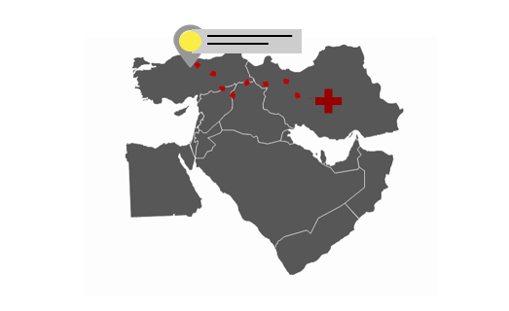

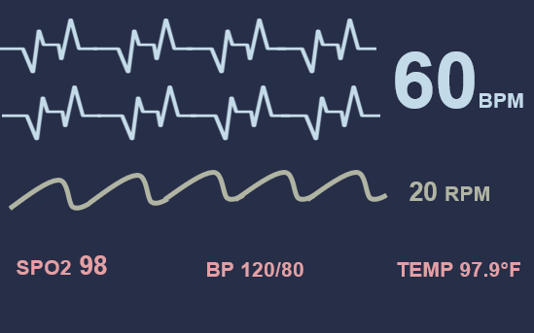


Automated Vitals Collection & Communication System for EMS (AVEMS)
5
SD Card – local storage
8
Central server – external storage and processor
Data processing
Triaging
Hospital matching
Route finding
4
Vitals collection device – collector
Sensors
Imbedded RFID
Bystander’s Smartphone – informer
Images
Videos
Alerts
Upload
Connection Type
3
Wireless patient scale
Wireless patient scale
Wired patient scale
Wireless vehicle or building scale
Wireless city scale
Upload
2
9
6, 7
Local server – external storage and processor
Data processing
Triaging
Field medics handsfree smart device, smartphone, or laptop – communicator and information displayer
Patient(s) profile: vitals, images, videos, notes, location, patient care report
Patient Status
10
Place of injury
Field Medic
Field Hospital
Central Hub
Patient 1’s ECG may be indicative of heart failure
11
Physicians' handsfree smart device, smartphone, or laptop – information displayer
Patient(s) profile: vitals, mages, videos, notes, location, patient care report
1
Key Info Over Time
Patient Care Report
Key Info Over Time
Patient Care Report
1.
2
1
1.
3
2
1.
4
3
1.
4

Slide 24




Automated Vitals Collection & Communication System for EMS (AVEMS)
8
9, 10
Central server – external storage and processor
Data processing
Triaging
Hospital matching
Route finding
Local server – external storage and processor
Data processing
Triaging
Connection Type
Patient Status
Wireless patient scale
Wireless patient scale
Wired patient scale
Wireless vehicle or building scale
Wireless city scale
Bystander
Emergency medical services (EMS)
Emergency Department (ED)
Central Hub
11
Physicians' handsfree smart device, smartphone, or laptop – information displayer
Patient(s) profile: vitals, mages, videos, notes, location, patient care report
2,3
4
5
6,7
Bystander’s Smartphone – informer
Images
Videos
Alerts
Vitals collection device – collector
Sensors
Imbedded RFID
SD Card – local storage
Field medics handsfree smart device, smartphone, or laptop – communicator and information displayer
Patient(s) profile: vitals, images, videos, notes, location, patient care report
Patient 1’s ECG may be indicative of heart failure
1
Key Info Over Time
Patient Care Report
2
Key Info Over Time
Patient Care Report
3
4
Upload
Upload

Slide 25

Upload
Upload
Patient 1’s ECG may be indicative of heart failure
1
Key Info
Patient Care Report
Key Info
Patient Care Report
1.
2
1
1.
3
2
1.
4
3
1.
4

Slide 26
1
1
1
2
2
2
3
3
3
4
4
4

Slide 27
1
2
3
4

Slide 28
Upload
Upload

Slide 29
Upload
Upload

Slide 30
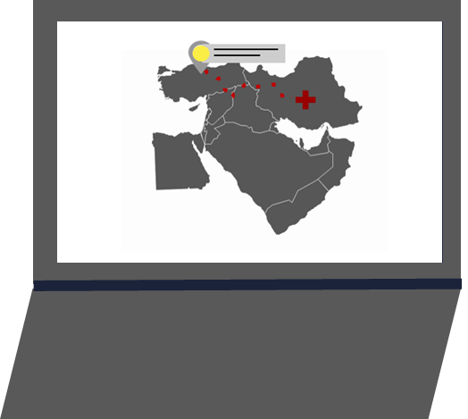

Slide 31





Leave

Slide 32
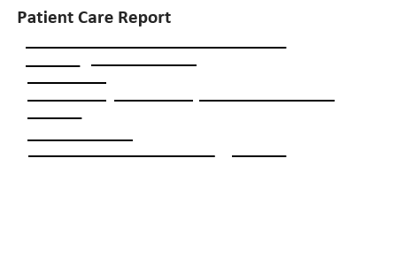
Patient Care Report

Slide 34
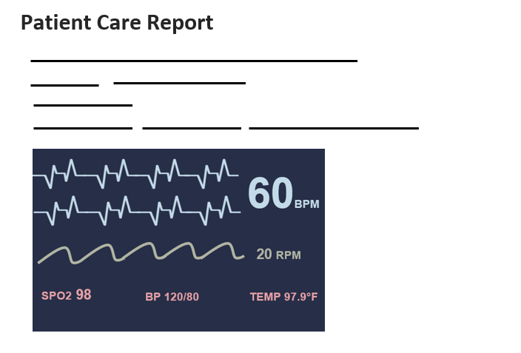
Patient Care Report

Slide 35

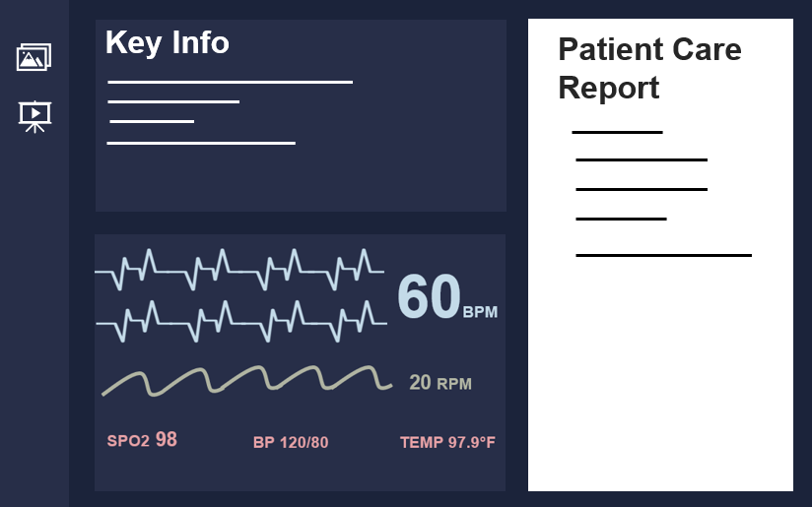
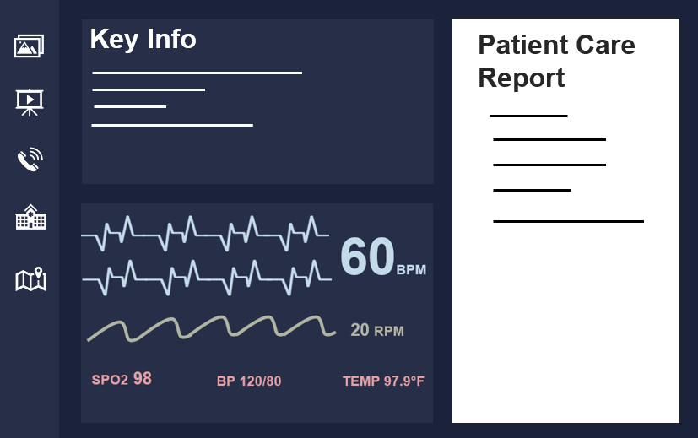
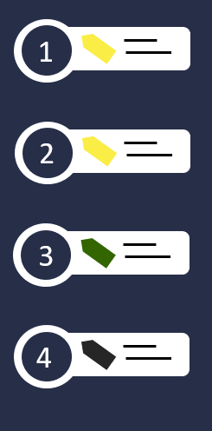

Automated Vitals Collection & Communication System for EMS (AVEMS)
Connection Type
Wireless patient scale
Wireless patient scale
Wired patient scale
Wireless vehicle or building scale
Wireless city scale
See or add images
See or add videos
Talk to on-call physician
Match patient to hospital
Determine best route to hospital or to patient
Patient Status
Ground
Transport
Emergency Department (ED)
Central Hub

Slide 36
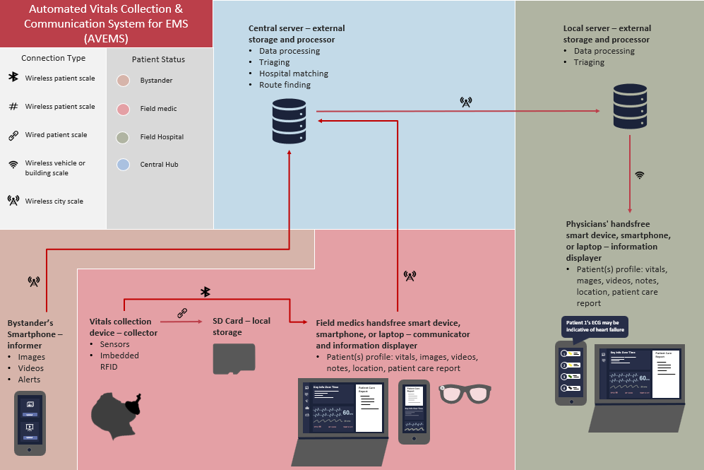
Time is Tissue
Problem
Pre-MTF phase of care is the 1st link in the chain of survival for those injured in combat and represents the next frontier for making further significant improvements in battlefield trauma care. [MD14]
The medics/surgeons only get a snapshot of data, instead of understanding what has been happening, being able to see the patient, the wounds, the presentation of the patients' symptoms.
Current State
In 2021 Hatzfeld [HHM+21] identified the top ten needs for en route combat casualty care, including:
Medical documentation,
Clinical decision support,
Patient monitoring,
Transfer of care,
Transport timing following damage control resuscitation or surgery,
Part of intelligent tasking,
Part of commander’s risk assessment tool,
“Technology needs for en route care must support interoperability of medical information, equipment, and supplies across the global military health system in addition to adjusting to a dynamic transport environment.“ [HHM+21]
Solution
ARMES system supports interoperability of medical information from point of injury through every level of chain of custody
ARMES Algorithm performs matching and constraint-based optimization to facilitate patient movement in a dynamic transport environment.

