Slide 1
Updates
EMS Automation IQP

Slide 2
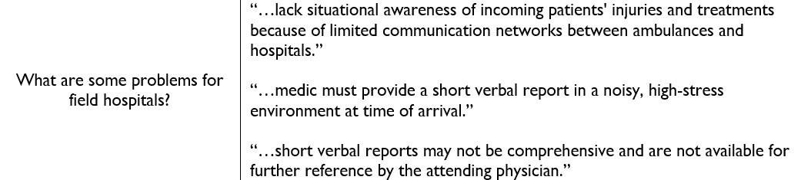

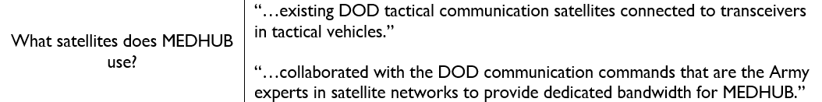
March 23, 20201
Done
Filled in the need's assessment document (Files/DisruptiveApplicationArmyResearch/NeedsAssessmentProblemFormulation.tex)
MEDHUB (Files/DisruptiveApplicationArmyResearch/MEDHUB.docx)
Who
Problems
Features
Communications
Masimo
BeWell
Diagnostic Robotics
*Resources excel has been updated
To Do
Fill in abstraction and synthesis document
Fill in the project milestones document

Slide 3
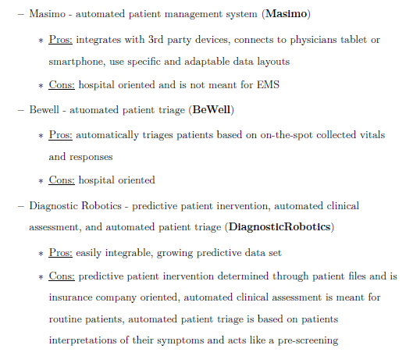

Slide 4
April 12, 20201
Links | Description
Developing TCCC Guidelines for Unmanned Aerial Vehicle Casualty Evacuation - PubMed (nih.gov) | Drones/unmanned vehicles in operational medicine
https://pubmed.ncbi.nlm.nih.gov/27280186/ | Tactical combat casualty care guidelines
The Good, the Bad, and the Future of Drones in Tactical/Operational Medicine - PubMed (nih.gov) | Drones in operational medicine
Telemedical Support for Military Medicine | Military Medicine | Oxford Academic (oup.com) | Telemedical support military medicine
A Systematic Review of the Use of Telemedicine in the Military Forces Worldwide | Shiraz E-Medical Journal | Full Text (kowsarpub.com) | History of telemedicine in the military
Done
Finished the Needs Assessment Problem Formulation Outline:
Competitor's strengths and weaknesses
Market needs
Updated Critical Times visual
Updated the resources excel sheet with…
Resources from others sent via email
Research in medical operation drones
Research in tactical combat casualty care guidelines
Research in telemedical support for the military
To Do
Fill in the project milestones document
Outlining project tasks (who, what, where, when, why)
Reviewing resources

Slide 5
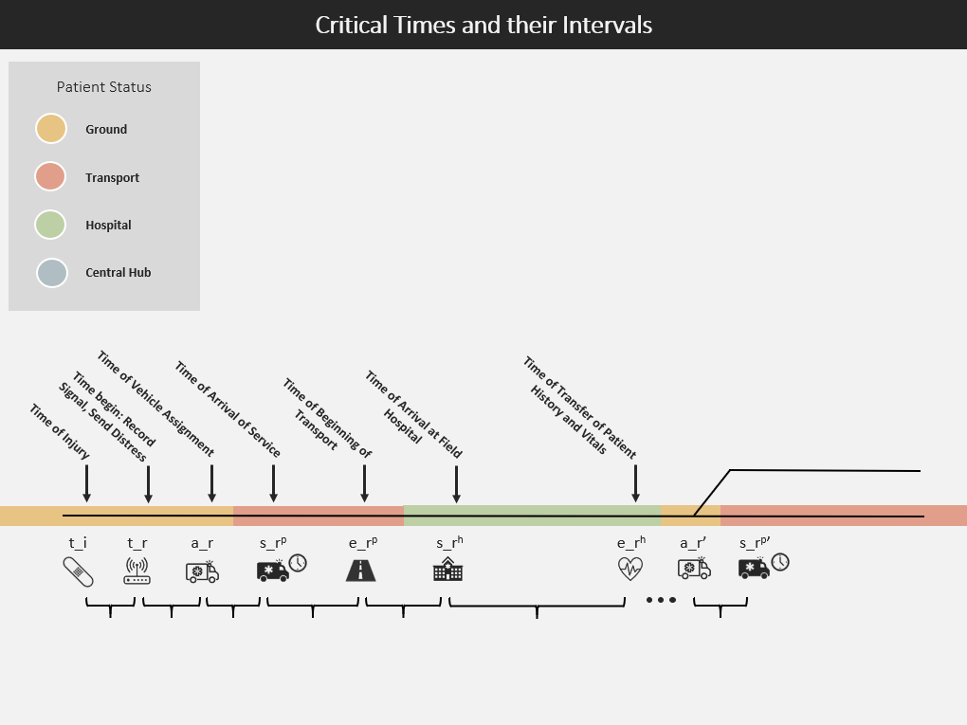

Slide 6
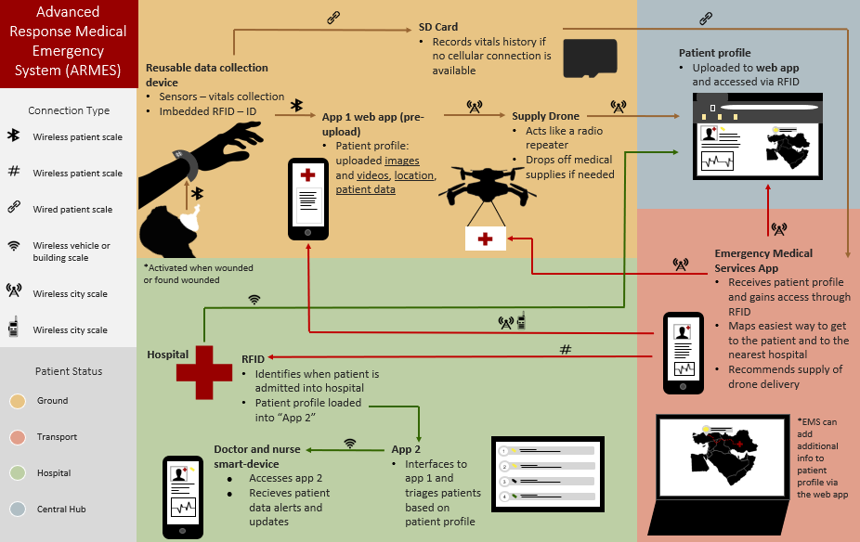

Slide 7
April 26, 2021
Done
List of questions expected from grant evaluator
Started answering questions
Added “the golden hour” to Time of Information doc
Created a visual of different paths of information in the Flow of Information doc
Created a visual of all applications that ARMES can interface with in the Flow of Information doc
To Do
Continue answering questions in the Questions Grant doc

Slide 8
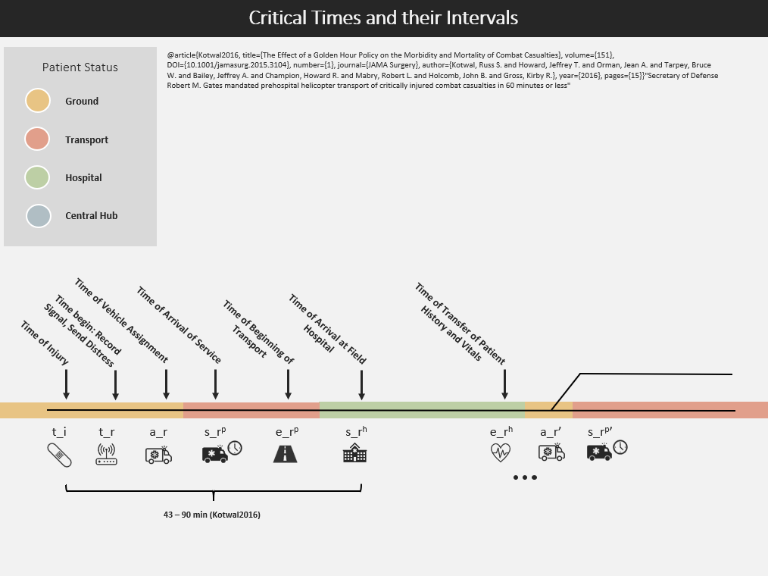

Slide 9
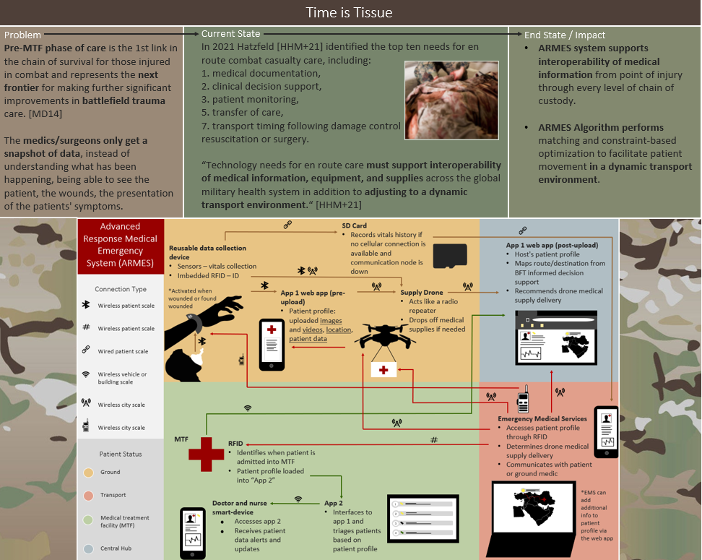

Slide 10
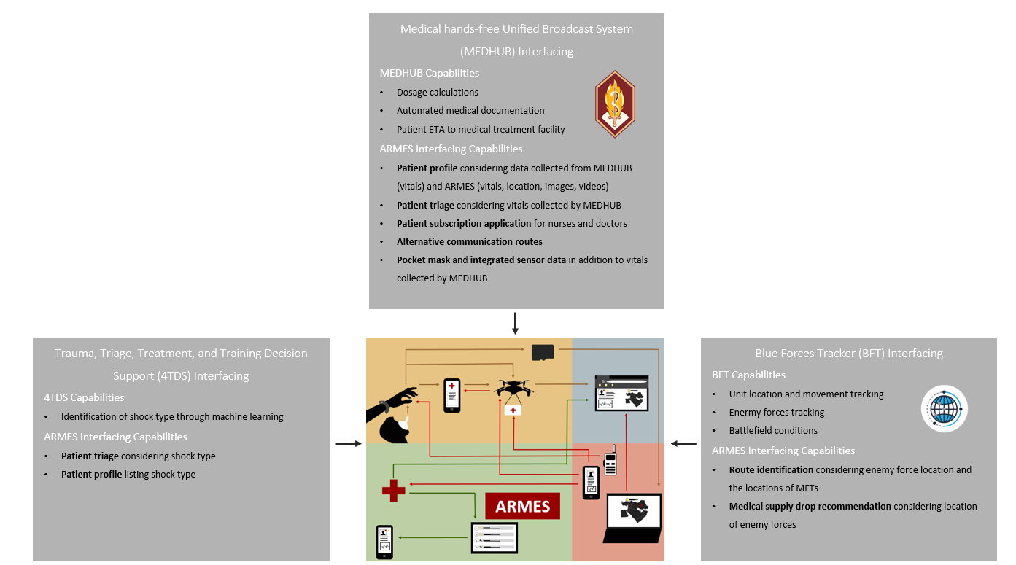

Slide 11
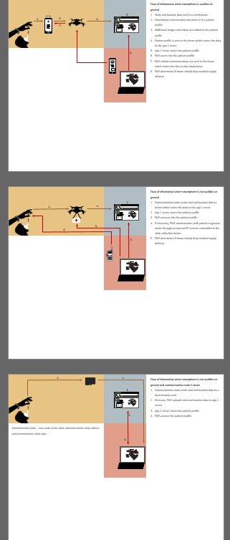
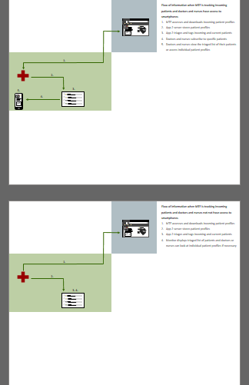
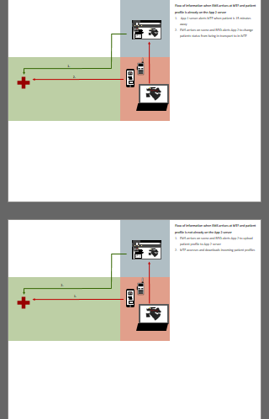

Slide 12
May 4, 2021
Done
Talked to Hurley, discussed wearables
Fanny pack system - carry battery, replacement sensors for MEDHUB, and a transmitter
Updated Time Flow of Information
Looked at APPRAISE, NW, And ViSi mobile and gathered info on each system
Updated flow of information
Data share concept
Started envelope diagrams
To Do
Start answering specific questions in the Questions Grant doc
Create a list of costs

Slide 13
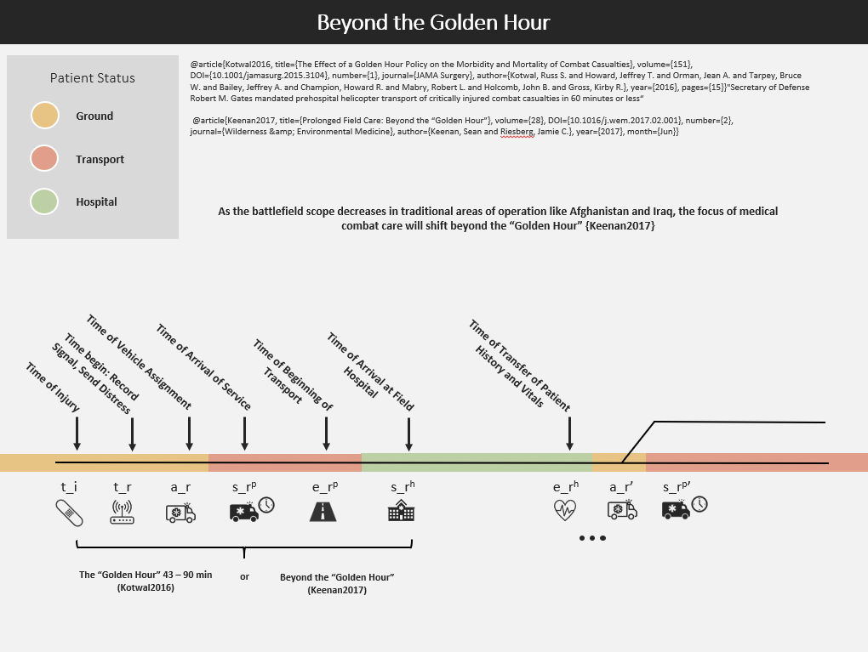

Slide 14
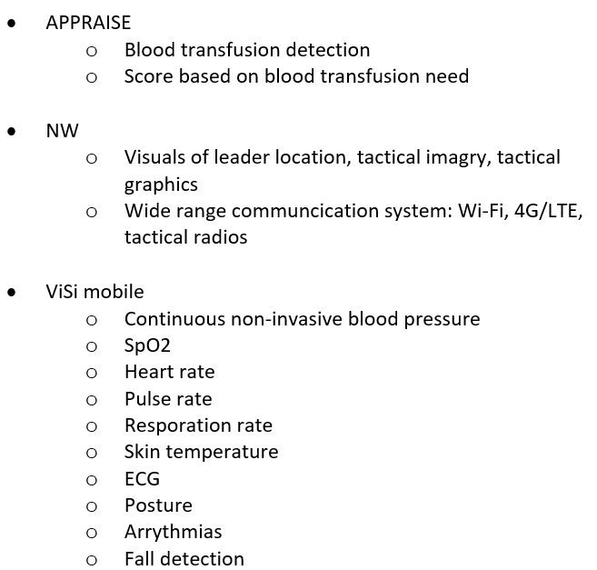

Slide 15
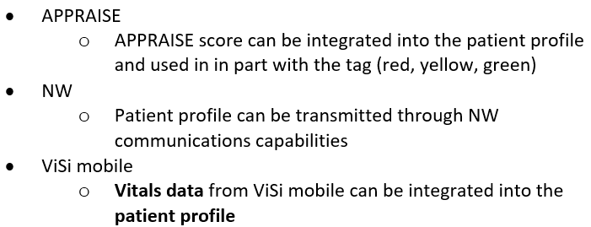
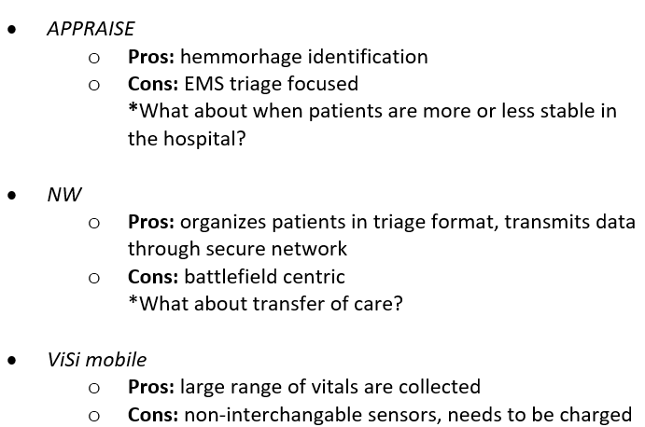

Slide 16
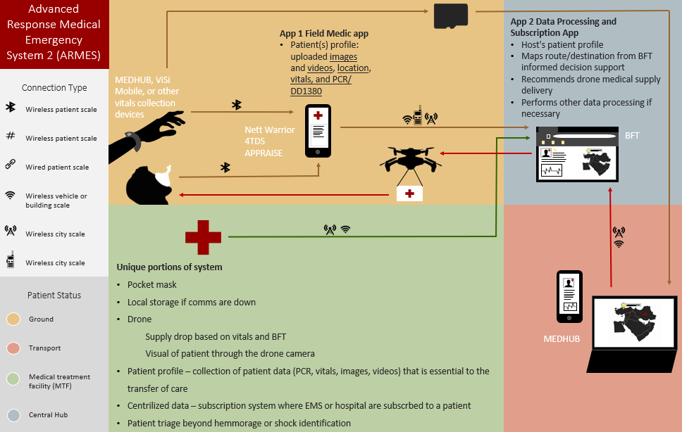

Slide 17
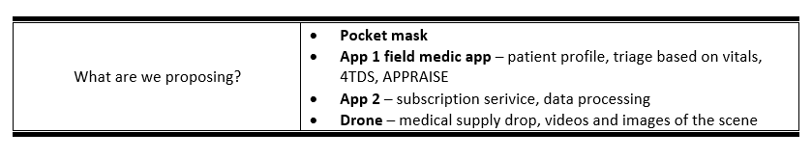

Slide 18
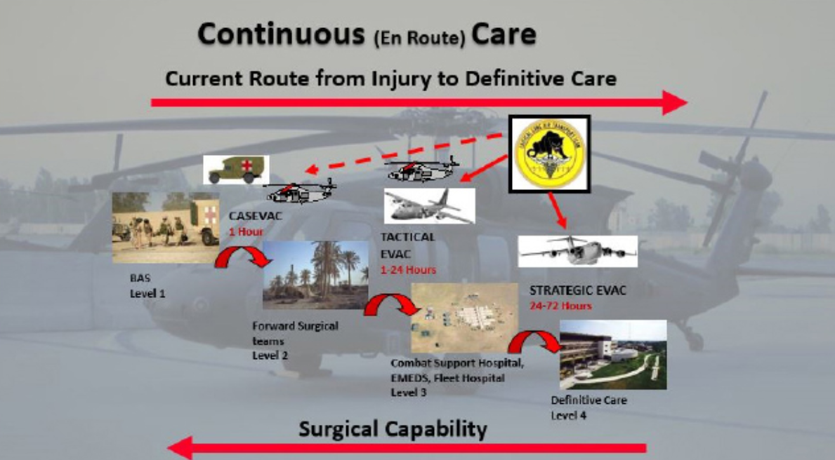

Slide 19
May 25, 2021
Done
Created envelope diagram
Checked Ellen’s email, seems like we are waiting for Rao
Established roles for previous EMARA members
Group has questions/suggestions
Fleshed out RFID grant section
Connecting medical systems JADC2, but for medics: Military looks to link medical networks, data (fedscoop.com)
To Do
Finish answering grant questions
Start working on filling out military medical capabilities of today chart

Slide 20
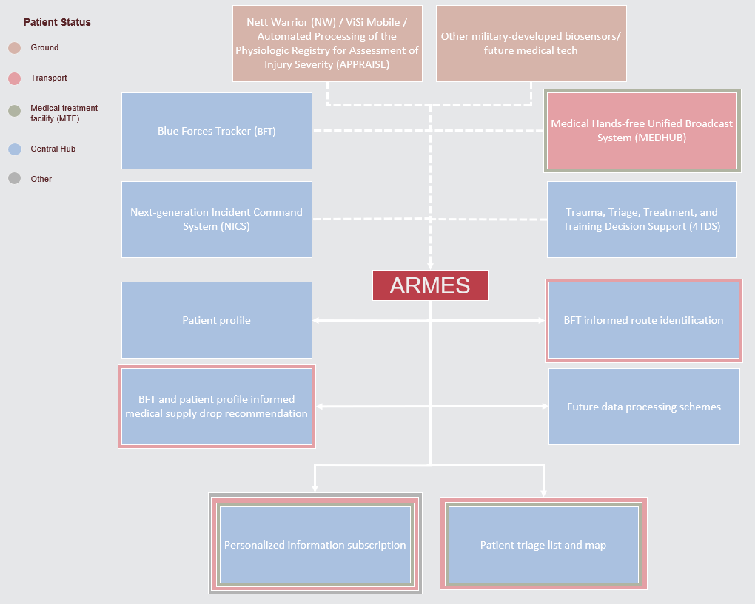

Slide 21
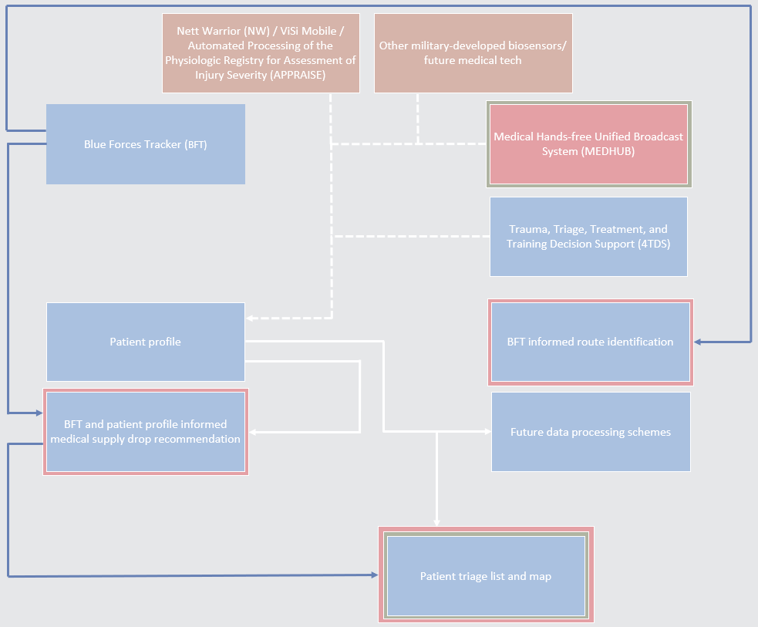

Slide 22
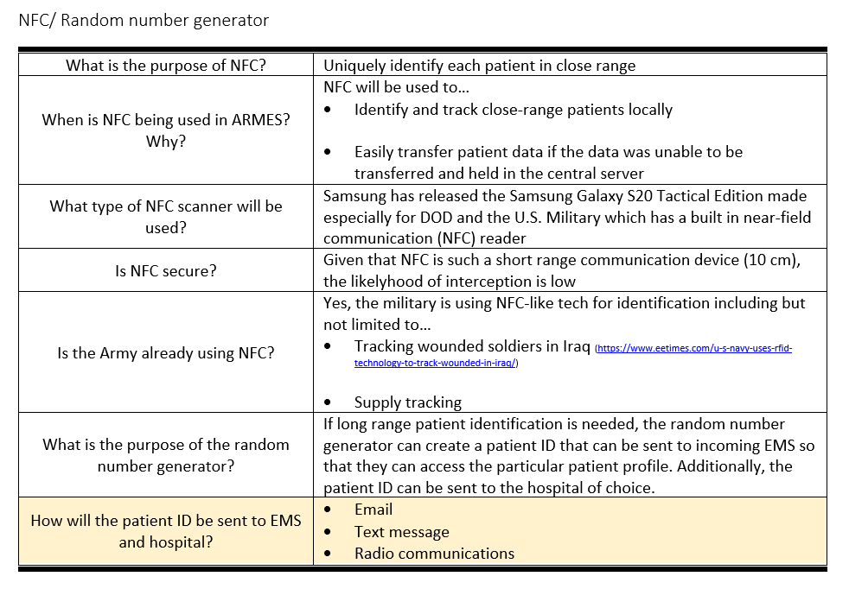

Slide 23
