Slide 1









Sort
Display fields are adjustable
John Doe
1
Time
MOI
Injury
15:32
Fall
Left lateral malleolus fracture
John Doe
2
Time
MOI
Injury
15:32
Fall
Left lateral malleolus fracture
John Doe
3
Time
MOI
Injury
15:32
Fall
Left lateral malleolus fracture
John Doe
4
Time
MOI
Injury
15:32
Fall
Left lateral malleolus fracture
John Doe
5
Time
MOI
Injury
15:32
Fall
Left lateral malleolus fracture
John Doe
6
Time
MOI
Injury
15:32
Fall
Left lateral malleolus fracture
Triage
Map
Tools
Settings

Slide 2
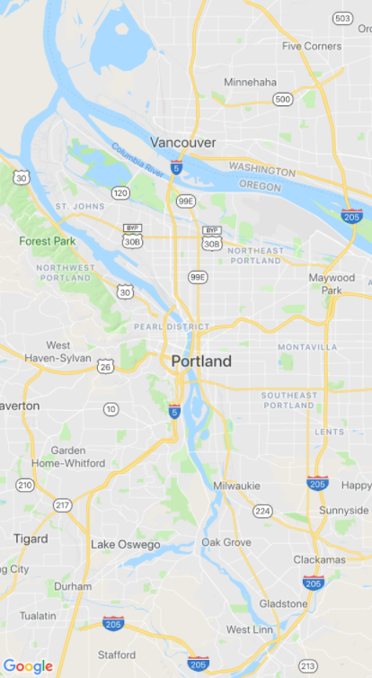















Display fields are adjustable
Triage
Map
Tools
Settings

