Slide 1



Slide 2




Language Used
Used Tool/Library
Version Control System
Framework

Slide 3
PLANNING
All requests have been examined and planned.
ANALYSIS
The requirements were agreed and detailed documentation was started after the approval of both parties.
DESIGNE
The general plan of the software product was made: Language, Modules, Tools, Framework, Database were determined
EXECUTE
All necessary coding has been meticulously done for the product to work efficiently, smoothly and safely.
During and after coding, many tests such as user acceptance, performance, false value were performed to ensure that the product works regularly and efficiently under all conditions.
Automation tests were designed for daily testing of important functions of the product.
TEST

Slide 4






Vegan restaurant and menu choices
Easy handling and strong relationships for restaurant owners
Dinein, pick-up or delivery opportunities
Easy access to your favourites from world cuisines
View the track of your order and receive it on time
Get healthy eating tips by following our blog

Slide 5
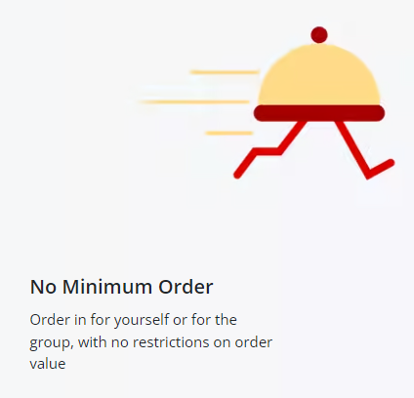
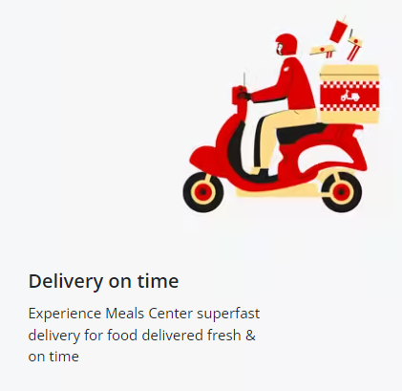
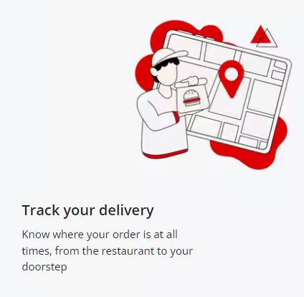
stay tuned for much more…

Slide 6
TEAM 3
TEAM LEAD
ERMAN C.
SCRUM MASTER
BETÜL A.
HAMZA Ç.
DUYGU G.
HÜSEYİN E.
MEHMET D.
MEHMET E.
MEHMET M.
MUHAMMET E.
VAHİT A.

Slide 7
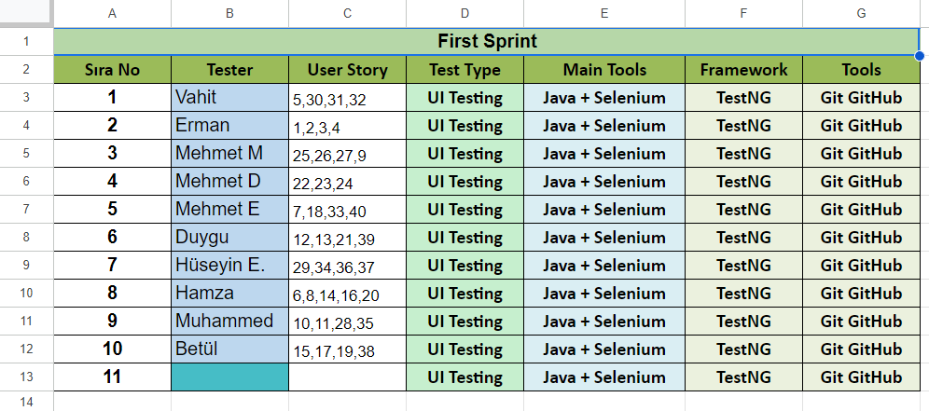

Slide 8
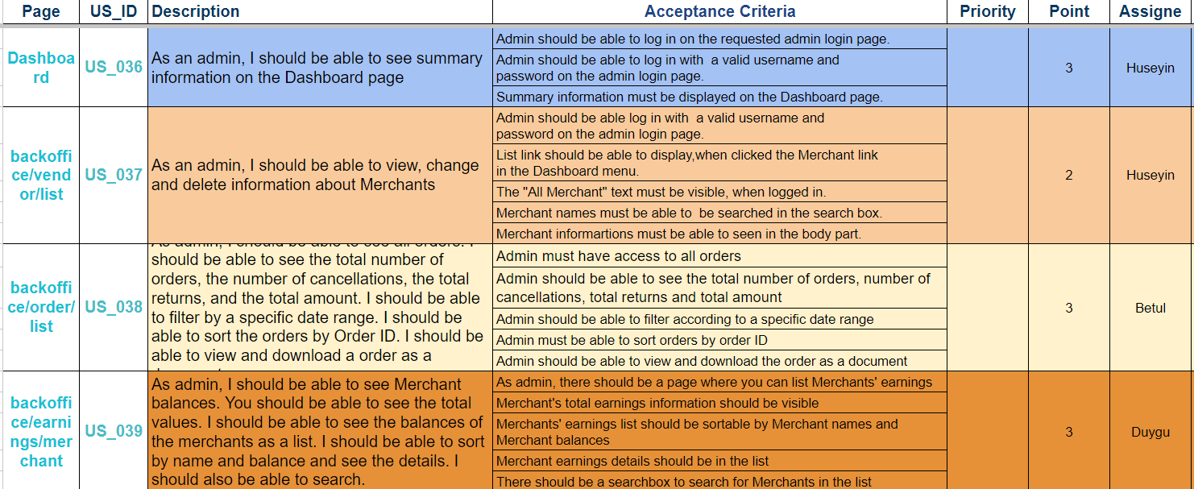

Slide 9
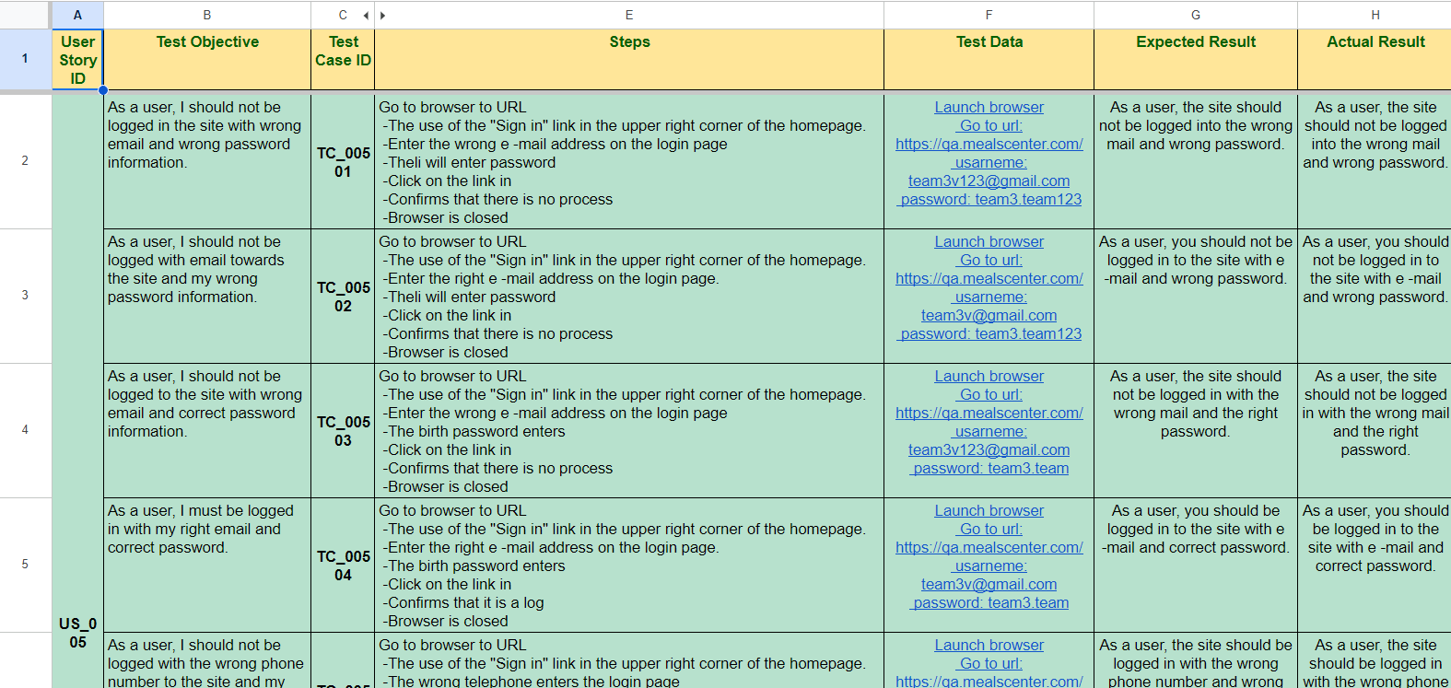

Slide 10
