Slide 1
Mongo Database(MongoDB)

Slide 2
Introduction
MongoDB is a cross-platform, document oriented database that provides, high performance, high availability, and easy scalability.
MongoDB works on concept of collection and document.

Slide 3
Intro…
Collection Collection is a group of MongoDB documents. It is the equivalent of an RDBMS table. A collection exists within a single database. Collections do not enforce a schema. Documents within a collection can have different fields. Typically, all documents in a collection are of similar or related purpose.
Document A document is a set of key-value pairs. Documents have dynamic schema. Dynamic schema means that documents in the same collection do not need to have the same set of fields or structure, and common fields in a collection's documents may hold different types of data.

Slide 4
Relationship of RDBMS terminology with MongoDB

Slide 5
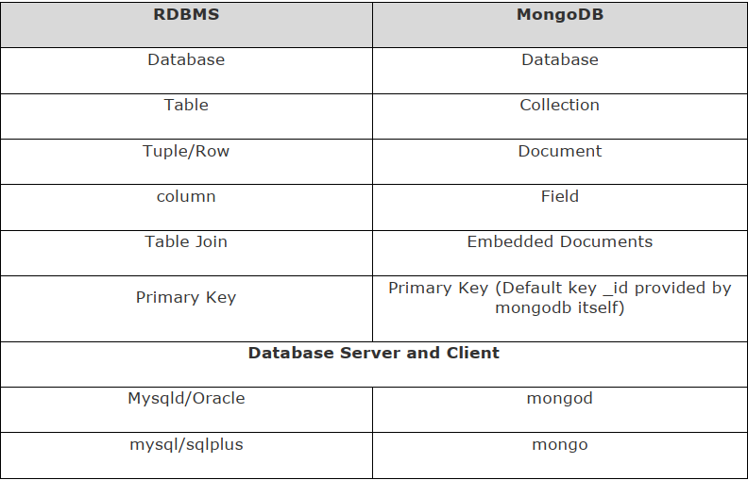

Slide 6
Advantages of MongoDB over RDBMS
Schema less: MongoDB is a document database in which one collection holds different documents. Number of fields, content and size of the document can differ from one document to another.
Structure of a single object is clear.
No complex joins.
Deep query-ability. MongoDB supports dynamic queries on documents using a document-based query language that’s nearly as powerful as SQL.
Ease of scale-out : MongoDB is easy to scale.
Conversion / mapping of application object to database to database objects not needed.

Slide 7
Why Use MongoDB?
Document Oriented Storage: Data is stored in the form of JSON style documents.
Index on any attribute
Replication and high availability .
Auto-sharding .
Rich queries .
Fast in-place updates

Slide 8
Where to Use MongoDB?
Big Data
Content Management and Delivery
Mobile and Social Infrastructure.
User Data Management.
When entities have variable field value.

Slide 9
Implementation…

