Slide 1
Home Security & Surveillance
Final Presentation Wireless Sensor Laboratory
Group 02, Summer Term 2013
Ermin SAKIC - ermin.sakic@tum.de
Berke AYDINLI – berke.aydinli@tum.de
16.07.2013

Slide 2
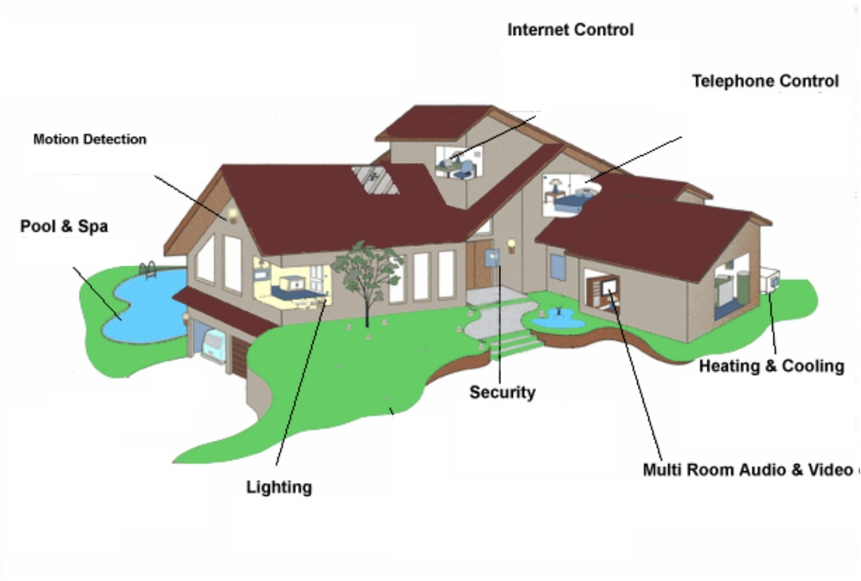
Motivation
Home Security & Surveillance
Generic solution for indoor monitoring and intruder detection using wireless sensor nodes
Offering a reliable and robust control & safety set of tools for home owners.
Distributed, highly-scalable, event-based system, manageable directly or remotely over Internet.
  IR and accelerometer sensors; positioned on windows, doors and various other "fragile" parts of the building.
    → Motion sensing and intrusion notification system
  Some other useful information, like temperature and illumination readings of different spots in the building.
→ Energy efficient regulation of heating / lightning and fire protection.
Image source: The Home SIP Project: Using Open Source SIP Stack for Home Autmation pp. 13. In FOSDEM ’07, Brussels, BE
16.07.2013
Ermin SAKIC, Berke AYDINLI

Slide 3
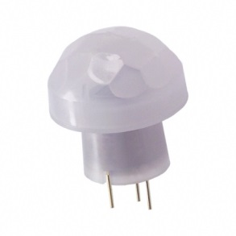
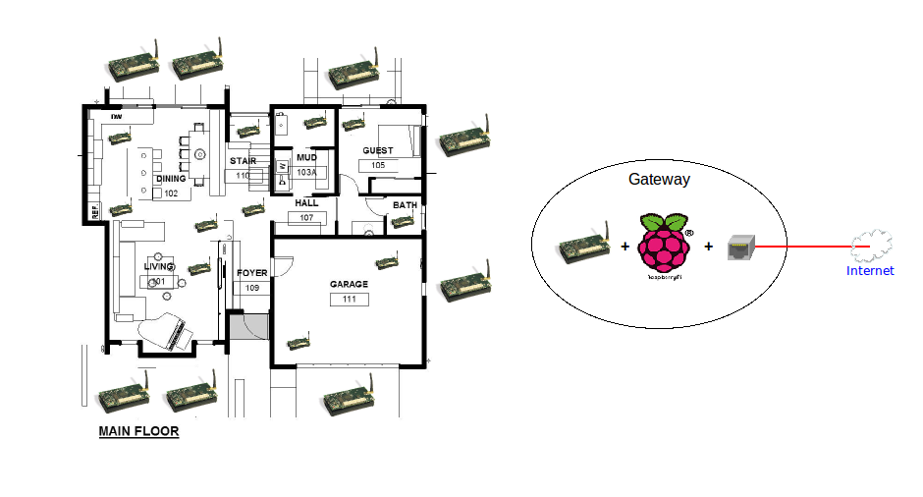
Concept
Home Security & Surveillance
Data collection nodes with IR, acceleration, temperature and
brightness sensors, forwarding data according to local routing tables
Commander node sends commands, manages global routing tables, connects over UART to the server interface
Server-client infrastructure for packet parsing, packet forwarding, remote communication over TCP sockets and graphical interfacing
Event-based data updates
Command & response (“on-demand”) management system (e.g. shutdown)
Distributed-system implemented:
WSN: Nano-RK & B-MAC (in C)
Server and GUI applications in Python
Image source: http://momoge.com/wp-content/uploads/2011/03/Green-house-concept-rendering-main-floor-sketch-plan.jpg
16.07.2013
Ermin SAKIC, Berke AYDINLI

Slide 4
Data-collection nodes Workflow
Home Security & Surveillance
No neighbours identified
A Warning/Info packet transmitted
c
Transmit a warning packet to the Commander
A suspicious activity identified
Send Your Info to Commander
Send heartbeat messages
Wait for a packet to arrive
An event occurred
Neighbours identified
c
For me?
Routing Table Updated
Start the
monitoring task
Wait for GUI to send commands
React to suspicious activities
A packet received
Route query
or command received
A path to commander node identified
For another node?
Listening mode
Forward the packet to the target node
New routing info received
A packet received
A Warning/Info packet received
For commander
Packet forwarded
16.07.2013
Ermin SAKIC, Berke AYDINLI

Slide 5
Implementation (IR – Accel Node)
Home Security & Surveillance
Initialisation:
Broadcast a “hello” packet with unique node-ID to inform and “synchronize” with the neighbour nodes → Contact established → Update the local routing table → Stand-by mode (wait until an init packet from an unknown node is received)
RX & TX:
Listening mode for incoming commands or events:
  For the node itself?: React to the different commands (command ID in package!) e.g. “Shut Down”, “Send Your Info”, “Routing Update”…
  For another node?: Forward the package to the target node (found in package) according to own routing table
Events:
Check periodically if the attached IR-sensor’s pin is high, room temperature too high or too low and similar → Raise event flag → Send a warning message to the commander → Pop-up window on GUI (Irrelevant alerts can be disabled by the user)
16.07.2013
Ermin SAKIC, Berke AYDINLI

Slide 6
Commander & GUI Workflow
Home Security & Surveillance
Notify the user
(pass message to the server interface)
UART TX
Wait for a packet to arrive
Received a response or a warning packet
No neighbours identified
New routing info received
An expected response or
an event identified
c
c
c
Data packet received
Send heartbeat messages
Neighbours identified
Routing Table Updated
Enable UART RX Task
Wait for GUI to Send Command
React to incoming packets
Command to be sent
Transmit Task
Initialization Task
Continuous Task
Reformat string (translate command)
Idle Mode
UART RX
Send packet
Wait for response and pass it to the server interface
16.07.2013
Ermin SAKIC, Berke AYDINLI

Slide 7
Implementation (Commander)
Home Security & Surveillance
Initialisation:
Broadcast a “hello” package to “synchronize” with the direct neighbours.
  →Contact(s) established → Routing table* updated (responses from all nodes)
→ Stand-by mode (wait until an init packet from an unknown node is received)
Data to and from data collection nodes and server interface:
Bidirectional communication with the server interface (Raspberry Pi) over UART and with the other nodes using B-MAC. The commander listens, forwards and parses command, response and event notification messages.
Command to node:
The command packets should be parsed and formatted so that the target node is able to understand and react correspondingly.
(*): see slide 10
16.07.2013
Ermin SAKIC, Berke AYDINLI

Slide 8
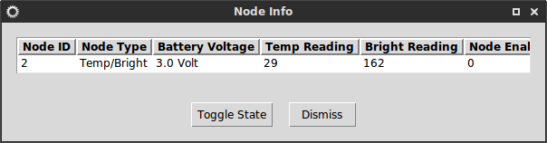
Implementation (Server & Client GUI)
Home Security & Surveillance
Server Interface (Python): Implemented to run on a Raspberry Pi. Utilizes PySerial and Socket libraries in order to write and read from the USB port and to communicate over TCP/IP. Serves as a package parser and string formatting tool.
Client GUI (Python): User interface used to manage the whole system by listing the nodes, sending commands, receiving data and visualizing information. Reacts to event notifications (pop-up warning). Connects to the server over the TCP/IP socket and uses TkInter as the base window library.
16.07.2013
Ermin SAKIC, Berke AYDINLI

Slide 9
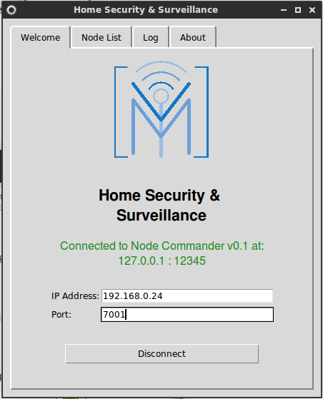
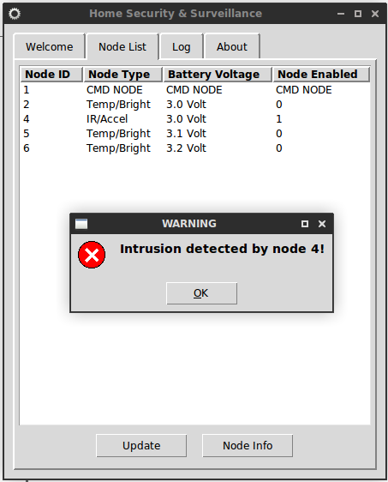
Implementation (Server & Client GUI)
Home Security & Surveillance
16.07.2013
Ermin SAKIC, Berke AYDINLI

Slide 10
Routing (Sample Scenario)
Home Security & Surveillance
Nodes
1 (Comm) | 5 | 2
2 | 1 | 5 | 3
3 | 2 | 6 | 5
4 | 5
5 | 3 | 2 | 1 | 4
6 | 3
Neighbors →
2-STEP Search algorithm:
Check if the direct neighbours array contains the target node identifier:
  If targetID == IDsIdentified[i]
  {
  dest = IDsIdentified[i];
  foundConnection = 1;
  return dest;
  }
If not, determine and choose one of the direct neighbours of the target node, and use this node as an argument of the function. Continue the recursive calling until the next hop in the path, over which the packet is to be sent, is detected:
  while( !foundConnection )
  target = routeTableSearch( target )
*
(*): The IDsIdentified[i] array
4
5
1
3
6
2
16.07.2013
Ermin SAKIC, Berke AYDINLI

Slide 11
Prospect
Home Security & Surveillance
Constraints on choosing the next hop are undefined (currently random)
Registration of the newly added nodes in the network is currently achieved via flooding. There might be better ways to do this but using fixed node ID‘s goes against the idea of dynamical network (re)organisation
Microphone and signal processing utilization is missing
Heartbeat task agent (so far, only warnings on low battery voltage available)
Conclusion
A distributed system was implemented
Focus on self-organization and low-overhead resource-constrained communication
Generic architecture, easily adaptable to other wireless sensor projects
A command & response based system
Asynchronous event-based communication
16.07.2013
Ermin SAKIC, Berke AYDINLI

Slide 12
Home Security & Surveillance
Thank You for listening!
Any questions? Suggestions?
16.07.2013
Ermin SAKIC, Berke AYDINLI

