Slide 1
Home Security & Surveillance
Kick-Off Presentation Wireless Sensor Laboratory
Group 02, Summer Term 2013
Ermin SAKIC - ermin.sakic@tum.de
Berke AYDINLI – berke.aydinli@tum.de
28.05.2013

Slide 2
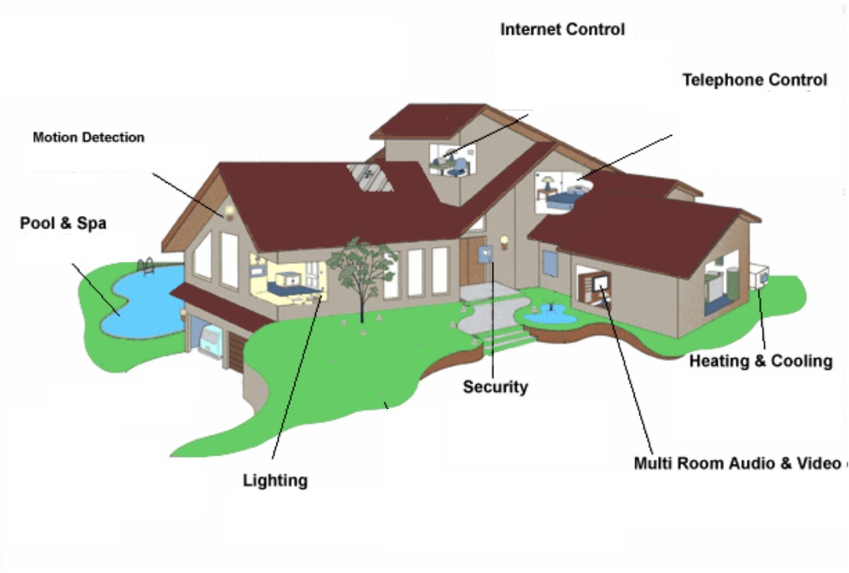
Motivation
Home Security & Surveillance
Intrusion detection is our biggest concern and the focus of the project, windows and doors need to be equipped with corresponding sensors.
We will also cover basic home monitoring (surveillance) as well (temperature and brightness conditions).
Inexpensive nodes and sensors, yet can be made to work very effectively with the available MicaZ nodes.
A lot to learn from: many different sensors, multi-hop routing, big-scale setup, gateways, Raspberry Pi and RJ45 interfacing, remote nodes management…
Image source: The Home SIP Project: Using Open Source SIP Stack for Home Autmation pp. 13. In FOSDEM ’07, Brussels, BE
28.05.2013
Ermin SAKIC, Berke AYDINLI

Slide 3
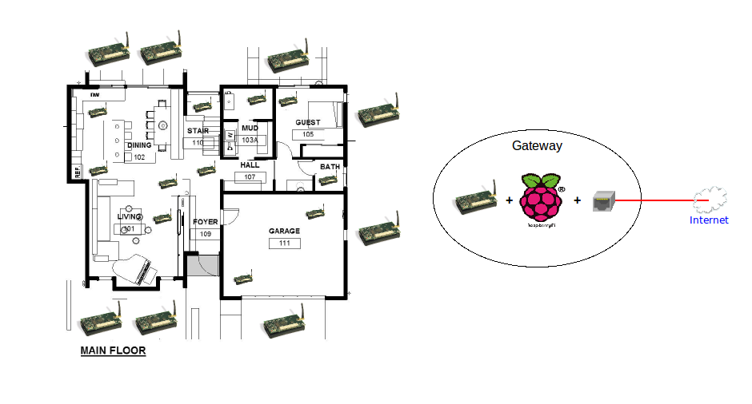
Sample scenario
Home Security & Surveillance
Data routing to the gateway node, attached to a Raspberry running a web-server (or a socket-based application), allowing for an authorized access from outside the home, bi-directional communication and a command system responsible for managing the nodes from the server application.
Image source: http://momoge.com/wp-content/uploads/2011/03/Green-house-concept-rendering-main-floor-sketch-plan.jpg
28.05.2013
Ermin SAKIC, Berke AYDINLI

Slide 4
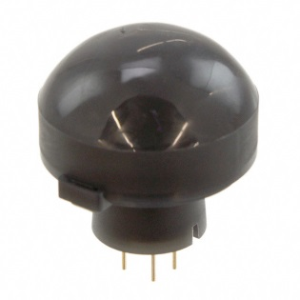
Sensors
Home Security & Surveillance
For security monitoring we will use:
The well-established infrared sensors for motion sensing: Pyroelectric IR sensors are low-power and fit our use-case, which detect movements up to 12m away (Panasonic PaPIRs Motion Sensor EKMB), 1uA current consumption in sleep mode
Accelerometers (analog): In a scenario where an attacker tampers with a secure node, if secured properly, the physical contact would allow for a spike in accelerometer readings to be detected and alarm raised
For general home surveillance:
We will be able to make use of the existing equipment (temperature and brightness sensors) to collect the monitoring data, we hope to be able to distinguish home fire, wasted ambience lights from normal conditions
Image source: http://media.digikey.com/Photos/Panasonic%20Elect%20Works%20Photos/EKMB1303112K.JPG
28.05.2013
Ermin SAKIC, Berke AYDINLI

Slide 5
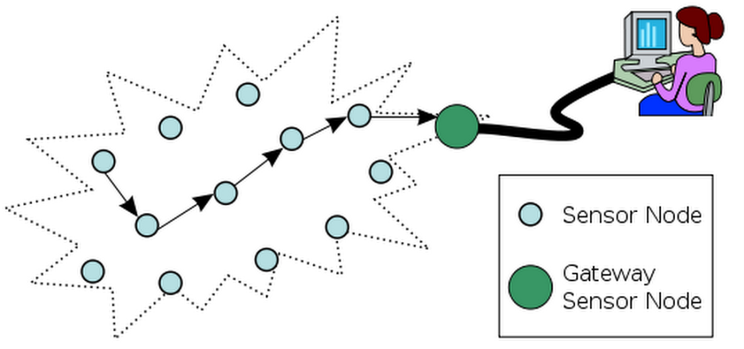
Security is important but there is more
Home Security & Surveillance
A server application running on Raspberry Pi will be accessible from afar, and allow for both on-demand and event-based data updates and manual system shutdown (for saving energy purposes)
If we are left with enough time, we might get to implement additional means of letting the home owner know of abnormalities (automated E-Mail over Raspberry, SMS gateway are some of the ideas)
Image source: http://upload.wikimedia.org/wikipedia/commons/thumb/2/21/WSN.svg/400px-WSN.svg.png
28.05.2013
Ermin SAKIC, Berke AYDINLI

Slide 6
MAC & Routing
Home Security & Surveillance
Our scenario: nearly-fixed topology (without rapid network dynamics) with one central gateway node and certain number of sensor nodes “around the house”.
Therefore multi-hop single path routing and schedule-based MAC
  No collisions or overhearing with a compromise over overhead
INIT
DATA TRANSFER
UPDATE
Assignment & synchronisation of MAC
Table-driven routing protocol (self-configuring maintenance)
Data transfer from a node within its time slot
Unicast routing through the neighbours according to the table
Topology control
Update medium access assignments
Update (re-configure) routing tables
28.05.2013
Ermin SAKIC, Berke AYDINLI

Slide 7
“Estimated” Timeline
Home Security & Surveillance
16.07.13
Presentation and Demo
28.05.13
Kick-Off
Data transfer available
App ready
4 weeks
Guidelines:
Concepts and Algorithms
Bidirectional Communication
Sensor data handling
MAC Settings
Routing
2 weeks
Retouches:
GUI
Webserver & RC
Optional Features
1 week
End Phase:
Testing
Bugfixing
Documentation
28.05.2013
Ermin SAKIC, Berke AYDINLI

Slide 8
Home Security & Surveillance
Thank You for listening!
Any questions? Suggestions?
28.05.2013
Ermin SAKIC, Berke AYDINLI

Slide 9
Literature
Home Security & Surveillance
Copy-Paste this slide as a template for additional literature references.
Author et al.: Title of the Publication. In ABC ‘09: Fourth International Conference on Strange Conference Titles,
Fantasy Town, New York, USA, pp. 10-20, 2009.
Author et al.: Title of the Publication. In XYZ: Proceedings of the 1st International Conference on Dummy Templates,
Nowhere City, New York, USA, pp. 200-222, 2010.
28.05.2013
Ermin SAKIC, Berke AYDINLI

Slide 10
Interactivity Slide
Home Security & Surveillance
Use this template (VL-Template dunkelblau) for interactive parts in the lecture
28.05.2013
Ermin SAKIC, Berke AYDINLI

Slide 11
Colors
Home Security & Surveillance
0.101.189
0.0.0
255.255.255
TUM Corporate Colors
0.51.89
0.82.147
0.115.207
100.160.200
152.198.234
Additional Colors - Blue
88.88.90
156.157.159
217.218.219
Additional Colors - Gray
162.173.0
227.114.34
218.215.203
Accent Colors
255.180.0
255.128.0
229.52.24
202.33.63
Accent Colors for Presentations
0.153.255
65.190.255
145.172.107
181.202.130
28.05.2013
Ermin SAKIC, Berke AYDINLI

