Slide 1
{ }
Software is a pipeline from sensing to evidence.
The code is not only a simulator: firmware, shared logic, logging tools, and replay all use the same data story.
Sensors
Firmware
Shared logic
Logger
Evaluation
Simulator
4 ultrasonic
far + near
->
Node A + Node B
ESP32 LoRa
->
sensing, queue,
controller, packets
->
serial B STATUS
saved CSV
->
TP/TN/FP/FN
stale + energy
->
CSV replay
digital twin
Repository structure used in the software slides
firmware/node_a/main.cpp // Side A sensing + LoRa TX
firmware/node_b/main.cpp // Side B sensing + control
lib/traffic_control/ // shared logic used by both nodes
tools/road_data_logger.py // live serial -> CSV evidence
tools/final_evidence_report.py // metrics and report
simulation/visual_simulator.py // CSV replay / digital twin
What this proves to the professor
- Real sensor readings are converted into queue states.
- Node A and Node B communicate through LoRa packets.
- Node B makes the final light decision locally.
- The same live log becomes CSV, metrics, graphs, and simulator replay.
- Improvements are visible in code: filtering, stale handling, emergency, energy logging.
Speaker message: each later slide zooms into one layer of this pipeline, then shows how we improved it after testing.
Wait Less | Sapienza IoT - Final Delivery
Software | general structure

Slide 2
A/B
Node A senses; Node B decides and controls.
The two ESP32 programs have different roles, but they share the same telemetry and sensing model.
Node A responsibilities
Node A: sensor state becomes LoRa payload
4
1
SideTelemetry telemetry =
laneEstimator.update(SideId::A,
farOccupied, nearOccupied, nowMs);
telemetry.farDistanceCm = farDistance;
telemetry.nearDistanceCm = nearDistance;
const String payload = encodeTelemetry(telemetry);
sendTelemetryOverLoRa(payload);
- read A_far and A_near
- filter + debounce occupancy
- estimate Side A queue
- encode LoRa telemetry
- print human-readable status
physical ultrasonic readings
LoRa direction: A to B
6
50 cm
LED outputs on Node B
live demo threshold
Node B responsibilities
Node B: combine A + B, then apply lights
if (loRaTryReceive(packet, Serial)) {
parseTelemetryLine(packet.payload, received);
lastRemoteRxMs = nowMs;
}
SideTelemetry remote = effectiveRemoteTelemetry(nowMs);
TrafficDecision decision =
controller.update(remote, localTelemetry, nowMs);
applyLights(decision.lights);
Live demo line proves all roles are active
- read B_far and B_near
- receive Node A telemetry
- detect stale LoRa
- run adaptive controller
- drive all six LEDs and log CSV line
B STATUS | A_queue=... | B_queue=...
| A_far=...cm/OCC | B_far=...cm/FREE
| source=LORA_RADIO | stale=OFF
| backup=OFF | green=A | lights=A:GREEN B:RED
Wait Less | Sapienza IoT - Final Delivery
Software | node firmware

Slide 3
lib
Shared code keeps the two nodes consistent.
The project avoids two separate implementations by putting sensing, packet, queue, and controller logic in reusable modules.
HardwareMap.h
SensorSupport.cpp
TrafficSensing.cpp
pin source of truth
A/B sensors, LEDs, button
HC-SR04 distance
median3 + debounce2
incoming/passed counters
queue estimate
NodeMessaging.cpp
AdaptiveController.cpp
Ina219Support.cpp
LoRa CSV payload
backward-compatible decode
demand score
min green + yellow
optional current/power
INA219_NA if absent
Reliability layer after real-road testing
SensorSupport.cpp: final occupancy is filtered, thresholded, then debounced
reading.distanceCm = readMedianUltrasonicDistanceCm(trigPin, echoPin,
medianSampleCount, timeoutUs);
reading.rawOccupied = isDistanceOccupied(reading.distanceCm, thresholdCm);
reading.stableOccupied = debouncer.update(reading.rawOccupied, debounceSamples);
farHealth.update(farDistance); // status: OK / WARN / FAIL
- Median filtering rejects one-sample ultrasonic spikes.
- Debounce requires repeated agreement before occupancy changes.
- Sensor health shows WARN/FAIL instead of hiding bad wiring or angle issues.
Speaker message: this slide shows that the software is engineered in layers, so every improvement is implemented once and reused by both boards.
Wait Less | Sapienza IoT - Final Delivery
Software | shared code

Slide 4
eq
The controller scores demand and switches safely.
The algorithm is intentionally explainable: queue pressure is weighted, but timing and emergency rules prevent unstable behavior.
Demand equation
TrafficTypes.h: exact demandScore() used by the firmware
const uint32_t queueWeight = telemetry.estimatedQueue * 3U;
const uint32_t incomingWeight = telemetry.farOccupied ? 2U : 0U;
const uint32_t stopLineWeight = telemetry.nearOccupied ? 4U : 0U;
return queueWeight + incomingWeight + stopLineWeight;
demand = 3 x queue + 2 x farOcc + 4 x nearOcc
Queue length matters most; the near sensor has extra weight because it means a vehicle is at the stop line.
AdaptiveController.cpp: switching is allowed only after safe timing
Improvements added after problems appeared
const bool canSwitch = phaseElapsedMs >= config_.minGreenMs;
const bool currentEmpty = !hasDemand(current);
const bool otherBusy = hasDemand(other);
const bool reachedMaxGreen = phaseElapsedMs >= config_.maxGreenMs;
const bool otherClearlyBusier =
demandScore(other) > (demandScore(current) + config_.advantageMargin);
if (canSwitch && ((currentEmpty && otherBusy) ||
(otherBusy && otherClearlyBusier) || (reachedMaxGreen && otherBusy))) {
beginYellow(other.side, nowMs);
}
- per-sensor threshold commands: set_thresholds 50 50
- median-of-3 ultrasonic filtering
- 2-sample occupancy debounce
- sensor health diagnostics: OK / WARN / FAIL
- emergency button: 1 click = B, 2 clicks = A
- stale Node A backup and recovery logging
Speaker message: the algorithm is not a black box. We can justify every number and explain every improvement as a response to measured behavior.
Wait Less | Sapienza IoT - Final Delivery
Software | adaptive algorithm

Slide 5
LoRa
Full packets became heartbeat mode.
First we sent complete telemetry periodically; the improvement separates traffic data from node-alive signals.
Before: full telemetry every 5 seconds
Problem: silence looked like failure
if (nowMs - lastTelemetryMs >= 5000) {
lastTelemetryMs = nowMs;
payload = encodeTelemetry(telemetry);
sendTelemetryOverLoRa(payload);
}
Old packet:
A,farOcc,nearOcc,incoming,passed,queue,timestamp
A,1,0,4,2,2,12345
// If packets stop, Node B cannot know why:
// 1) no cars, so Node A is quiet
// 2) Node A failed
// 3) LoRa link failed
if (nowMs - lastRemoteRxMs > timeoutMs) {
lastRemoteSource = "LORA_STALE";
backup = ON;
}
What was missing
Why that mattered
Implemented transition
- full packets even when nothing changed
- silence could mean empty road or failure
- no heartbeat meaning node alive / no traffic
- no peak-hour low-traffic-message mode
- LoRa traffic wastes energy when repeated state is unchanged
- stale detection can conflict with energy saving
- backup mode may activate even when the road is simply empty
- we need reliability and energy saving together
Active mode sends full telemetry. Idle or peak-saturated mode sends heartbeat only every long period. Node B keeps controlling the LEDs locally, while heartbeat proves Node A is alive.
Speaker message: the improvement is not just fewer packets. It separates traffic telemetry from health heartbeat, so energy saving does not break failure detection.
Wait Less | Sapienza IoT - Final Delivery
Software | communication before

Slide 6
RX
Improved communication carries state and health.
Node B now separates full traffic telemetry from heartbeat packets, so low communication is not confused with failure.
Final packet format sent by Node A
NodeMessaging.cpp: encodeTelemetry()
side,farOcc,nearOcc,incoming,passed,queue,
emergency,timestampMs,farDistanceCm,nearDistanceCm
Example:
A,1,0,4,2,2,0,12345,42.0,999.0
return String(sideName(telemetry.side)) + "," +
String(telemetry.farOccupied ? 1 : 0) + "," +
String(telemetry.nearOccupied ? 1 : 0) + "," +
String(telemetry.incomingCount) + "," +
String(telemetry.passedCount) + "," +
String(telemetry.estimatedQueue) + "," +
String(telemetry.emergencyRequested ? 1 : 0) + "," +
String(telemetry.timestampMs) + "," +
String(telemetry.farDistanceCm, 1) + "," +
String(telemetry.nearDistanceCm, 1);
Node B: stale data becomes backup mode, not silent failure
Implemented: telemetry vs heartbeat modes
lowCommunicationExpected =
lastRemotePacketWasHeartbeat || !hasDemand(remoteTelemetry);
timeoutMs = lowCommunicationExpected
? kRemoteHeartbeatTimeoutMs // 25 s
: kRemoteTelemetryTimeoutMs; // 3 s
if (lastRemoteRxMs == 0 || nowMs - lastRemoteRxMs > timeoutMs) {
setNodeABackupActive(true, "NODE_A_STALE");
remoteTelemetryStale = true;
}
if (currentTxMode == ActiveTelemetry) {
sendFullTelemetryEvery(1000);
} else if (currentTxMode == IdleHeartbeat) {
sendTelemetryOnlyOnStateChange();
sendHeartbeatEvery(10000); // H,A,I,timestamp
} else if (currentTxMode == PeakHeartbeat) {
sendHeartbeatEvery(15000); // H,A,P,timestamp
} else {
setNodeABackupActive(true);
}
Communication improvement
Important limitation
- full telemetry still carries distances, queue, emergency
- heartbeat packets keep liveness while reducing repeated LoRa traffic
Node A sleeps only in peak fixed-cycle mode, when Node B intentionally handles both sides locally. Normal adaptive mode keeps Node A awake to avoid missing vehicles.
Wait Less | Sapienza IoT - Final Delivery
Software | communication after

Slide 7
mW
Measured energy, then peak sleep.
INA219 gives the baseline; heartbeat and peak sleep reduce repeated work without hiding node failures.
123.0 mA
174.8 mA
297.9 mA
INA219
Node A measured average
Node B measured average
combined baseline
measured, not guessed
Current firmware: optional INA219 evidence
Implemented improvement: communication + peak sleep
lastPowerReading = ina219Read();
Serial.print(" | power=");
if (lastPowerReading.ok) {
Serial.print(lastPowerReading.currentMa, 1);
Serial.print("mA/");
Serial.print(lastPowerReading.powerMw, 1);
Serial.println("mW");
} else {
Serial.println("INA219_NA");
}
if (peakSleepEnabled && peakTrafficModeActive()) {
sendHeartbeatOverLoRa(PeakHeartbeat, nowMs);
esp_sleep_enable_timer_wakeup(kPeakSleepMs * 1000ULL);
esp_deep_sleep_start();
} else if (currentTxMode == IdleHeartbeat) {
sendHeartbeatEvery(10000); // low LoRa traffic
} else {
sendFullTelemetryEvery(1000); // adaptive mode
}
Before improvement
After implemented improvement
Peak sleep condition
- fixed telemetry interval
- continuous sensing and logging
- Node B radio receive and LED load always active
- baseline measured with INA219
- full telemetry only when useful
- heartbeat proves node is alive
- peak sleep wakes only for heartbeat
- Node B uses longer heartbeat timeout
Only use peak_sleep_on when Node B is intentionally running balanced fixed-cycle control. Normal adaptive mode keeps Node A awake for real-time sensing.
Speaker message: the INA219 values are measured baseline values. Peak sleep is implemented; the exact current reduction still needs a second INA219 measurement.
Wait Less | Sapienza IoT - Final Delivery
Software | power and duty cycling

Slide 8
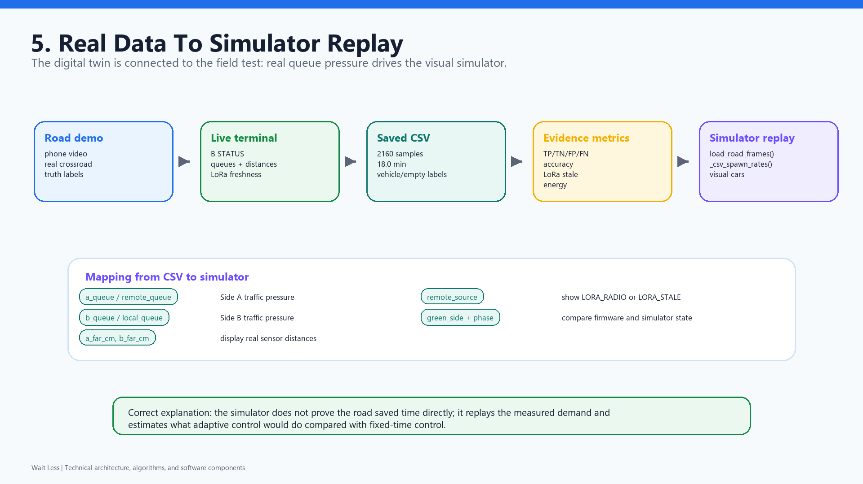
sim
The simulator became a real-data replay tool.
We kept random/manual modes for testing, but the important final mode is CSV replay from the road run.
Simulator modes
Why CSV replay matters
- CSV replay from road data
- direct queue input
- manual rates
- random traffic
- fixed scenarios
- uses real sensor demand
- shows queues visually
- compares adaptive vs fixed-time idea
- connects IoT evidence to digital twin
simulation/visual_simulator.py: road CSV becomes replay frames
frames = load_road_frames(path)
self.csv_status_var.set(
"CSV replay loaded: " + csv_status_line(frames, path)
)
// CSV fields used: A/B queues, distances, phase, green side,
// source=LORA_RADIO or LORA_STALE
How to say this honestly
The simulator does not replace field evidence. It replays the measured demand from the road CSV so we can visualize and compare the controller behavior against a fixed-time baseline. That is the digital twin connection.
End of software story: sensors -> firmware -> LoRa -> controller -> log -> CSV -> evaluation -> replay.
Wait Less | Sapienza IoT - Final Delivery
Software | simulators

