Slide 1
Wait
Less
SAPIENZA(DIAG)
Presented by:
- Hamza Abdel kader
- Ermin lilaj - Edo
Presented to:
Prof. Chatzigiannakis
Prof. Vitaletti
Date: 17/03/2026

Slide 2
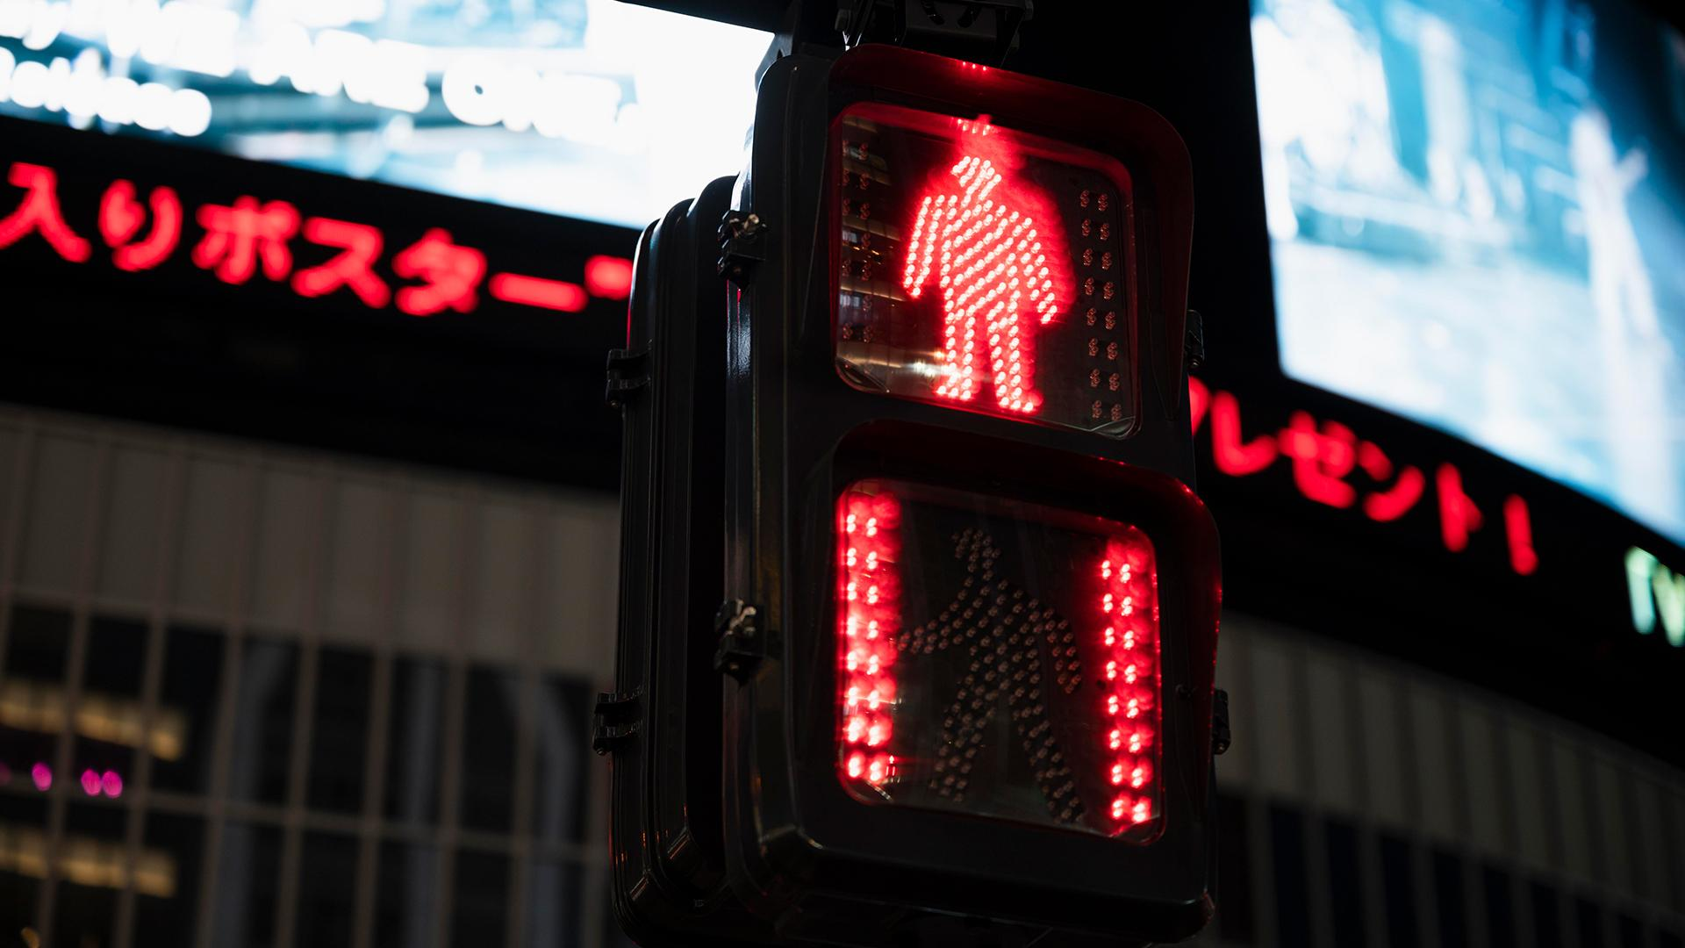
I CANT WAIT ANYMORE!!!!
TRAFFIC LIGHT
30 min per day

Slide 3
I CANT WAIT ANYMORE!!!!
TRAFFIC LIGHT
30 min per day

Slide 4
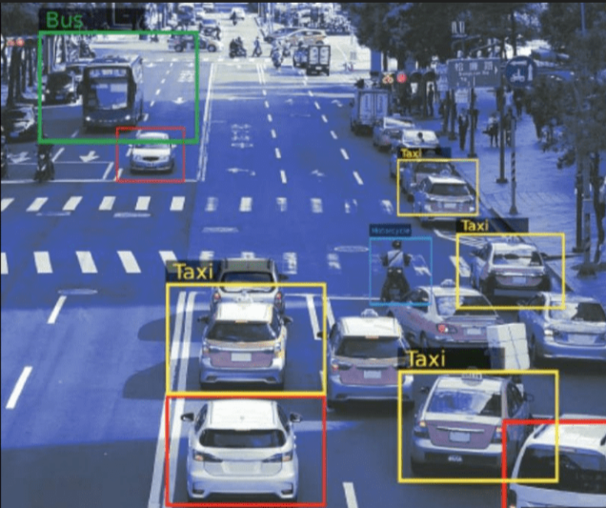
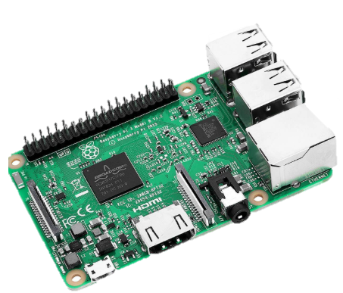

No budget

Slide 5
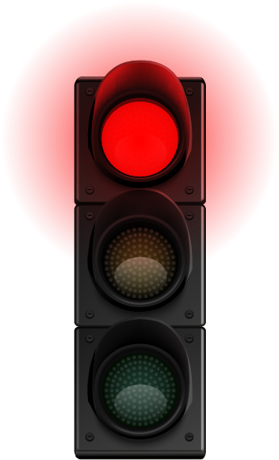

OUR ALTERNATIVE
Far sensor
Near sensor
Near sensor
Far sensor

Slide 6
OUR ALTERNATIVE
2 × ESP32 LoRa boards
4 × IR sensors (2 per side: far + near)
6 × LEDs (Red, Yellow, Green for each side)
Resistors (for LEDs)
Breadboard
Jumper wires
Power supply (battery)
INA219 sensor
Far sensor
Near sensor
Near sensor
Far sensor

Slide 7
Smart traffic light
1 Problem & Why IoT
Fixed traffic lights cause congestion, so IoT is needed for real-time adaptive control.
2 Data & Sensors
IR sensors collect data on approaching cars and queue length on each side.
3 Learning & Actuation
The system compares traffic levels and adjusts LED traffic lights accordingly.

Slide 8
Smart traffic light
Frequency: Data is updated continuously during the traffic light cycle.
Bandwidth: Only small data packets are transmitted.
Latency: Decisions are made within 1–2 seconds to react in near real-time.
Energy: Each battery-powered sensing node is expected to consume about 60–80 mA on average (around 0.22–0.30 W at 3.7 V), giving roughly 1 day of operation with a 2000 mAh Li-Po battery.
Duty Cycle: Transmissions are controlled to avoid excessive channel usage

Slide 9
THANKS!

