Slide 1
Customer Support
Ticket Analysis
EDA & Insights Report | 2020–2021
Data-driven analysis of 8,469 support tickets across channels, products, priorities & customer segments

Slide 2
Executive KPI Summary
8,469
0.33%
19.35 hrs
Total Tickets
Resolved TTs %
Avg Response Time
9.61 hrs
2.99 / 5
0.50%
Avg Resolution Time
Avg Rating
Priority TTs %

Slide 3
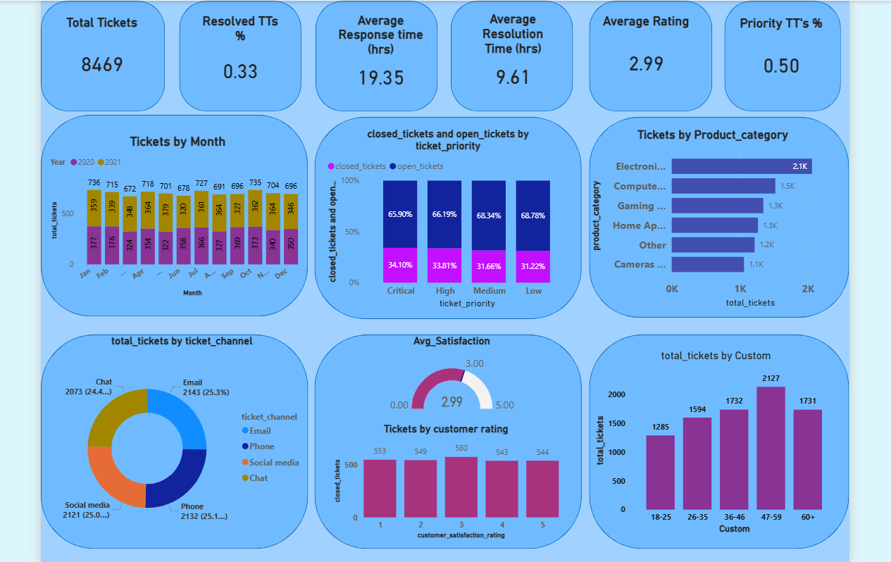
Dashboard Overview

Slide 4
Monthly Ticket Volume Trend

Slide 5
Ticket Priority — Open vs Closed

Slide 6
Tickets by Product Category & Channel

Slide 7
Customer Satisfaction & Age-Group Breakdown

Slide 8
Key Findings & Recommendations
High Open Rate Across All Priorities
Electronics Dominates Volume
65–69% of tickets remain unresolved regardless of priority level, indicating systemic backlog issues that need process intervention.
Electronics & Gadgets accounts for the most tickets (~2.1K), suggesting a need for improved self-service resources or product QA.
Channel Distribution is Near-Equal
Older Customers File More Tickets
All four channels (Email, Phone, Chat, Social) handle ~25% of tickets each — a balanced multi-channel model.
The 47–59 age bracket generates the highest volume (2,127), warranting age-targeted support optimisation.
Satisfaction Fairly Uniform
Avg Resolution Faster Than Response
Ratings 1–5 all hover around 544–580 resolved tickets, suggesting satisfaction is not strongly linked to resolution speed.
Resolution time (9.61 hrs) is significantly lower than response time (19.35 hrs) — first response lag is the primary bottleneck.

Slide 9
Conclusion
This EDA reveals that the customer support system handles a large, diverse ticket volume. The primary challenges are high open-ticket rates and slow first-response times. Prioritising automation for initial responses, strengthening Electronics support resources, and targeting the 47–59 age segment with dedicated support workflows are key next steps.
Thank you

