Slide 1

LECTURE 1
Your First Steps in Python
Talk to a computer - before we ever touch a drone
Bumblebee drone · programming in the Gazebo simulator
1

Slide 2

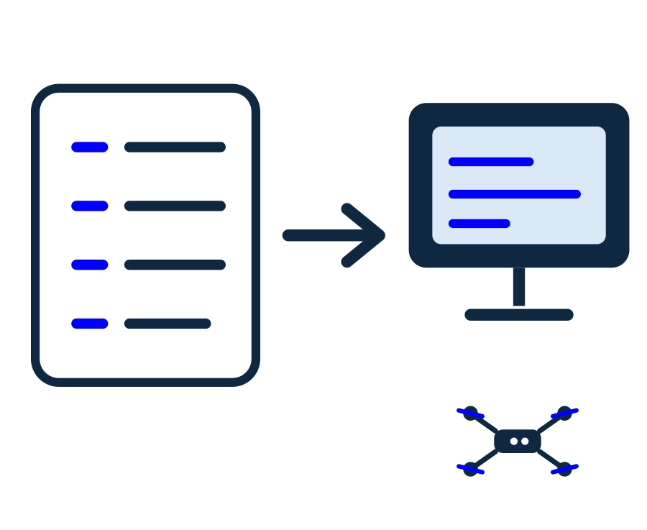
What is programming?
Today: no drone yet. First we learn to give clear instructions.
● A computer is very fast, but it only does exactly what you tell it.
● Programming = writing a list of steps for the computer to follow.
● Think of a recipe: 'take 2 eggs, add flour, bake 20 minutes'.
● We write our recipe in a language called Python.
2

Slide 3

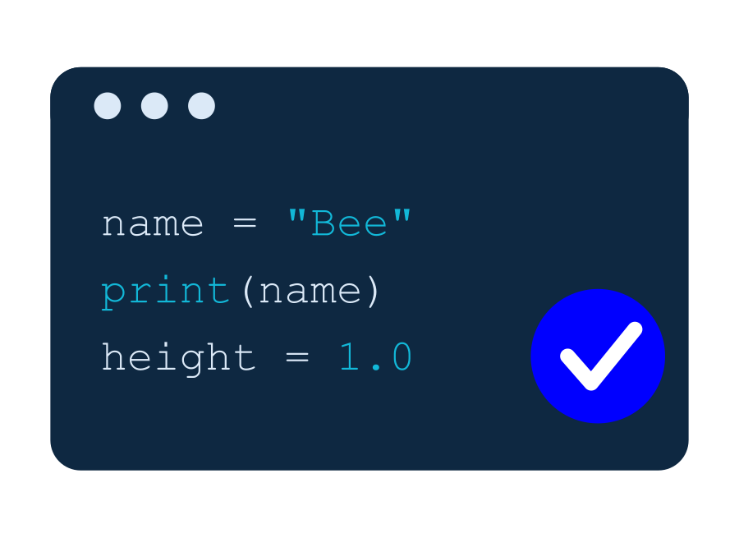
Why Python?
● Python reads almost like English - easy for beginners.
● It is one line = one instruction, from top to bottom.
● The same Python we learn today will fly our drone next time!
● We type Python into a file that ends with .py
3

Slide 4

print() - make the computer talk
print() shows text on the screen.
print("Hello!")
print("I am learning Python")
💡 Text always goes inside quotes: "like this".
4

Slide 5

Variables - boxes that remember
● A variable is a box with a name.
● You put a value inside with =
● Later you use the name to get the value back.
● The name is yours to choose.
# put 1.0 into a box called height
height = 1.0
name = "Bumblebee"
print(height)
print(name)
= means 'store into', not 'equals' like in math.
5

Slide 6

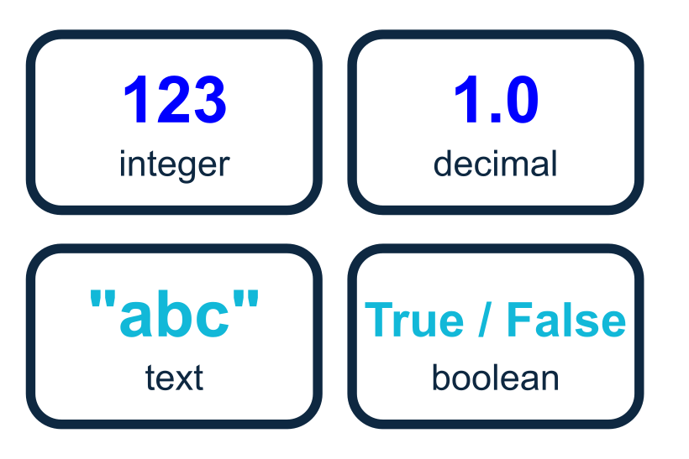
Types - kinds of values
Every value has a type. Python cares which one you use.
● Number (integer): 5, 42, -3
● Number (decimal): 1.0, 0.4, 3.14
● Text (string): "hello" -- always in quotes
● True / False - yes-or-no answers (we use these for decisions).
6

Slide 7

Comments - notes for humans
Anything after # is a comment.
# This line is a note. Python ignores it.
speed = 0.4 # comments can sit after code too
print(speed) # only the code runs
💡 Comments explain WHY. They never change what the program does.
7

Slide 8

Doing math
Python is a calculator too.
a = 10
b = 3
print(a + b) # 13 add
print(a - b) # 7 subtract
print(a * b) # 30 multiply
print(a / b) # 3.33 divide
8

Slide 9

if / else - making decisions
● Sometimes the computer must choose.
● if a question is True -> do one thing.
● else -> do something else.
● Notice the spaces (indent) under if.
battery = 30
if battery > 20:
print("OK to fly")
else:
print("Charge me first!")
The : and the indent tell Python what belongs to the if.
9

Slide 10

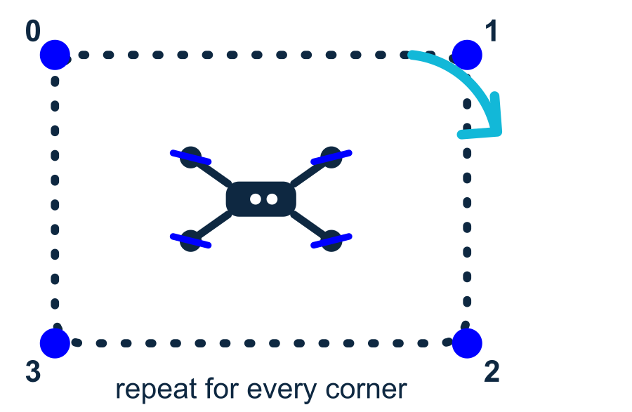
for - repeat things
● A loop repeats the same steps.
● range(3) gives us 0, 1, 2.
● Great for doing something N times.
● No copy-paste needed!
for i in range(3):
print("Beep", i)
# prints:
# Beep 0
# Beep 1
# Beep 2
Next lecture: we will loop to fly a drone around a square.
10

Slide 11
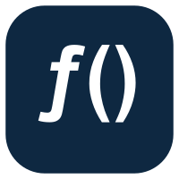
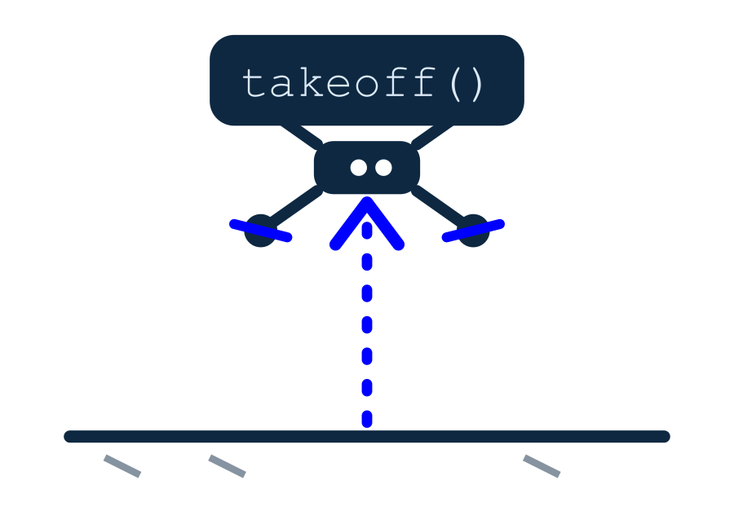
Functions - teach a new word
● A function is a mini-program with a name.
● def creates it. You run it by calling its name.
● Write once, use many times.
● It can take inputs (here: name).
def say_hi(name):
print("Hi", name)
say_hi("Anna")
say_hi("Max")
Later, drone.takeoff() is just a function someone wrote for us.
11

Slide 12

Putting it together
Variables + loop + function, all at once.
# A tiny program using everything we learned
def countdown(start):
for i in range(start, 0, -1):
print(i)
print("Lift off!")
countdown(3)
💡 This prints 3, 2, 1, Lift off!
12

Slide 13

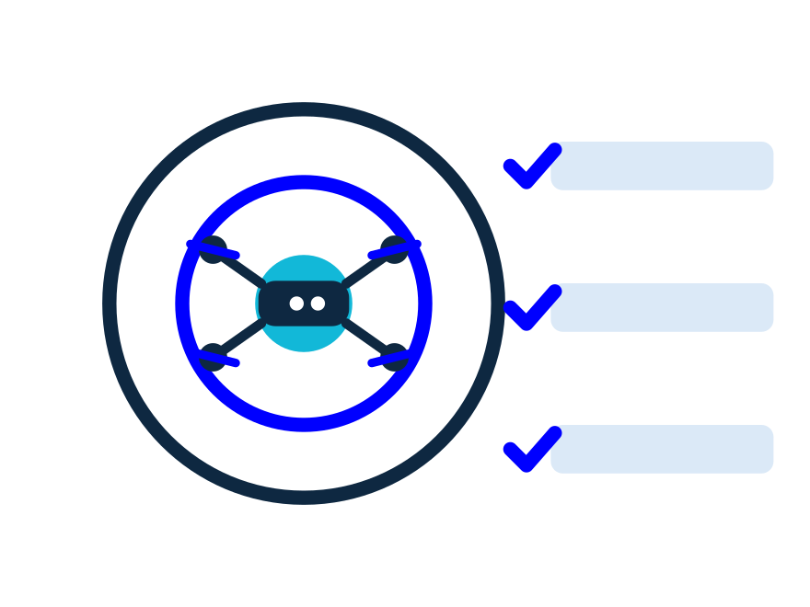
Your turn - mini challenges
Try these on any computer with Python. No drone needed.
● 1) Print your name 5 times using a for loop.
● 2) Make a variable age and print 'You can fly!' if age > 10.
● 3) Write a function add(a, b) that prints a + b.
13

Slide 14

PRACTICE 1
Say hello to the pilot
● Make a variable name with your name.
● Use print() to greet the pilot.
● Bonus: greet the drone too, on a second line.
# your code here
name = "Anna"
print("Hello, " + name + "!")
▶ Expected: Hello, Anna!
14

Slide 15
PRACTICE 2
Can we fly?
● The battery level is 45 .
● Print "OK to fly" if it is above 20.
● Otherwise print "Charge me first!" .
battery = 45
if battery > 20:
print("OK to fly")
else:
print("Charge me first!")
▶ Expected: OK to fly
15

Slide 16
PRACTICE 3
Countdown to launch
● Write a function countdown(n) .
● Use a for loop to print n, n-1, ... 1 .
● After the loop, print "Lift off!" .
● Call countdown(3) .
def countdown(n):
for i in range(n, 0, -1):
print(i)
print("Lift off!")
countdown(3)
▶ Expected: 3 / 2 / 1 / Lift off!
16

Slide 17
Recap
print · variables · types · comments · math · if/else · for · functions
17

Slide 18
NEXT TIME
We fly a real drone!
Same Python - now it makes a drone take off in the simulator
Bumblebee drone · programming in the Gazebo simulator
18

Slide 19
QUIZ TIME
Let's play Kahoot!
Open kahoot.it and join with the game PIN
Show what you learned today.
19

