Slide 1

LECTURE 2
Fly Your First Drone
Same Python - now it commands the Bumblebee in Gazebo
Bumblebee drone · programming in the Gazebo simulator
1

Slide 2

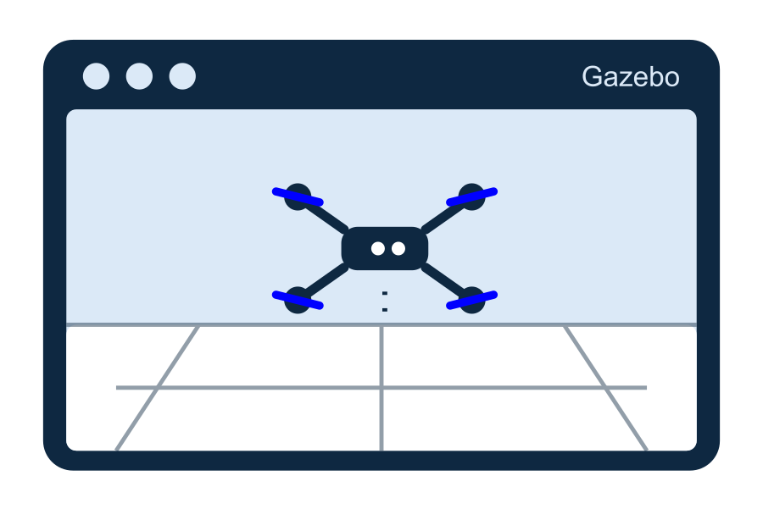
Meet Bumblebee - in a simulator
Today we send our very first commands to a drone.
● Gazebo is like a video game world for robots.
● The drone inside it flies with real physics - but it is virtual.
● If we crash, nothing breaks. We just restart. Perfect for learning!
● Everything you write here also works on the real drone.
2

Slide 3

How we talk to the drone
● One line unlocks all drone commands:
● import drone
● Then we call functions like drone.takeoff().
● That is the same 'function call' idea from Lecture 1.
# every flight script starts like this
import drone
# now drone.<command>() is available
Someone already wrote the drone functions for us. We just use them.
3

Slide 4

How to run your script
sim-run starts your program in the simulator.
# save your code in a file, e.g. flight.py
# then in the terminal type:
sim-run flight.py
💡 Watch the drone move in the Gazebo window while your code runs.
4

Slide 5
The 5 magic commands
takeoff · move · hover · fly_to · safe_land
5

Slide 6

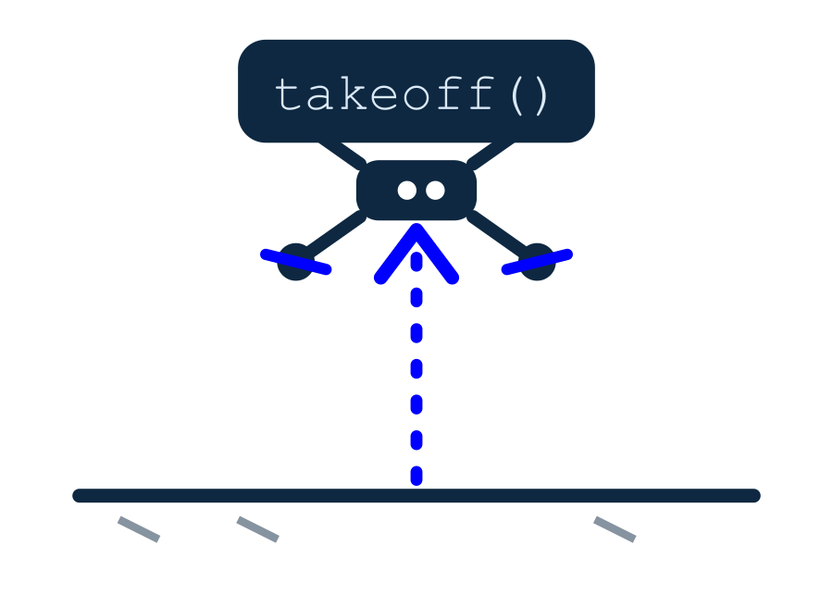
takeoff() - go up
● Arms the motors and climbs.
● The number is the height in meters.
● 1.0 means one meter above the floor.
● Always the first thing we do.
import drone
# climb to 1 meter
drone.takeoff(1.0)
takeoff(1.0) -> the drone rises to 1 m and waits there.
6

Slide 7

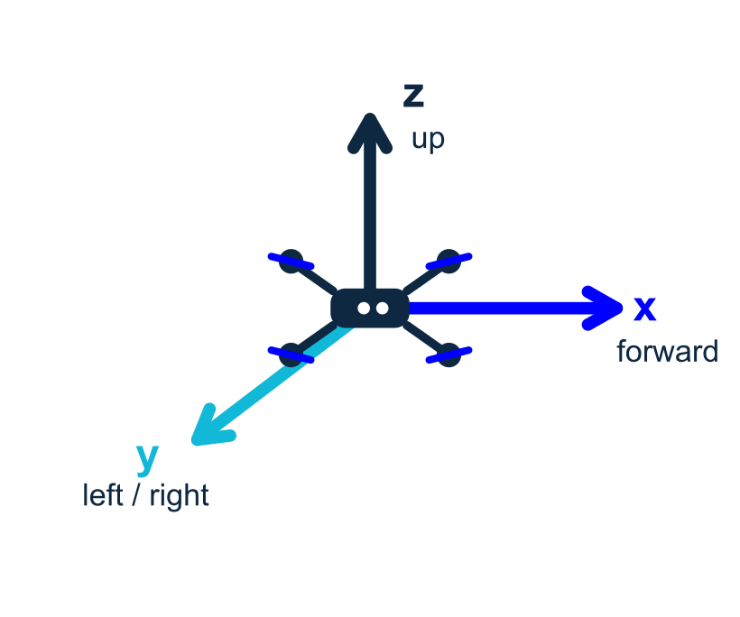
move() - step in a direction
● Moves relative to where the drone is now.
● x = forward, y = left, z = up (in meters).
● Negative numbers go the other way.
● y = -1 means one meter to the RIGHT.
# 1 meter forward
drone.move(x=1.0)
# 1 meter to the right
drone.move(y=-1.0)
# go up 0.5 m
drone.move(z=0.5)
Think from the drone's point of view: forward is where its nose points.
7

Slide 8

hover() - wait in the air
● Stay still and hold position.
● The number is seconds.
● Good for a pause between moves.
# hover in place for 3 seconds
drone.hover(3.0)
Useful to let the drone settle before the next command.
8

Slide 9

safe_land() - come down safely
● Lands gently and turns the motors off.
● Always end your flight with it.
● Never just stop the program in the air!
# land and disarm
drone.safe_land()
safe_land checks the drone really touched down before finishing.
9

Slide 10

Our first full flight
Up, forward, pause, land. That is a complete mission.
import drone
drone.takeoff(1.0) # up to 1 m
drone.move(x=1.0) # forward 1 m
drone.hover(2.0) # pause 2 s
drone.safe_land() # land
💡 Run it with: sim-run flight.py
10

Slide 11

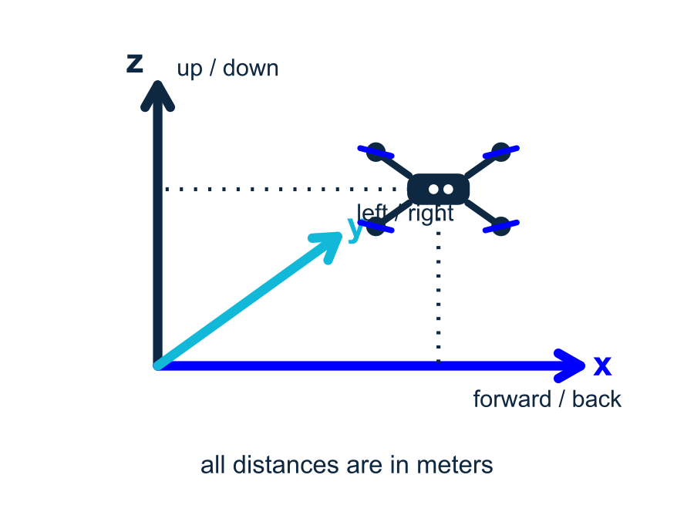
Coordinates, simply
The drone lives in 3D space. Three numbers point anywhere.
● x -> forward / backward
● y -> left / right (left is +, right is -)
● z -> up / down
● All distances are in meters. 1.0 = one meter.
11

Slide 12

Safety: always land!
● Computers can hit errors halfway.
● try / finally makes sure we land no matter what.
● enable_safe_interrupt(): press Ctrl+C -> lands, not crash.
● This is the grown-up, safe way to fly.
import drone
drone.enable_safe_interrupt()
try:
drone.takeoff(1.0)
drone.move(x=1.0)
finally:
drone.safe_land() # always runs
finally: runs even if something above it fails.
12

Slide 13

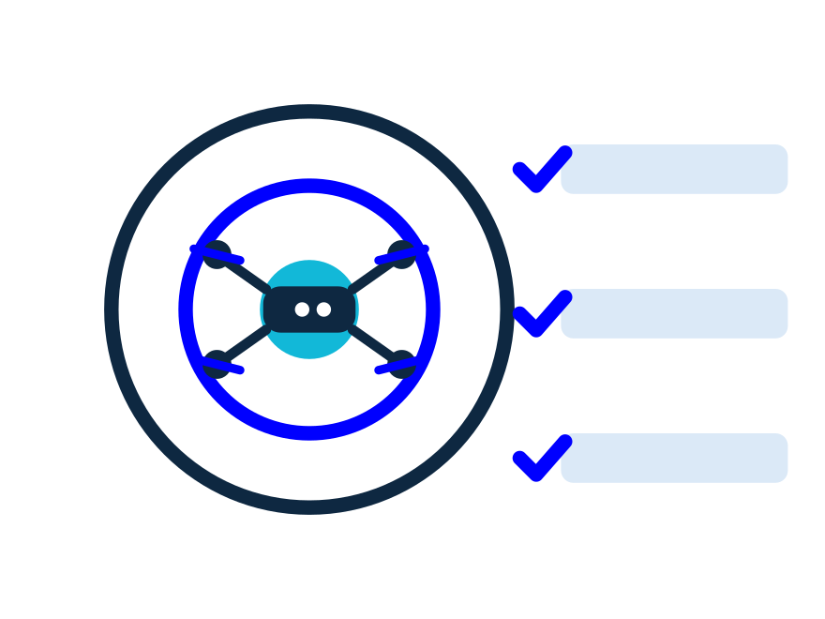
Mini challenge
Edit flight.py and run sim-run flight.py
● Make the drone take off, fly forward 2 m, then back 2 m, and land.
● Add a hover(2.0) in the middle.
● Bonus idea: can you fly a full square? (that is next lecture!)
13

Slide 14

PRACTICE 1
Up and hover
● Take off to 1 meter.
● Hover in place for 2 seconds.
● Land safely with safe_land().
import drone
drone.takeoff(1.0) # up to 1 m
drone.hover(2.0) # wait 2 s
drone.safe_land() # land
▶ Run it: sim-run flight.py
14

Slide 15
PRACTICE 2
There and back
● Take off, then fly forward 2 m.
● Fly back 2 m to the start.
● Hover, then always safe_land().
import drone
drone.takeoff(1.0)
drone.move(x=2.0) # forward 2 m
drone.move(x=-2.0) # back 2 m
drone.hover(2.0)
drone.safe_land()
▶ Run it: sim-run flight.py
15

Slide 16
PRACTICE 3
Always land
● Turn on safe interrupt (Ctrl+C lands).
● Put takeoff & move inside try.
● Land in finally — so it always lands.
import drone
drone.enable_safe_interrupt()
try:
drone.takeoff(1.0)
drone.move(x=1.0)
finally:
drone.safe_land() # always runs
▶ Run it: sim-run flight.py
16

Slide 17
Recap
import drone · takeoff · move · hover · safe_land · try/finally
17

Slide 18
NEXT TIME
Missions, loops & markers
Fly a whole path with a for loop - and follow floor markers
Bumblebee drone · programming in the Gazebo simulator
18

Slide 19
QUIZ TIME
Let's play Kahoot!
Open kahoot.it and join with the game PIN
Show what you learned today.
19

