Slide 1

LECTURE 3
Missions: Waypoints, Loops & Markers
Combine Python loops and functions to fly real missions
Bumblebee drone · programming in the Gazebo simulator
1

Slide 2

Quick recap
You already know everything you need. Now we combine it.
● import drone -> unlocks the commands.
● takeoff, move, hover, safe_land -> the basics.
● for loops and functions -> from Lecture 1.
● Today we join them into missions.
2

Slide 3

Two ways to move
● move(): relative - from where I am now.
● fly_to(): absolute - to a fixed point in the room.
● map coordinates never change, wherever the drone is.
● fly_to is great for a planned path.
# relative step
drone.move(x=1.0)
# absolute point in the room (map)
drone.fly_to(x=0.0, y=1.4, z=1.0)
Same 3 numbers x, y, z -- but a different starting point.
3

Slide 4

The drone knows where it is
● get_pos() gives the current x, y, z.
● It returns three numbers at once.
● Handy to print or to make decisions.
x, y, z = drone.get_pos()
print("I am at", x, y, z)
This is a function that gives a value back -- we store it in variables.
4

Slide 5

A list of waypoints
● A waypoint is one target point (x, y).
● A list holds many of them, in order.
● Square method: 4 corners.
● Lists use square brackets [ ].
# four corners of a 1 m square
waypoints = [
(0.0, 0.0),
(1.0, 0.0),
(1.0, 1.0),
(0.0, 1.0),
]
Each corner is a pair of numbers grouped with ( ).
5

Slide 6

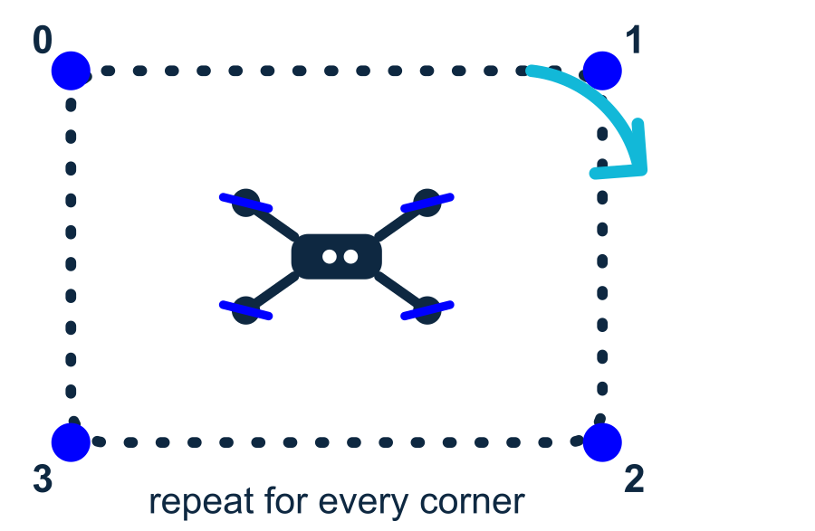
for loop -> fly the path
● Loop over every waypoint.
● fly_to each corner, one by one.
● No copy-paste - the loop repeats for us.
● This is Lecture 1's for loop doing real work!
for (px, py) in waypoints:
drone.fly_to(x=px, y=py, z=1.0)
drone.hover(1.0)
Four lines fly the whole square, however many corners you add.
6

Slide 7

Wrap a mission in a function
One function = one reusable mission. Change the size in one place.
def fly_square(size):
corners = [(0,0), (size,0), (size,size), (0,size)]
for (px, py) in corners:
drone.fly_to(x=px, y=py, z=1.0)
drone.hover(1.0)
drone.takeoff(1.0)
fly_square(1.5) # a 1.5 m square
drone.safe_land()
💡 Call fly_square(2.0) for a bigger square - same code.
7

Slide 8
Seeing the floor: ArUco markers
Black-and-white squares that tell the drone exactly where it is
8

Slide 9

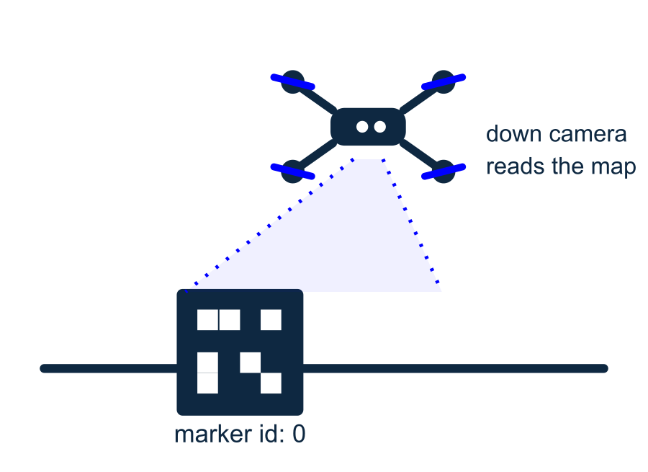
What are ArUco markers?
Indoors there is no GPS. Markers become the drone's map.
● Special black-and-white squares, like simple QR codes.
● Each one has a number (an id): 0, 1, 2, ...
● The down-facing camera sees them on the floor.
● From them the drone knows its exact position - very accurate.
9

Slide 10

Tell the drone the map
● We list where each marker sits (id, x, y).
● Lengths are in meters.
● check_aruco() waits until the camera sees markers.
● Now fly_to uses that shared map.
drone.set_aruco_map([
{"id": 0, "length": 0.19, "x": 0.0, "y": 0.0},
{"id": 1, "length": 0.19, "x": 0.4, "y": 0.0},
{"id": 2, "length": 0.19, "x": 0.8, "y": 0.0},
])
drone.check_aruco(timeout=10)
Marker 0 sits at (0, 0) -- the origin of the whole room.
10

Slide 11
A marker mission
Fly from marker 0 to marker 2 and back, then land.
import drone
drone.set_aruco_map([
{"id": 0, "length": 0.19, "x": 0.0, "y": 0.0},
{"id": 2, "length": 0.19, "x": 0.8, "y": 0.0},
])
drone.check_aruco(timeout=10) # wait to see markers
drone.takeoff(0.8)
drone.fly_to(x=0.8, y=0.0, z=0.8) # over marker 2
drone.fly_to(x=0.0, y=0.0, z=0.8) # back to marker 0
drone.safe_land()
💡 Because of the markers, the drone lands right where it started.
11

Slide 12

Python + drone = smart flight
● fly_to tells us if it reached the point (True/False).
● Use if to react - exactly like Lecture 1.
● Now the drone can make decisions in the air.
ok = drone.fly_to(x=0.8, y=0.0, z=0.8)
if ok:
drone.hover(2.0)
else:
print("Could not get there")
drone.safe_land()
Everything ties back to the basics you learned first.
12

Slide 13

PRACTICE 1
Fly a square
● Make a list of 4 waypoints (a square).
● Take off, then fly_to each corner in a for loop.
● Hover at each corner, then safe_land().
import drone
waypoints = [(0,0), (1,0), (1,1), (0,1)]
drone.takeoff(1.0)
for (px, py) in waypoints:
drone.fly_to(x=px, y=py, z=1.0)
drone.hover(1.0)
drone.safe_land()
▶ Run it: sim-run flight.py
13

Slide 14
PRACTICE 2
Reusable mission
● Wrap the square in a function fly_square(size).
● Call fly_square(2.0) for a bigger square.
● Change the size in ONE place.
def fly_square(size):
corners = [(0,0), (size,0), (size,size), (0,size)]
for (px, py) in corners:
drone.fly_to(x=px, y=py, z=1.0)
drone.hover(1.0)
drone.takeoff(1.0)
fly_square(2.0) # bigger square
drone.safe_land()
▶ Run it: sim-run flight.py
14

Slide 15
PRACTICE 3
Markers + decision
● Set the ArUco map, then check_aruco().
● fly_to a marker; save the result in ok.
● if ok: hover; always safe_land().
import drone
drone.set_aruco_map([
{"id": 0, "length": 0.19, "x": 0.0, "y": 0.0},
{"id": 2, "length": 0.19, "x": 0.8, "y": 0.0},
])
drone.check_aruco(timeout=10)
drone.takeoff(0.8)
ok = drone.fly_to(x=0.8, y=0.0, z=0.8)
if ok:
drone.hover(2.0)
drone.safe_land()
▶ Run it: sim-run flight.py
15

Slide 16

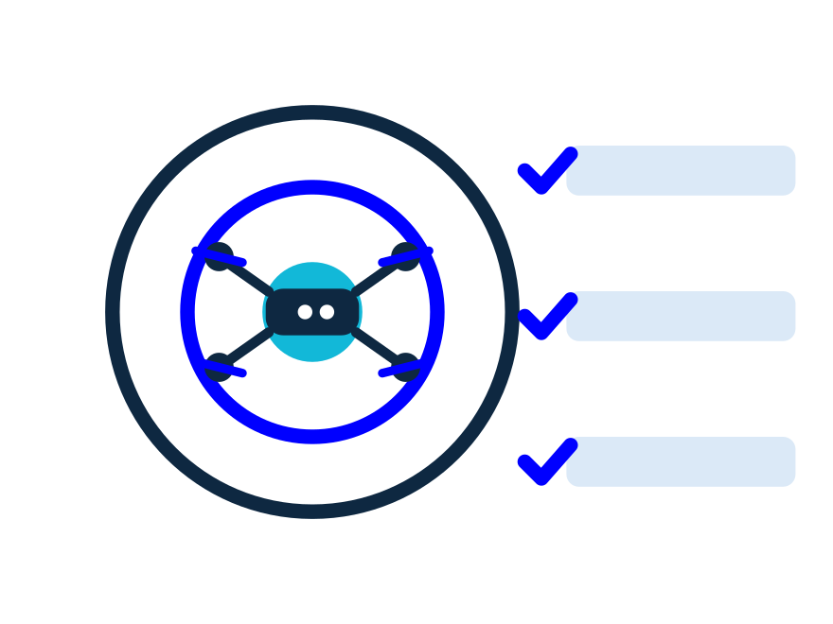
Where to go next
You can now program real drone missions. Congratulations!
● Try longer paths: add more waypoints to the list.
● Make functions for takeoff-patrol-land you can reuse.
● Explore more markers and bigger maps.
● When you are ready - the very same code flies the real Bumblebee.
16

Slide 17
Recap
fly_to · get_pos · waypoint lists · for loops · functions · ArUco markers
17

Slide 18
QUIZ TIME
Let's play Kahoot!
Open kahoot.it and join with the game PIN
Show what you learned today.
18

