Slide 1
Are meta materials useful for brain stimulation?
Luis Hernandez-Garcia

Slide 2
Background info
Metamaterials work at specific frequencies (“resonance phenomenon”)
Higher frequency -> easier to simulate, design new coils and materials.
All TMS work is based on single pulses or trains of single pulses with big spaces
What about continuous waves?

Slide 3
Neuronal Stimulation
Hodgkin and Huxley (1952)
Amassian, Maccabbee, Roth
Lots of electrode work
Some TMS simulation
Again: single pulses in uA range.

Slide 4
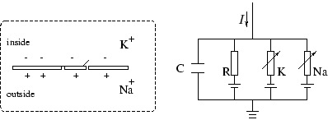

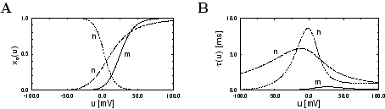
Classic model: Hodgkin and Huxley’s membrane
R_{k} and R_{Na} are voltage dependent

Slide 5
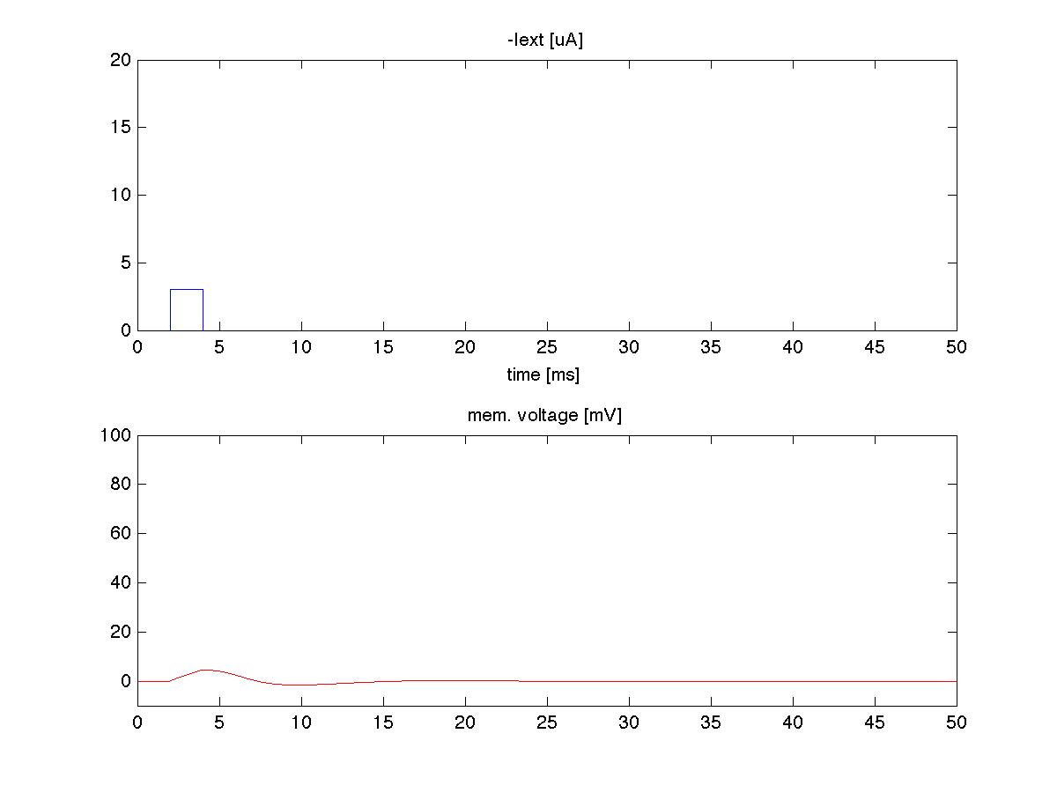
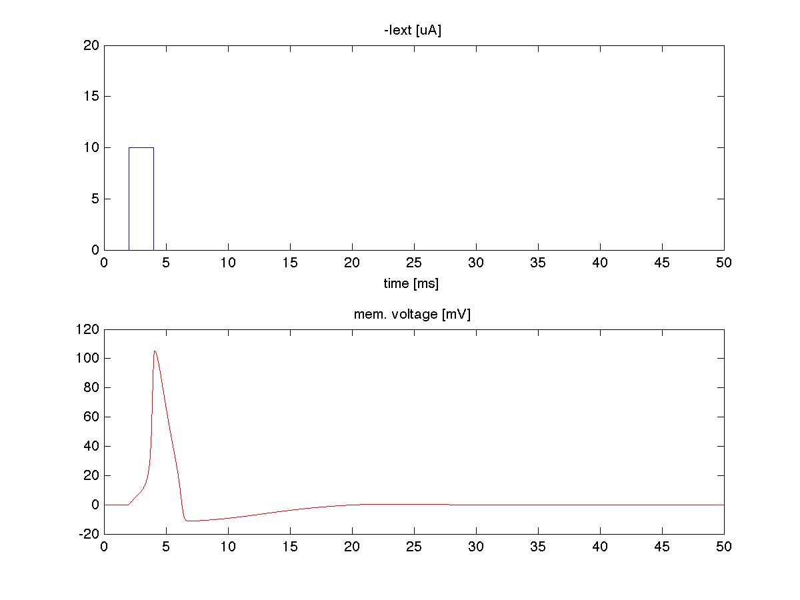
Simulations
Matlab
  Euler method solution,
  constants from old paper
Assume that a current is produced across membrane by the incident Electric field.
Below threshold
Above threshold

Slide 6
Warning
Magstim 200 produces 3 Khz sinusoidal single pulses that result in action potentials
The model’s constants are based on squid axons

Slide 7
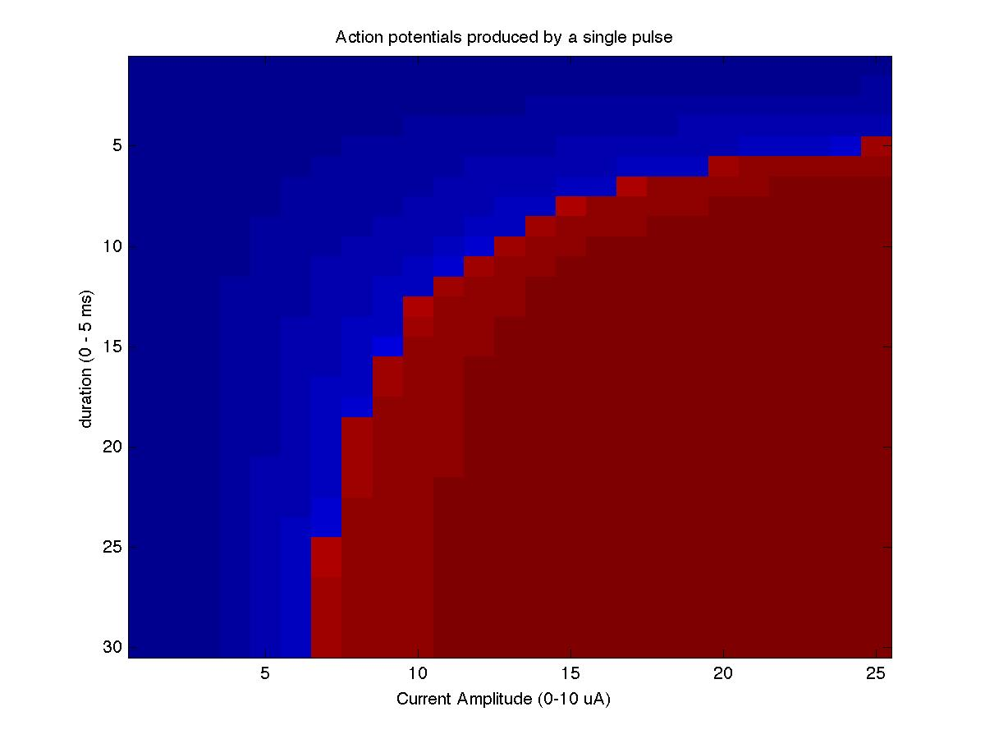
Amplitude and Duration of Single Pulse

Slide 8
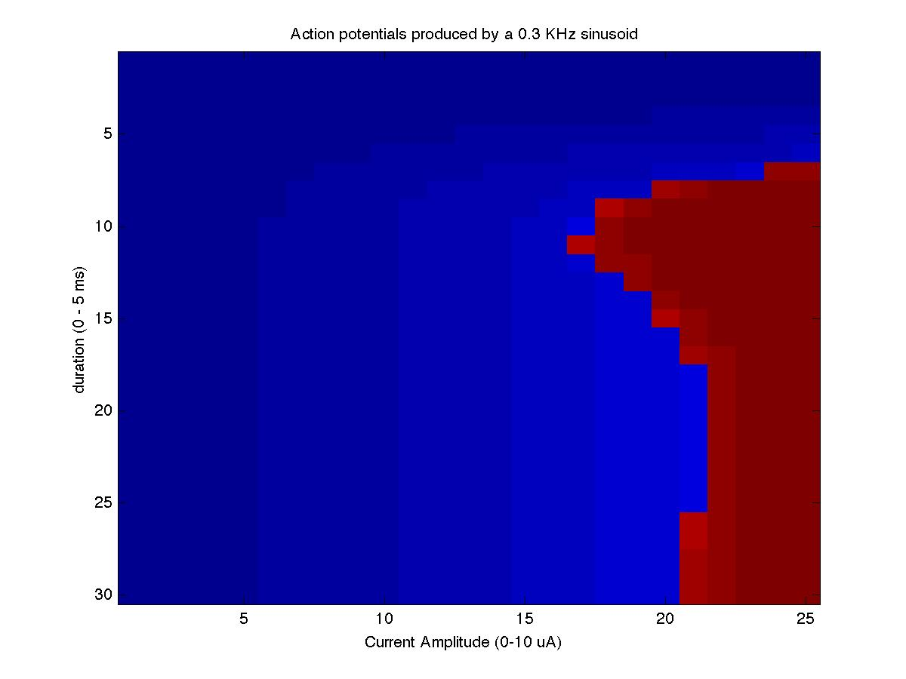
Amplitude and Duration of wave stimulus

Slide 9
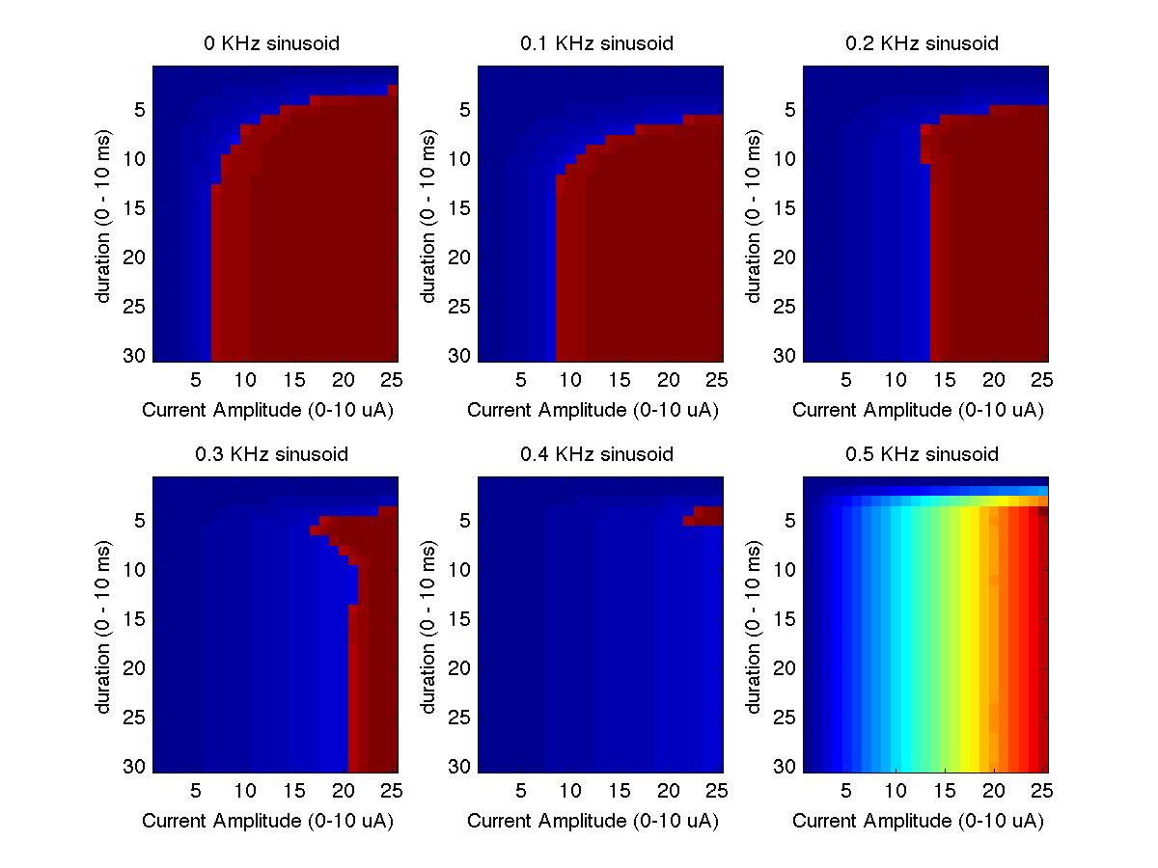
Now at different frequencies (low range)
No action potentials here

Slide 10
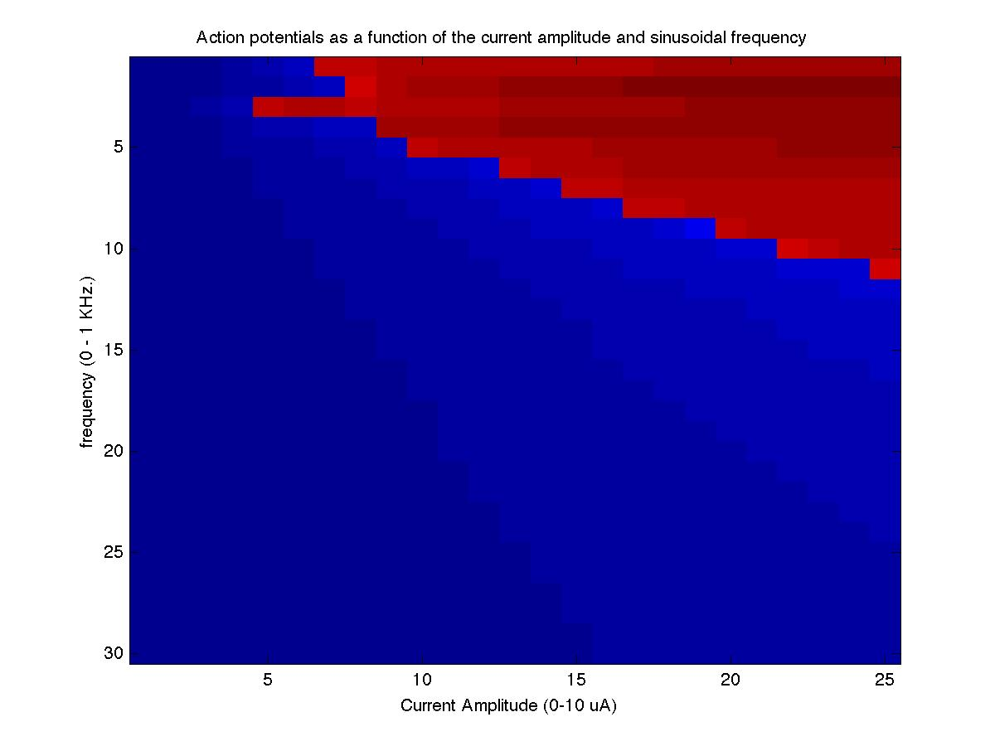
Amplitude and Frequency

Slide 11
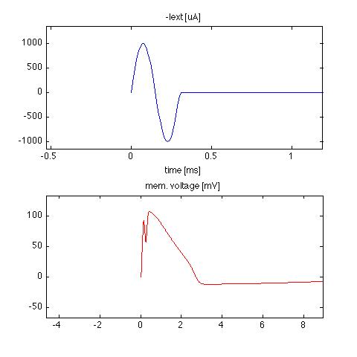
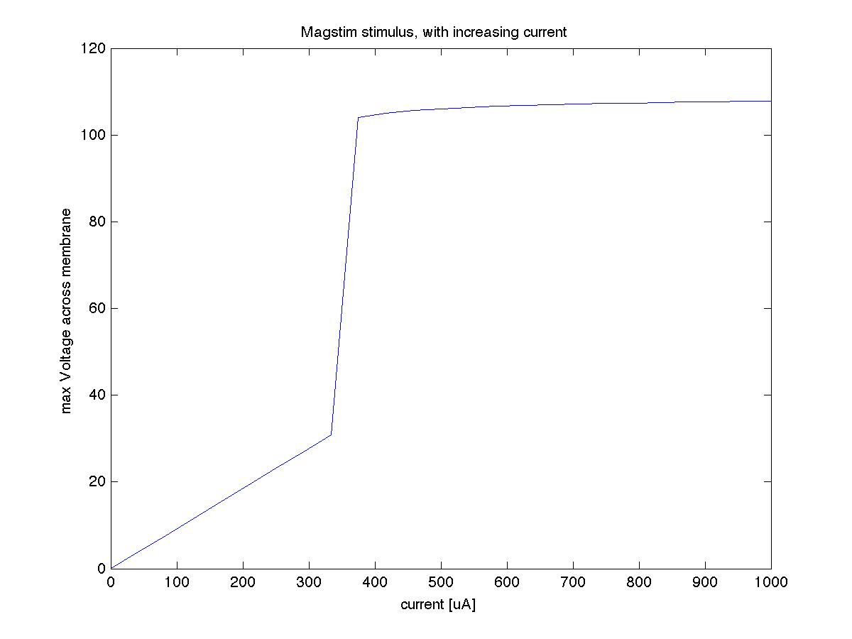
Higher Frequencies and Amplitudes: Magstim 200
This is what Magstim does as you turn up the power

Slide 12
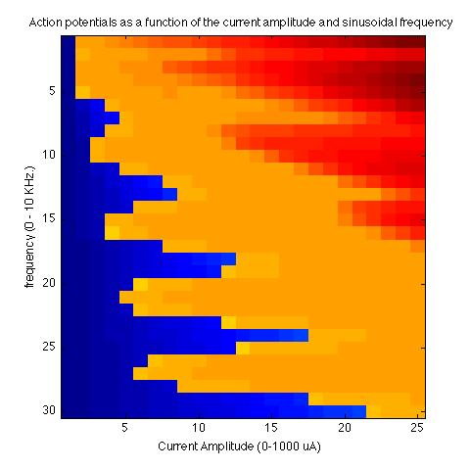
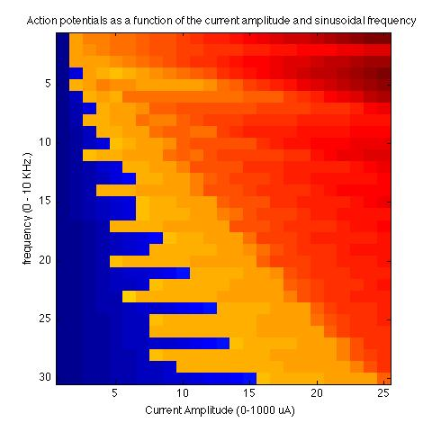
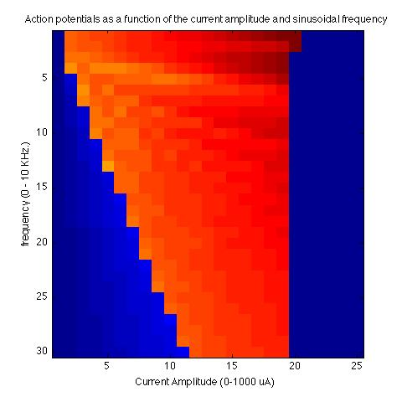
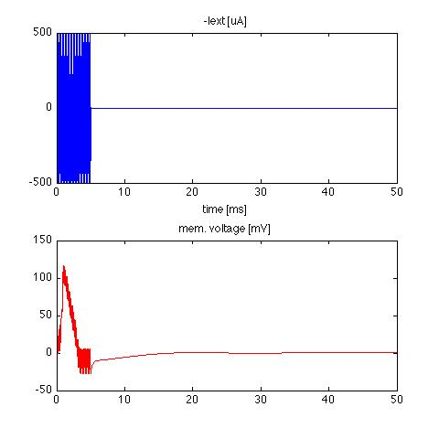
Higher Frequencies and Amplitudes
0.5 ms burst
1 ms burst
5 ms burst
TMS frequency
Junk data: Euler Algorithm went unstable
Sample waveform:
5 ms, 5 Khz, 500uA

Slide 13
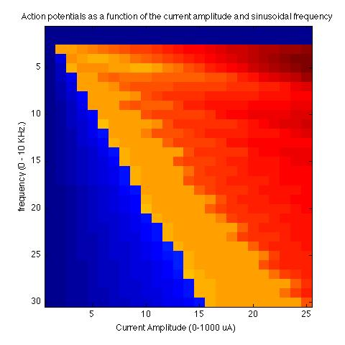
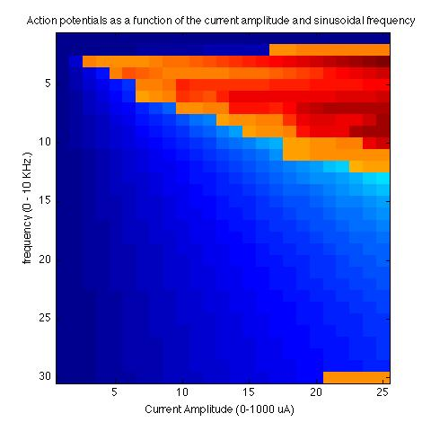
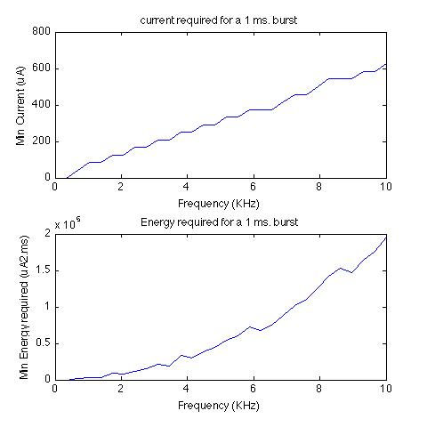
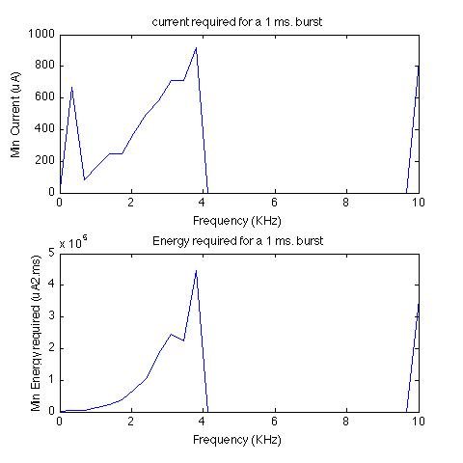
Phase matters: integer number of cycles
sin()
cos()
Duration = integer number of cycles near 1 ms.
Sine vs. cosine stimulation current.
Magstim produces single cycle damped cosine E-field!
We want sine, if we’re going to do higher freqs.

Slide 14
Implications
Seems like we need more power at higher frequencies!
How much power can metamaterials tolerate?
How much power can we produce with amplifier at these frequencies?
Will this produce heating?

