Slide 1
Introduction to Supervised Learning

Slide 2

Supervised Learning: Boston Example
Below is a portion of the Boston data set:
crim zn indus chas nox rm age dis rad tax ptratio medv
1 0.00632 18 2.31 0 0.538 6.575 65.2 4.0900 1 296 15.3 24.0
2 0.02731 0 7.07 0 0.469 6.421 78.9 4.9671 2 242 17.8 21.6
3 0.02729 0 7.07 0 0.469 7.185 61.1 4.9671 2 242 17.8 34.7
4 0.03237 0 2.18 0 0.458 6.998 45.8 6.0622 3 222 18.7 33.4
5 0.06905 0 2.18 0 0.458 7.147 54.2 6.0622 3 222 18.7 36.2
6 0.02985 0 2.18 0 0.458 6.430 58.7 6.0622 3 222 18.7 28.7
crim: per capita crime rate by town.
zn: proportion of residential land zoned for lots over 25,000 sq.ft.
indus: proportion of non-retail business acres per town.
chas: Charles River dummy variable (= 1 if tract bounds river; 0 otherwise).
nox: nitrogen oxides concentration (parts per 10 million).
rm: average number of rooms per dwelling.
age: proportion of owner-occupied units built prior to 1940.
dis: weighted mean of distances to five Boston employment centers.
rad: index of accessibility to radial highways.
tax: full-value property-tax rate per \$10,000.
ptratio: pupil-teacher ratio by town.
medv: median value of owner-occupied homes in \$1000s
Bill Damon Flickr
What would you do, if you were to try unsupervised learning?

Slide 3
Unsupervised learning vs Supervised learning
Unsupervised learning: find subgroups in the dataset:
group towns that look similar in terms of ALL or some variables
searches patterns
it only has X variables, no Y variable.
Supervised learning: what are the variables that might impact house prices?
How are they impacting house prices?
tries to estimate a “function” that maps X variable(s) to Y variable.
can be used to explain a relationship, or to predict the outcome of a given X

Slide 4
The models
Unsupervised learning models:
Clustering; k-means, hierarchical clustering..
Principal Component Analysis
…
Supervised learning models:
Linear regression
K-nearest neighborhood (KNN)
Support Vector Machines
Naïve Bayes
Decision Trees (and their extensions)
Neural Network
…

Slide 5
Types of “fitting”
Classification refers to the type of supervised learning models with a binary response variable, for example:
Is this email a spam or not?
Is this patient diagnosed with cancer or not?
Is this picture a cat or not?
Regression refers to the type of supervised learning models with a non-binary response variable, for example:
Credit card balance of customers.
Students’ grade from a class.
Most of the models have a classification version, and also a regression version.

Slide 6
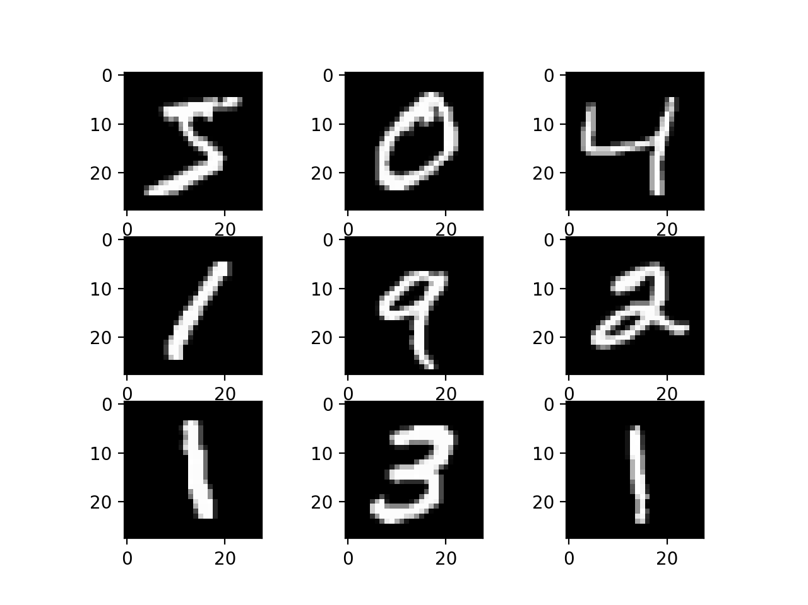
Recognize hand-written digits: MNIST database

Slide 7


Predict the age of a person using their grocery store spending data?
Predict the age of a person from their picture?

Slide 8
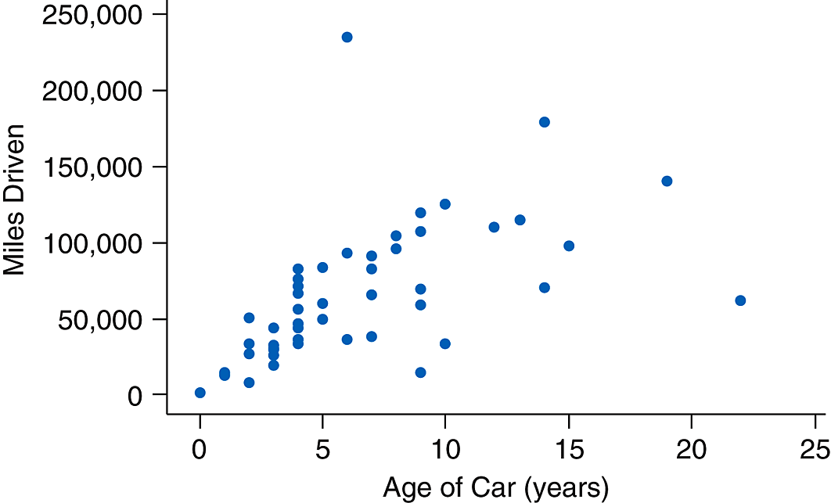
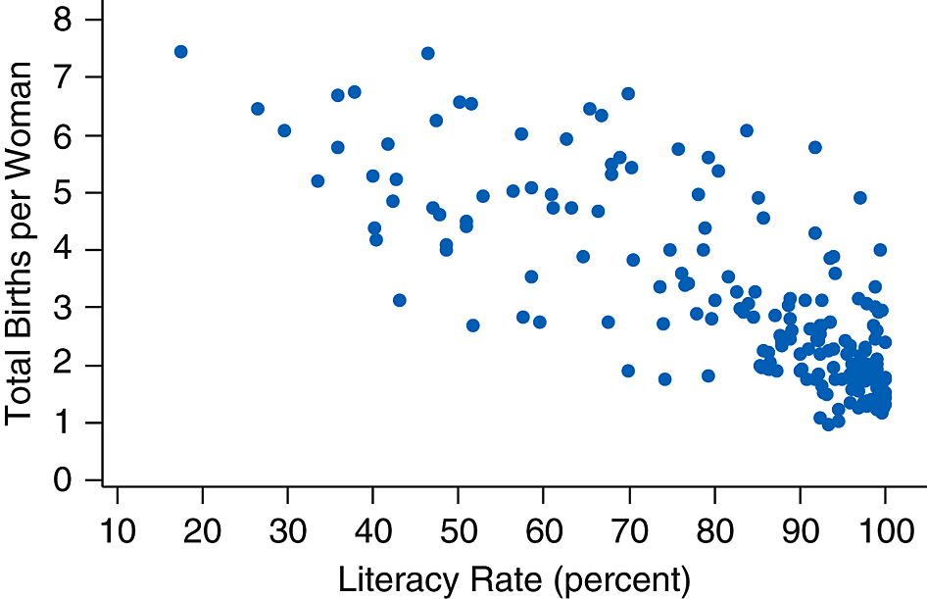
Why do we need models?
A simplified version:

Slide 9
Why do we need models?
A simplified version:

Slide 10
Why do we need models?
A simplified version:
A model could be:
Miles Driven = 10000*Age
Number of birth = 8 – 10*literacy rate

Slide 11
Terms to know:
Training dataset refers to the sample used to build a model.
Model fitting refers to how well the model fits on the training dataset.
Testing dataset refers to a sample, presumably coming from the same population as the training set, but different from the training set.
Prediction refers to applying the model on the testing dataset.

Slide 12
Linear regression
Linear regression is to assume a linear relationship between the predictors and the response.
What is a linear relationship?
Assuming b is a parameter, which one of the following assumes a linear relationship between age and milesdriven?
MilesDriven = b*Age
Miles Driven = exp(b*Age)

Slide 13
Linear regression
Linear regression is to assume a linear relationship between the predictors and the response.
What is a linear relationship?
A linear relationship must have the following form:
y = a + bx
where x is a predictor, and y is the response. Further, a is the intercept, b is the slope.

Slide 14
Linear regression
Linear regression is to assume a linear relationship between the predictors and the response.
What is a linear relationship?
A linear relationship must have the following form:
y = a + bx
where x is a predictor, and y is the response. a and b are parameters, where a is the intercept and b is the slope.
What if there are multiple predictors?

Slide 15
Linear regression
Linear regression is to assume a linear relationship between the predictors and the response.
A linear regression takes the following form:
y = b₀ + b₁x₁ + b₂x₂ + … + b_{D}x_{D}
where D is the total number of variables.
The goal of linear regression is to calculate b₀, b₁, b₂, …, b_{D} so that the model best fits the training set.
How do we define “fit”?

Slide 16
Model “fit”
Which line is a better fit, green or yellow? Why?

Slide 17
Model “fit”
The most classical way to decide ”fit“ is to measure how big of a “mistake” the model made on the training set.

Slide 18
Model “fit”
Which line is a better fit, orange or yellow?
Alternatively, what information do you need to decide which line is a better fit?

Slide 19
Model “fit”
The most classical way to decide ”fit“ is to measure how big of a “mistake” the model made on the training set.
For Age = 10, the yellow time (model) thinks the car should have (around) 100k miles.
In our sample, the 10-year-old car has a mileage of less than 50k.
In other words, the model made a (100k-50k) mistake for this sample unit.

Slide 20
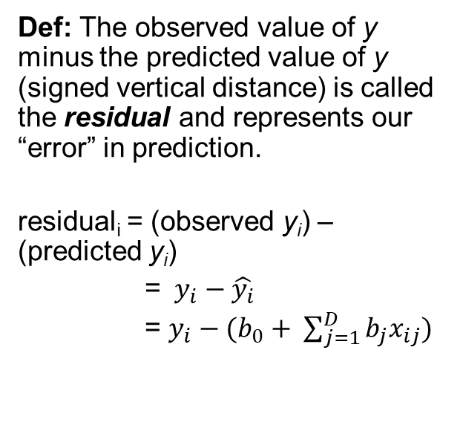
Residual
Def: The observed value of y minus the predicted value of y (signed vertical distance) is called the residual and represents our “error” in prediction.
residual_{i} = (observed y_{i}) – (predicted y_{i})
= $y_{i}−\hat{y_{i}}$
= $y_{i}−(b_{0}+ \sum_{j=1}^{D}{b_{j}x_{ij})}$

Slide 21
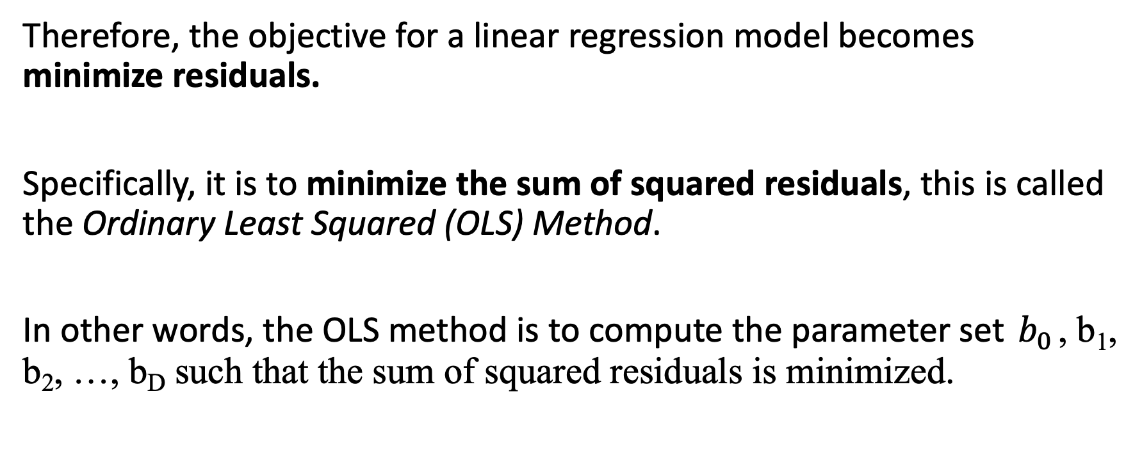
Objective function for linear regression
Therefore, the objective for a linear regression model becomes minimize residuals.
Specifically, it is to minimize the sum of squared residuals, this is called the Ordinary Least Squared (OLS) Method.
In other words, the OLS method is to compute the parameter set $b_{0}$, b₁, b₂, …, b_{D} such that the sum of squared residuals is minimized.

Slide 22
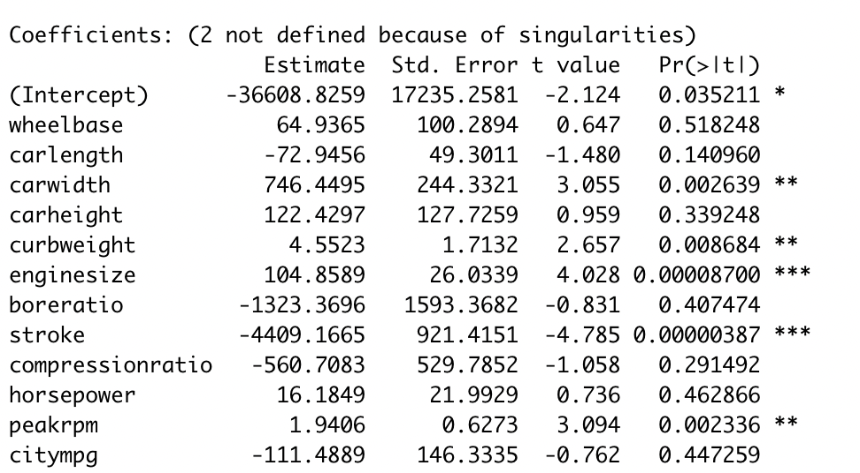
Interpret linear regression results

