Slide 1
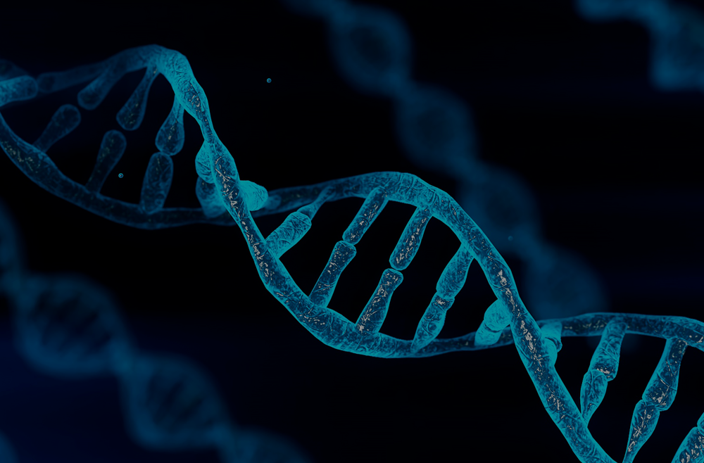
Differential Gene Expression Analysis
DATA 400 Mini Project

Slide 2
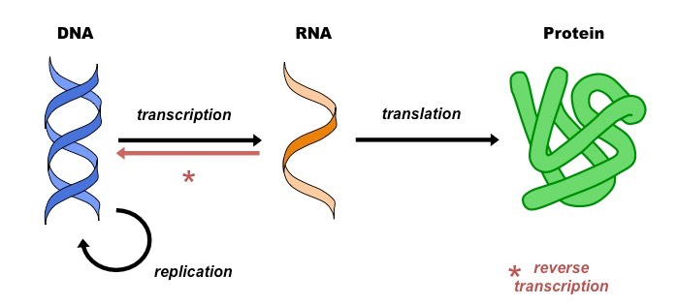
Biological Background
The central dogma of biology governs how your genes function

Slide 3
Biological Background
All living organisms have a genome
That genome creates a transcriptome
Transcriptomes are the target of differential gene expression analysis
Transcriptomes are made up of the mRNA that the genome produces in a specialized cell

Slide 4
Data
RNA-seq data from 28 individuals adipose stem cells
This data contains uses Illumina’s RNA-seq method
These individuals were either healthy or had in/active Crohn’s disease
Raw data is stored in FASTQ format with PHRED scores
Single-read data
Contains several hundred thousand 50-bp reads per sample
GEO Accession GSE60450

Slide 5
Research Question
What genes are differentially expressed (if any) in people with active/inactive Crohn’s Disease and healthy individuals?

Slide 6
Data Processing
Download FASTQ files with SRA Toolkit
Run preliminary FastQC/MultiQC reports
Clean up data with Trimmomatic
Rerun FastQC/MultiQC reports
Align to human genome with HISAT2
Compress .sam to .bam with samtools
Run featureCounts to obtain counts matrix
Compile in R with DESeq2

Slide 7
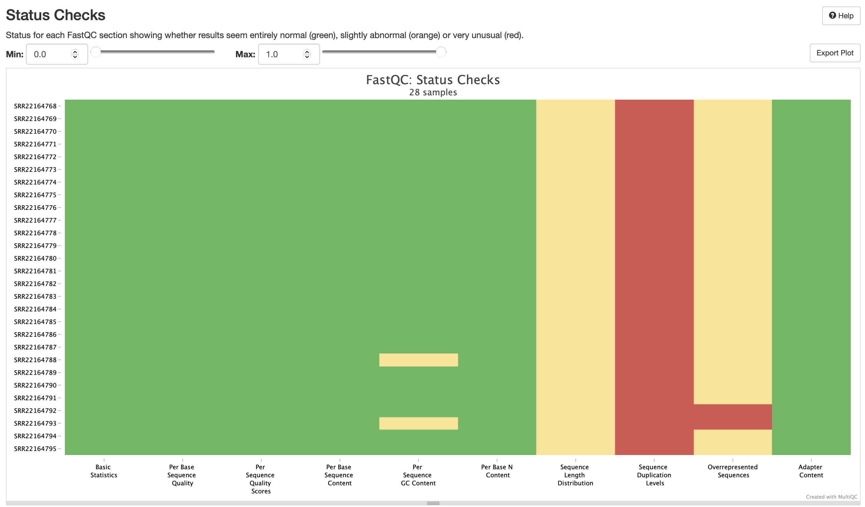
MultiQC report

Slide 8
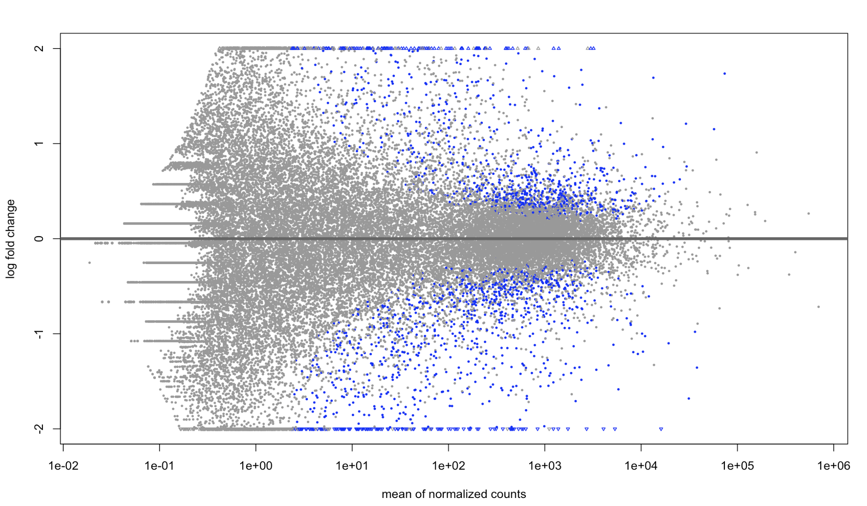
Results

Slide 9
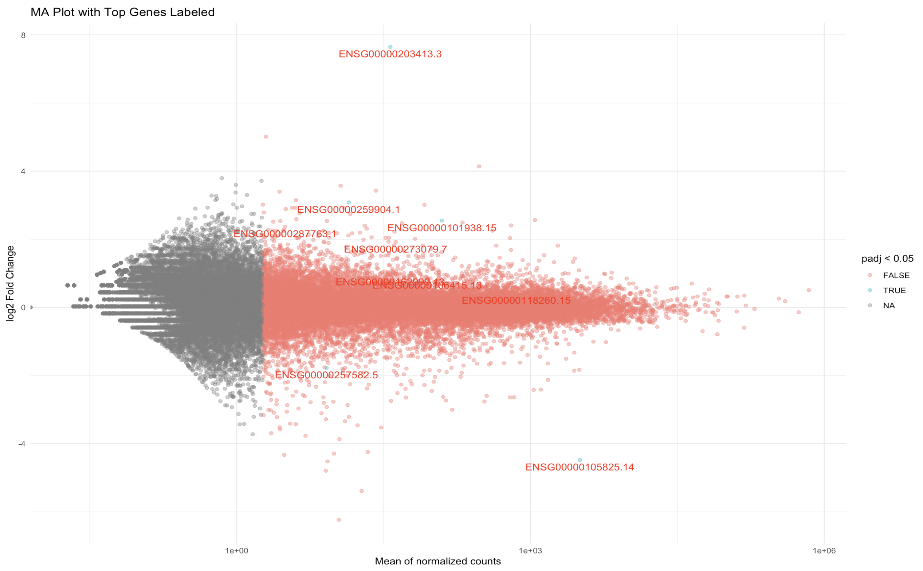
Results

Slide 10
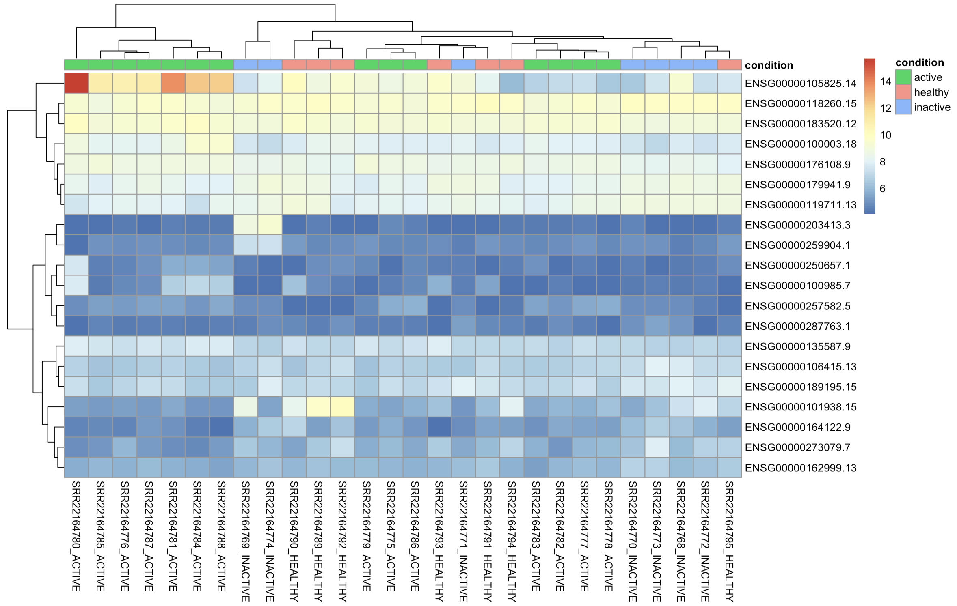
Results

Slide 11
Significant Genes
ENSG00000105825 – tissue factor pathway inhibitor 2 – REF1: involved in the repair of DNA damage as well as the transcriptional regulation of genes
ENSG00000118260 – cAMP responsive element binding protein – CREB1: phosphorylated by several protein kinases, and induces transcription of genes in response to hormonal stimulation of the cAMP pathway
ENSG00000183520 – small subunit processome component – UTP11: involved in nervous system development and positive regulation of apoptotic process

Slide 12
Implications for Stakeholders
The most common use of DGE Analysis is to examine which genes are up/down regulated
This can provide targets for treatment
This treatment can help people live longer, more fulfilling lives (especially with Crohn’s disease)

Slide 13
Ethical Considerations
RNA-seq samples came from real people
These specific samples came from people with diabetes
How are these samples stored? What security measures are in place?
How did the original authors censor their data? Is it possible to figure out identities from their work?

