Slide 1
Staying Mobile in an Unstable World: Understanding Travel Behavior During Political Turbulence
Han Nguyen
2/22/2024

Slide 2
Trips by distance Dataset
Download from Bureau of Transportation Statistics
Method: The travel statistics are produced from an anonymized national panel of mobile device data from multiple sources. Data analysis is conducted at the aggregate national, state, and county levels.
“Trips are defined as movements that include a stay of longer than 10 minutes at an anonymized location away from home. Home locations are imputed on a weekly basis. A movement with multiple stays of longer than 10 minutes before returning home is counted as multiple trips. Trips capture travel by all modes of transportation. including driving, rail, transit, and air.”
“The deduplication algorithm considers the most frequent locations visited by each device including the identified home location to detect duplicate devices in our sample.” (Bureau of Transportation Statistics, 2022)

Slide 3
Trips by distance Dataset
Original # Observations: 5,918,482
Current # Observations: 75,888
Unit-level analysis: state-level daily figure
Time Frame: 01/01/2020 – 02/03/2024
Data Cleaning Steps:
Merge with State dataset to get full state names
Rename variables
Convert to thousand units
Group by Date for further visualizations and analysis

Slide 4
Trips by distance Example
Dickinson College to Issei Noodle: 0.5 miles
Dickinson College to Walmart: 1.1 miles
Dickinson College to Capitol Hill (DC): 116 miles
Dickinson College to Cloud Gate (Chicago): 667 miles

Slide 5
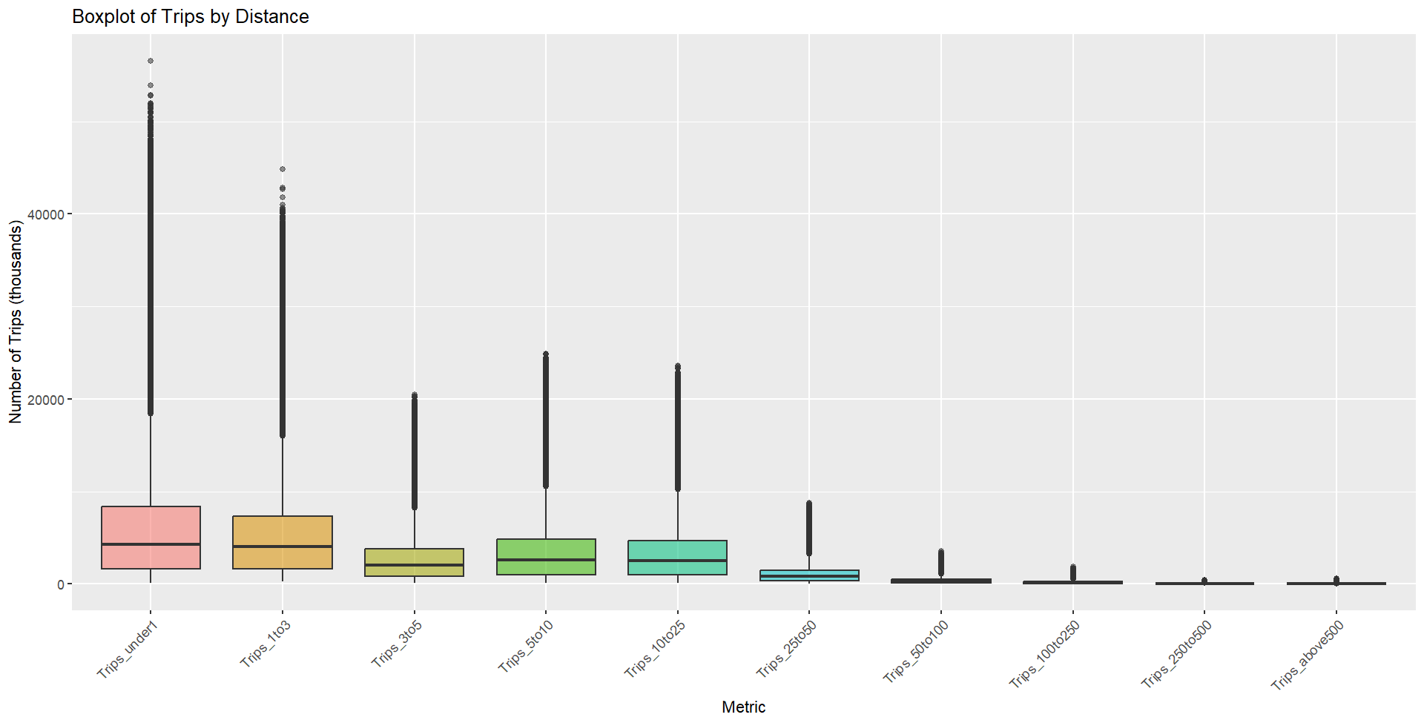
Notes:
The most common trip distances are under 1 miles, between 1 and 3 miles, and between 3 and 5 miles. There were around 20 million trips in each of these ranges.
There were significantly fewer trips longer than 25 miles. There were only about 1.2 million trips between 25 and 50 miles, and fewer for longer than 50 miles.
There were a lot of outliers, which are trips that are much longer or shorter than the majority of trips. And this shows that there is a variation in

Slide 6
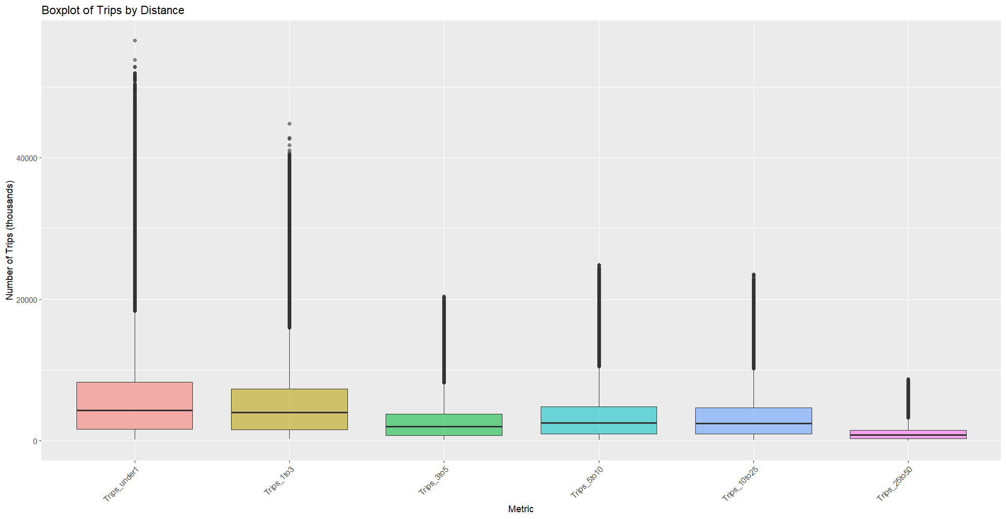
Notes:
The most common trip distances are under 1 miles, between 1 and 3 miles, and between 3 and 5 miles. There were around 20 million trips in each of these ranges.
There were significantly fewer trips longer than 25 miles. There were only about 1.2 million trips between 25 and 50 miles, and fewer for longer than 50 miles.
There were a lot of outliers, which are trips that are much longer or shorter than the majority of trips. And this shows that there is a variation in

Slide 7
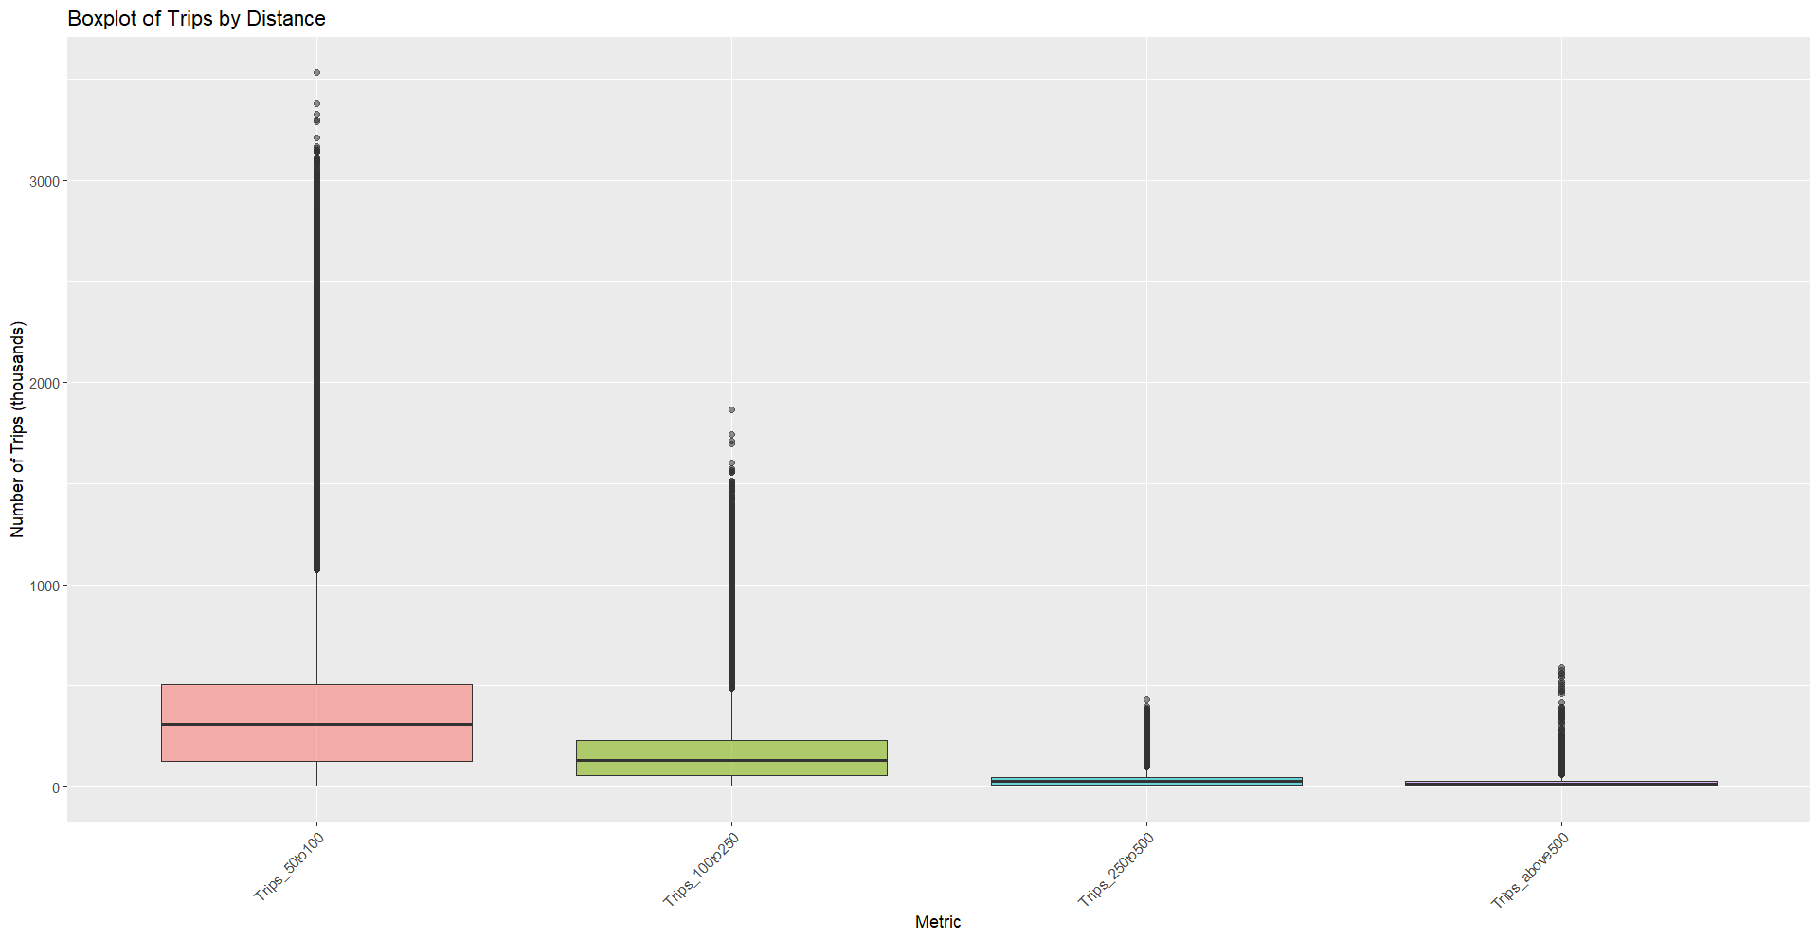
Notes:
The most common trip distances are under 1 miles, between 1 and 3 miles, and between 3 and 5 miles. There were around 20 million trips in each of these ranges.
There were significantly fewer trips longer than 25 miles. There were only about 1.2 million trips between 25 and 50 miles, and fewer for longer than 50 miles.
There were a lot of outliers, which are trips that are much longer or shorter than the majority of trips. And this shows that there is a variation in

Slide 8
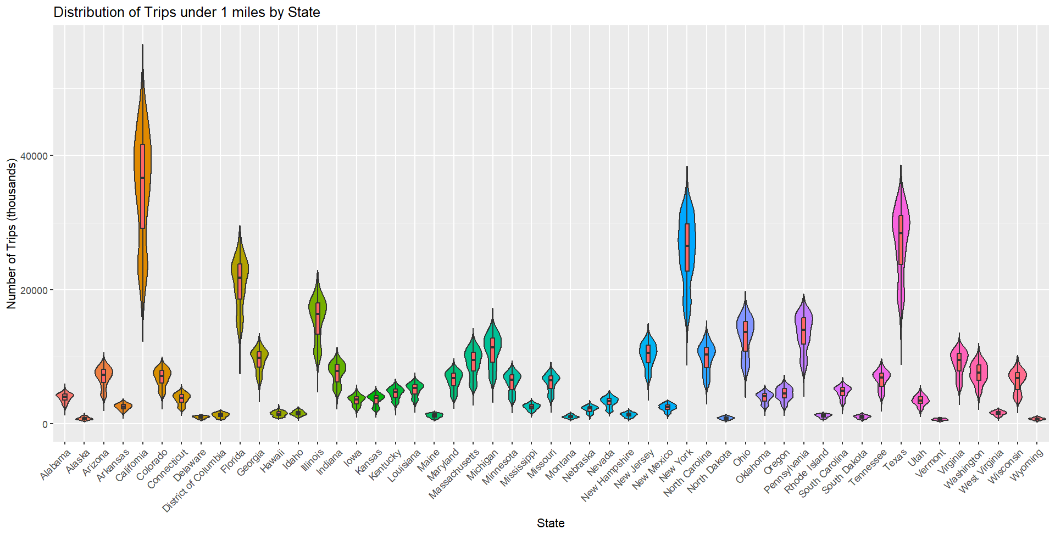
Notes:
- Most follow bimodal kernel density plots

Slide 9
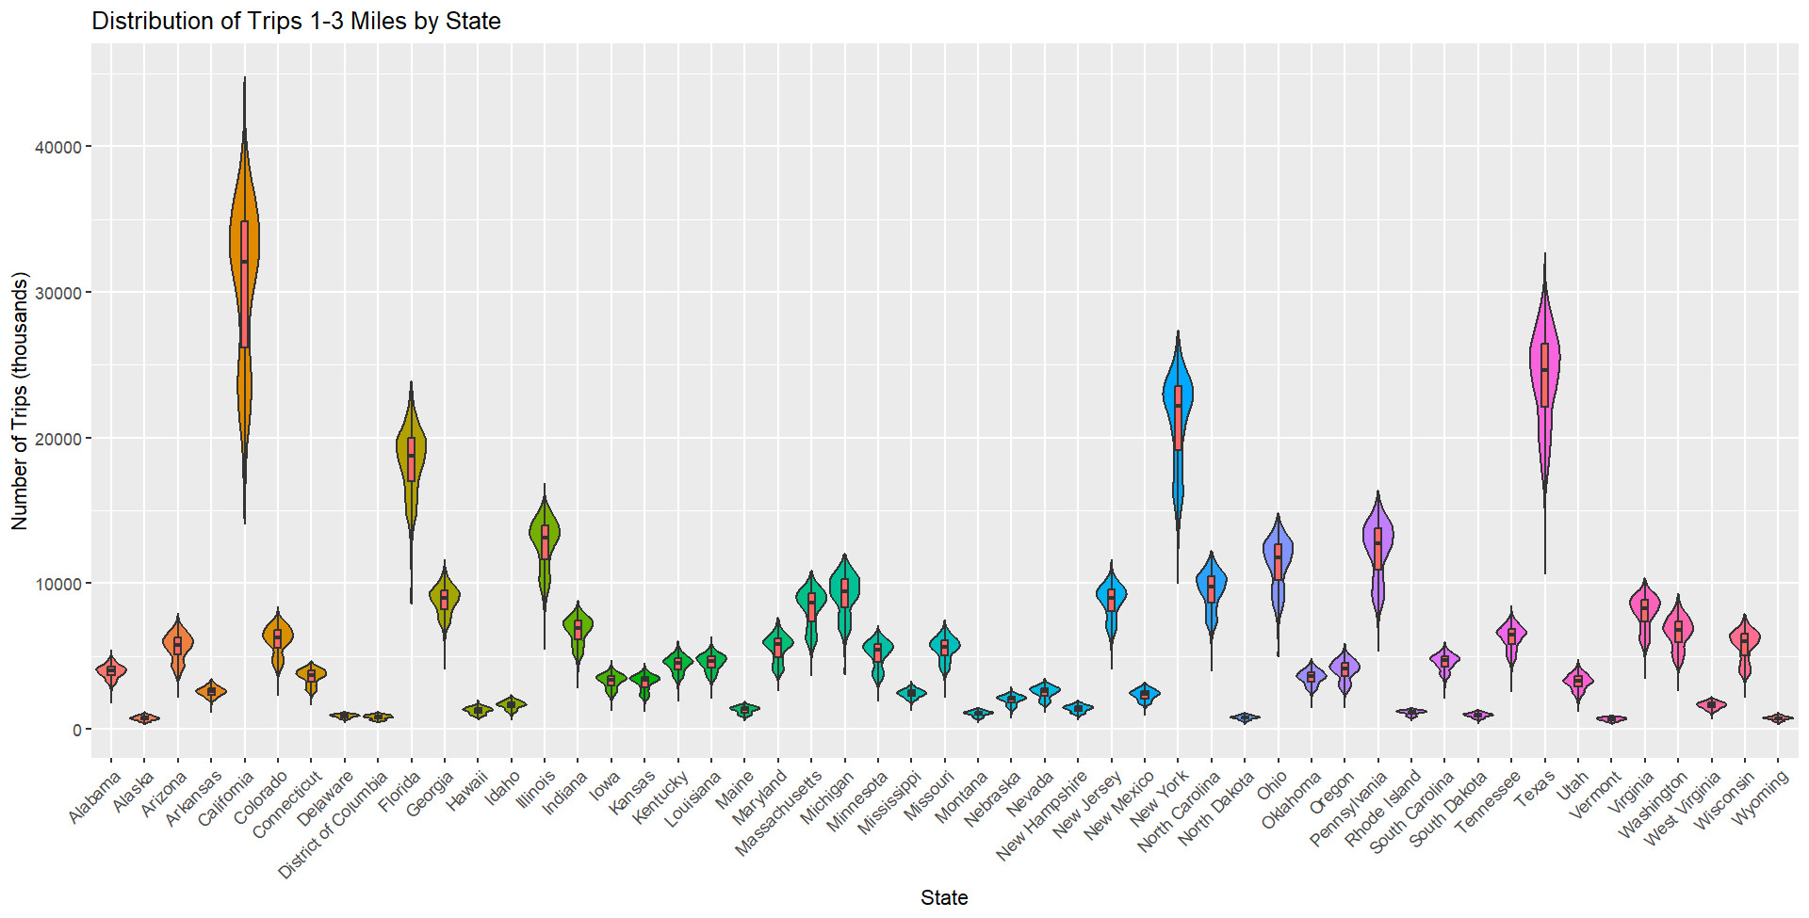

Slide 10
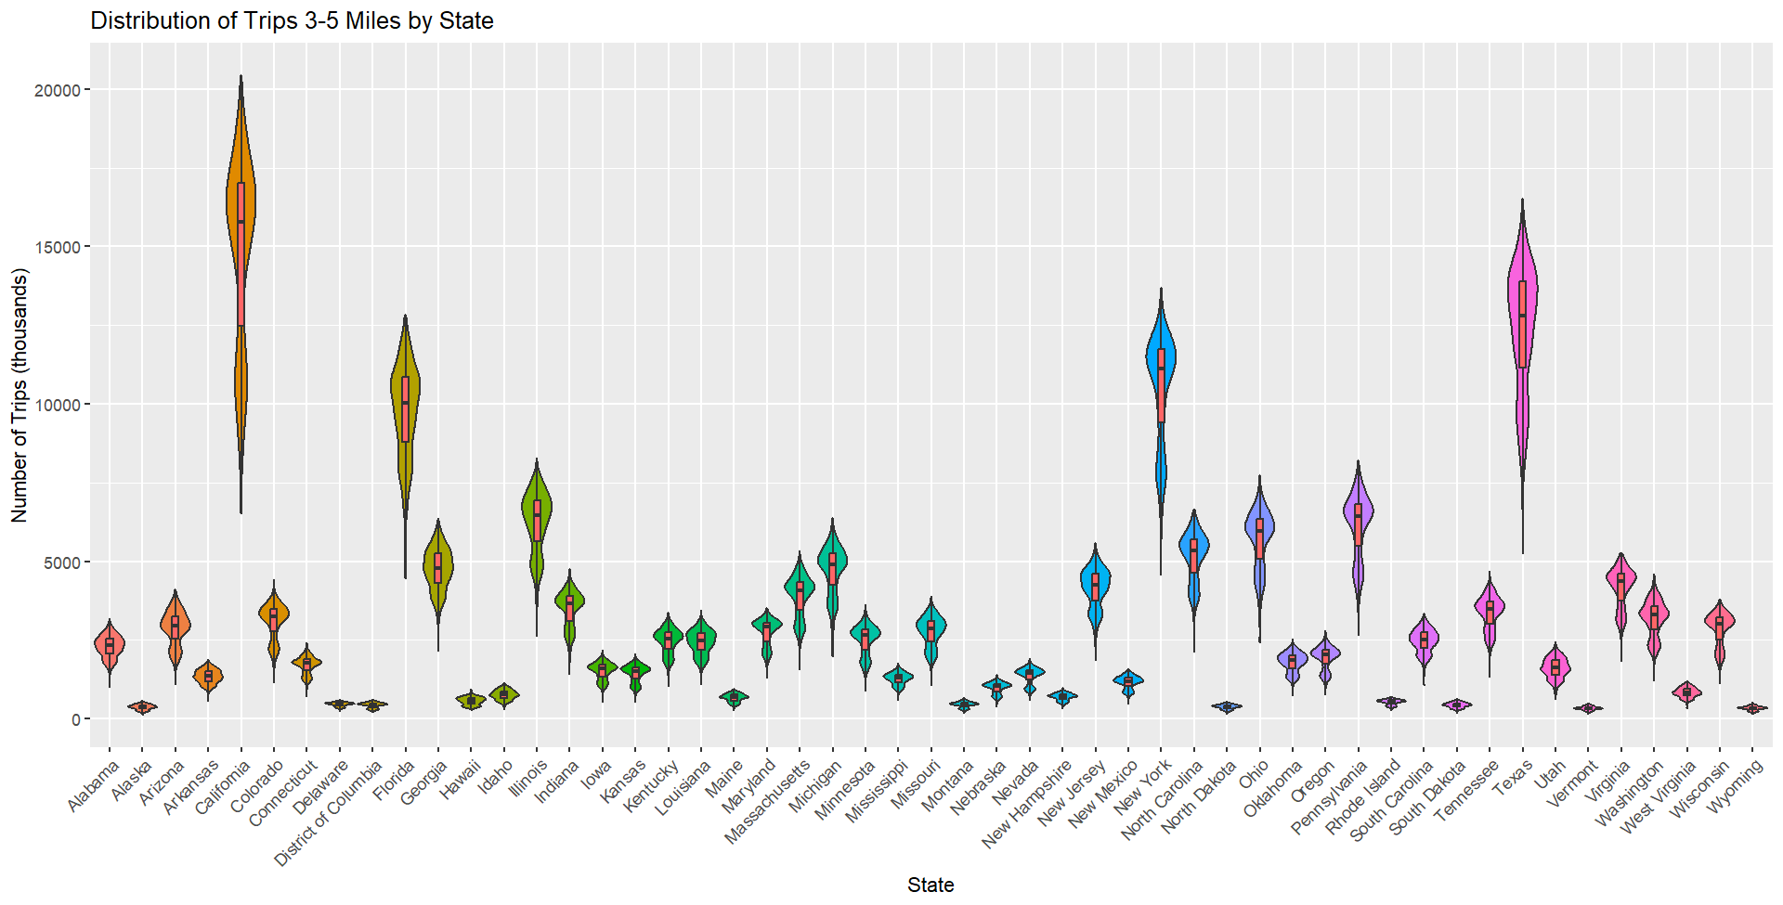

Slide 11
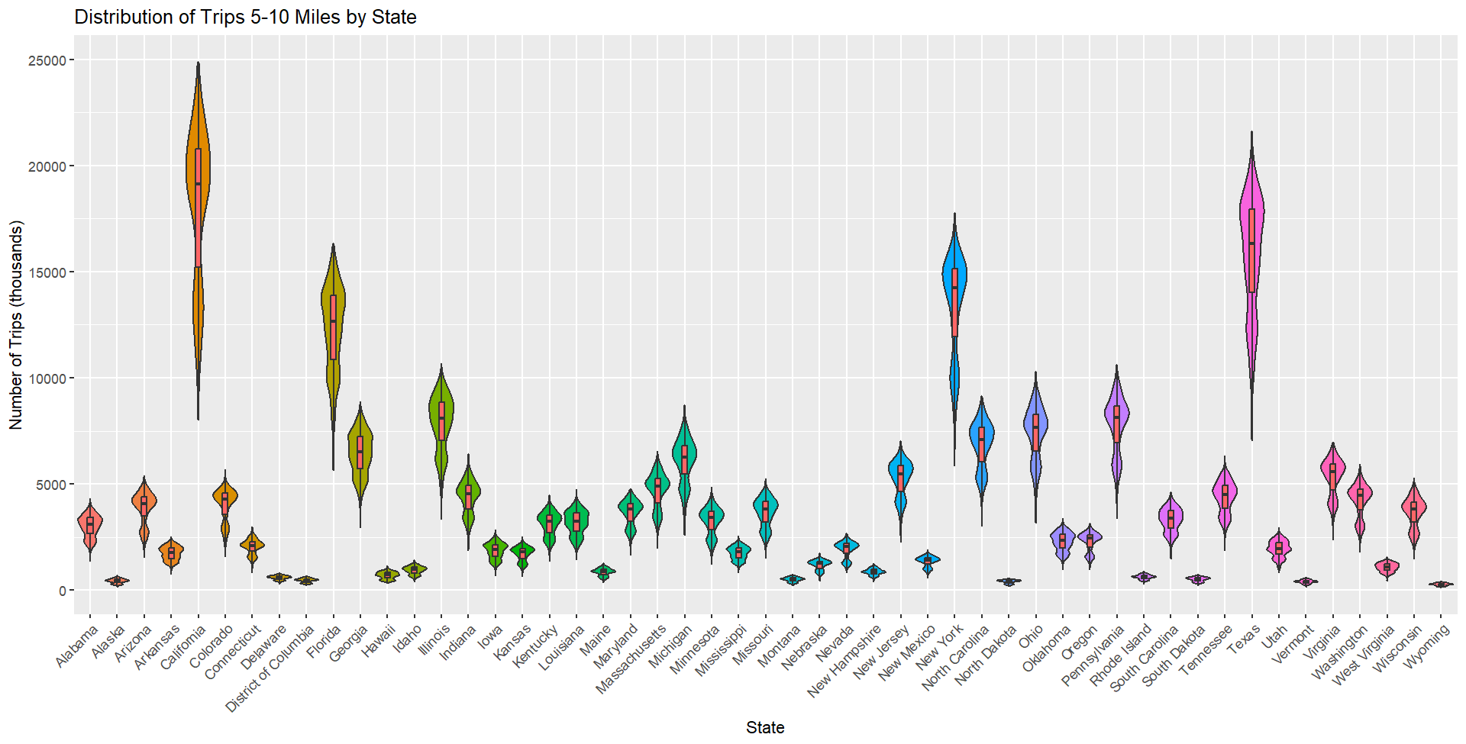

Slide 12
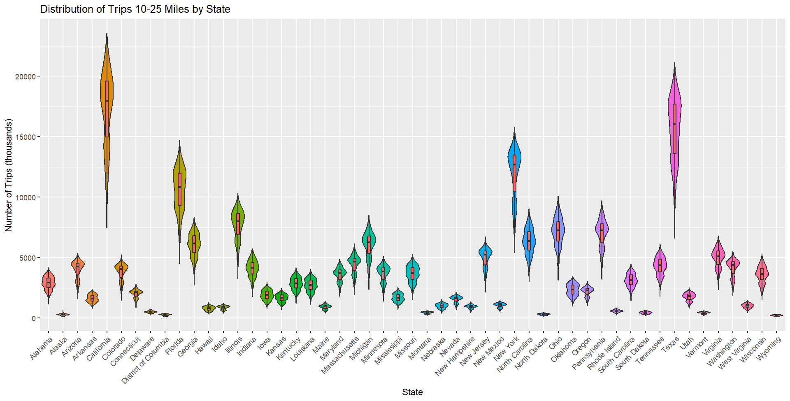

Slide 13
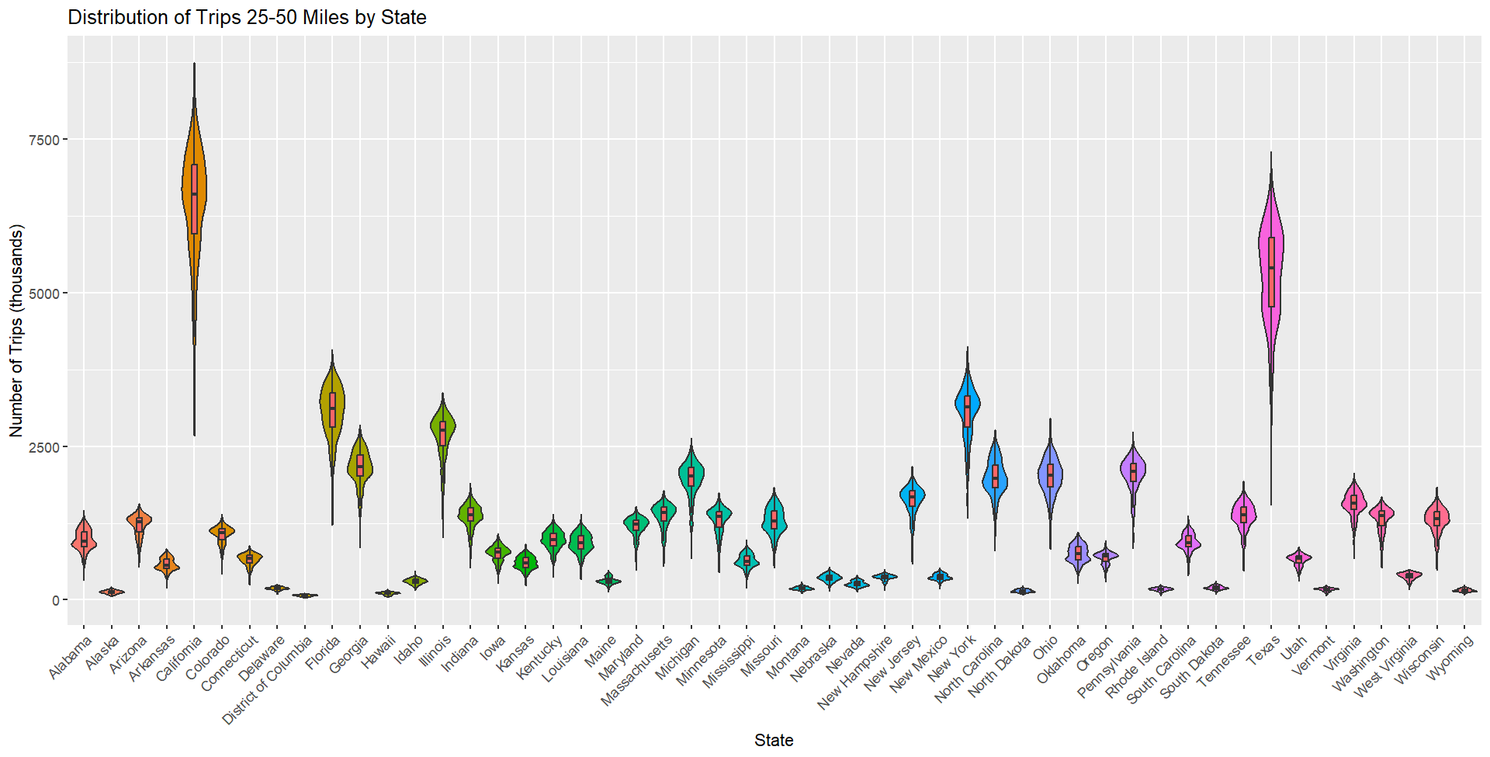

Slide 14
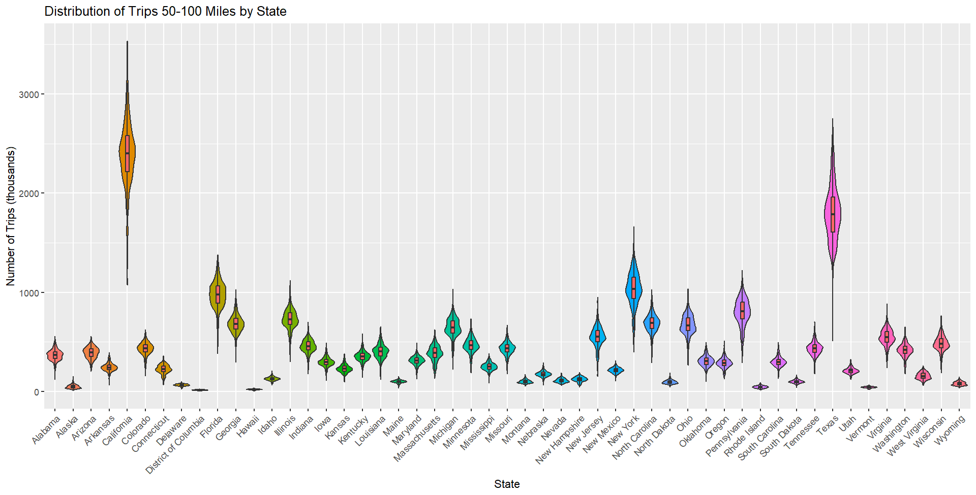

Slide 15
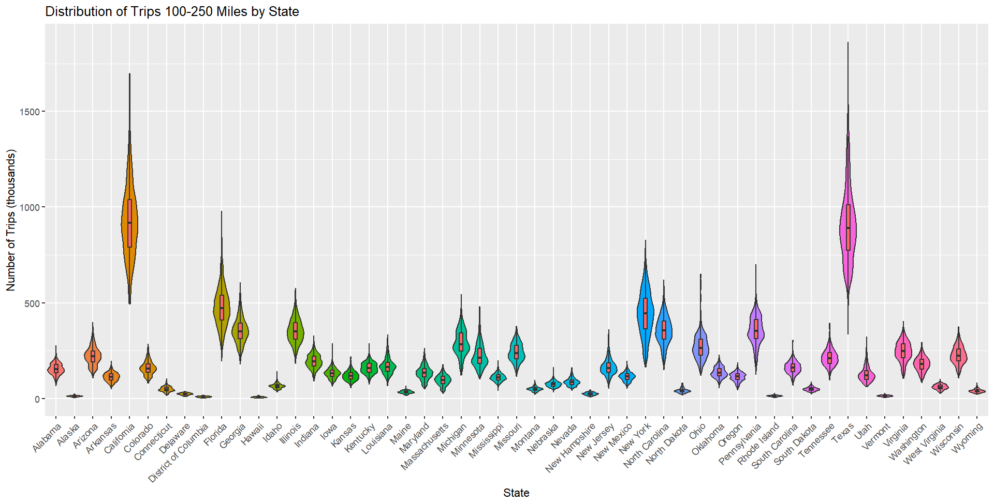
Notes:
- Note at Texas.
- Other states seem to have

Slide 16
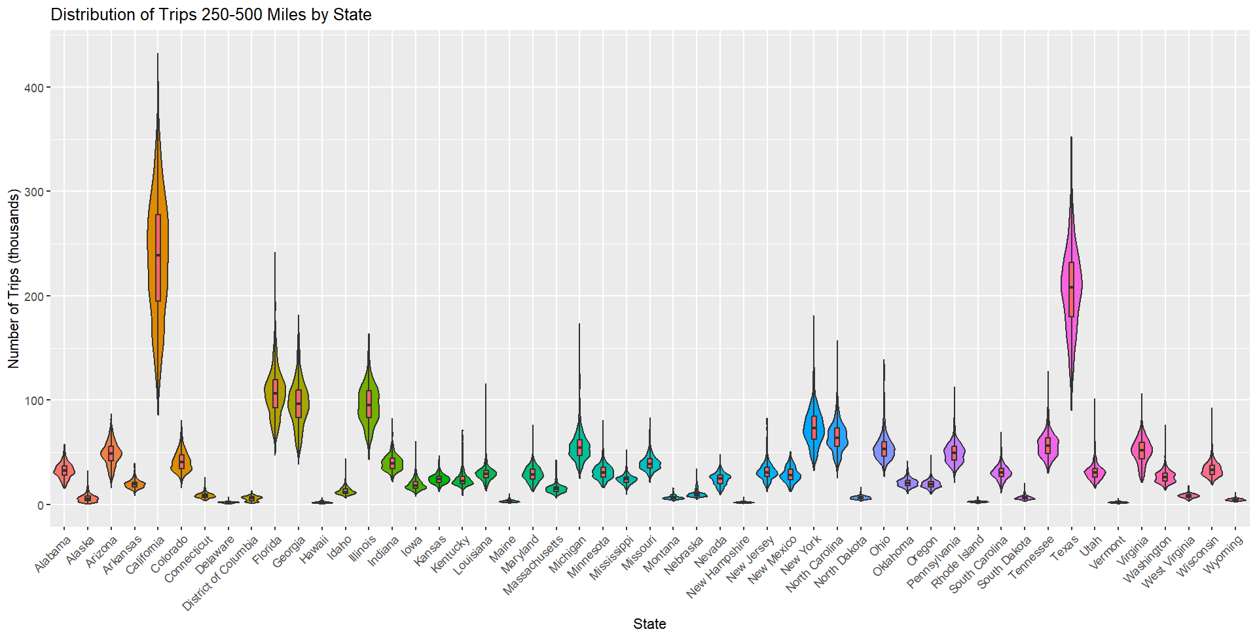
Notes:
- Note at Texas.
- Other states seem to have

Slide 17
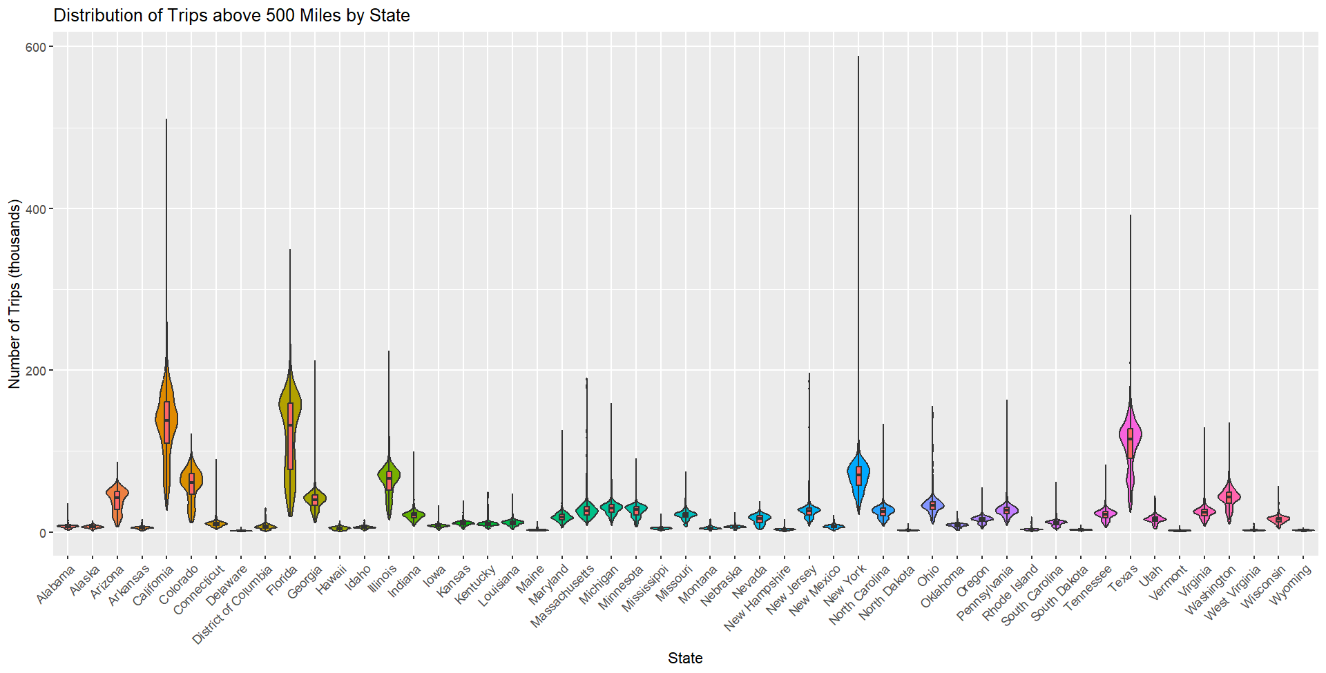
Notes:
- Note at Texas.
- All states seem to have a lot of outliers in this tip metric

Slide 18
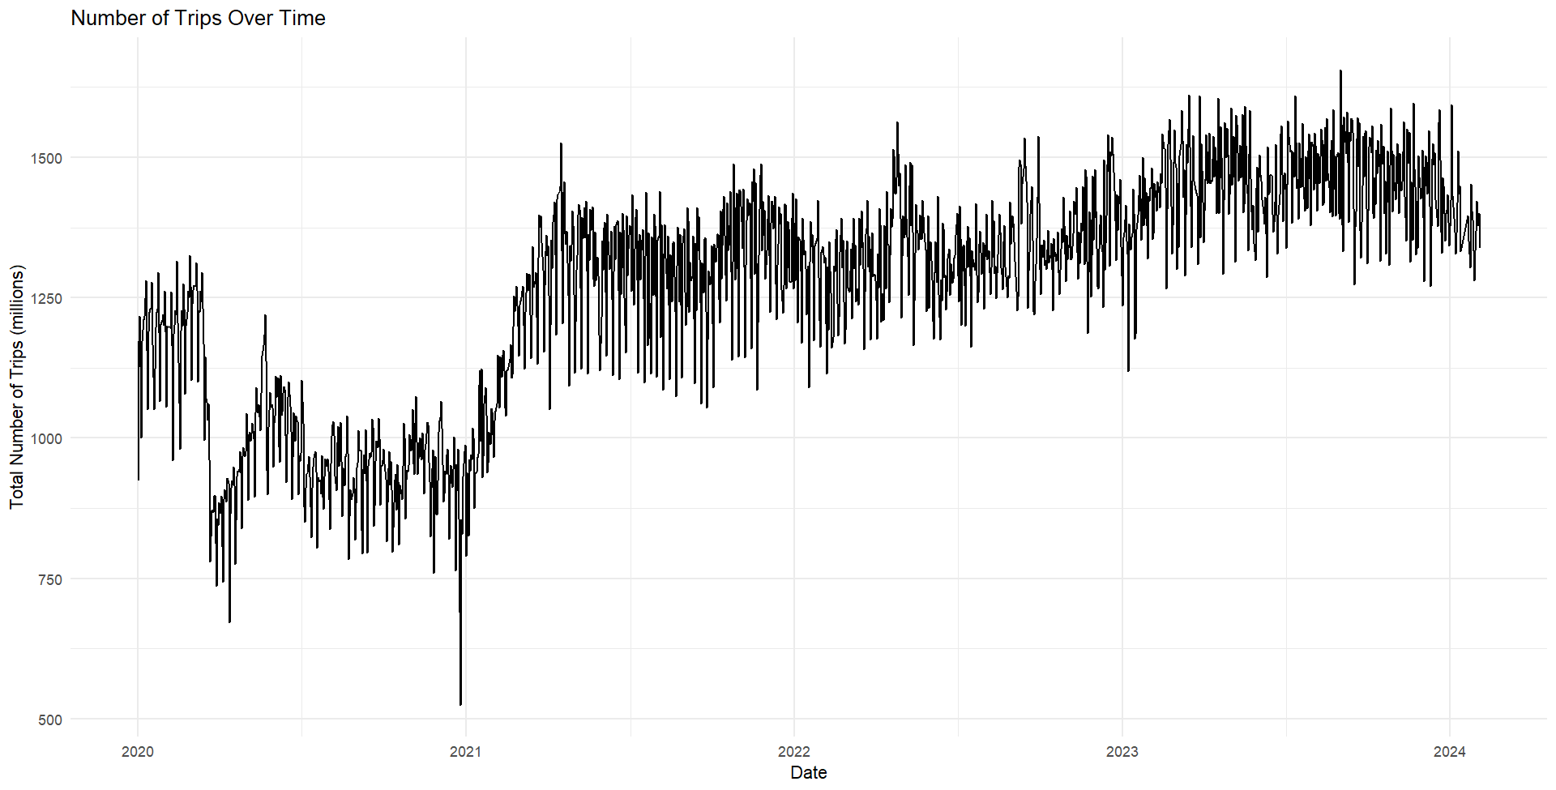

Slide 19
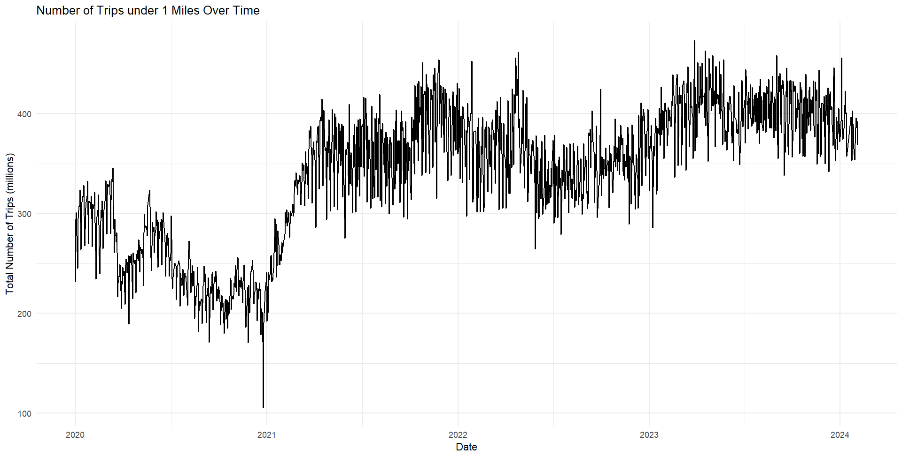

Slide 20
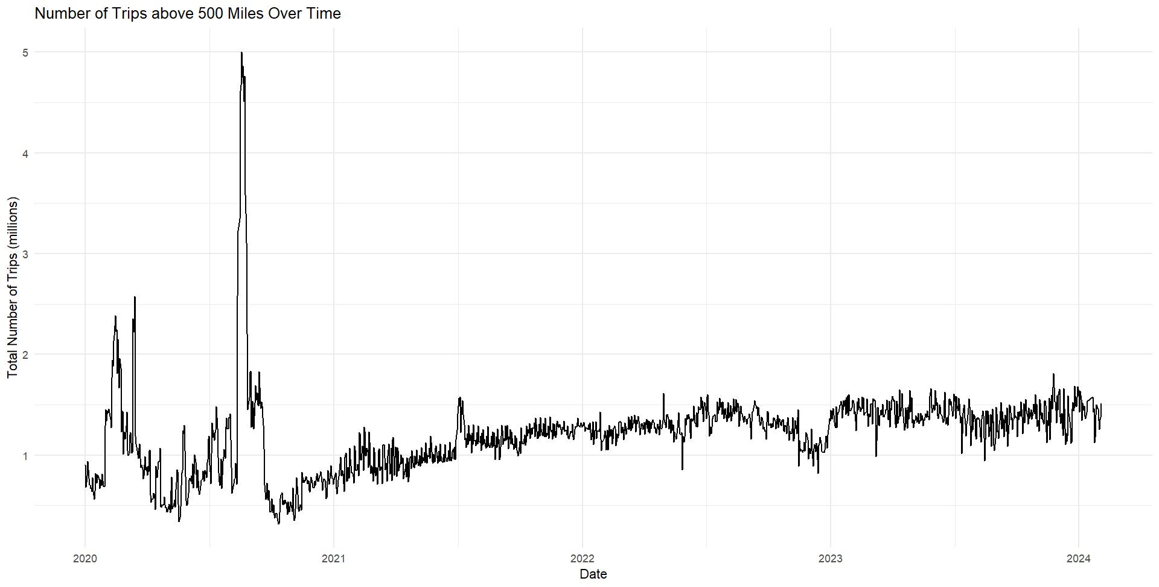

Slide 21
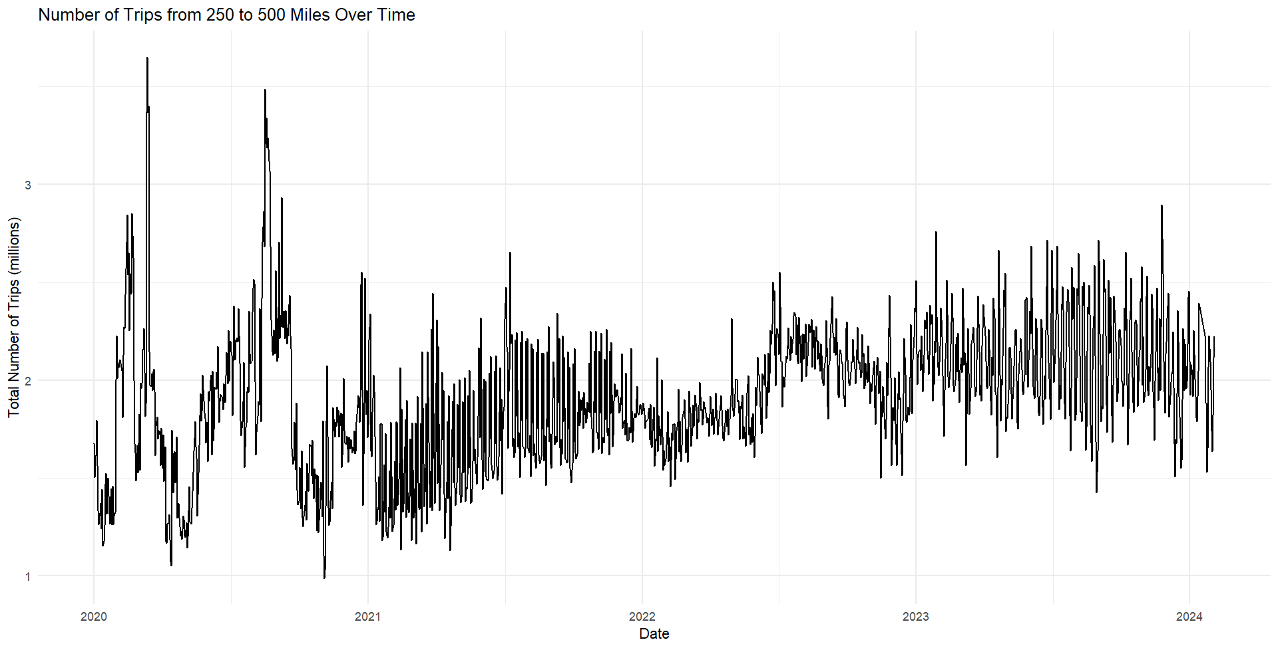

Slide 22
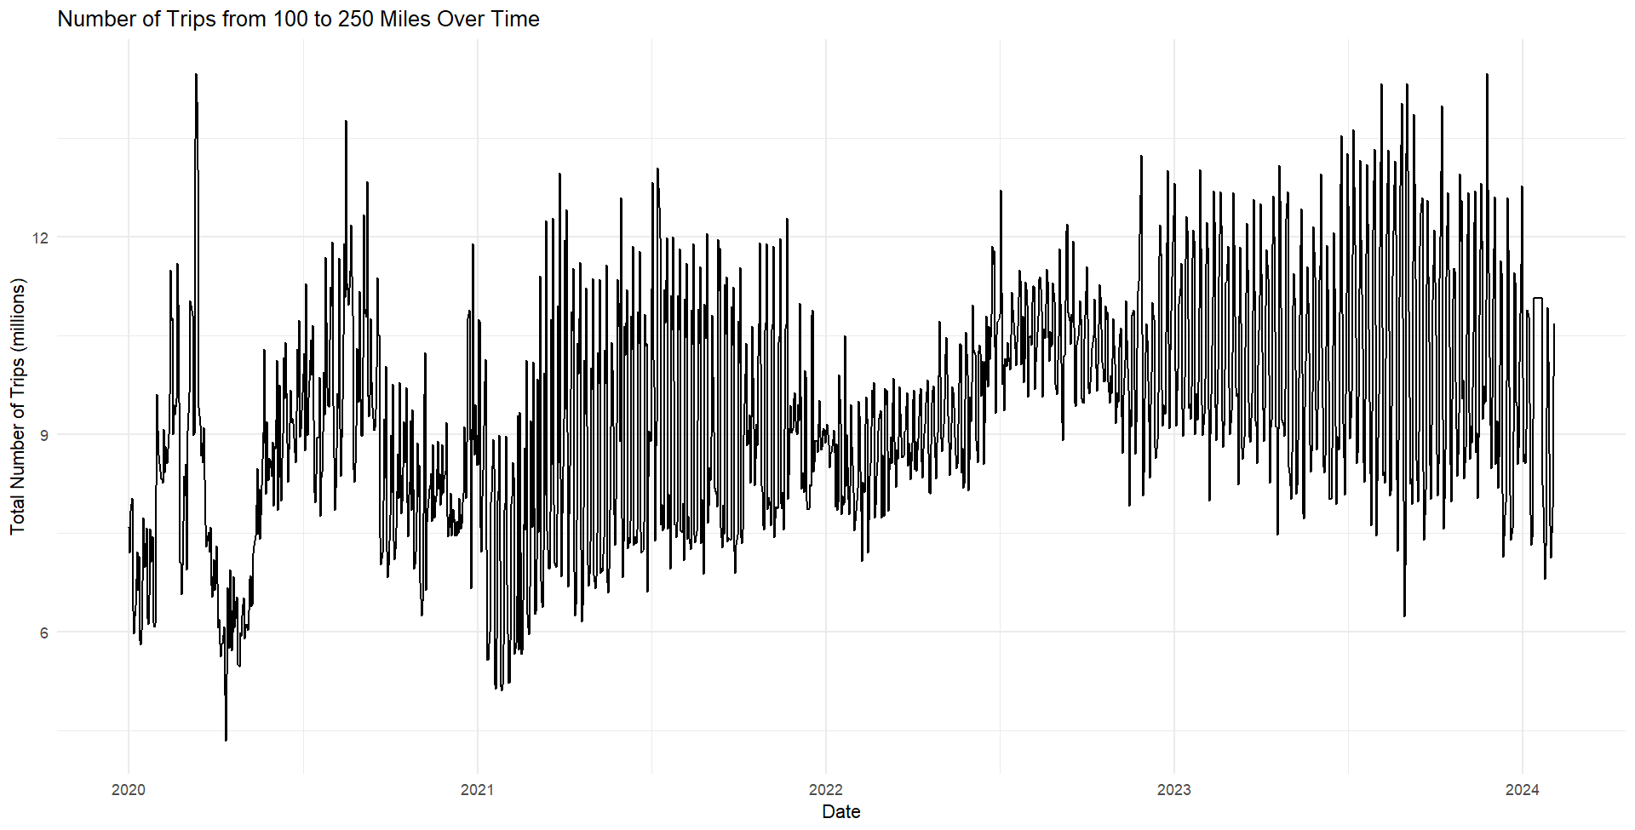

Slide 23
Political Violence Events Dataset
Download from Armed Conflict Location & Event Data Project (ACLED)
ACLED collects real-time data on the locations, dates, actors, fatalities, and types of all reported political violence and protest events around the world.
ACLED does not record all instances of violence. For example, criminal violence, defined as violence that is motivated by personal or purely criminal motives, is excluded from the ACLED dataset. Some mass shooting events fall into this category.
An Agenda for Addressing Bias in Conflict Data | Scientific Data
Notes:
This means that an event such as the shooting on 3 August 2019 in El Paso, Texas, where a white nationalist opened fire inside of a Walmart shopping center, killing 22 civilians including eight Mexican nationals, would be included given its political links and its intent to challenge public security. However, an event such as the shooting in Dayton, Ohio on 4 August 2019 that resulted in the deaths of nine people would not be included as the motives for the attack remain uncertain and likely linked to personal dynamics, given one of the victims was the shooter’s sister.

Slide 24
Political Violence Events Dataset
# Observations: 64,444
Unit-level analysis: political violence event
Time Frame: 01/01/2020 – 02/09/2024
Data Cleaning Steps:
Merge with State dataset to get state abbreviations
Rename variables
Group by Year and Event Types for further visualizations and analysis

Slide 25
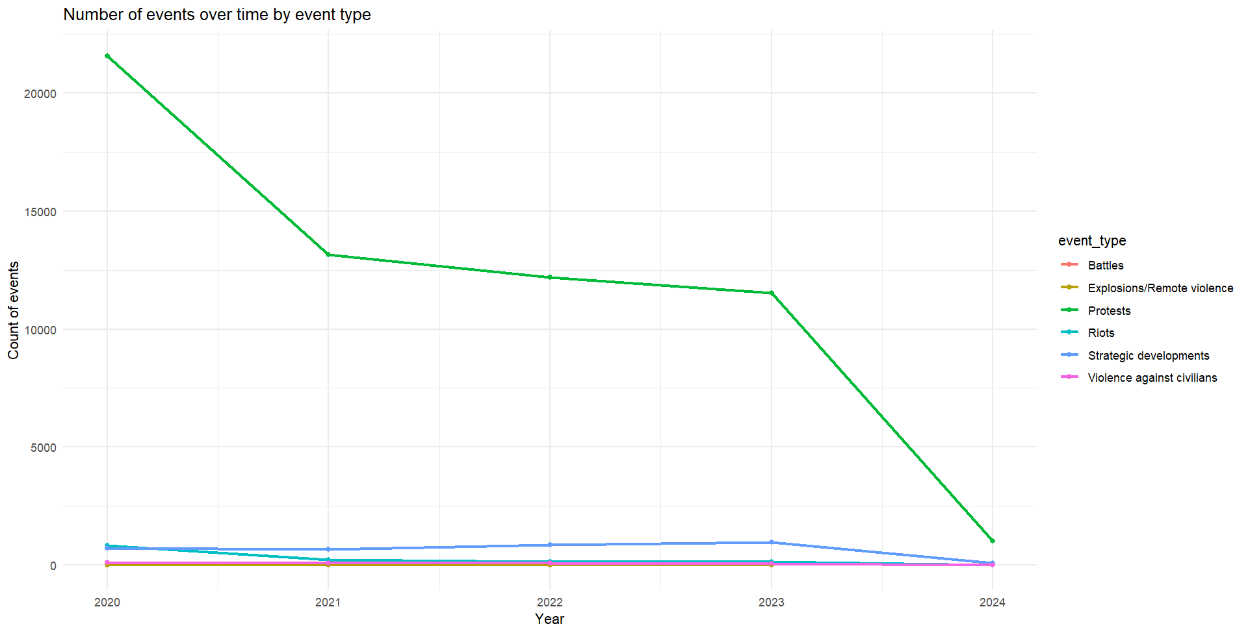
Notes:
Protests outweigh other event types

Slide 26
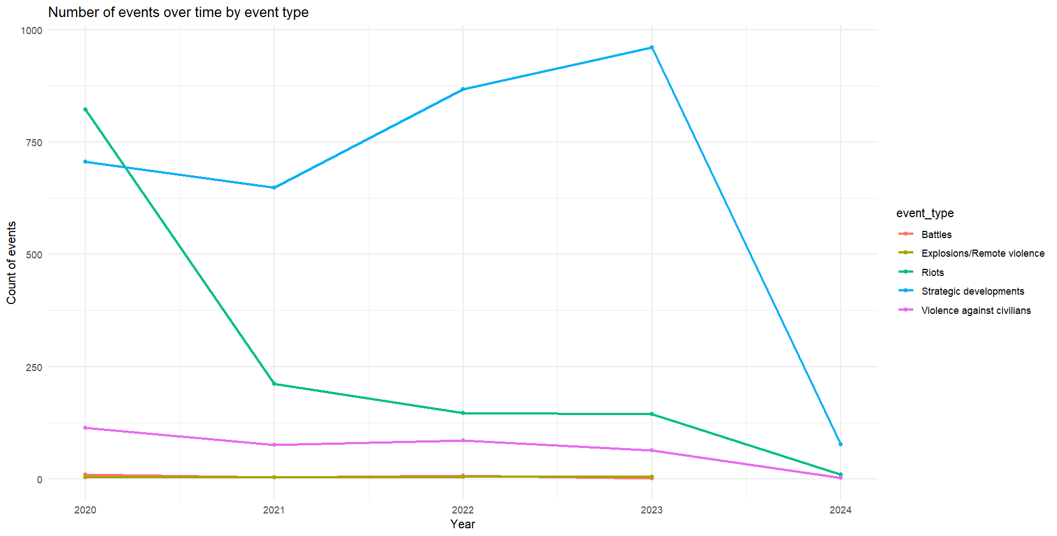

Slide 27
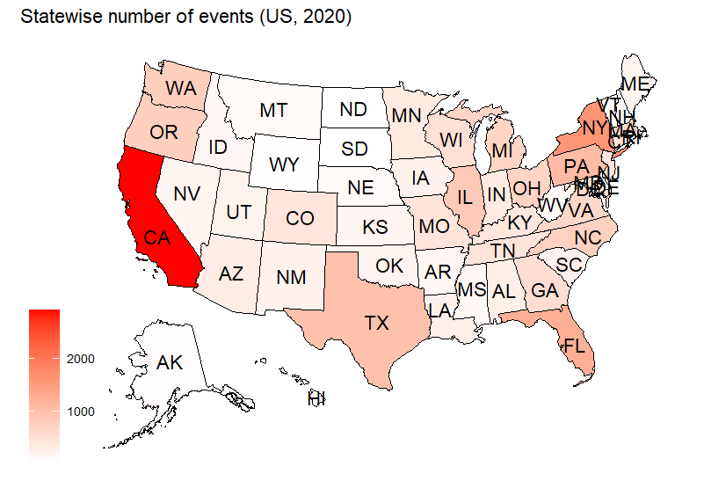

Slide 28
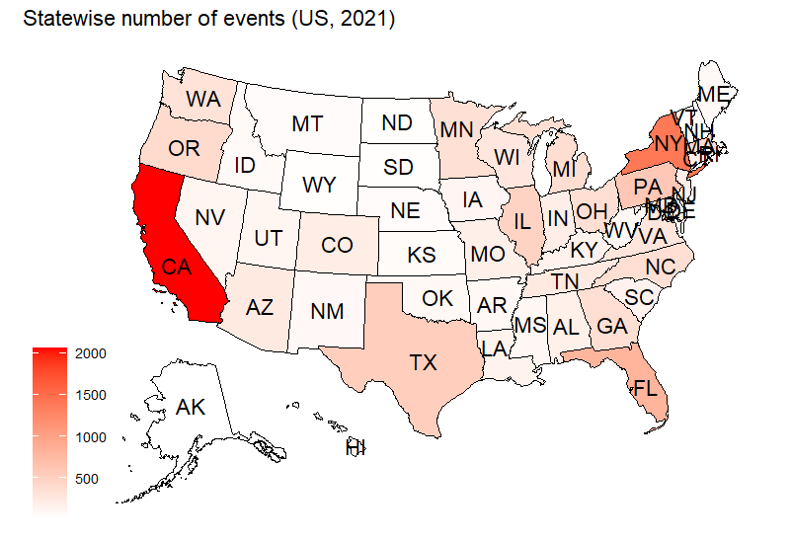

Slide 29
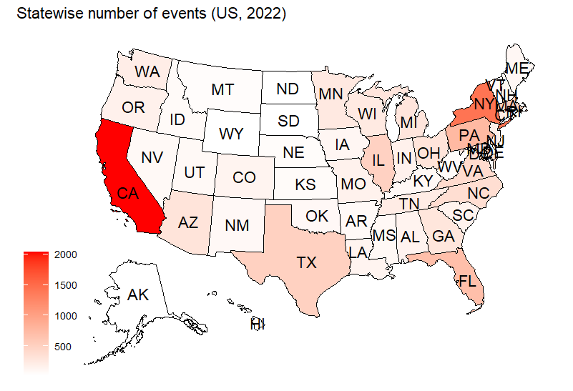

Slide 30


Slide 31
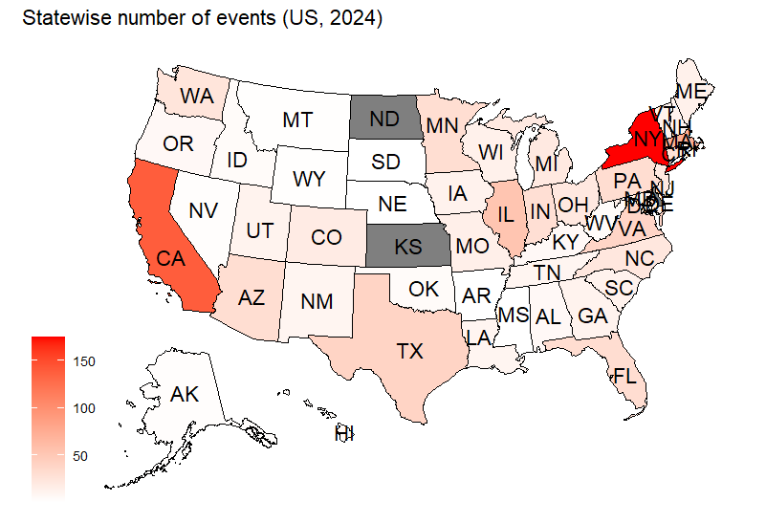

Slide 32
COVID-19 Cases Dataset
Download from Centers for Disease Control and Prevention (CDC)
This aggregate dataset was structured to include weekly and cumulative numbers of cases and deaths retrieved by CDC from states and territories over time.
Metrics included are:
Cumulative total number of cases
Number of new cases (7-day sum)
Cumulative total number of deaths
Number of new deaths (7-day sum)
Number of new historic cases (7-day sum)
Number of new historic deaths (7-day sum)

Slide 33
COVID-19 Cases Dataset
Original # Observations: 10,380
Current # Observations: 8,823
Unit-level: state-level weekly figure
Time Frame: 01/23/2020 – 05/11/2023
Data Cleaning Steps:
Drop unnecessary states
Combine the figures for NYC to NY State
Rename variables

Slide 34
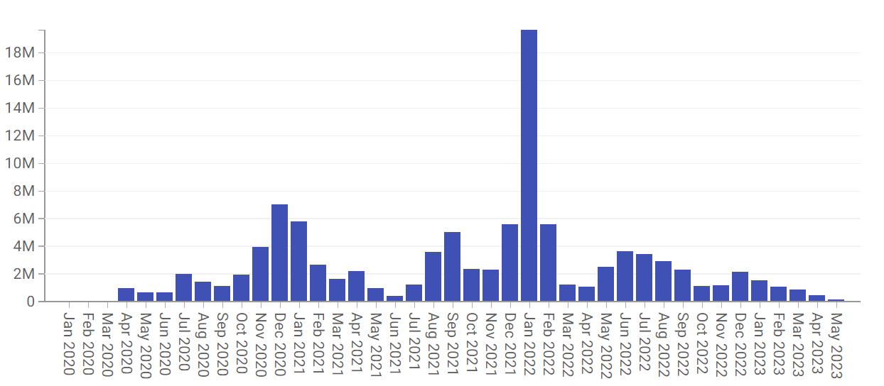
COVID-19 National Number of Cases over time

Slide 35
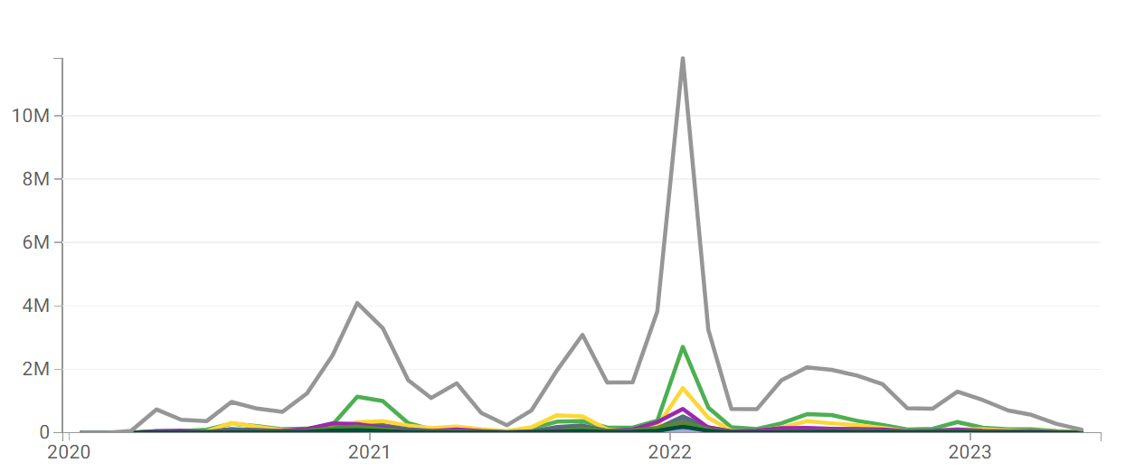
COVID-19 National Number of Cases by State over time
https://data.cdc.gov/d/pwn4-m3yp/visualization

Slide 36
Master Dataset
# Observations: 93,817
Time Frame: 01/01/2020 - 05/11/2023
Unit-level analysis: state-level daily figure
Concerns:
Not addressing the weekly COVID-19 data → Inconsistent structure
Unbalanced panel data may lead to skewed model estimate
More variables should be created or added to be controlled in the model.

Slide 37
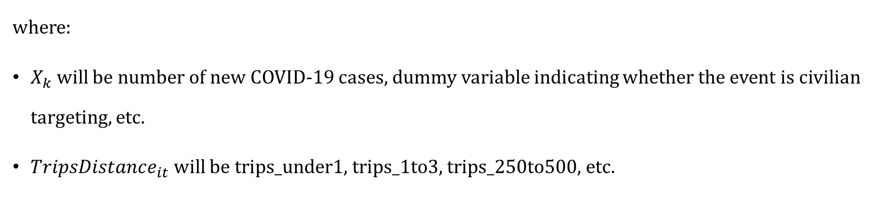
Potential Models
Research Question: estimate the impact of political violence events (categorized by type) on daily trip numbers while accounting for state-specific characteristics and time-varying factors.
Two-way Fixed Effects Model:
$$TripsDistance_{it}=β_{0}+β_{1}ha{s_event}_{it}+β_{2}event_type_{it}+β_{k}X_{kit}+α_{i}+τ_{t}+μ_{it}$$
where:
$X_{k}$ will be number of new COVID-19 cases, dummy variable indicating whether the event is civilian targeting, etc.
$TripsDistance_{it}$ will be trips_under1, trips_1to3, trips_250to500, etc.

Slide 38
Potential Models
Research Question: How does the timing of political violence events affect and predict trip behavior in the United States?
Two-way Fixed Effects Model:
$$TripsDistance_{it}=β_{0}+β_{1}day_beforeorafter_event_{it}+β_{2}event_{type_{it}}+β_{k}X_{k}$$
$$+α_{i}+τ_{t}+μ_{it}$$
where:
$X_{k}$ will be number of new COVID-19 cases, dummy variable indicating whether the event is civilian targeting, etc.
$TripsDistance_{it}$ will be trips_under1, trips_1to3, trips_250to500, etc.
Notes:
"What is the immediate impact of political violence events on trip behavior? Are there significant changes in trip patterns in the days following an event?"
"Do trip behaviors exhibit anticipation or reaction to political violence events? Are there discernible changes in trip patterns leading up to an event?"
"How do different types of political violence events (e.g., protests, riots, demonstrations) influence trip behavior differently over time?"

Slide 39
Implications for Stakeholders
National and State Government:
Inform government agencies responsible for transportation and public safety.
Insights from the model can help in developing policies and strategies to manage transportation systems during periods of civil unrest or political instability.
Enhance public safety measures and improve emergency response protocols.
Local Government:
Local governments can benefit from insights into how events affect local travel patterns and traffic flow.
Planning departments can use the information to optimize infrastructure development and transportation planning, especially in areas prone to political demonstrations or unrest.
City councils and local authorities may need to consider adjusting public transit routes or schedules in response to changing patterns of trip demand.

Slide 40
Ethical, Legal, and Societal Implications
Transparency in data collection and analysis methods is crucial to maintaining trust among stakeholders and the public.
Residents are able to make informed decisions about their travel and safety, potentially reducing their exposure to risks during periods of political unrest.
Findings from the analysis can inform efforts to promote equitable access to transportation resources, particularly for marginalized communities.
Communities can develop strategies to adapt to changing travel patterns during times of instability, fostering greater resilience in the face of social and political challenges.

Slide 41


Slide 42
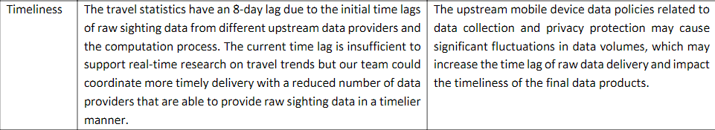
More about Trips by Distance dataset

Slide 43
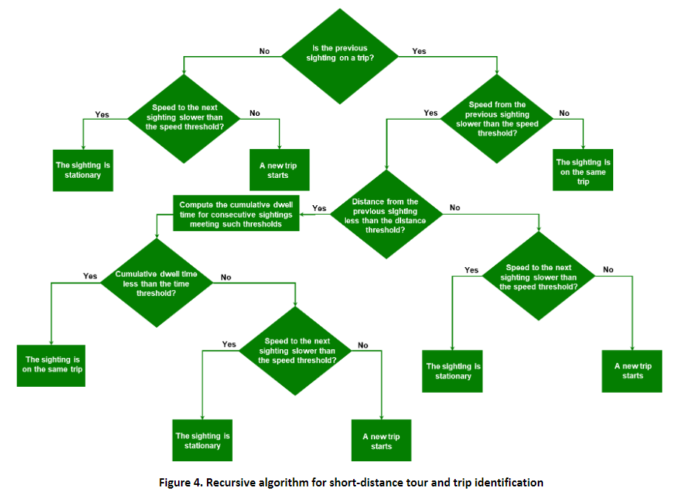

Slide 44
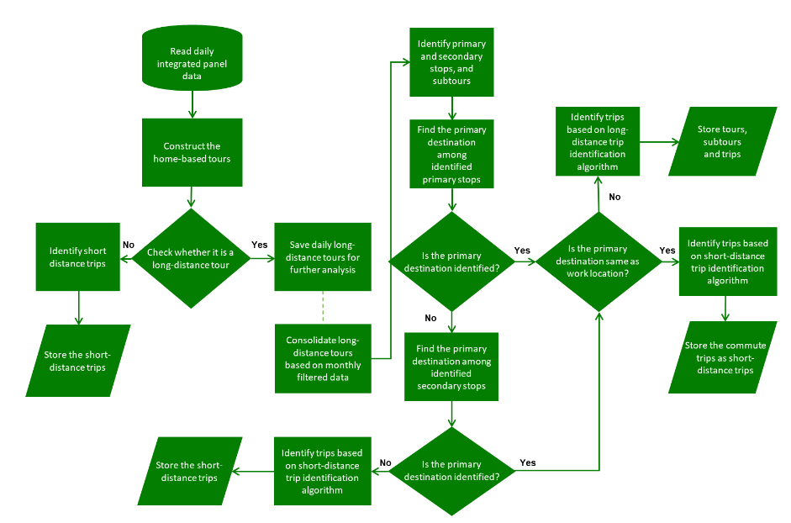
Figure 5. Recursive algorithm for long-distance tour and trip identification

Slide 45
More about Trips by Distance dataset’s Method
The rule-based model has three hyper-parameters: a distance threshold of 984 ft (i.e., 300 meters), a time threshold of 5 minutes, and speed threshold of 3 miles per hour (3 mph or 1.4 m/s). The speed threshold is used to identify if a sighting is recorded on the move, and the distance and time thresholds are used to identify trip ends.
In long-distance tours, all the trip ends are first identified and named as “secondary stops.” Primary stops are then identified from the secondary stops as places where the device stays for a significant amount of time and/or from which the device makes local trips. A subtour is considered a segment of a long-distance tour that falls between two primary stops. Therefore, all sightings between two primary stops are considered to be on the same subtour.

