Slide 1

Predicting Overall Survival in Lung Adenocarcinoma Patients Based on Mutational Profile
Billy Wilkerson and Whitney Finney

Slide 2
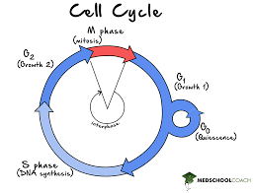
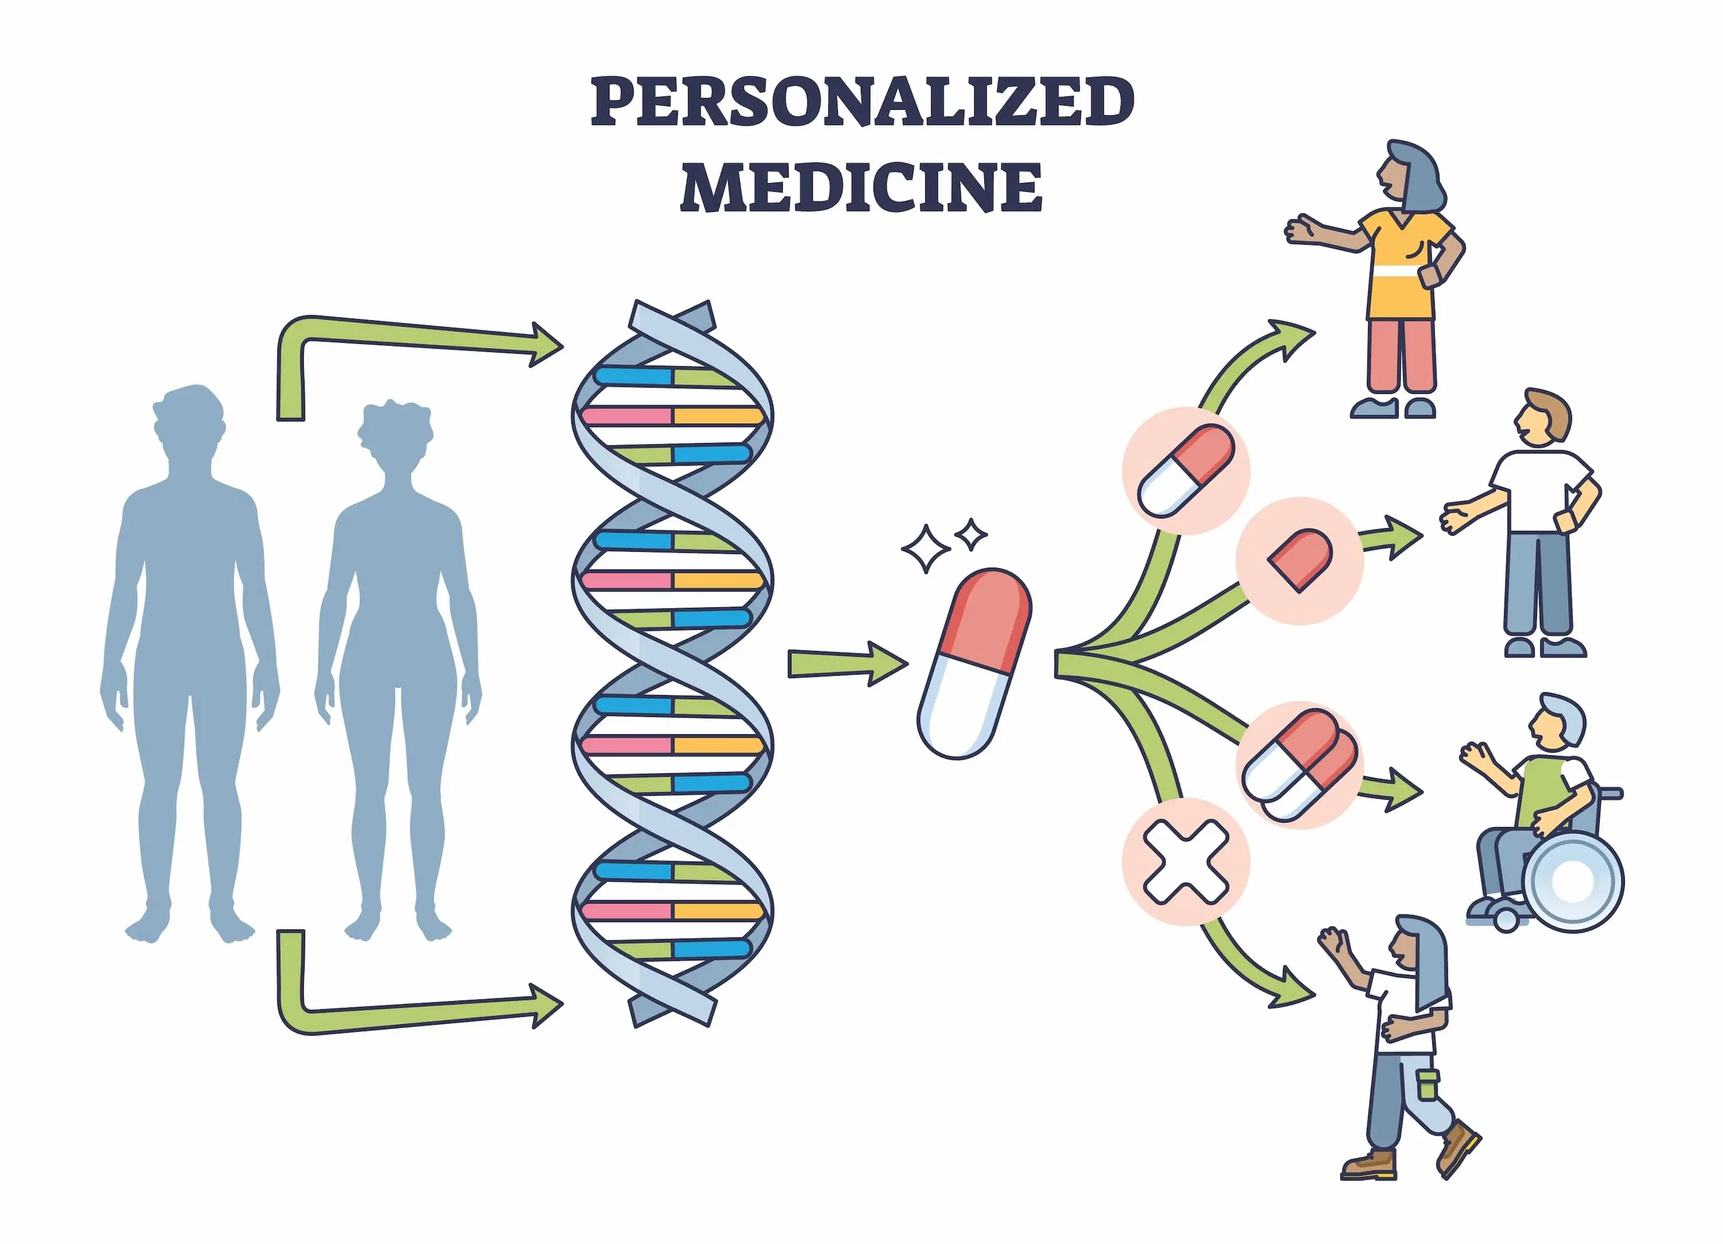
What Is Cancer?
1 in 2 men and 1 in 3 women will be diagnosed with cancer in their lifetime
Many different diseases defined by uncontrolled cell growth and eventually invade healthy tissue
Genes affecting the signaling and control of cell cycle become dysregulated
Every patient’s disease is unique, and must be treated as such (personalized medicine)
Check out http://www.oncolnc.org/
x
Image taken from medznat.ru

Slide 3
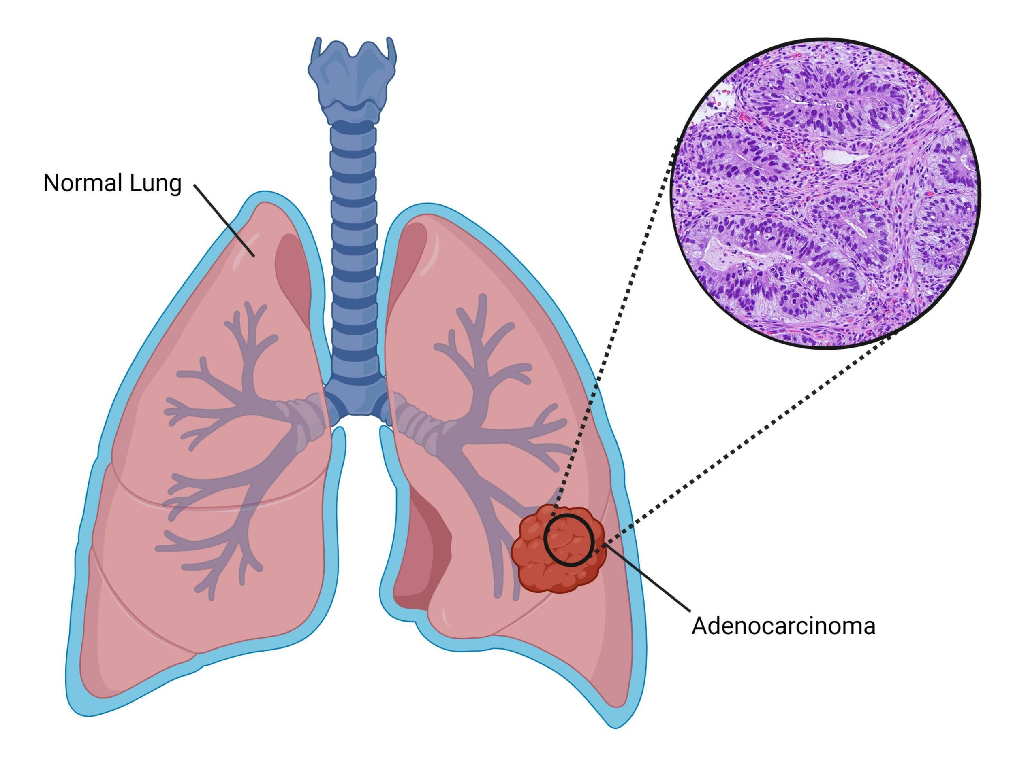
Introduction of Lung Adenocarcinoma (LUAD)
There were an estimated 238,340 new lung cancer cases in the US in 2023.
Accounts for 1 in 5 of all cancer deaths.
Lung adenocarcinomas originate from bronchioles, mucus-producing cells lining the small airways of the lung.
Affects smokers and non-smokers.
85% of lung cancers are non-small cell lung cancers (NSCLC)
40% of NSCLC diagnoses are lung adenocarcinomas
Image taken from dogodan.com/home/luad

Slide 4
Cell Line and Patient Datasets
Cancer Cell Line (CCL) Data from Broad, 2019
Contains clinical and sample data, RNA-seq, drug treatment response and exome sequencing data on 1,570 CCL
This includes 89 LUAD CCLs
Patient Data from MSK, Nature Medicine 2022 and MSK, Cancer Cell 2023
These combined dataset contain clinical and sample data, RNA-seq and exome sequencing data on 2,324 LUAD patients
Data obtained from studies available on cbioportal.org

Slide 5
Cleaning and Preprocessing
Conventional cleaning and preprocessing (removing NAs, long -> wide, etc.)
Removed patients without overall survival data and exome sequencing
Mutational datasets contain a lot of mutations that are unlikely to be oncogenic
Use cancer hotspots identified by Chang et al. 2017
1,165 mutational hotspots in 247 genes

Slide 6
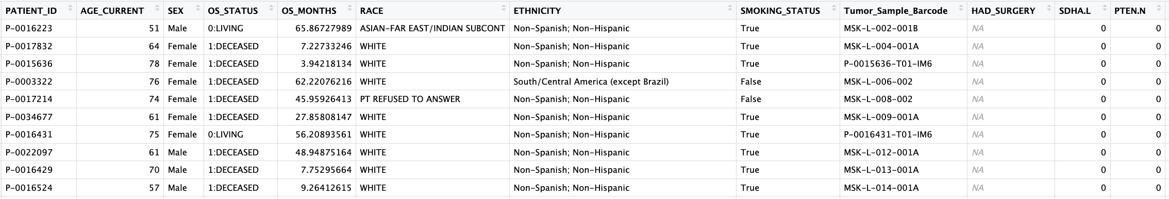
Processed Datasets
1,314 patients with both overall survival and exome sequencing data
Pre-processed data looks like this:
10 clinical variables of interest
299 mutational hotspots (297 not shown)
Broad, 2019 LUAD CCL lacks overall survival data – other clinical variables are included

Slide 7
Unsupervised Models and EDA
Clustering patient with LUAD CCL
Prediction of best treatment through CCLE drug response data
Hierarchical clustering of LUAD patients
Survival analysis of patients assigned to different clusters (more EDA)

Slide 8
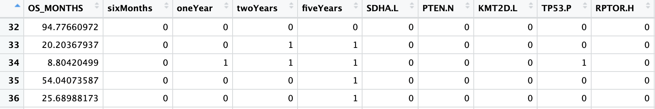
Supervised Models
Multiple Linear Regression
Logarithmic Regression
Logistic Regression (6 months, 1 year, 2 years, 5 years)
Feature selection and over-fitting concerns

Slide 9
Why Does This Matter? - Update
Opportunity to improve LUAD treatment regimens
Impacts patients and their families, healthcare providers, and the cancer research community
Unsupervised model has the potential to guide and inform further research endeavors, contributing to the advancement of LUAD treatment strategies.
Supervised model could help patients to better understand their life expectancy + informed decisions on

Slide 10
Considerations
Ethical and legal considerations need to be made regarding patient consent and data privacy.
The data obtained through studies conducted at cancer research centers with informed consent and have been made publicly available.
The application of a patient-cell line matching model presents no major ethical concerns.
Ethics of telling a patient when they will die.
Do we put more resources into those deemed more likely to survive? (ethical and societal implications)
The interesting backstory of HL-60 and the importance of informed consent

Slide 11

Questions?

