Slide 1


Forecasting in Shipping & Distribution
Paul Florio & George Thorp

Slide 2

Importance of Forecasting in Shipping and Distribution
Shipping rate forecasting involves predicting future shipping rates based on historical data, market trends, and various economic indicators. These forecasts are essential for planning and decision-making, helping companies anticipate market changes and make informed decisions about fleet management, chartering, and pricing strategies.

Slide 3
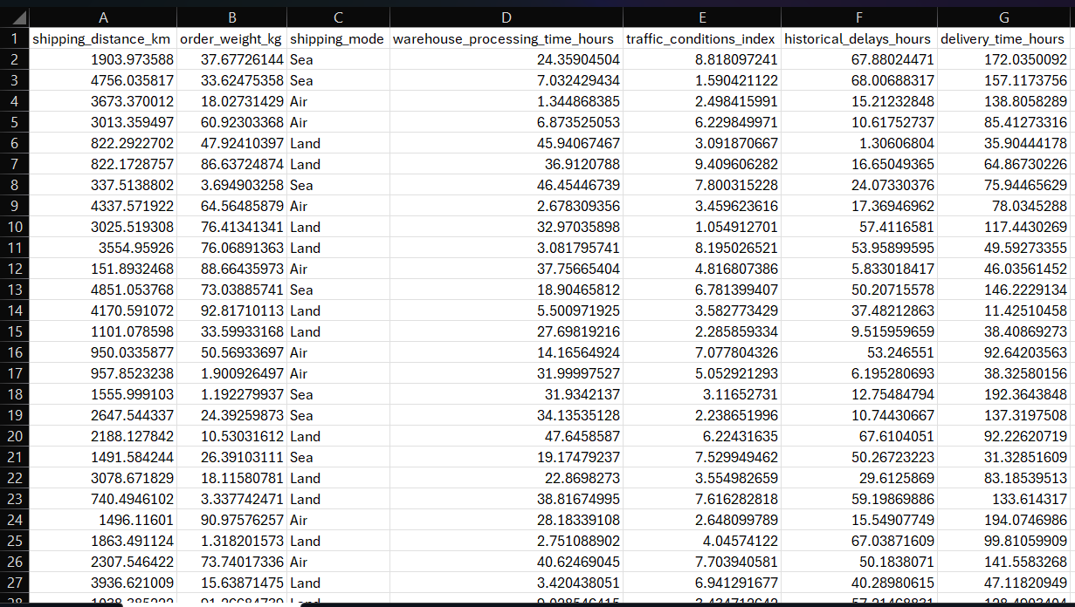
Data
From Notions Marketing Database, 10,000 records were pulled containing their Shipping Distance in kilometers, Weight in kilograms, Time Processed in hours, Traffic Conditions Index, Delay Times in hours, and Total Time of Delivery in hours.

Slide 4
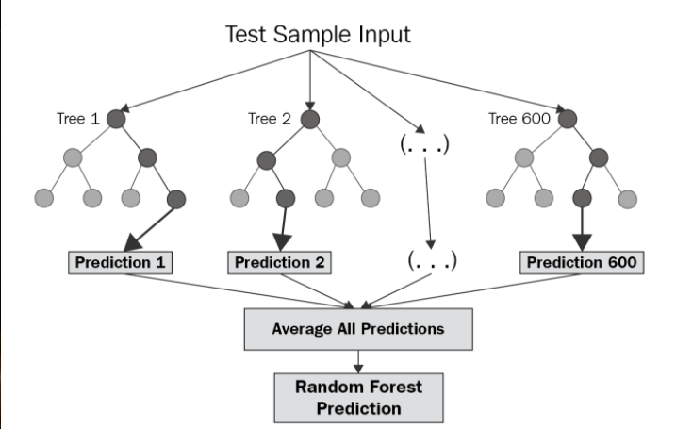
Model: Random Forest Regressor
Random Forest is an ensemble learning technique that builds multiple decision trees and combines their outputs to make a prediction. In regression tasks, it averages the predictions of all trees to provide a more stable and accurate estimate.

Slide 5

Purpose of Model and Forecasting
Looking to improve delivery estimates, optimize logistics, and reducing costs.
This model is used for how it handles the complex interactions such that it accounts for how features impact each other (high traffic + long distance = more delays).
Works well with missing data, it can handle missing values better than other models.
Avoids Overfitting, this generalizes well to new shipping data.

Slide 6


Code
80% of data is used for training & 20% of data is used for testing.
Scaling here ensures the model doesn’t give more importance to large-scale features
Using n_estimators=100 makes the model create 100 decision trees. Each tree is trained on a random subset of data (boosting diversity). The model learns patterns from X_train to predict delivery_time_hours.

Slide 7
Predictions/Outputs
The model returns the Mean Absolute Error, Mean Squared Error, and Root Mean Squared Error for expected delivery time.
On average, the model's predictions are off by 48.15 hours (~2 days) from the Mean Absolute Error.
A high Mean Squared Error suggests that a few extreme mispredictions are skewing the results.
For the Root Mean Squared Error the model's typical error is almost 56 hours (~2.3 days).
Initially, we thought that the model was flawed but after looking at many other outside factors. An estimate of 2 days is a good timeframe on when to expect our deliveries.

Slide 8
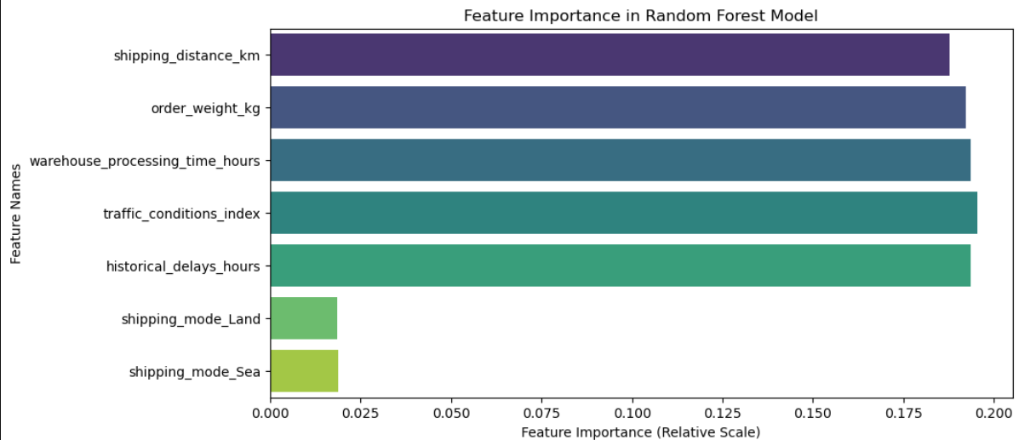
Feature Importance (Bar Chart)
Shows which features impact delivery time (hours) the most, and the higher values indicate more influence on delivery time.

Slide 9
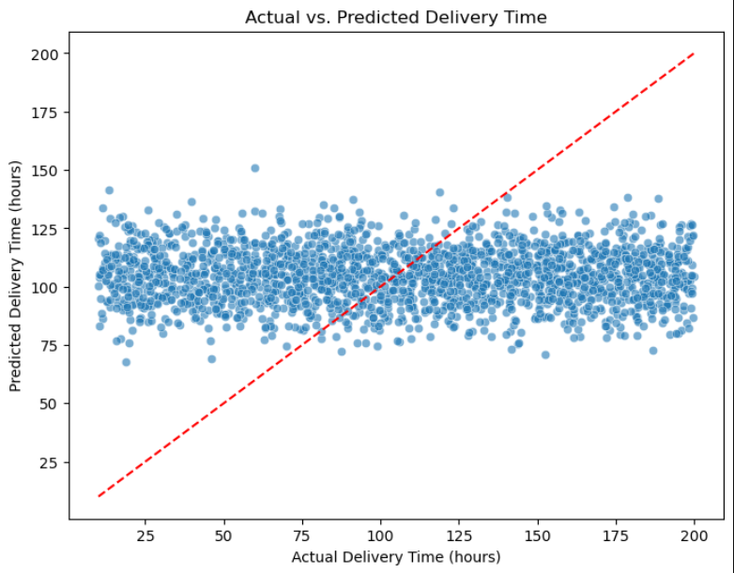
Actual vs. Predicted Delivery Time (Scatter Plot)
Helps visualize model accuracy and detect over/under-prediction, If points are close to the red diagonal line, predictions are accurate & Large deviations mean the model is over/under-predicting.

Slide 10
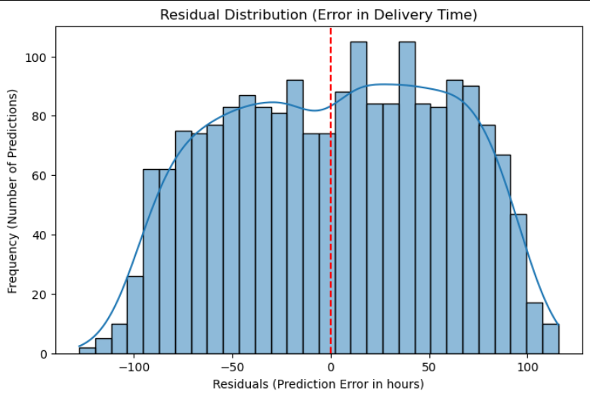
Residual Plot (Prediction Errors)
Checks if errors are randomly distributed (a good sign) or show patterns (a bad sign), If the plot was right-skewed the Model underpredicts or left-skewed the Model overpredicts.

Slide 11

Additions of Geopolitical Events
We investigated the idea of adding a Geopolitical Risk Index Feature, where it captures geopolitical risk for each shipment, possibly based on origin and destination countries & global geopolitical risk index.
Conflict Zones or Trade Routes were another feature to include, such that creating this as a binary value adds to the complexity of our model.
Event-Based Delays with Time Features, here we can take events that have happened during the shipment to better predict and evaluate delays.

Slide 12

Code Implementations
Geopolitical Risk Index is shown and gives decimal values to indicate the level of risk in each country.
Conflict Zones are assigned binary values based on the countries that are designated in the conflict zone data frame.
Disruptions during the shipments are flagged here for patterns that associates spikes in delays with real world events.

Slide 13
Affected Model
Improvements | Which Variables ? | Output's Outcome
Sudden delays not explained by distance, weight, or traffic cause large residuals. | Event indicators such as geo_disruption_event helps the model learn that delays are not random. | Lowers MAE & RMSE
Model assumes all months are equal which underpredicts in disruption months. | shipment_month, geo_disruption_event, or is_conflict_zone gives context to predict higher delays during unstable periods. | Lowers MSE & RMSE
Shipping to conflict zones is sporadically late, making training data messy. | is_conflict_zone or geopolitical_risk_index provides clarity on which regions are high risk. | Lowers MAE, MSE, & RMSE

Slide 14
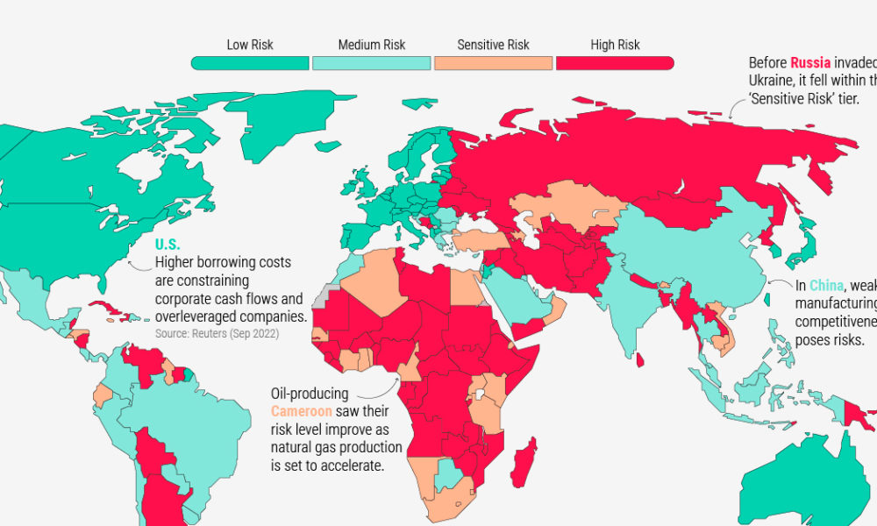
Complications with these Additions
Incorporating geopolitics into shipping prediction is valuable but requires:
External data mapping (countries, dates, events).
Preprocessing and imputation (some data may be missing or outdated).
Awareness of correlation vs causation; adding poorly sourced or noisy geopolitical data could harm model performance.

Slide 15
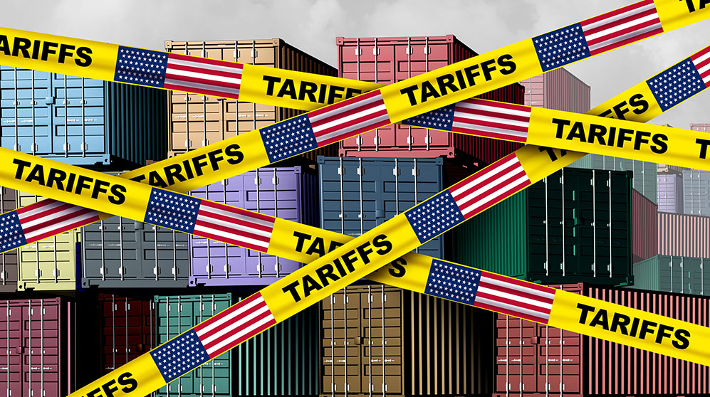
Tariffs
Increased customs processing time: Higher tariffs typically lead to more thorough customs inspections and documentation reviews, potentially adding delays that our current model might not account for.
Supplier behavior changes: Suppliers might consolidate shipments differently to minimize tariff impacts, changing typical shipping patterns and timelines.
Port congestion: If there's a rush to import goods before tariffs take effect or changes in shipping volumes afterward, this could create unusual port congestion patterns as has happened throughout April 2025
Routing changes: Shippers might choose different routes or transportation methods to optimize for cost rather than speed, affecting typical transit times.

Slide 16



Prospective Refinements
Tariff-Related Variables: Adding variables such as customs processing time by product category, the country-of-origin risk factor, and factoring in a potential tariff rate percentage
Other External Factors: Potentially accounting for weather pattern disruptions along shipping routes, port congestion metrics and historical trends, construction and infrastructure delays, and seasonal shipping volume variations.
Cost-Optimization Variables: Finding ways to incorporate fuel price fluctuations and projections along with supply & demand pricing dynamics would help eliminate the variability that we may have in the model.

Slide 17
Stakeholder’s Implications
Risk Management: Accurate forecasts help mitigate risks associated with fluctuating shipping rates. By anticipating rate changes, companies can better manage their exposure to market volatility.
Operational Efficiency: Forecasting enables more efficient planning of shipping routes, vessel utilization, and maintenance schedules, leading to cost savings and improved operational performance.
Strategic Planning: Long-term forecasts support strategic planning and investment decisions, helping companies allocate resources effectively and pursue growth opportunities.

Slide 18
Ethical, Legal, Social Implications
Supply and Demand: The balance between the supply of shipping capacity and the demand for shipping services is a primary driver of shipping rates. Factors such as global trade volumes, economic growth, and seasonal variations impact this balance.
Fuel Prices: Fuel costs are a significant component of shipping expenses. Changes in fuel prices directly affect shipping rates, with higher fuel costs typically leading to higher rates.
Regulatory Changes: Environmental regulations, such as those related to sulfur emissions, can influence shipping rates by increasing operational costs.
Geopolitical Events: Political instability, trade disputes, and natural disasters can disrupt shipping routes and impact shipping rates.

