Slide 1
Culture of Competition: Coke vs Pepsi
Data 400
Jenna and Malena

Slide 2
AGENDA
01
Tractable Data
02
Data Retrieval
03
Model
04
Implications for Stakeholders
05
Ethical, legal, societal implications
06
Next Steps..
Culture of Competition: Coke vs Pepsi

Slide 3
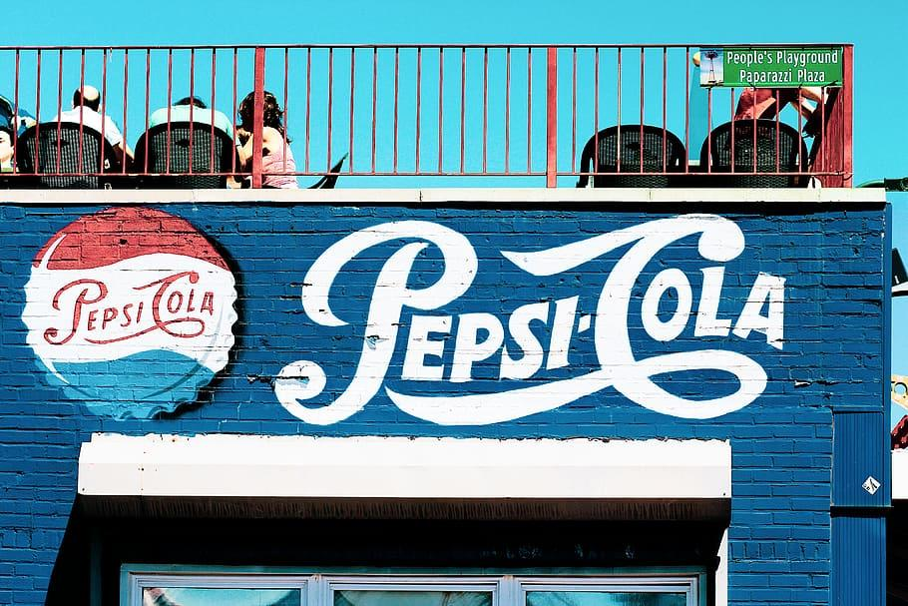
1
Tractable Data

Slide 4
Coke vs Pepsi:
Looking into the effects of stocks and sales: Pepsi Superbowl Halftime Show 2012-2022 vs Coca-Cola’s annual Santa Campaign (November-January).
Pepsi
Pepsi sponsored the SuperBowl halftime show until 2022, allowing them positive advertisement. Looking into the most recent ten years (2012-2022), how does this affect their sales and stocks.
Coca-Cola
Similarly, Coca-Cola has a well-known and established Christmas-themed and Santa Campaign annually. This increase in marketing during the months of November-January 1st could lead to an effect in sales and stocks.
Rivalry/Why?
How do these two compare? Who is more successful? Are there seasonal trends?
Testing to see if these months contribute to higher sales and stock prices?

Slide 5
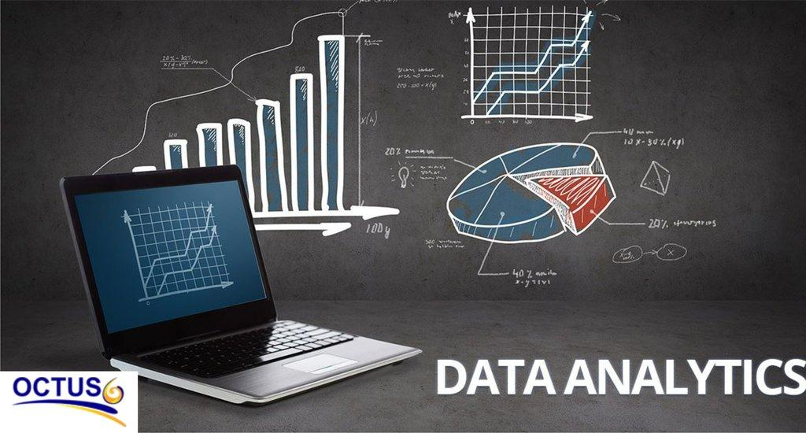
2
Data Retrieval

Slide 6
Analyzing the Rivalry
Google Searches
Stock Prices
Sales
Seeing how this marketing (in specified time frame) translates to an increase, decrease, or plateau in sales in both Coke and Pepsi.
Can find sales of Coke on their website.
Pepsi… TBD, still working on it.
Sorting through Kaggle as backup.
Looking into the difference in google searches can allow us some insight into how many people are interested in Coke or Pepsi.
Google Trends grants us data internationally from a range of dates and times.
We will be limiting it to Pepsi in February (when Super Bowl occurs 2012-2022); and Coke Nov-Jan 1st 2012-2022.
Looking into the difference of stock prices of Coke vs Pepsi.
Especially, an incline vs decline around these timeframes.
Sources: utilizing yahoo finance package for latest stock prices
These three data sources allows us to gain an understanding to how the marketing of Coca-Cola and Pepsi translates to positive growth for each company. Also, allowing us to see trends and more over time.

Slide 7

3
Model (subject to change)

Slide 8
Model
When analyzing trends, sales, and stock prices over time, there are many potential approaches. We also may change some of these models once we discover new things.
Regression Models
Sentiment Analysis
Line/Time Series Analysis
Linear Regression and Logistic Regression
Seeing how sales, stocks, and google trends is affected during these time frames and seeing the comparison of the two companies.
Looking into how the google searches are positive vs negative.
Are people associating Coke and Pepsi with negative or positive words?
Example: “How long until Coke goes flat?”
If there appear to be seasonal trends, how do they carry out over the years?
Are there years where Pepsi’s SuperBowl presence really stood out?
Have these sodas seen consistent increases in sales over the years?
Seeing trends over time.

Slide 9

4
Implications to Stakeholders

Slide 10
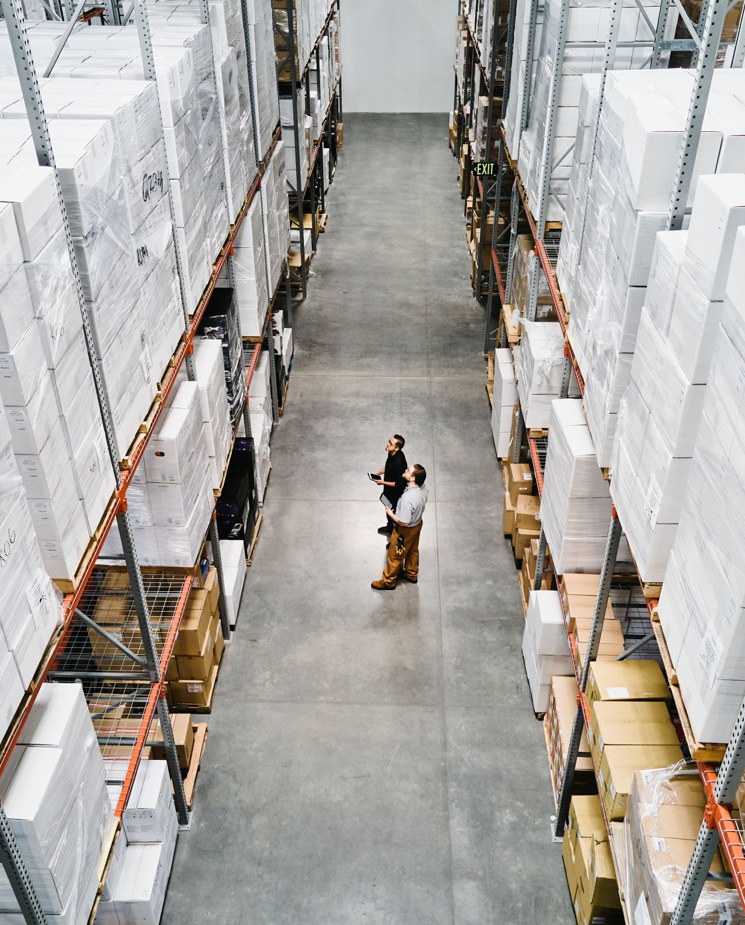
Stakeholders
Coca-Cola
Coca-Cola would like to learn how well their marketing campaigns are translating to sales - if it worth it? etc.
Pepsi
Pepsi could gain insights to see if they should bring back another major marketing opportunity like the Super Bowl. (Have not held the Super Bowl halftime show since 2022 once it was sold to Apple Music). Should they look into a similar situation or was it proven to not be worth their resources?
Everyday Consumers
American consumers have a keen interest in rivalries - Coke vs Pepsi, McDonald’s vs Burger King, Del Taco vs Taco Bell, etc. This is a fun and insightful way to learn how different companies benefit off certain marketing strategies.

Slide 11

5
Ethical, Legal, Societal Implications

Slide 12
Ethical
Societal
Legal
Societal
Ethical
Legal
Consumers should be aware of how marketing influences their perception and consumption of a product.
No major legal implications given that all the data is legal and readily available online.
Information is power!!!!
Granting the everyday American information about how their purchases have real effects on different companies.
Potential investors can use this knowledge to adapt new strategies when buying and selling Coca-Cola and PepsiCo stocks.

Slide 13

6
Next Steps

Slide 14
Data Analysis
PROCESS 1
Cleaning the data, converting to tables, merging when necessary.
PROCESS 2
Seeing overall trends.
PROCESS 3
Implementing necessary and helpful data models.
PROCESS 4
Analyze what it reveals.
PROCESS 5
Make adjustments, different models, etc.
PROCESS 6
Put everything together to bring a deliverable/result next presentation.
I believe data analysis is a constant back and forth of progress, analysis, then trying a different and potentially better approach. This will allow for the best possible concrete result.

Slide 15
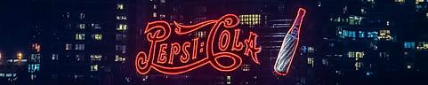
THANK YOU
Jenna and Malena

