Slide 1


Forecasting in Shipping & Distribution
Paul Florio & George Thorp

Slide 2

Importance of Forecasting in Shipping and Distribution
Shipping rate forecasting involves predicting future shipping rates based on historical data, market trends, and various economic indicators. These forecasts are essential for planning and decision-making, helping companies anticipate market changes and make informed decisions about fleet management, chartering, and pricing strategies.

Slide 3
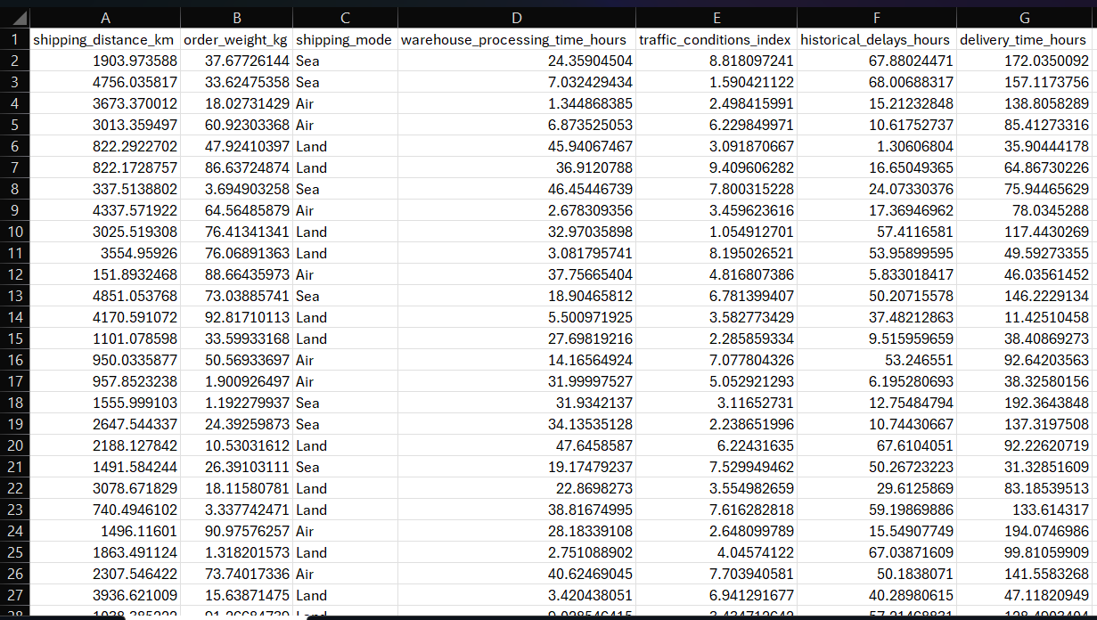
Data
From Notions Marketing Database, 10,000 records were pulled containing their Shipping Distance in kilometers, Weight in kilograms, Time Processed in hours, Traffic Conditions Index, Delay Times in hours, and Total Time of Delivery in hours.

Slide 4
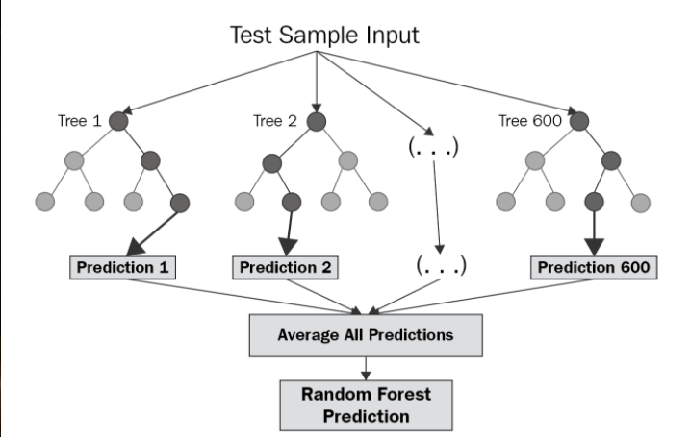
Model: Random Forest Regressor
Random Forest is an ensemble learning technique that builds multiple decision trees and combines their outputs to make a prediction. In regression tasks, it averages the predictions of all trees to provide a more stable and accurate estimate.

Slide 5

Purpose of Model and Forecasting
Looking to improve delivery estimates, optimize logistics, and reducing costs.
This model is used for how it handles the complex interactions such that it accounts for how features impact each other (high traffic + long distance = more delays).
Works well with missing data, it can handle missing values better than other models.
Avoids Overfitting, this generalizes well to new shipping data.

Slide 6


Code
80% of data is used for training & 20% of data is used for testing.
Scaling here ensures the model doesn’t give more importance to large-scale features
Using n_estimators=100 makes the model create 100 decision trees. Each tree is trained on a random subset of data (boosting diversity). The model learns patterns from X_train to predict delivery_time_hours.

Slide 7
Predictions/Outputs
The model returns the Mean Absolute Error, Mean Squared Error, and Root Mean Squared Error for expected delivery time.
On average, the model's predictions are off by 48.15 hours (~2 days) from the Mean Absolute Error.
A high Mean Squared Error suggests that a few extreme mispredictions are skewing the results.
For the Root Mean Squared Error the model's typical error is almost 56 hours (~2.3 days).
Overall, the model has errors are too large for practical use. If you were expecting delivery times in hours, an error of 48-56 hours is problematic

Slide 8
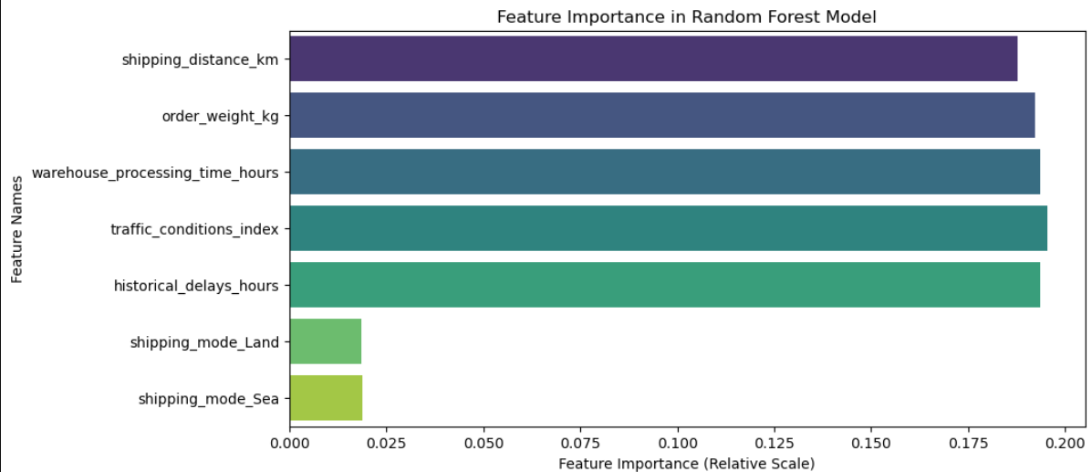
Feature Importance (Bar Chart)
Shows which features impact delivery time (hours) the most, and the higher values indicate more influence on delivery time.

Slide 9
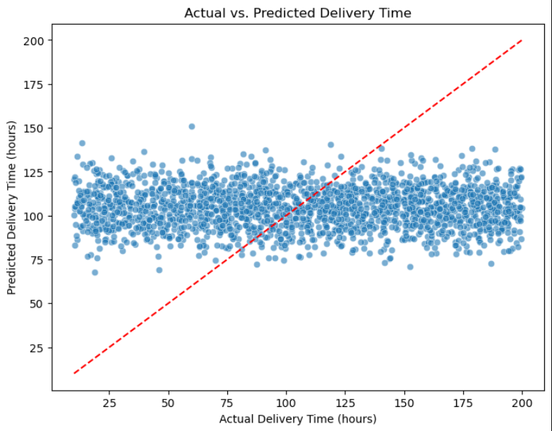
Actual vs. Predicted Delivery Time (Scatter Plot)
Helps visualize model accuracy and detect over/under-prediction, If points are close to the red diagonal line, predictions are accurate & Large deviations mean the model is over/under-predicting.

Slide 10
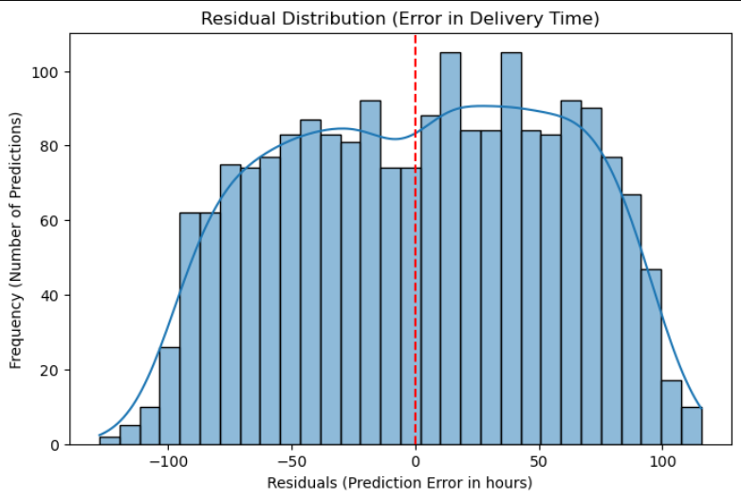
Residual Plot (Prediction Errors)
Checks if errors are randomly distributed (a good sign) or show patterns (a bad sign), If the plot was right-skewed the Model underpredicts or left-skewed the Model overpredicts.

Slide 11
Stakeholder’s Implications
Risk Management: Accurate forecasts help mitigate risks associated with fluctuating shipping rates. By anticipating rate changes, companies can better manage their exposure to market volatility.
Operational Efficiency: Forecasting enables more efficient planning of shipping routes, vessel utilization, and maintenance schedules, leading to cost savings and improved operational performance.
Strategic Planning: Long-term forecasts support strategic planning and investment decisions, helping companies allocate resources effectively and pursue growth opportunities.

Slide 12
Ethical, Legal, Social Implications
Supply and Demand: The balance between the supply of shipping capacity and the demand for shipping services is a primary driver of shipping rates. Factors such as global trade volumes, economic growth, and seasonal variations impact this balance.
Fuel Prices: Fuel costs are a significant component of shipping expenses. Changes in fuel prices directly affect shipping rates, with higher fuel costs typically leading to higher rates.
Regulatory Changes: Environmental regulations, such as those related to sulfur emissions, can influence shipping rates by increasing operational costs.
Geopolitical Events: Political instability, trade disputes, and natural disasters can disrupt shipping routes and impact shipping rates.

