Slide 1
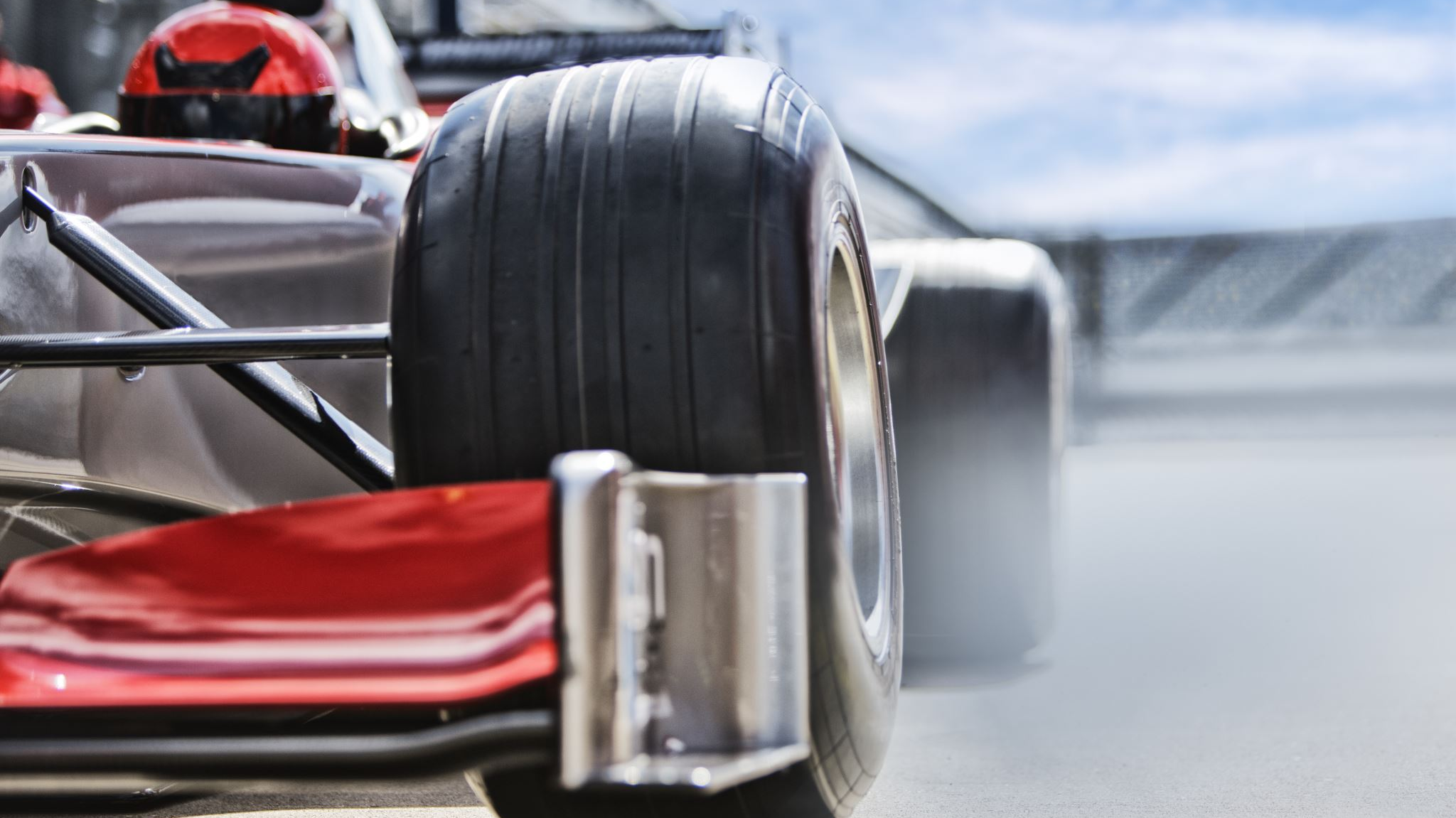
Rain or Shine: Formula 1 Analysis
Elsa Hritz

Slide 2
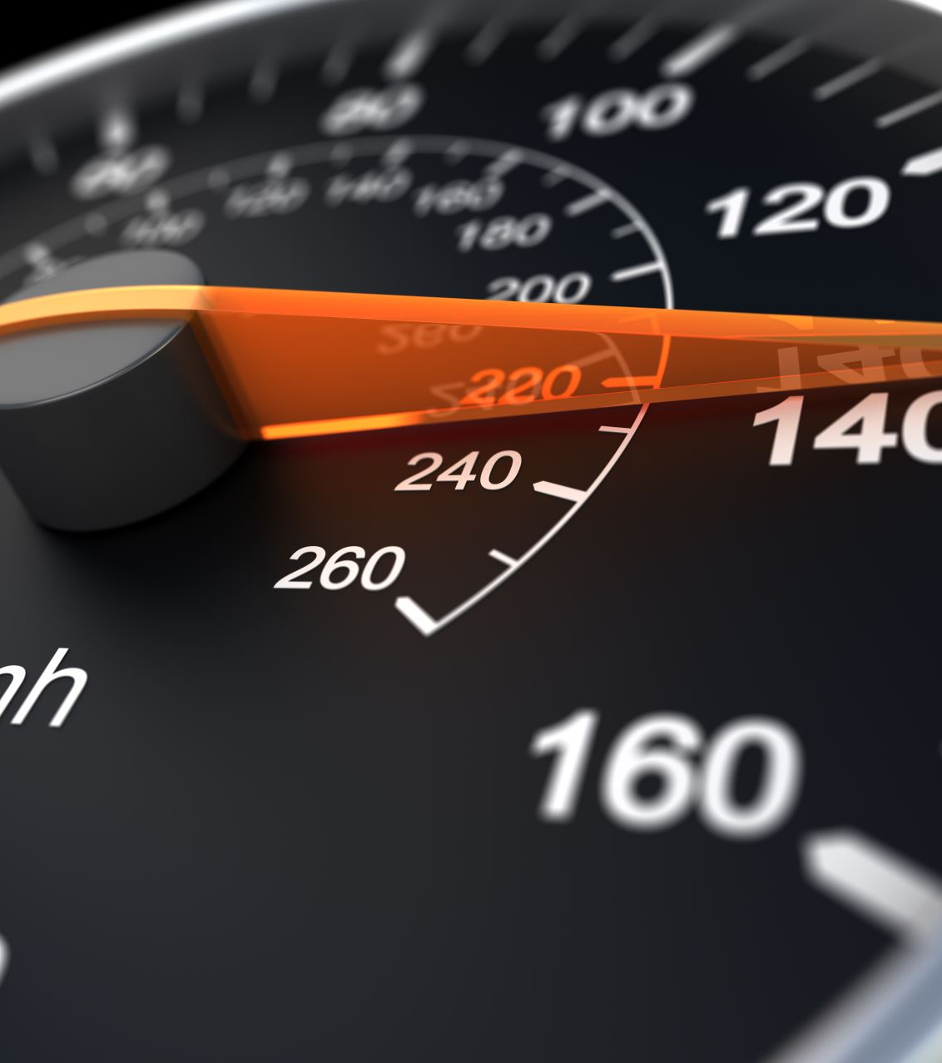
Research Question
What variables are most impactful in predicting F1 crashes and how do these parameters differ for various conditions?

Slide 3
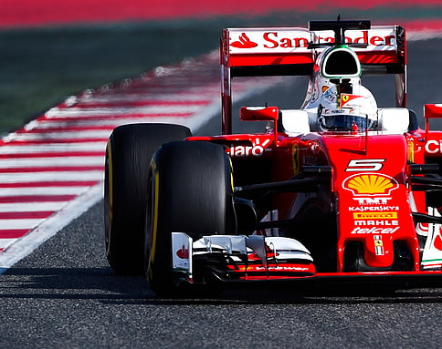
Tractable Data
The data comes from OpenF1–a large free and open-source API database.
Contains real-time and historical Formula 1 data
Data is not maintained by Formula 1
This database contains multiple data frames including: Car data, Drivers, Intervals, Laps, Location, Pit, Position, Race control, Sessions, Stints, Team radio, and Weather. This project would use columns from the Race control, Sessions, Stints, and Weather data frames.
The data is relatively clean, but each variable has a large set of categories, which may need cut down to increase model speed
Data is extensive and offers information on many different aspects of F1 races and practices

Slide 4
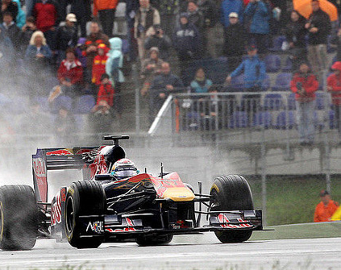
Data Retrieval
Data retrieved through many HTTP Queries
Pulled all races and practices from 2023 and 2024
Cleaning
Removed any non-impactful, high factor columns (date, flag, driver_name, …)
Removed all NA columns
Sorted data into rainy and clear
This Photo by Unknown Author is licensed under CC BY

Slide 5
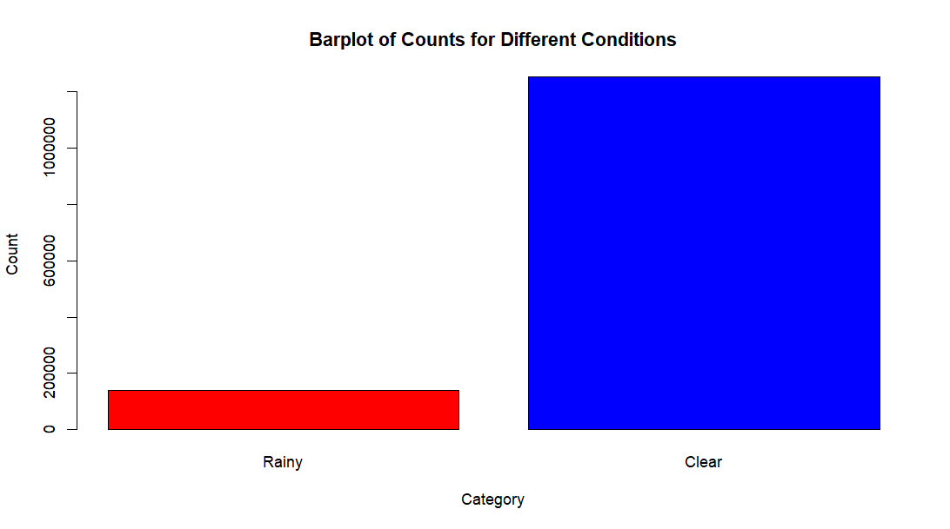
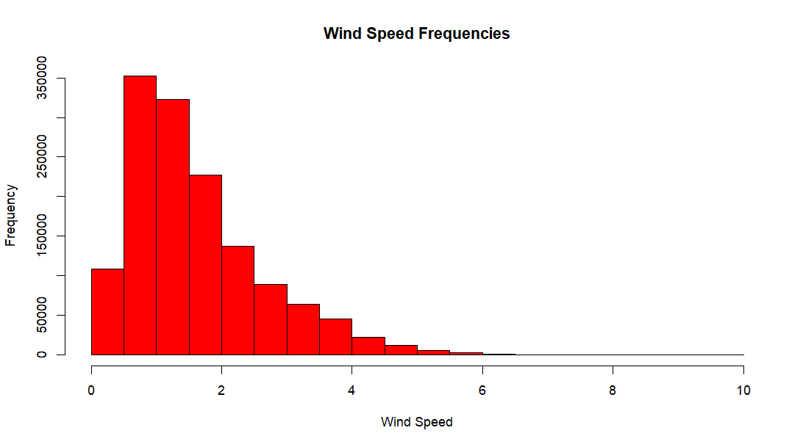
Data Exploration: Condition Analysis
Linear Classification
Clear vs Rainy Days
Potential Wind Speed Division
Hybrid resample crash and safe points due to severe imbalances

Slide 6
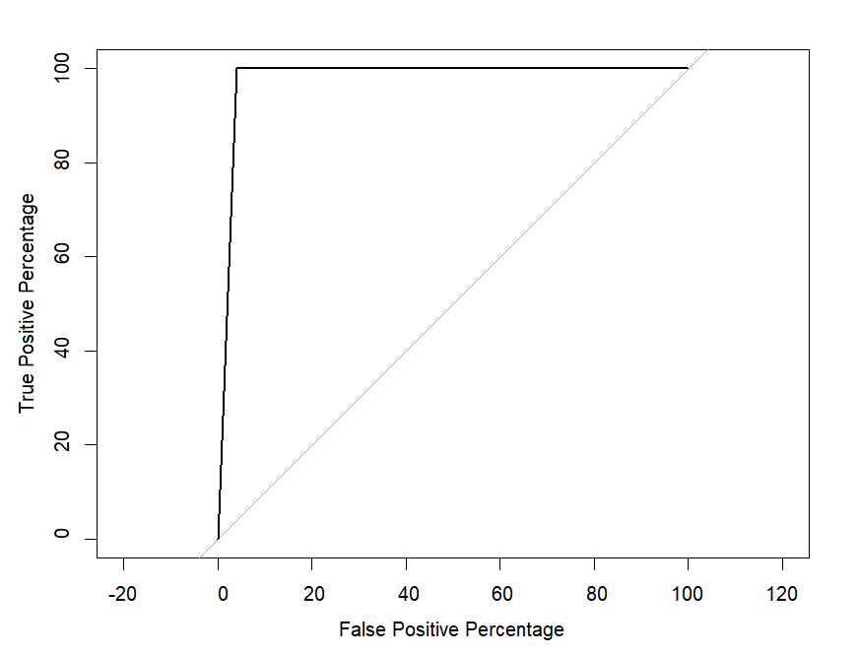
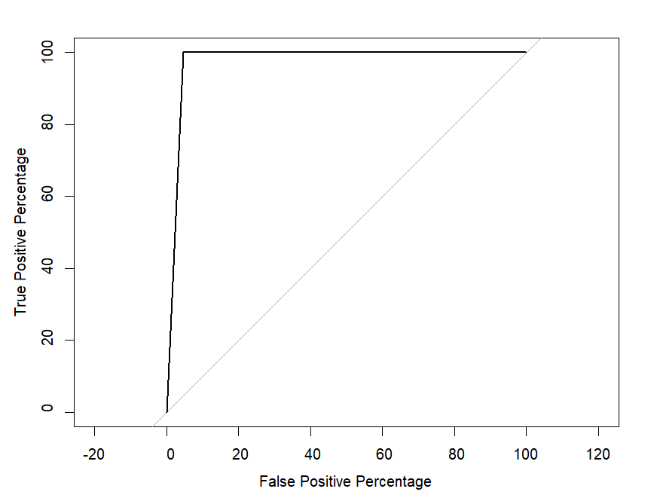
Data Exploration: Model Accuracy
Clear Day:
AUC- 97.76%
Rainy Day:
AUC- 97.61%
 | Predicted 0 | Predicted 1
True 0 | 116458 | 5453
True 1 | 0 | 57
 | Predicted 0 | Predicted 1
True 0 | 13075 | 655
True 1 | 0 | 19

Slide 7
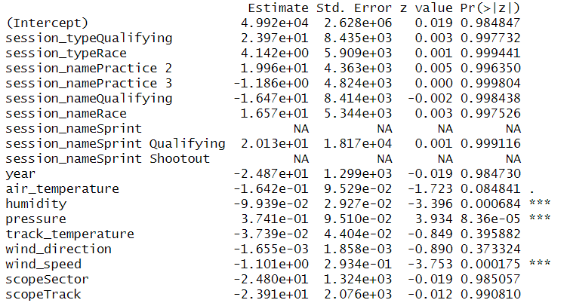
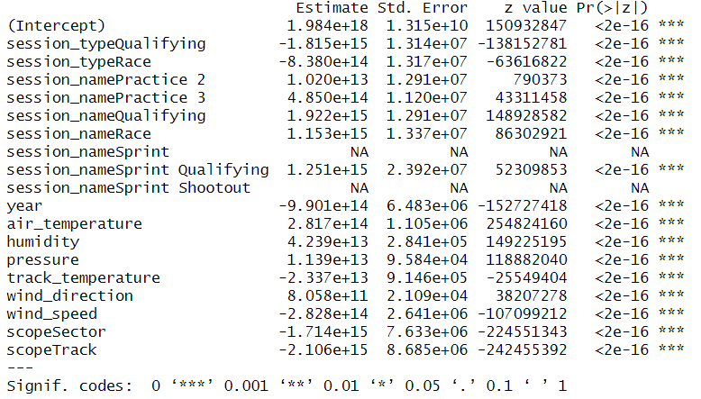
Data Exploration: Predictors Comparison
Clear
Rainy

Slide 8
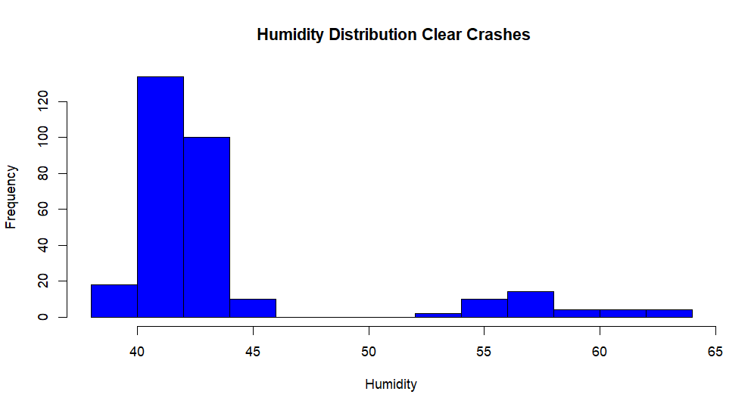
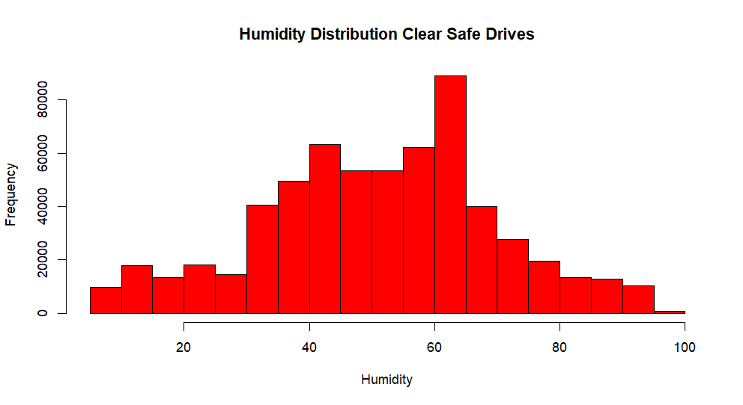
Data Exploration: Predictor Distributions
Humidity Coefficient: -9.9e-02
*note scales

Slide 9
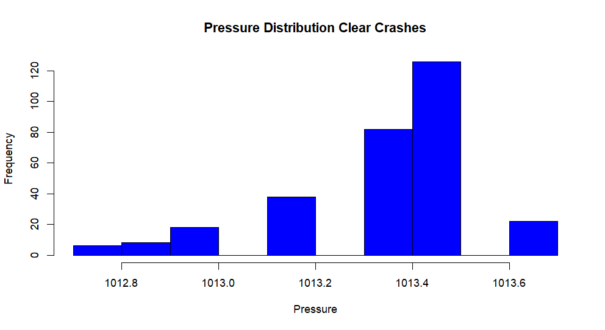
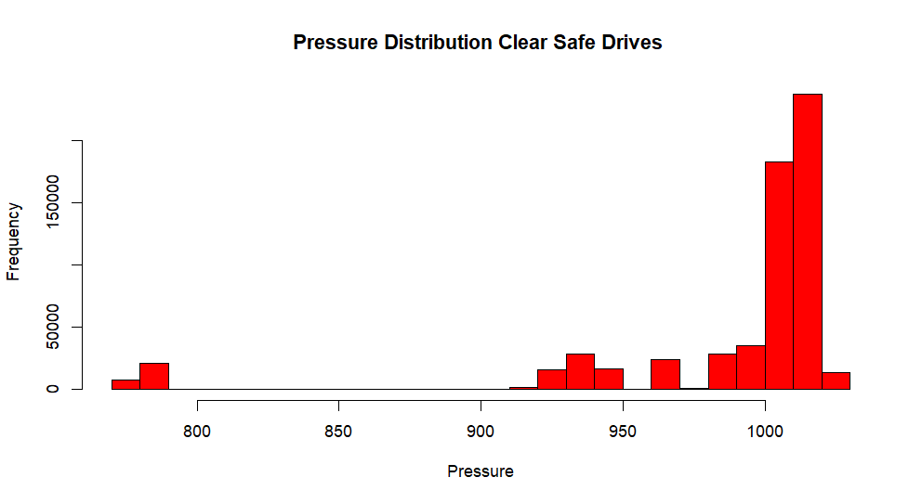
Data Exploration: Predictor Distributions
Pressure Coefficient: 3.7e -01
*note scales

Slide 10
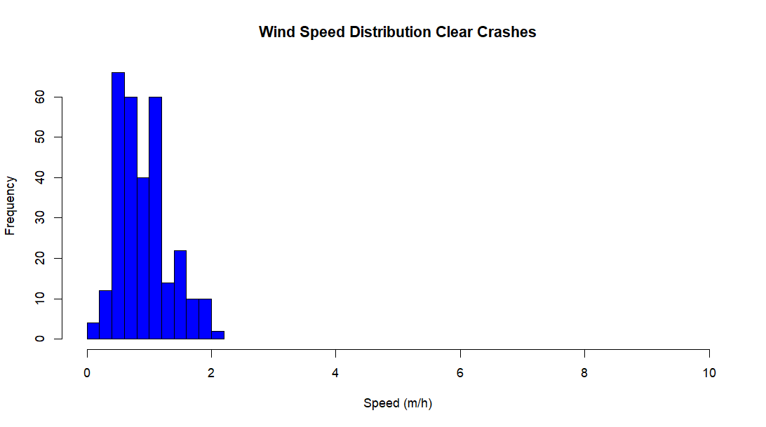
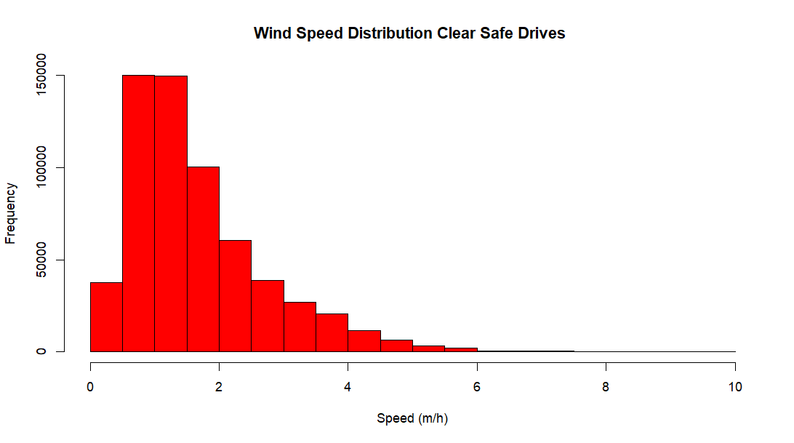
Data Exploration: Predictor Distributions
Wind Speed Coefficient: -1.1e00

Slide 11
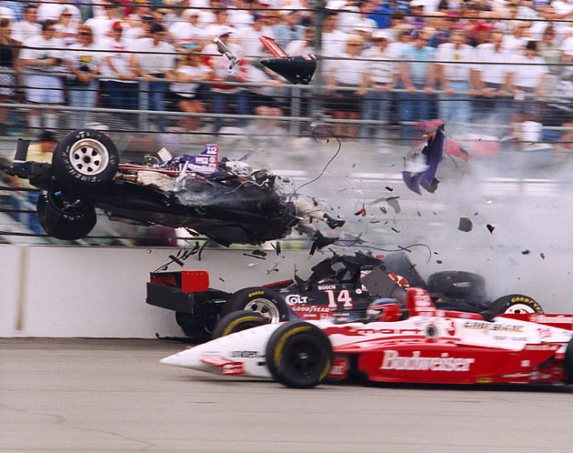
Implications for Stakeholders
Driver’s Safety and crash rate deduction
Help trainers prepare drivers for a greater variety of conditions
Mechanically improve aerodynamics for adjustments in different wind speeds/tires for various pressures and humidities
Improve overall reputation of F1
Could be implemented for sports betting

Slide 12
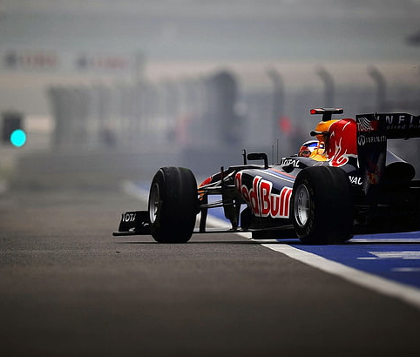
Ethical, Legal, and Societal Implications
Data not from F1—not guaranteed to be correct and could be risky to use for implementing changes
Formula 1 may not have permitted this data to be used for analysis
If used for betting purposes, it faces legal and ethical consequences
If a model predicts there will be a crash, should the race go on?

Slide 13
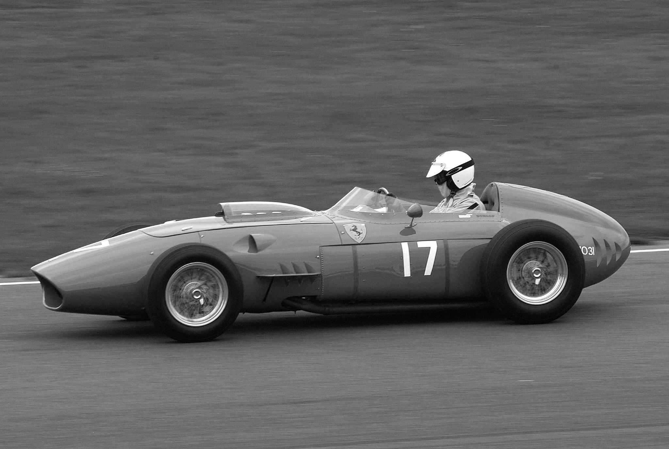
Further Analysis
I would like to evaluate and predict, not only if a crash will occur but the position and speed leading up to the crashes as well
This Photo by Unknown Author is licensed under CC BY-SA

