Slide 1
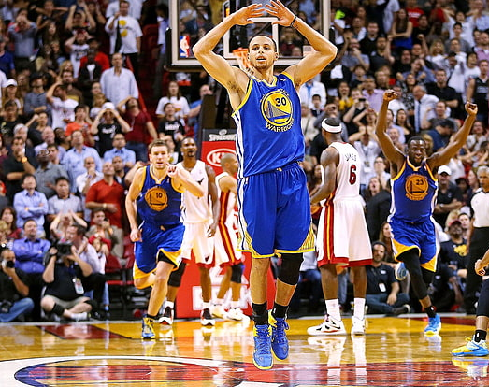
Clutch Factor Performance In The NBA
Mahim Dahal and Michael Freda

Slide 2
Research Question
Which NBA players elevate or decline in performance during clutch-time situations, and what statistics help identify them?

Slide 3
Definition Of Clutch
Clutch time is defined as: The last 5 minutes of the 4th quarter or overtime, with the score margin at 5 points or less.
This definition is used in all clutch-related endpoints of the NBA's official stats database and nba_api, including:
PlayerDashboardByClutch
TeamDashboardByClutch
LeagueDashPlayerClutch

Slide 4
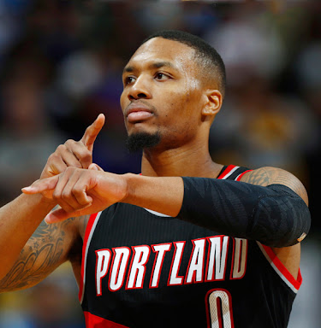
Data Sources
NBA API (python package). provides player-level box scores, clutch-time stats, and advanced metrics.
Data used:
Clutch-time player stats (via PlayerDashboardByClutch)
Regular season averages (via LeagueLeaders)
🗓️ Season: 2023–24 Regular Season
This Photo by Unknown Author is licensed under CC BY-NC-ND

Slide 5
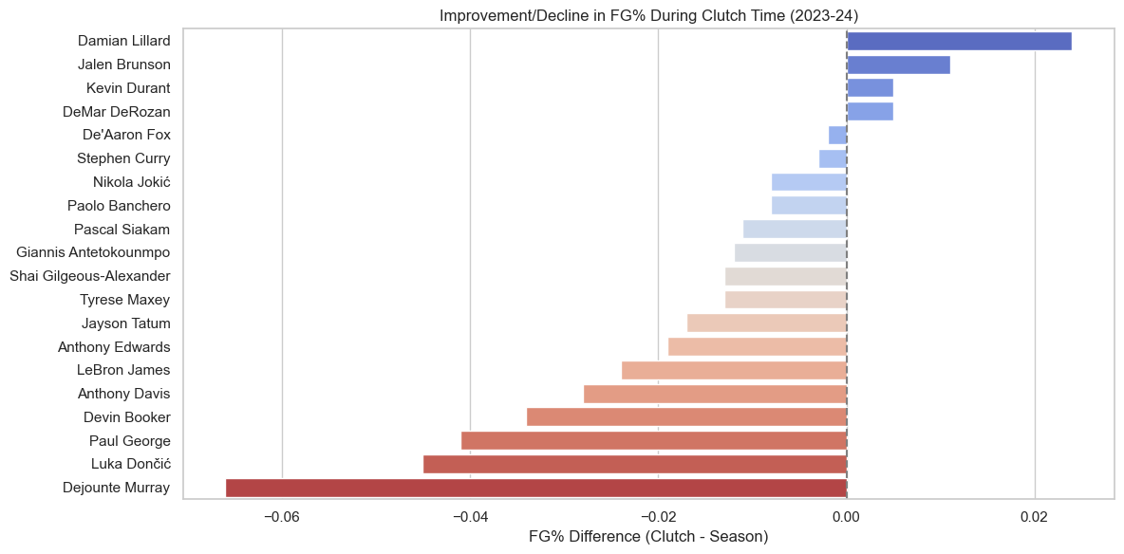
Damian Lillard leads all players with the biggest improvement in FG% in clutch situations.
Jalen Brunson, Kevin Durant, and DeMar DeRozan also perform better under pressure.
❌ Luka Dončić, Paul George, and Dejounte Murray show the largest drop-offs in clutch FG%.
⚖️ Helps identify players whose reputations may not match their actual performance in key moments.

Slide 6
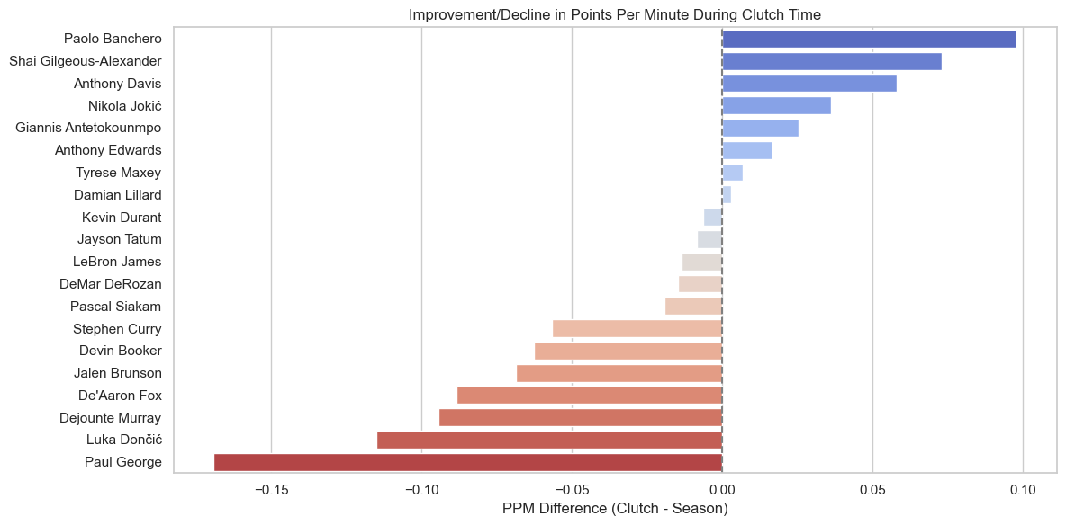
Paolo Banchero, Shai Gilgeous-Alexander, and Anthony Davis increase their scoring rate in clutch moments.
❌ Luka Dončić and Paul George again show the biggest declines — both in FG% and scoring rate.
🔁 Some players like Kevin Durant and Jayson Tatum stay relatively consistent in both metrics.

Slide 7
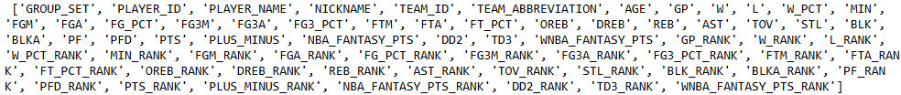
Model we plan on using
Random Forest Model
Provide important insights into which features are most important for determining what makes a player "clutch"
Works well with the selected dataset, which contains over a dozen unique statistics for a given player
Convenient to implement and tune
Unlike other models (e.g., logistic regression or SVM), Random Forest doesn't require special data preprocessing.

Slide 8
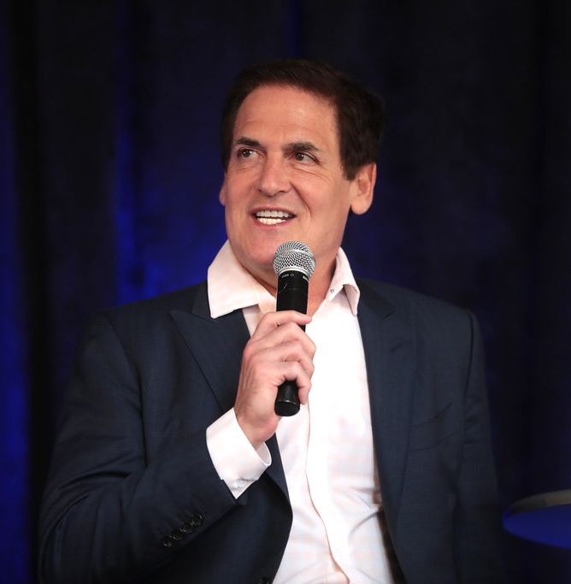
Implications For Stakeholders
🔹 For Teams & Coaches
Identify who to trust with the ball in the final minutes.
Support contract, trade, or lineup decisions with data.
🔹 For Analysts & Media
Challenge media-driven narratives with statistical evidence.
Highlight underappreciated clutch performers.
🔹 For Fans & Fantasy Players
Better understanding of which players deliver when it counts.
Data-driven basis for fan discussions and player rankings.
This Photo by Unknown Author is licensed under CC BY-SA

Slide 9
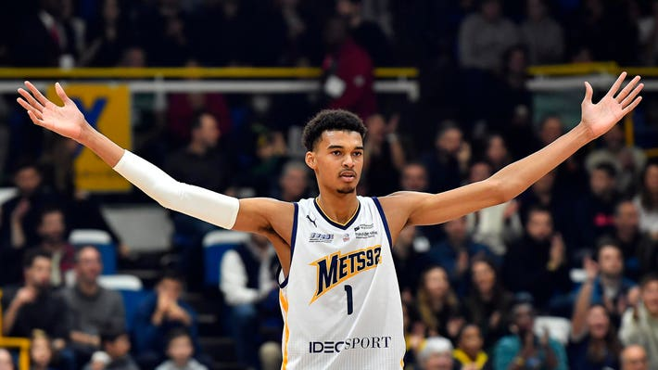
Ethical, Legal, Societal Implications
🔹 Ethical Use of Data
All data used is from public APIs and official sources.
No private or restricted information involved.
🔹 Reducing Bias
Analysis based on stats, not reputation or media coverage.
Seeks to highlight players who are overlooked by traditional narratives.
🔹 Fair Representation
Includes both stars and rising talents in the evaluation
Provides a more equitable look at performance under pressure.
This Photo by Unknown Author is licensed under CC BY-NC-ND

