Slide 1
Social Media Sentiment Analysis
Data 400
By Abhik and Amanda

Slide 2
Contents
Initial Research Idea
New Research Topic
Data set
Exploratory Data Analysis
Next steps

Slide 3
Initial Project Idea
Topic: The True Cost of Fast Food: Is It Actually Affordable?
Main Question: Are fast food prices increasing faster than inflation and wages?
Task: Conduct time series analysis and compare price growth to income trends.
Problem: No historical data regarding menu prices

Slide 4
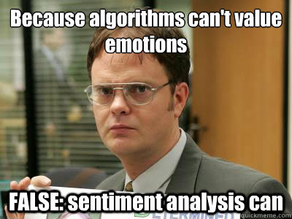
2. Research Topic
Topic: Social Media Sentiment Analysis
Objective: Finding out people’s feeling about a brand or product at scale
Task: Conduct sentiment analysis through models like Naive Bayes Classifier, Logistic Regression, Random Forest, and Passive Aggressive Classifier

Slide 5
3. Data set
The data set is from kaggle and contains 732 records and includes the following columns:
Text: Content of social media posts. Sentiment: Sentiment classification of the text (Positive, Negative, Neutral). Timestamp: Date and time when the post was made. User: Username or identifier of the poster. Platform: Social media platform used (e.g., Twitter, Instagram, Facebook). Hashtags: Hashtags included in the posts. Retweets: Number of retweets the post received. Likes: Number of likes the post received. Country: Country associated with the post. Year, Month, Day, Hour: Time-related columns extracted from the timestamp for analysis.

Slide 6
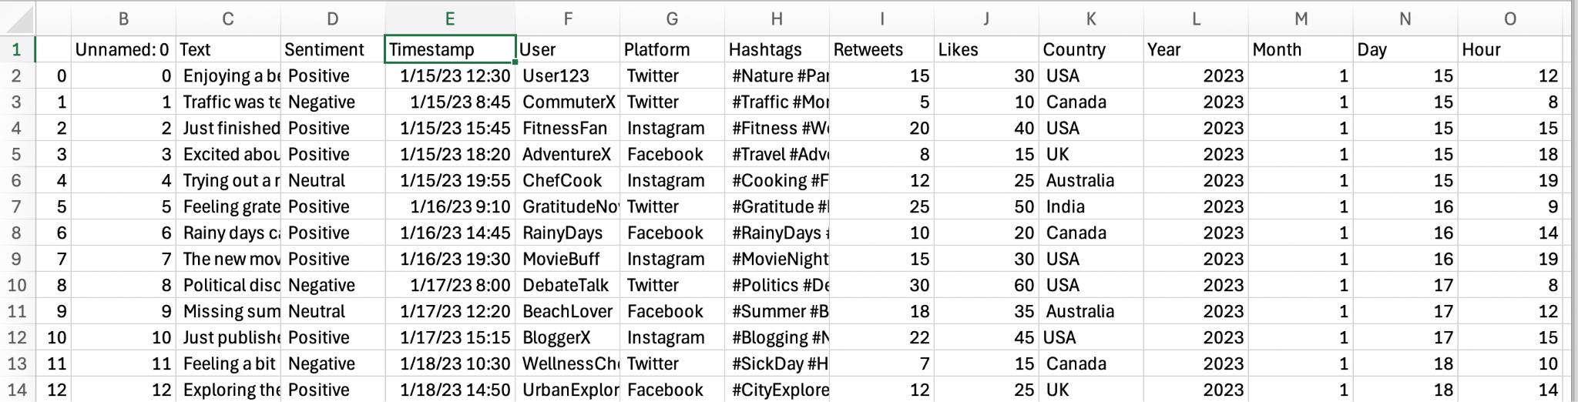

Slide 7
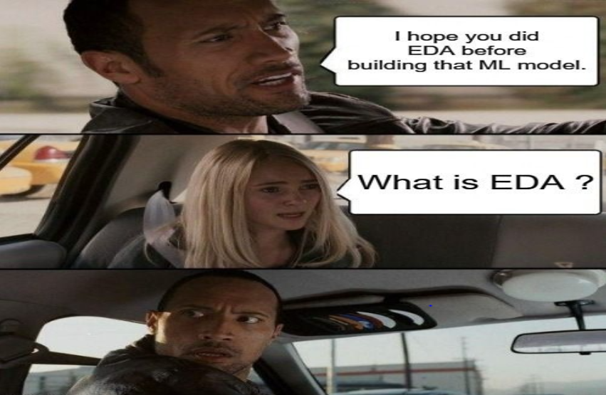
4. Exploratory Data Analysis
yay

Slide 8
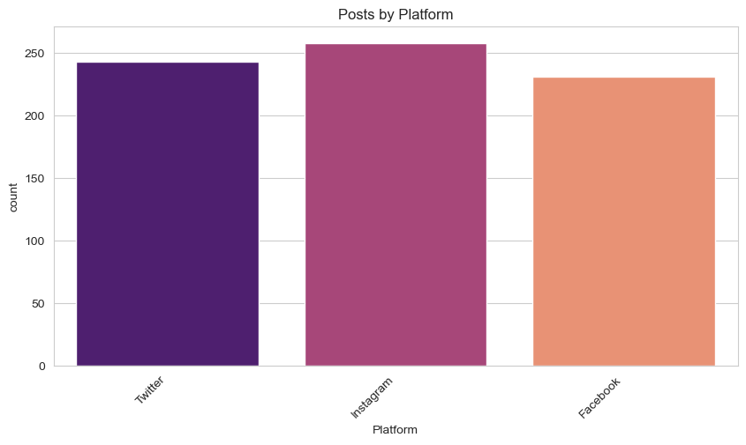
Number of Posts by Platform
Instagram has the most posts from this data set.
Twitter has second most, then Facebook.
All around the same amount.

Slide 9
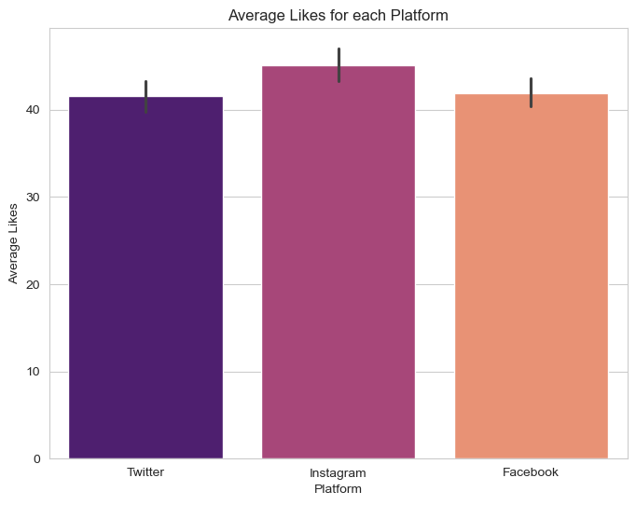
Average Likes for each Platform
Very similar to last graph with instagram leading.
Facebook is higher than twitter in likes.

Slide 10
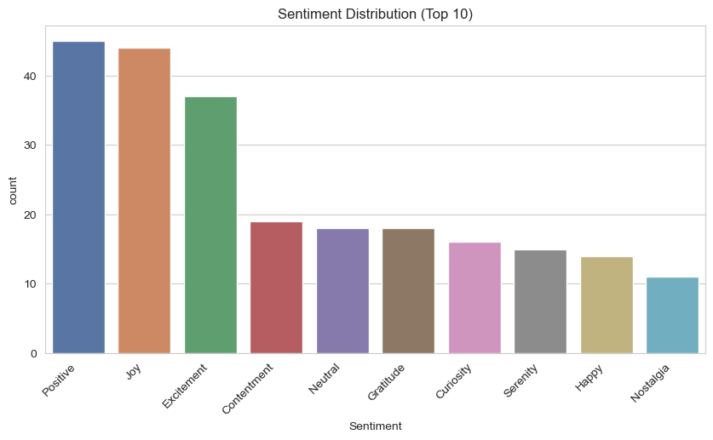
Top 10 Sentiment Distribution
Top Ten: Positive, Joy, Excitement, Contentment, Neutral, Gratitude, Curiosity, Serenity, Happy, Nostalgia

Slide 11
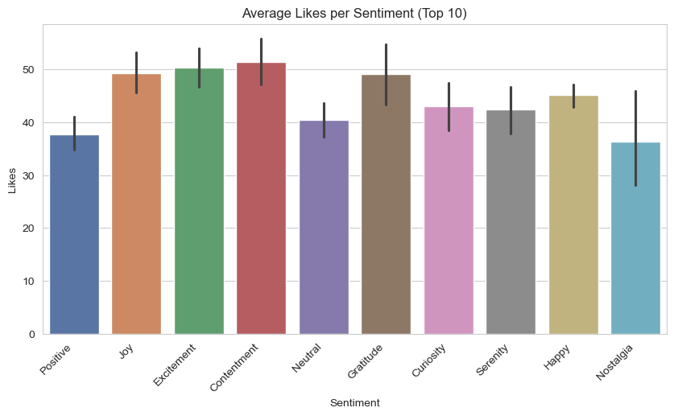
Average Likes per Sentiment
Positive is the top sentiment yet has the lowest likes among the top ten.
Contentment has the highest average likes per sentiment.

Slide 12
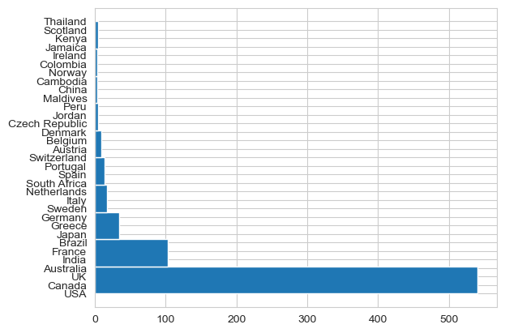
Data Collected: Countries
Most of the data comes from:
USA
Canada
UK
Australia
India

Slide 13
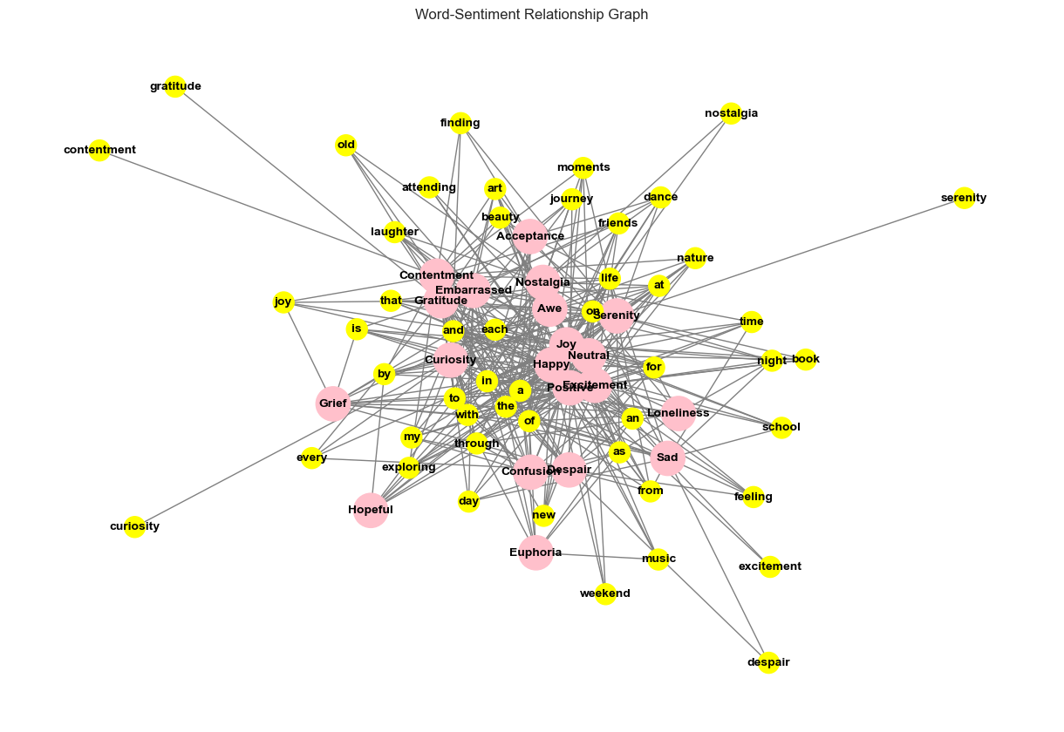
Sentiment to Word Relationship
Pink → Top 20 Sentiments
Yellow → Top 50 frequently used words
Some close connections: new + confusion and despair, laughter + contentment and embarrassed, school + sad and loneliness (haha)

Slide 14

5. Next Steps
Use machine learning models to train and identify patterns
learn to identify and classify the emotional tone or sentiment (positive, negative, or neutral) expressed in a piece of text
Can be used by corporations to understand the sentiment of people using their product/service

Slide 15
Thanks!

