Slide 1
What Actually Drives the Price at the Pump?
Modeling Speed, Asymmetry, and Regional Disparity
in U.S. Fuel Markets
Data Analytics — Progress Presentation
March 2026

Slide 2
Why This Matters
The Problem:
• Americans pay an average of $3.50+ per gallon — a non-discretionary cost for 150+ million daily commuters with no alternative.
• ~50% of the pump price is determined by global crude oil markets — completely outside the consumer's control.
• Gas prices rise ~3x faster than they fall — the "Rockets and Feathers" effect. Stations raise prices like rockets when crude goes up, but lower them like feathers when it drops.
• This asymmetry costs a typical household an estimated $50–150/year in excess fuel spending during volatile periods.
• Low-income households spend 8–10% of income on fuel (vs. 2–3% for high-income) and cannot defer purchases, switch to EVs, or access public transit.
What This Project Does:
Using 26 years of weekly U.S. fuel market data from public APIs (EIA + FRED), this project:
1. Measures whether the rockets-and-feathers asymmetry is real and quantifies how large it is
2. Maps which U.S. regions (PADD districts) are most vulnerable to price shocks
3. Builds predictive models to forecast next-week gas price movements from supply chain signals
Sources: EIA Open Data API, FRED API | Bacon (1991) — rockets-and-feathers literature

Slide 3
Research Questions
Q1
Speed & Asymmetry
Do gas prices rise faster than they fall? How many weeks does it take for a crude oil change to reach the pump — and is that lag different for increases vs. decreases?
Q2
Regional Disparity
Which U.S. regions are most vulnerable to price shocks? Do some PADD districts face consistently higher markups or faster pass-through?
Q3
Predictive Power
Can a model using crude oil prices, refinery utilization, inventory levels, and futures data outperform a naive baseline in forecasting next-week's retail gas price?

Slide 4
Data Sources & Pipeline
3 free, public API sources — 12 data series — merged into 1 master dataset
EIA API
FRED API
Engineered
Retail gas prices (5 regions)
Spot/wholesale prices
Refinery utilization
Gasoline inventory
Crude oil futures
WTI & Brent crude oil
USD exchange rate
CPI / Inflation
Consumer sentiment
Federal funds rate
Crack spread (margin)
Week-over-week changes
Rolling averages
Seasonal indicators
Prediction targets
5 datasets
7 series
15+ features
All data is weekly frequency, covering 2000–2026 (~1,300 weeks)

Slide 5
Processing Pipeline: Step by Step
1
→
2
→
3
→
4
→
5
EXTRACT
VALIDATE
CLEAN
ALIGN
MERGE
Pull data from
2 APIs via Python
Audit for quality
issues & anomalies
Fix issues and
standardize data
Resample to
weekly (Monday)
Join all sources
into one dataset
EIA API → 5 datasets
FRED API → 7 series
All saved as raw CSVs
Null detection: 10.3%
Negative filter: 6,531
Type casting fixes
Forward-fill gaps
Filter invalid ranges
Convert all to numeric
Daily → weekly mean
Monthly → forward-fill
All on same time axis
Left-join on date index
Handle column overlaps
~1,300 weeks × 30+ cols

Slide 6
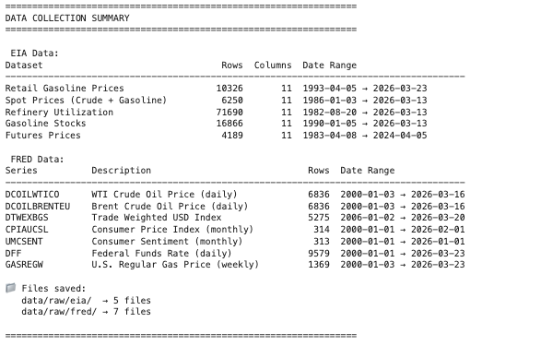
Data Extract.
[ INSERT: P2_crude_vs_retail.png from your outputs/ folder ]

Slide 7
Data Validation: Issues Found in Raw Data
Before any analysis, we audited all 12 raw datasets for quality problems:
Refinery Utilization: 10.3% Null Values
EIA API: Type Mismatch Error
Problem: 7,372 rows had missing values — some PADD regions don't report every week, plus gaps during holidays and reporting delays.
Problem: API returned pagination metadata ("total" field) as a string instead of integer, breaking our loop comparison.
Fix: Forward-filled gaps up to 4 weeks. Dropped rows beyond that threshold to avoid fabricating data.
Fix: Cast all API response metadata to int() before comparison. Documented as a known EIA API v2 quirk.
Refinery Utilization: 6,531 Negative Values
Mixed Frequencies Across Sources
Problem: API returned mixed data: actual utilization rates (0–100%) AND week-over-week changes (which can be negative).
Problem: EIA data was weekly, FRED had daily, weekly, and monthly series — cannot merge directly without alignment.
Fix: Filtered to keep only values between 0–105% (valid utilization). Separated change series for separate analysis.
Fix: Resampled all series to Monday-weekly frequency: daily → weekly mean, monthly → forward-fill into weeks.

Slide 8
Data Cleaning: Before vs. After
BEFORE (Raw Data)
AFTER (Clean Dataset)
✗
12 separate files
✓
1 unified master dataset
5 EIA CSVs + 7 FRED CSVs, different formats
Single CSV with all variables aligned
✗
Mixed frequencies
✓
Weekly (Monday) frequency
Daily, weekly, and monthly data mixed together
All series resampled and aligned consistently
✗
~7,400 null values
✓
< 2% missing data
10.3% of refinery data missing
Forward-filled small gaps, dropped long ones
✗
~6,500 invalid rows
✓
All values validated
Negative values in utilization data
Filtered to valid ranges, types corrected
✗
String type errors
✓
Robust pipeline code
API metadata returned as text, not numbers
API bugs fixed, error handling added
✗
No derived features
✓
15+ engineered features
Raw prices only, no margins or changes
Crack spread, changes, MAs, seasonal flags

Slide 9
Feature Engineering
Derived variables created from the raw data to support analysis and modeling:
Crack Spread
Rolling Averages
Spot gasoline price minus crude oil
cost per gallon — measures refinery
profit margin
4-week and 12-week moving averages
of retail price — smooths noise and
reveals trends
Price Changes
Seasonal Flags
Week-over-week dollar and percent
changes for retail gas, crude oil,
and wholesale gasoline
Month, quarter, and summer blend
season indicator (March–September)
for seasonal patterns

Slide 10
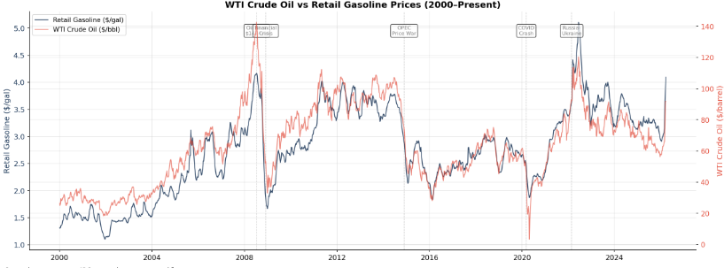
Initial Findings: Crude Oil vs Retail Gas
Crude oil and retail gasoline prices track closely, but with visible lags during major events
(COVID crash, Ukraine invasion). Quantifying this lag is a core research question.

Slide 11
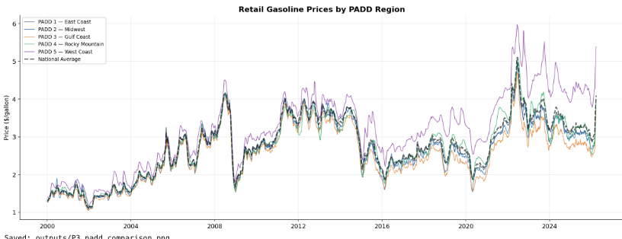
Initial Findings: Regional Price Disparities
West Coast (PADD 5) consistently pays the highest prices due to stricter fuel formulations and
limited pipeline access. Gulf Coast (PADD 3) benefits from proximity to refineries.

Slide 12
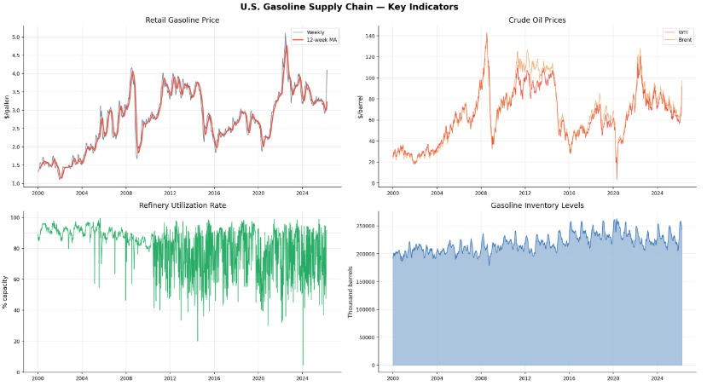
Supply Chain Overview
[ INSERT: P6_supply_chain_dashboard.png from your outputs/ folder ]
Four-panel view: retail gas price with moving averages, crude oil benchmarks (WTI vs Brent),
refinery utilization rate, and gasoline inventory levels — the complete supply chain picture.

Slide 13
Ethical Implications: Consumer Impact
Rockets & Feathers: Who Pays?
Disproportionate Burden on Low-Income
When crude oil rises $10, gas stations raise pump prices within days. When crude drops $10, they lower prices over weeks. This asymmetry means consumers systematically overpay during volatile periods. Over a year of normal price swings, this "slow-drop" effect can cost a typical household an estimated $50–150 in excess fuel costs.
Low-income households spend 8–10% of income on transportation fuel vs. 2–3% for high-income households. They cannot defer purchases, switch to electric vehicles, or use public transit in most U.S. regions. Every penny of asymmetric pricing represents a regressive wealth transfer from those least able to absorb it.
Information Asymmetry
Oil companies and fuel traders have real-time access to crude prices, inventory data, and futures markets. Consumers see only the number on the pump. If our model can predict price movements from public data, it demonstrates that the information exists to empower consumers — it's just not accessible in a useful format. This raises questions about whether pricing transparency tools should be a public good.

Slide 14
Societal Implications: Who Is Affected?
Rural Communities
Regional Economies
No public transit alternatives. Longer commutes to jobs, hospitals, and schools. Fuel costs are inescapable — price spikes directly reduce disposable income for essentials like food and healthcare.
PADD regions with structural price disadvantages (fewer refineries, limited pipelines) face a persistent economic drag. Higher fuel costs raise prices for all local goods and services — a hidden tax on geography.
Small Businesses
Environmental Justice
Delivery companies, trucking firms, and local retailers absorb fuel costs in their margins. Rapid price spikes can't be passed to customers fast enough, creating cash flow crises for the smallest operators.
Communities near refineries bear pollution costs but don't necessarily benefit from lower prices. Price shocks may delay the transition to cleaner energy by making fossil fuel dependency feel inescapable.

Slide 15
Implications for Stakeholders
Stakeholder | What This Project Means for Them | Potential Action
Consumers | Better understanding of pricing patterns enables smarter purchasing decisions — knowing when prices are likely to drop can save money on fill-ups | Public-facing price prediction tools, fuel timing apps
Policymakers | Evidence of systematic asymmetry supports case for stronger consumer protection in energy markets and targeted support for vulnerable regions | Price monitoring, targeted subsidies, infrastructure investment
Regulators (FTC/DOE) | Regional disparity data highlights areas where market concentration may be harming consumers — provides data-driven basis for enforcement priorities | Market concentration reviews, refinery capacity planning
Industry | Transparency pressure — if pricing patterns are publicly documented, it incentivizes more competitive and responsive pricing behavior | Voluntary price adjustment guidelines, industry self-regulation
Researchers | Methodological framework for studying price transmission in other commodity markets (natural gas, electricity, food supply chains) | Replicable pipeline, open data, published methodology
Limitations: This model captures historical correlations, not causal mechanisms. Results should not be used for
individual trading decisions. All findings should be presented with appropriate uncertainty quantification.

