Slide 1

Data Capstone Progress Presentation
David Whitmer
Ben Fox

Slide 2
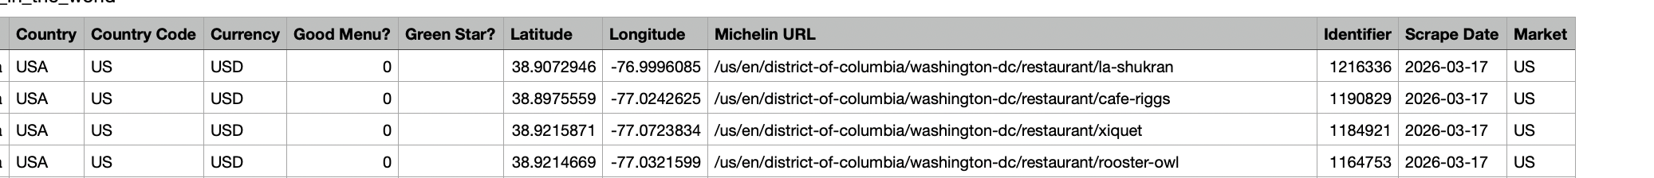
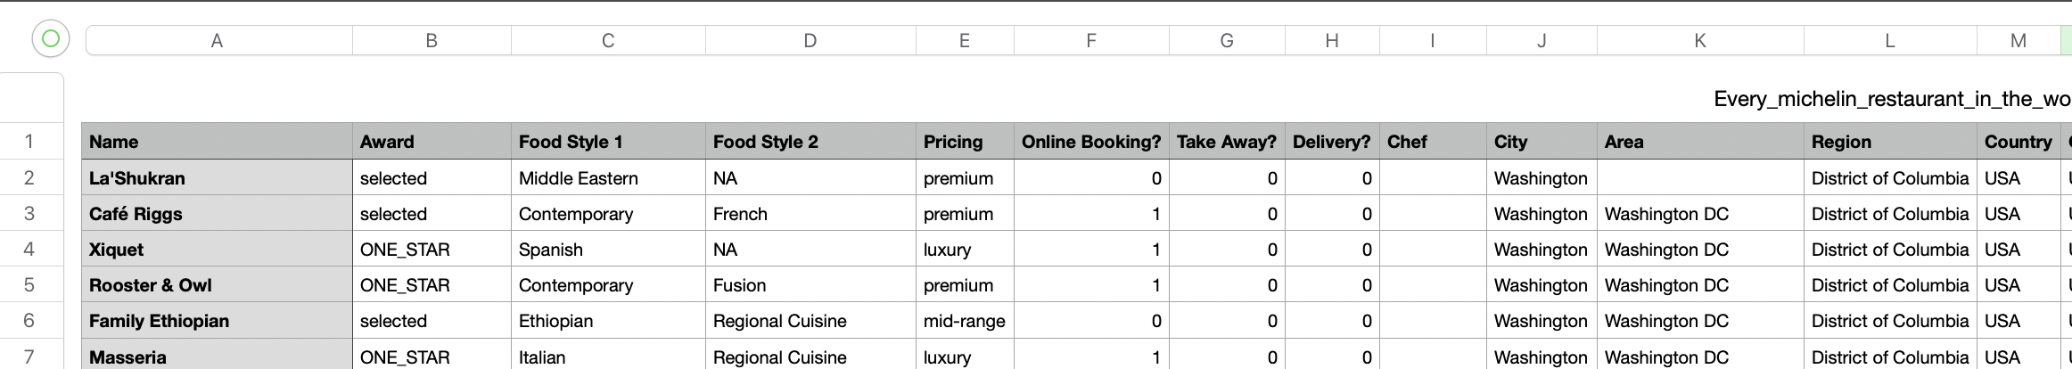
Data Collection

Slide 3

Research Roadblock
Historical Michelin data cannot be scraped — the pages we need do not exist in any accessible archive.
Wayback Machine coverage is too sparse to reconstruct a meaningful time series.
Original Thesis: Were Michelin stars being inflated over time, outpacing restaurant industry growth?

Slide 4

Blog

Slide 5
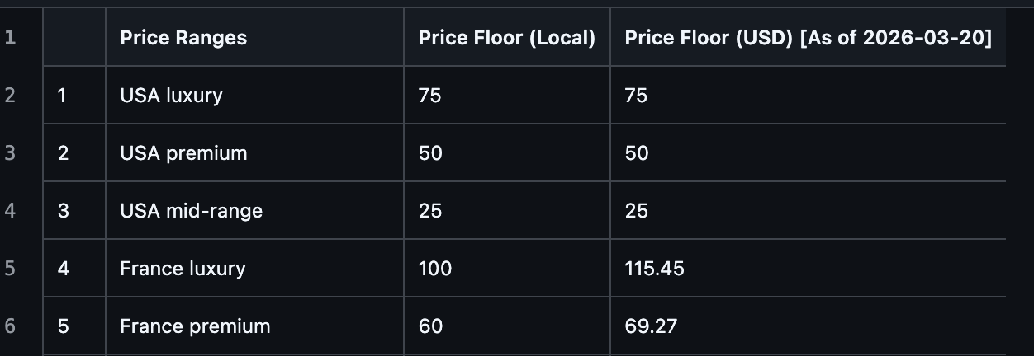

Dataset Enrichment

Slide 6
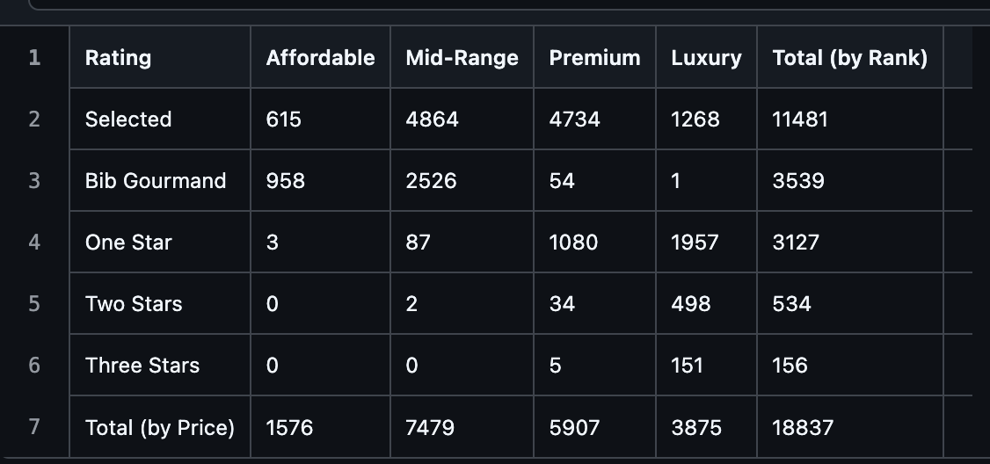
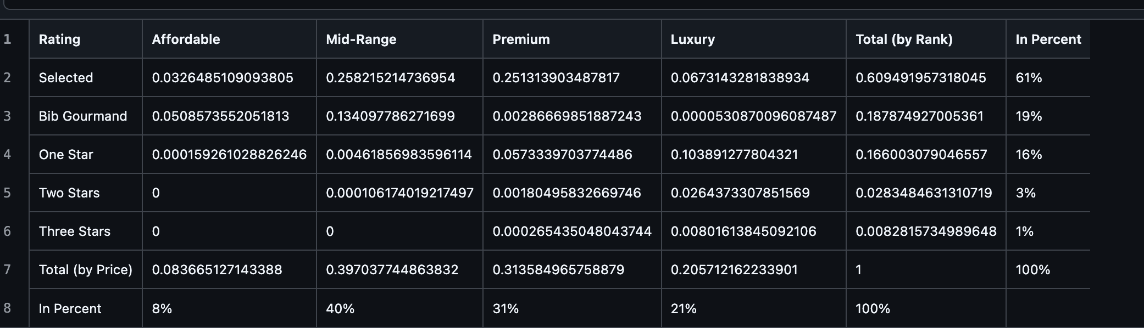
Initial Data Analysis

Slide 7
Pivot: Cross-Sectional Analysis
Approach
Shifting from trend analysis to a cross-sectional study using the 2026 dataset: 18,000 rows, globally complete, no missing values
Research Question
Are Michelin stars efficiently allocated across global markets, given economic, geographic, and market constraints?
Method
Negative binomial regression (count outcome) to generate predicted star counts per country; define a Star Allocation Residual (actual − predicted)
Visualizations
D3.js interactive bubble map: countries sized by star count, colored by residual, with city-level drill-down
Regression diagnostics and a Lorenz curve showing global star concentration

Slide 8
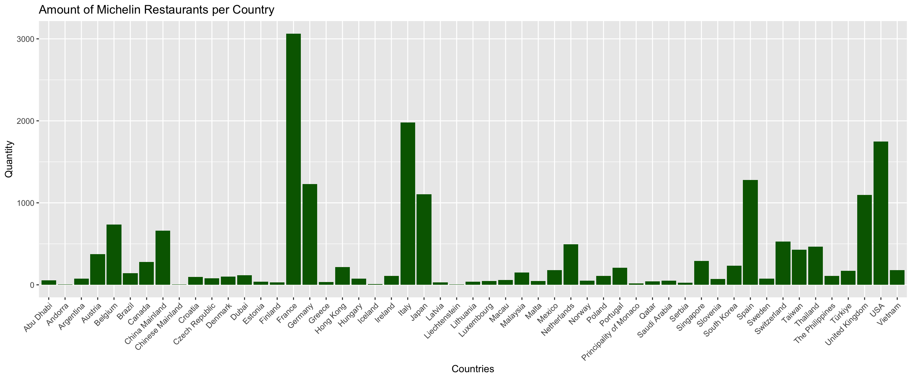
Some More Data Analysis

Slide 9
Building the Country-Level Dataset
Merging four external variables into a country-level dataset:
GDP per capita — World Bank
Restaurant / fine dining counts — OECD Structural Business Statistics
Inbound tourism arrivals — UNWTO
Urbanization rate — UN World Urbanization Prospects

Slide 10
Data Harmonization Challenges
Monaco, Andorra, Liechtenstein — tiny microstates often excluded from World Bank/OECD/UNWTO datasets or merged with neighboring countries
Hong Kong, Macau — listed separately in Michelin but aggregated under China in most economic databases; World Bank does track them separately
Abu Dhabi, Dubai — emirates, not sovereign countries; map both to UAE as the country code
Taiwan — politically contested; absent from World Bank, but trackable via IMF and some OECD sources under "Chinese Taipei"
China Mainland / Chinese Mainland — duplicate entries in your dataset, treat as one

Slide 11
External Data Sources & Workarounds
World Bank — GDP per capita
Bulk CSV download: data.worldbank.org/indicator/NY.GDP.PCAP.CD
Edge cases: HK and Macau have own World Bank entries; Taiwan not listed — use IMF WEO database instead
OECD — Restaurant / food service counts
OECD Structural Business Statistics — filter by ISIC code I56 (food and beverage service activities)
Caveat: OECD covers member states only; non-members (Singapore, UAE, China, etc.) require national statistics offices or World Bank proxies
UNWTO — Inbound tourism arrivals
UNWTO compendium download covers most countries; if paywalled, identical data available via World Bank (indicator: ST.INT.ARVL)
UN World Urbanization Prospects — Urbanization rate
population.un.org/wup/downloads — file: "Urban population as % of total"; covers all countries including microstates and Taiwan

Slide 12
Thank You
What we’ve done
Scraped and cleaned 18,000-row global Michelin dataset (2026)
Enriched with price-floor and currency conversion data
Pivoted research question and identified the right methodology
What’s next
Merge in external datasets (World Bank, OECD, UNWTO, UN)
Run negative binomial regression; compute Star Allocation Residuals
Build D3.js interactive map and Lorenz curve visualizations

