Slide 1
DEMO

Slide 2
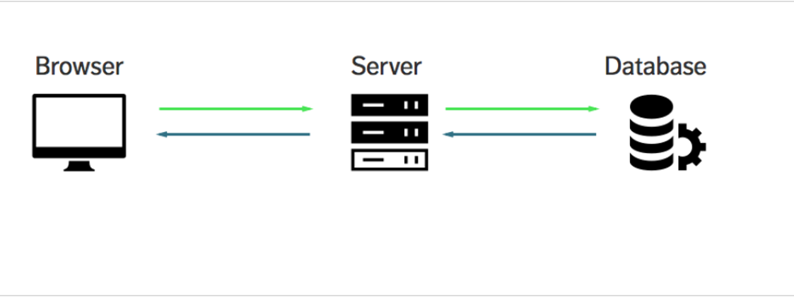
Demo
Built a 3-tier application with NodeJS Mongo and ICP

Slide 3








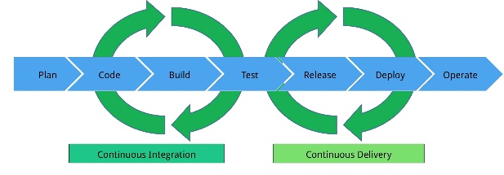
Continuous integration vs. continuous delivery vs. continuous deployment
3
5
7
8
Infrastructure Toolchain
1
2
Remote Desktop
4
IBM Prod
helm
Notify
Push
Changes
Auto
Push
Code/config change
6
Development
Pull

Slide 4
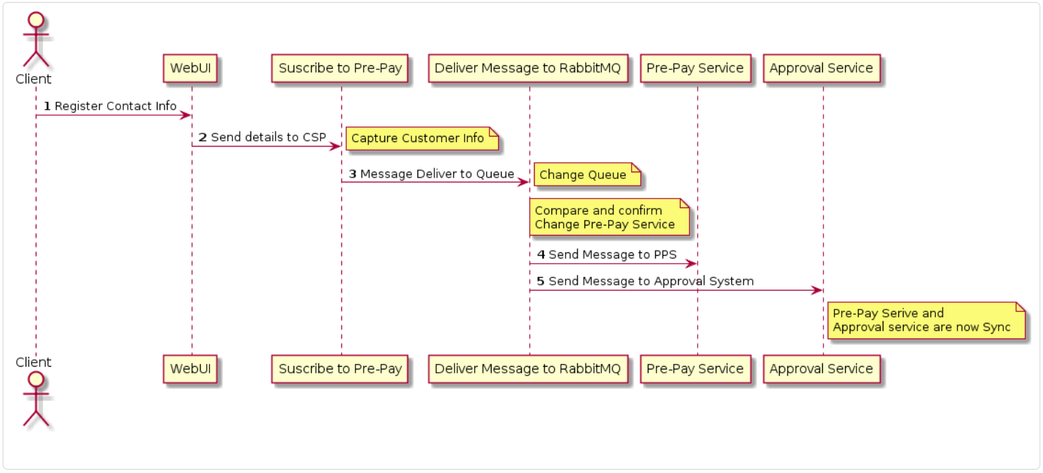
Demo
Client Register Pre-Pay Service

Slide 5
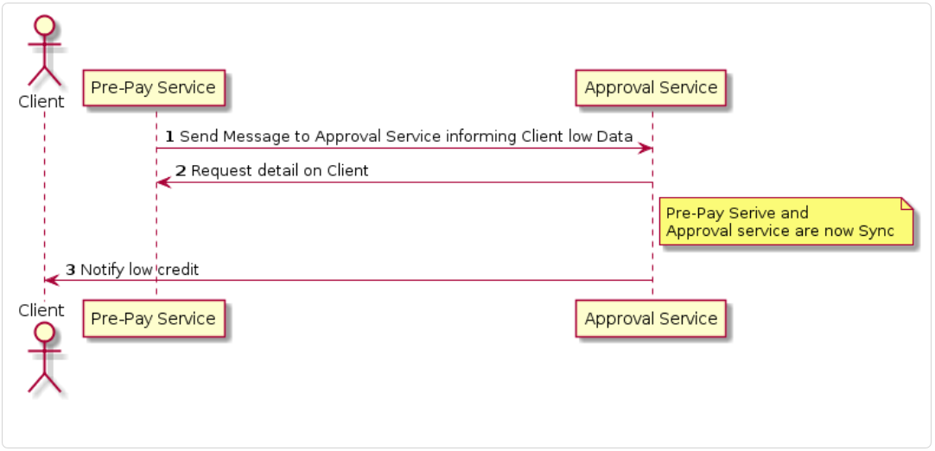
Demo
Pre-Pay Service Notify Client low credit

Slide 6
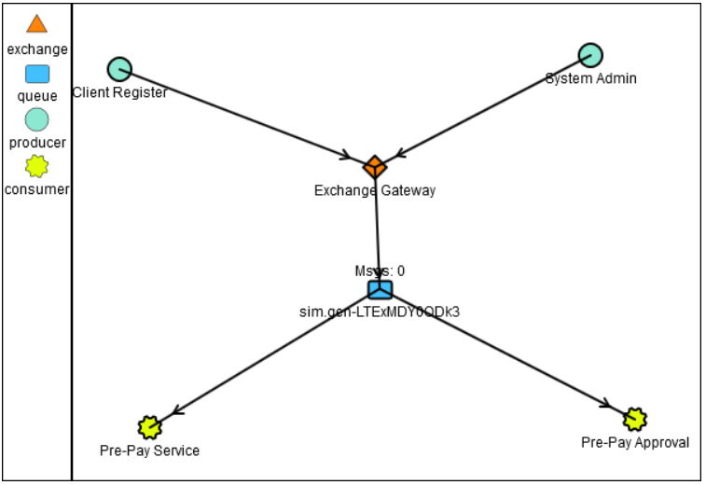
Demo
AMQP Sending message

Slide 7
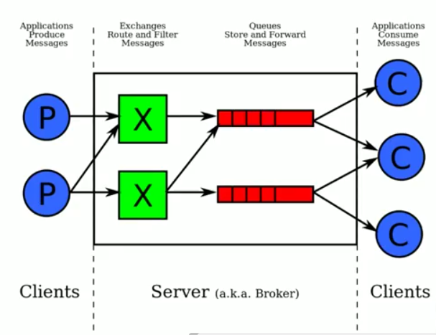
Demo
AMQP Sending message

Slide 8
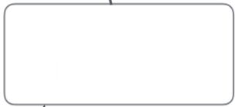



Full scenario
Client Registration
Service Admin
Middleware
Pre-pay Service
Approval Service
8
Notes:
https://en.wikipedia.org/wiki/Non-functional_requirement

