Slide 1
Scrubless
Stop scrubbing. Start searching.
Chukwuebuka Ernest-Opara — getscrubless.com

Slide 2
The problem
Video is the one medium you still can’t search.
500+ hours are uploaded to YouTube every minute — and that’s one platform.
Inside any single video, finding a moment means scrubbing: linear, manual, slow.
Ctrl+F solved this for text 40 years ago. There’s still none for video.
Editors lose up to a third of post-production
just finding the right footage — before a single cut.

Slide 3
The solution
Scrubless is Ctrl+F for video.
Upload a video — or point Scrubless at a whole folder of them.
Search in plain English: “the part where someone is laughing.”
Click a result and the player jumps to that exact second.
It searches what’s shown and what’s said — not just captions.

Slide 4
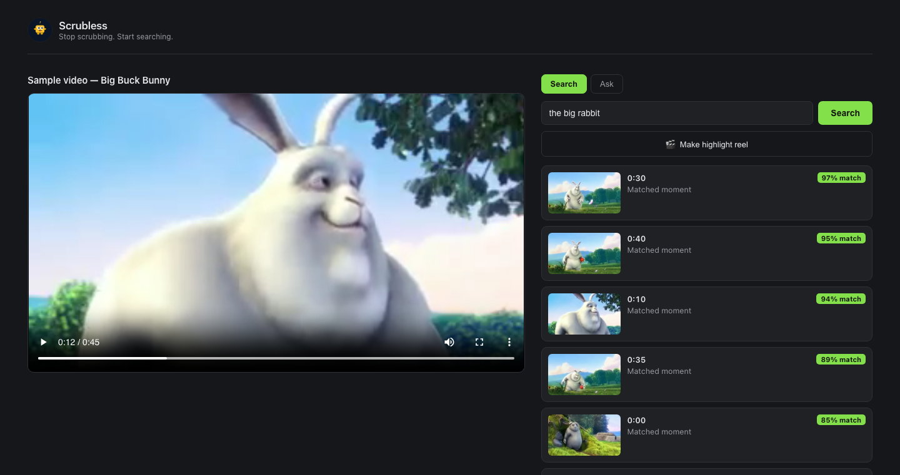
Live today — and it works
Real search on getscrubless.com: “the big rabbit” → ranked moments with match scores; click one, the player jumps to that second. Shipped to production — not a prototype.

Slide 5
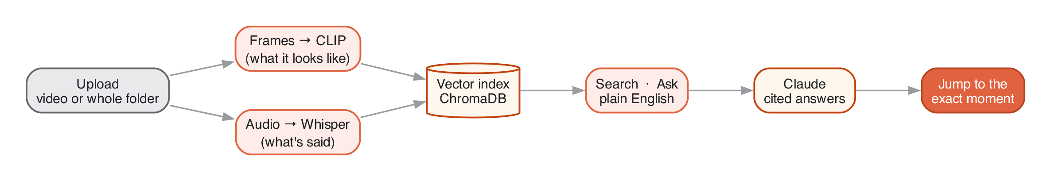
How it works
One pipeline turns every video into three searchable signals.
Frames become CLIP vectors (the visuals), audio becomes a Whisper transcript (the words), and Claude turns retrieved moments into cited answers. One search box over all of it.

Slide 6
More than search
Once a video is indexed, the hard part is done — everything else is free.
Library mode — search across an entire folder of videos at once.
Ask — questions answered in prose, with clickable cited timestamps.
Auto-chapters & summaries generated on every upload.
Highlight reels — stitch the best moments into a shareable clip.
Index once. Search, ask, summarize, and cut — from the same index.

Slide 7
Why now
The pieces only just became cheap enough to put in one small app.
Multimodal embeddings (CLIP) are good, fast, and open.
Whisper drove transcription cost toward zero.
LLMs (Claude) can now reason over retrieved moments and cite them.
Video volume is compounding while tooling stays stuck on scrubbing.
The tech is finally ready — and we’ve already shipped on it.

Slide 8
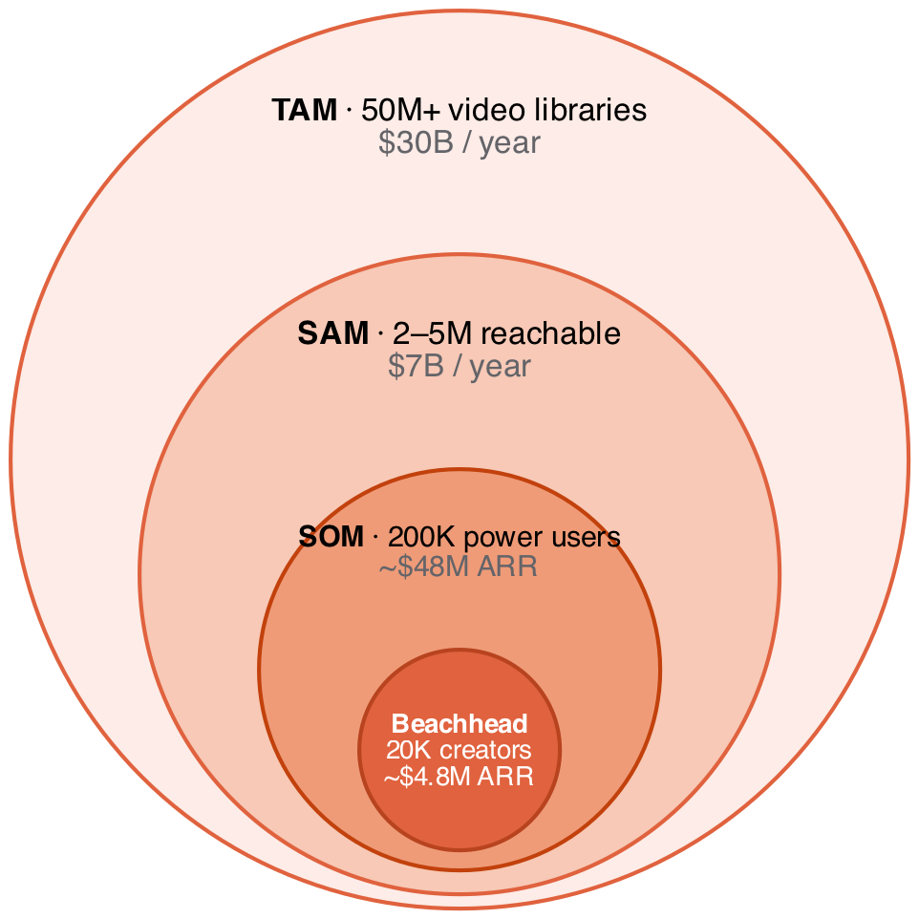
Market
TAM ≈ $30B / year — the spend on making video findable.
Bottom-up: 50M creators × $240/yr + 30M businesses × $600/yr.
Beachhead: 20K heavy-library creators → ≈$4.8M ARR reachable now; SOM 200K → ≈$48M.
Cross-check: DAM ≈$5B · search ≈$6B · video intelligence ≈$11B — same order of magnitude.

Slide 9
Traction
Shipped and live at getscrubless.com:
V1 search, V2 library mode, V3 Q&A / chapters / reels — all in production.
Auth + Stripe billing working; durable per-user storage.
Targets — next two quarters, post public launch:
1,000 signups in the first 90 days (Show HN / Product Hunt).
100 paying customers and $2K MRR by end of Q3 2026.
10,000 hours of video indexed.
40% week-4 retention on activated users.

Slide 10
Business model
Freemium SaaS, priced on what costs us money: indexed hours.
Free — a few minutes to feel the magic.
Pro — monthly plan by indexed hours, self-serve via Stripe.
Expansion — team seats, API access, on-prem / enterprise.
Cheap to run: one process, model and vector DB in-memory, fits on a single small instance — gross margin is on our side.

Slide 11
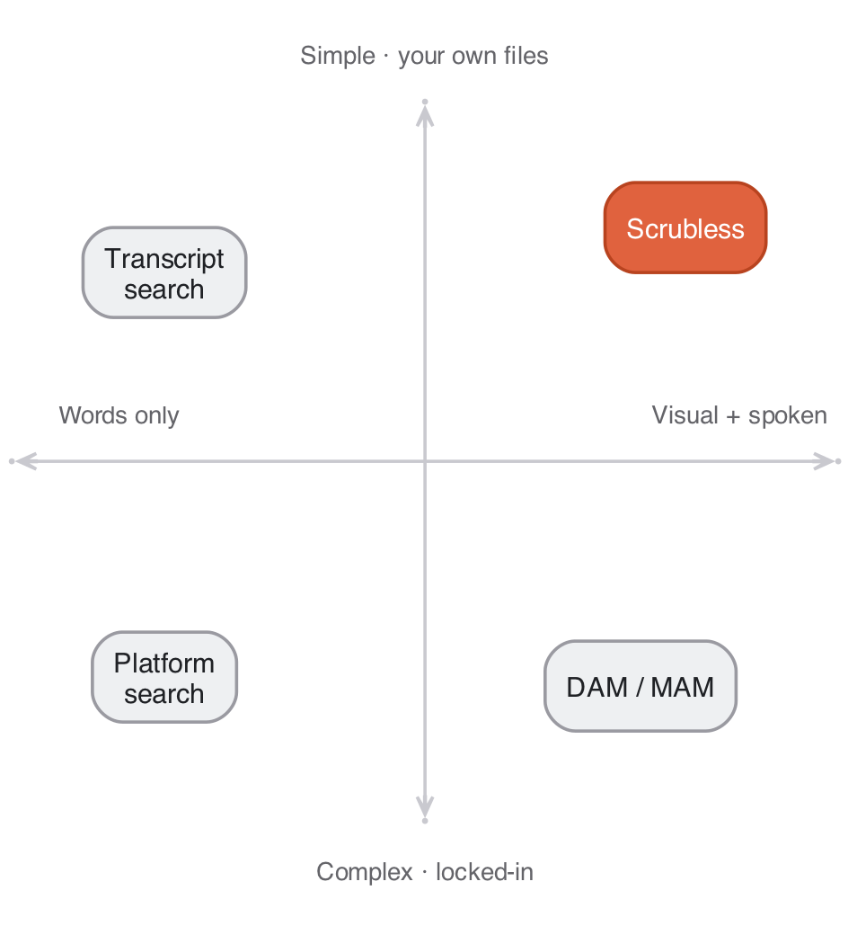
Competition
Everyone else finds words or needs manual tags.
Scrubless searches what’s shown and said — semantic, instant, on your own files. Top-right, and alone there.

Slide 12
Why we win
Multimodal, not transcript-only — we search the pixels and the audio; competitors are blind to anything unspoken.
Live and billed today — a shipped product, while most “AI video search” is still a waitlist.
Built on real embedding infra — the founder ships ML/embedding systems in production; the hard part is home turf.
Index once, do everything — search, ask, chapters, reels off one index → widening surface area and switching cost.
The capability is commoditizing — the product, polish, and data flywheel are not.

Slide 13
Team
Chukwuebuka Ernest-Opara — founder & sole engineer · Oakland.
ML & Platform Engineer at GEICO — ships embedding infrastructure and ML deployment pipelines in production (Go · Python · Azure ML · Kubernetes).
Videographer for several years before tech — has lived the scrubbing problem first-hand.
MS & BS in Computer Science (Houston-Victoria; Babcock).
Built all of Scrubless solo — V1–V3, auth, and Stripe billing.
In talks with two co-founders with media experience to lead content and go-to-market.
Built the embedding engine and lived the problem it solves — rare founder-market fit for video.

Slide 14
Vision
The index layer for the world’s video. Every clip, meeting, lecture, and archive — instantly searchable, anywhere it lives.
Search was the gateway to the web. Scrubless is that gateway for video.
Stop scrubbing. Start searching.
getscrubless.com · contact@getscrubless.com

