Slide 1
Where got time?
Real-time canteen information programme
By Ernest, Jeremy and Joshua

Slide 2

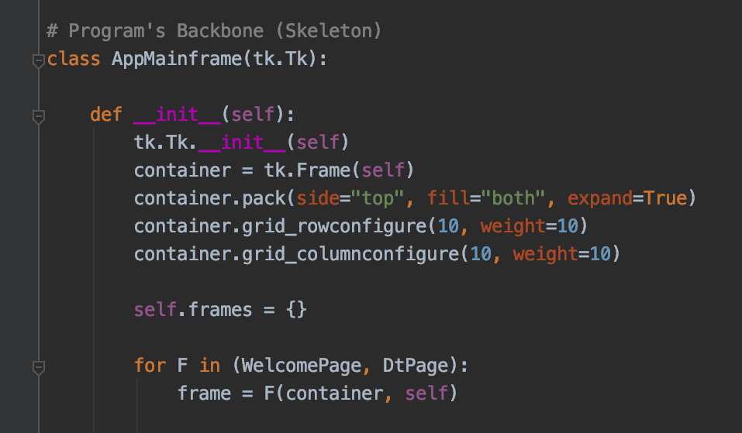

Program Information

Slide 3
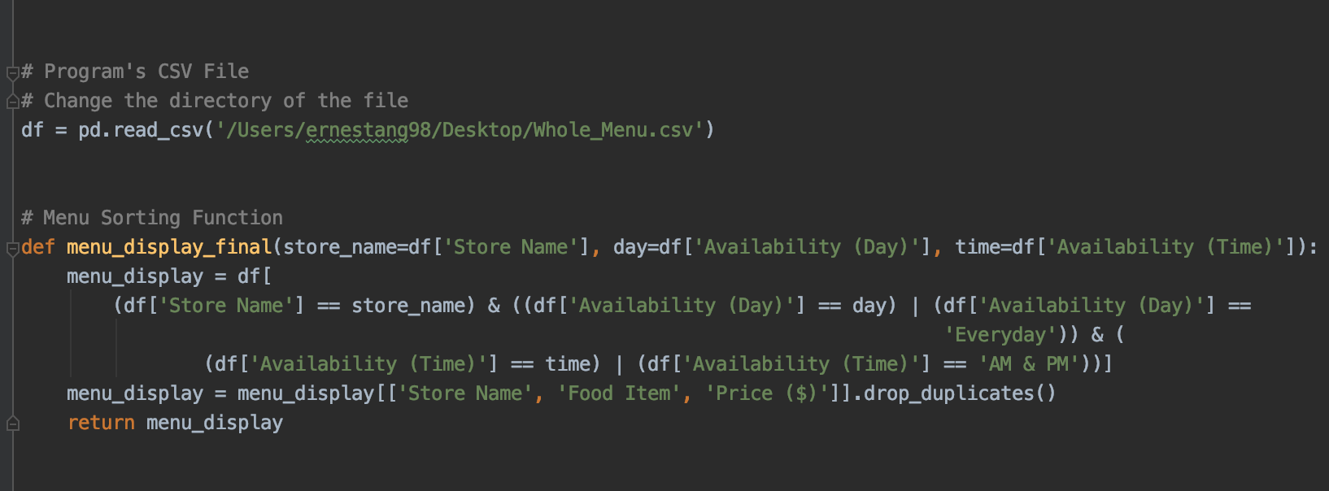

Pandas Library + Menu Sorting Function

Slide 4
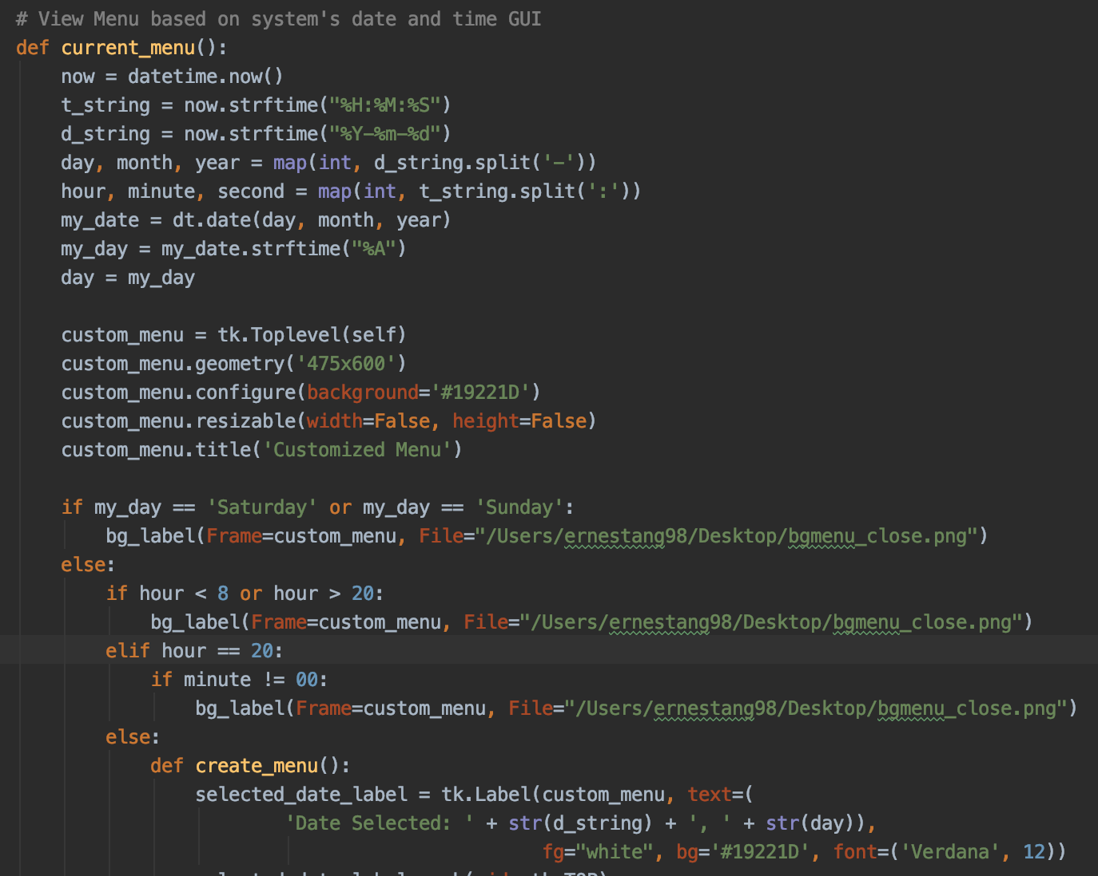
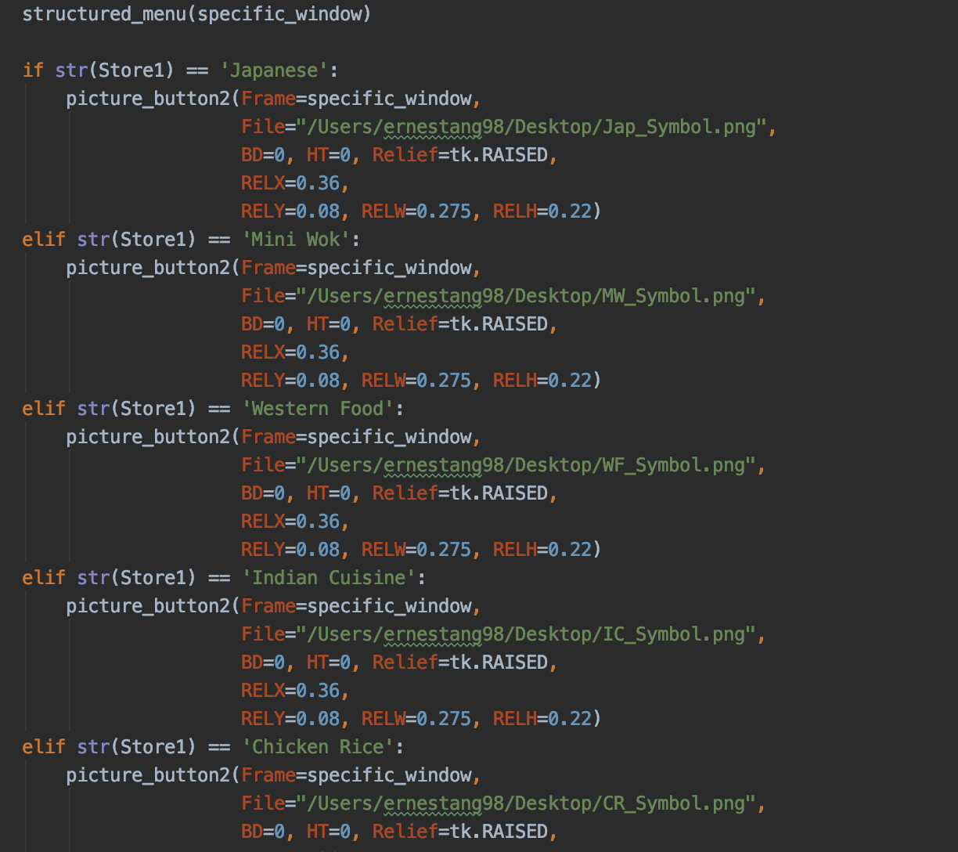
Sorting Menus based on date and time
Sorting the menu based on current time and date
Further sorting the menu based on store

Slide 5
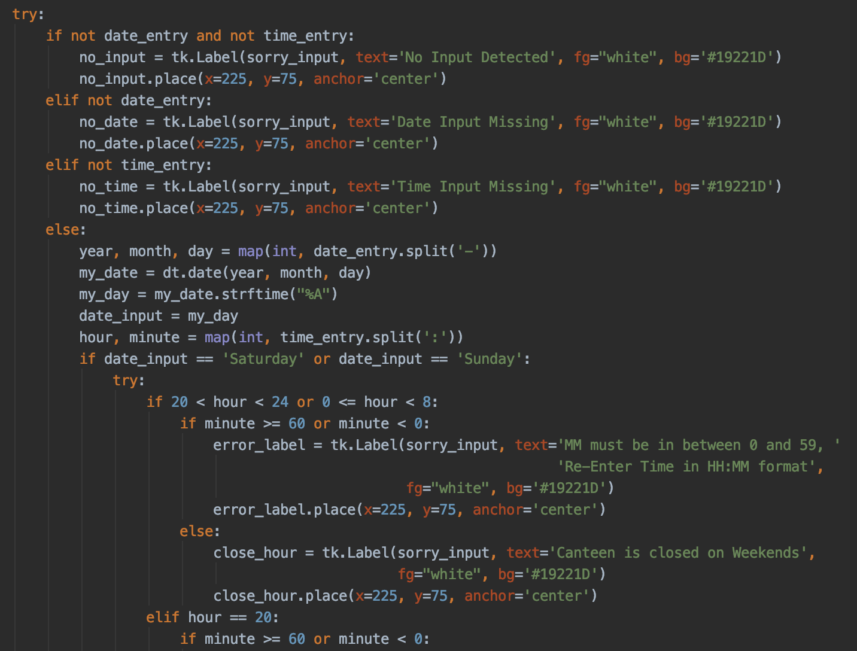
Sorting Menus based on date and time
Nested If-Elif-Else loop within Try - Except Loop to perform error handling

Slide 6
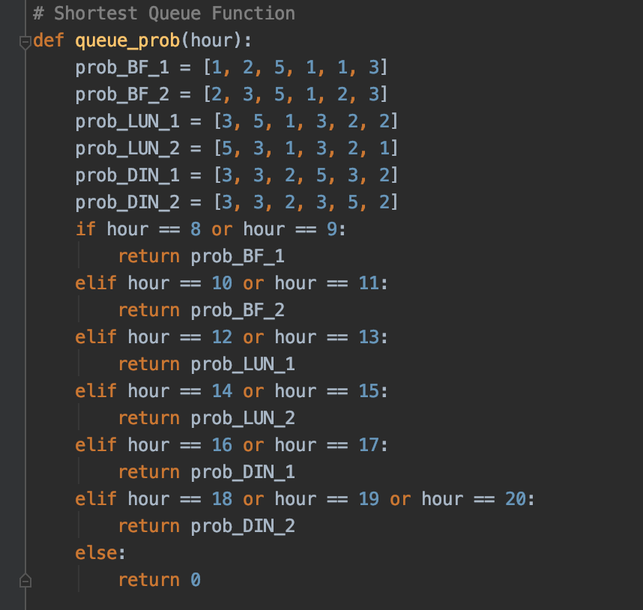
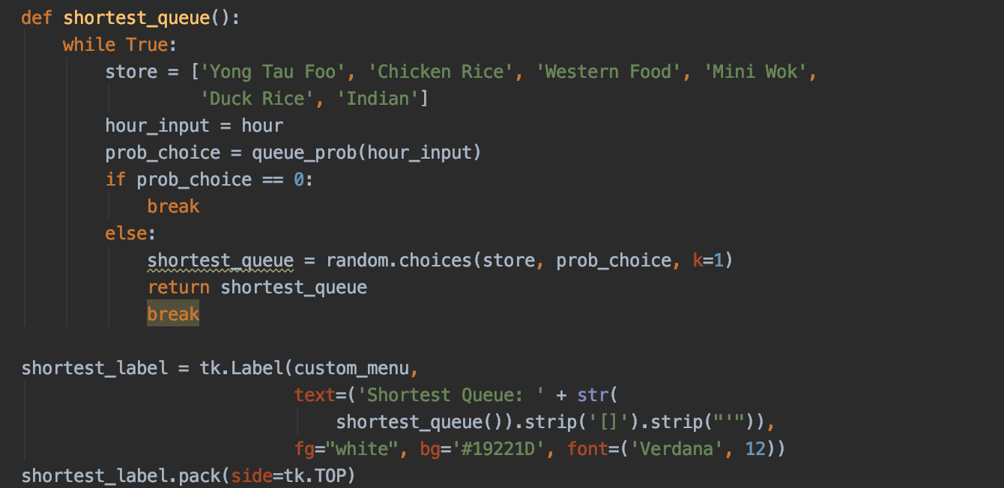
Shortest Queue Function
Different stores have different probability at different timing
Tagging the stores to the different probability
Using the ‘random.choices()’ method to return the predicted store with the shortest queue
Notes:
Thank you joshua. During the demo of the program, did you notice this subtle but powerful feature - the Shortest queue feature.
Determining the store with shortest queue will definitely be helpful for those of us who are tight on time.
Now, how do we do this? Introducing the shortest queue function. This func will select a store with the shortest queue from the list of stores available. Well, how is this store selected? We could simply randomly pick any of the stores and determine that store to have shortest queue. But we wanted to make out program ever so realistic
Hence we introduced the queue prob func, which assigns a different number to different stores at the different timing based on the popularity of the store. Well, this means that a higher number assigned that that store , the more likely the store will have the shortest queue. Because different stores are popular at different times of the day depending on say the offerings of the store
Using this, the function can thus make a more realistic prediction of the store with the shortest queue based on past data as you can see.

Slide 7
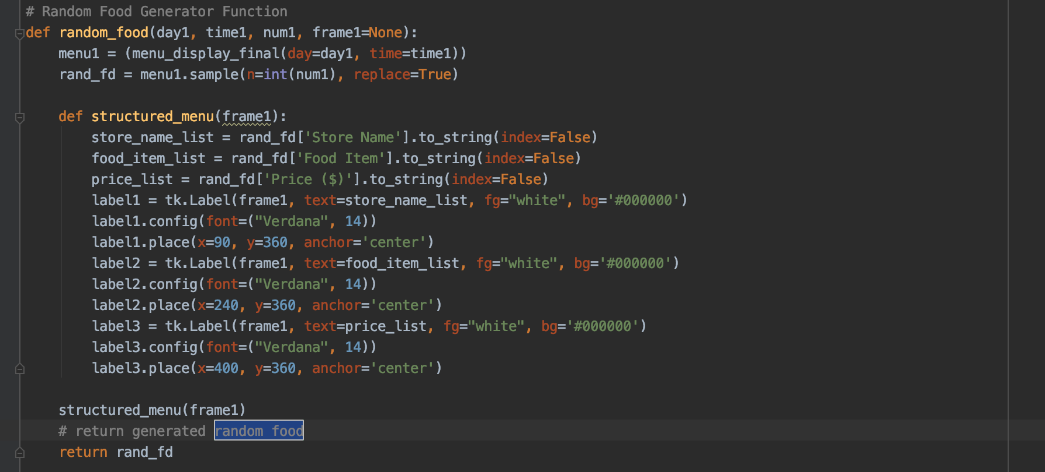

Random Food Generator
Random Food Generator Function
Notes:
Next up, the RFG func.
Imagine a grp of 5 of you guys , have no clue on what to eat, this feature is just for you.
By filtering out the food options available based on current date and time whenever you choose the use the program ,
And keying in the number of you guys eating,
This feature will generate the food options for you guys.
Now imagine you are in a grp of 20 ppl, at certain timings, 20 unique food options will not be available hence this feature allows for repeated food options to be generated.

Slide 8
Thank you
Notes:
In closing, on top of the basic features of the program to view the entire store menu and estimate the average waiting time at each store, we hope that the additional time-saving features
will help in improving the customer eating experience at NS Food court. Because residing in one of the busiest countries in the world, WHERE GOT TIME!
Thank you for your kind attention.

