Slide 1

RwandaRide
A Real-Time Ride-Monitoring Data Pipeline
with Machine-Learning ETA Prediction
Hadoop HDFS · Apache Kafka · Apache Spark · Spark MLlib · Django
Big Data Essentials Group Final Exam Project
Adventist University of Central Africa
Lecturer: Dr.Kundan Kumar
101420 Patrick Niyonshuti
101414 Erneste Uwimpuhwe
101366 Gisele Uwibereyeho
Notes:
Open with the one-sentence framing on slide 2. Do not read the tech list aloud - they can see it.

Slide 2
The problem, in one sentence
A good case study makes the topic, the target and the decision obvious
The Kafka stream carries trip events as they happen, the Spark MLlib model predicts trip duration in minutes, and the dashboard shows dispatchers which trips are running late and which zones are short on drivers.
1
What the stream is
One record per completed trip: route, distance, weather, traffic, surge, duration.
2
What the model predicts
Trip duration in minutes — the ETA a dispatcher promises a rider.
3
What decision it supports
Which late trips need a call, and which hours need more drivers on shift.
Kigali: eight zones · sixty drivers · fares in RWF ride-hailing with ETA prediction
Notes:
Memorise the quoted sentence. It answers all three things the guidelines demand.

Slide 3
Architecture as built
Nothing is copied by hand — both storage layers are fed automatically from one topic
Faker generator
Django REST
Framework
Kafka
trip-events
Kafka Connect
→
→
→
tunable rate
key = driver_id
3 partitions
two sinks
MariaDB
HDFS
Operational store
Historical store
One row per trip, indexed.
Answers: what is true now.
Every event, Parquet, replicated.
Answers: what happened.
PySpark insights
Spark MLlib
Django dashboard
3 business insights from HDFS
GBT trained, saved, redeployed
live board + admin, 7 charts
A custom consumer group runs alongside the sinks in its own group — applying business logic and writing late-trip alerts.
One topic, read three ways by three independent consumers. That fan-out is why the producer never writes twice — and why one sink can fail without affecting the others, which is exactly what happened to us.
Notes:
Point at the fan-out. Then mention that the HDFS sink died for 12 hours while the database sink kept working - that is the fan-out proving itself.

Slide 4
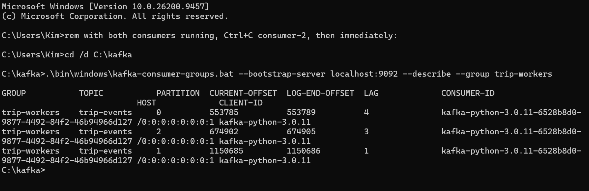
Scale reached
Volume, velocity and variety — each demonstrable, not asserted
2.39M
3
172.6 MB
Trip events ingested
Kafka partitions
Parquet in HDFS
end to end through every stage
keyed by driver_id, offsets tracked
vs 517.7 MB as text — 3.0x smaller
After one consumer leaves the group, a single consumer ID owns all three partitions. Lag of 4, 3 and 1 shows the survivor keeping pace with the producer in near-real-time.
Velocity is a knob, not a claim:
the generator's rate is an environment variable. Change it live and Kafka offsets, MariaDB rows and HDFS size all accelerate together.
Notes:
Have watch_growth.cmd running on screen if possible - numbers moving is more persuasive than the slide.

Slide 5
Why records land where they do
The partitioning strategy, and the trade-off it buys
The Kafka message key is driver_id. Kafka hashes that key and takes the remainder over the partition count — so every event from one driver always lands on the same partition.
Why this key
Alternatives rejected
Kafka guarantees ordering only WITHIN a partition.
A driver cannot start trip 2 before finishing trip 1 — per-driver ordering is what the domain needs.
Ordering across different drivers is not required, which is what makes 3 partitions safe.
key = trip_id: perfect spread, no useful ordering — every trip is unique.
no key: round-robin, ordering lost entirely.
Cost of our choice: skew. 60 keys over 3 partitions left partition 1 with roughly double the traffic.
Verified, not assumed
D0001 → partition 0, offset 0
D0007 → partition 1, offset 4
D0042 → partition 1, offset 5
D0001 → partition 0, offset 1
Same key, same partition.
Both D0001 messages landed on partition 0 at consecutive offsets — the same key always goes to the same partition, and stays in order.
D0007 and D0042 sharing partition 1 shows each partition holds many drivers, which is why the load does not divide evenly.
Notes:
Then switch to the browser and POST two records live through the DRF form.

Slide 6
Consumer group, offsets and delivery guarantees
Named group trip-workers, run with two instances, manual commits
The commit sequence
Two guarantees, one system
1
Poll a batch of records
Our consumer is at-least-once. It does the work first and tells Kafka afterwards, so a crash in between means the record is read again — harmless, because writing the same trip twice overwrites the old row.
The HDFS sink goes further — it never writes the same record twice. Each file is named after the exact range of records inside it, so after a crash it resumes at that boundary.
Committing before the work would be at-most-once: faster, no duplicates, but a crash loses those records for good.
Repeating work is recoverable. Losing it is not.
2
Apply business logic, write alerts
3
Commit the database transaction
4
Commit Kafka offsets — last
Work first, commit second. A crash in between means the record is re-read — never lost.
Proved by accident:
the consumer crashed on a malformed record left by an earlier console-producer test. On restart it resumed from its committed offsets — {0: 749, 1: 0, 2: 749} — not from zero. Nothing lost, nothing reprocessed.
MariaDB outage
Unclosed HDFS lease
Operational store lost
sink stopped, Kafka kept accepting.
15,000 records drained on restart.
one sink died, the other lived.
1,045,459 records replayed.
full 2.39M-row database rebuilt
from the log, no manual copying.
Notes:
Demo: two consumer windows, kafka-consumer-groups --describe, Ctrl+C one, show PARTITIONS REVOKED then ASSIGNED [0,1,2].

Slide 7
Why HDFS and not just a database
The question the guidelines ask explicitly
MariaDB
HDFS
Operational
Historical / analytical
Holds the current state: one row per trip
Small, fast, indexed lookups
Powers the dashboard directly
A full-history scan would lock it and stall the dashboard
Every event, append-only, forever
Large blocks replicated across nodes
Survives disk or node loss unaided
Scales by adding nodes, not bigger disks
Spark reads it in parallel per block
The filename is the guarantee
/data/trip-events/dt=2026-09-18/trip-events+0+0000020150+0000020349.parquet
Topic, partition, start offset, end offset. On restart the connector knows exactly which offsets are already durable — so it never double-writes.
2,346,029 rows in, 369 out of the first aggregate Spark computed partial aggregates locally before shuffling.
Column pruning: 7.6 MB read to aggregate 450,000 rows, because Parquet is columnar and we touched 2 of 14 columns.
Small files (18 KB against a 256 MB block) are deliberate so files appear during the demo the classic HDFS anti-pattern, accepted knowingly.
Notes:
Open the NameNode UI at :9870. Be honest that one DataNode means blocks are under-replicated.

Slide 8
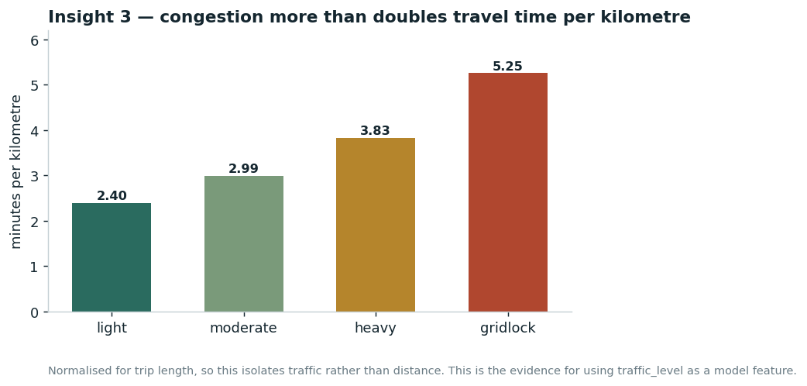
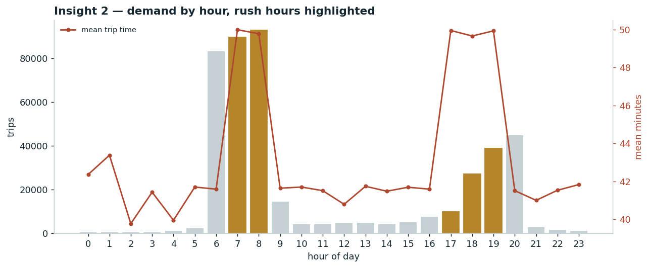
Three insights from PySpark
Batch jobs reading Parquet straight out of HDFS, deduplicated on trip_id
Insight 3 — minutes per kilometre, so trip length is cancelled out and this isolates traffic.
Insight 2 — two commuter peaks; the line is mean duration, rising to ~50 min in rush hours.
Congestion more than doubles pace
The instructive error
gridlock 5.25 min/km · light 2.40 min/km Monotonic, and stable as the dataset grew twenty-fold.
This is the evidence for using traffic as a model feature.
Our first hourly chart showed all demand in three evening hours — clean, plausible, and entirely wrong. pickup_hour was stamped from the wall clock, not simulated. We fixed the generator and now train on the corrected date partition, which also exercises partition pruning.
Notes:
Insight 3 - demand near-uniform across zones - is a negative result, reported as one: the generator samples zones uniformly. Its reading is that dispatch gains come from timing, not geography.

Slide 9
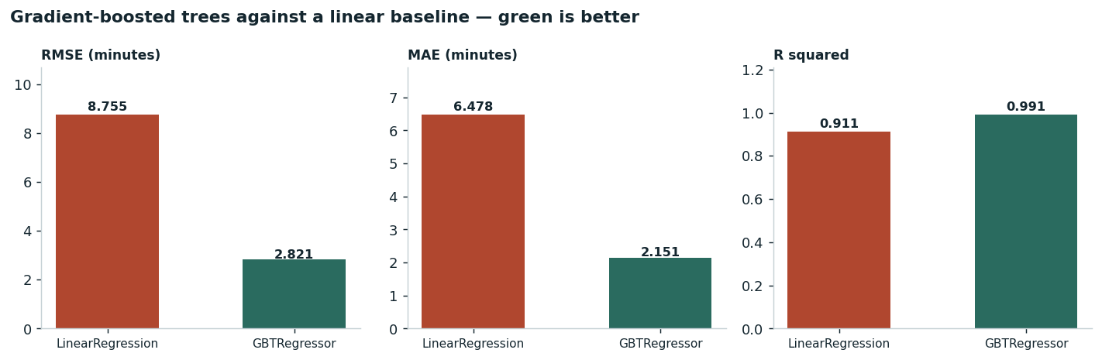
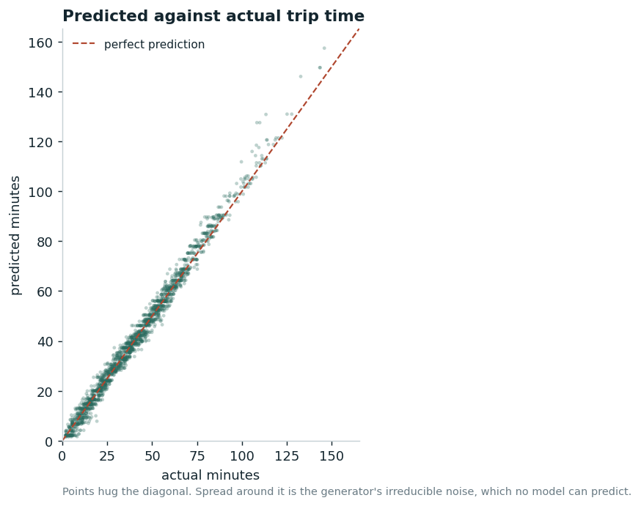
Spark MLlib trained, evaluated, deployed
Supervised regression on features derived from the pipeline's own data
2.82
2.15
0.991
67.8%
RMSE, minutes
MAE, minutes
R squared
lower RMSE than linear
floor is 1.8
average ETA error
variance explained
8.755 → 2.821 on the same split
GBT against a linear baseline, identical split, same job.
2,000 scored trips.
Why GBT, not linear
Why R2 is not 1.0
The feature we withheld
Traffic and weather SCALE base travel time and interact with distance. A linear model can only add.
The generator adds noise, SD 1.8 min. Irreducible and a result BELOW 1.8 would mean leakage.
fare_rwf is computed FROM duration. Known only after the trip ends, so using it is target leakage.
Notes:
Trained on 58,048 rows, tested on 14,316 never seen. Feature importance: distance 0.60 - physics dominating is a sanity check passed.

Slide 10
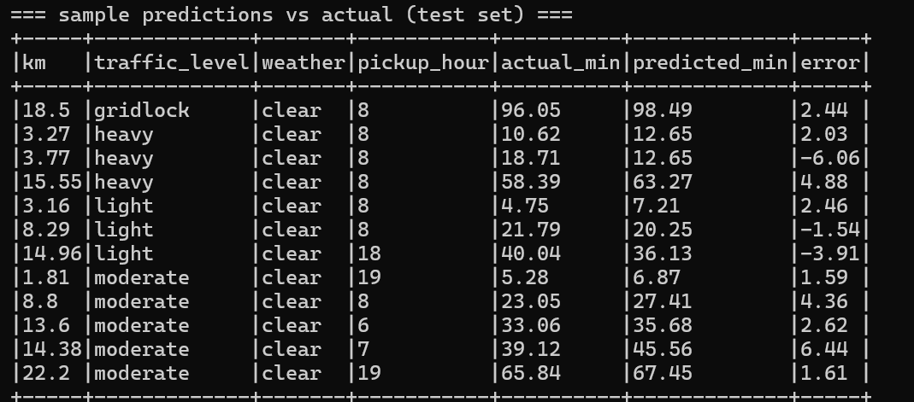
Deployed, not just trained
A separate job loads the persisted model from HDFS and scores records it has never seen
What makes it deployed
A separate job, in a separate process.
Loads the PipelineModel from hdfs:///models/eta_gbt.
The fitted indexers, encoders and 30 trees all come back from disk exactly as saved.
Nothing about training is repeated.
Predictions land in MariaDB, where the dashboard shows them beside the actuals.
Real output from score_batch.py: the 18.5 km gridlock trip is predicted within 2.4 minutes.
Where the model is weakest — and why that is worth showing
Our largest errors cluster on long gridlock trips, where the model over-predicts. That is consistent with gridlock being the rarest traffic category at roughly 6% of trips, so the tree splits are coarser at that extreme. More gridlock data would help. We surface the worst errors on the dashboard rather than hiding them.
Notes:
If asked why accuracy is not higher, go to the noise-floor argument on the previous slide.

Slide 11
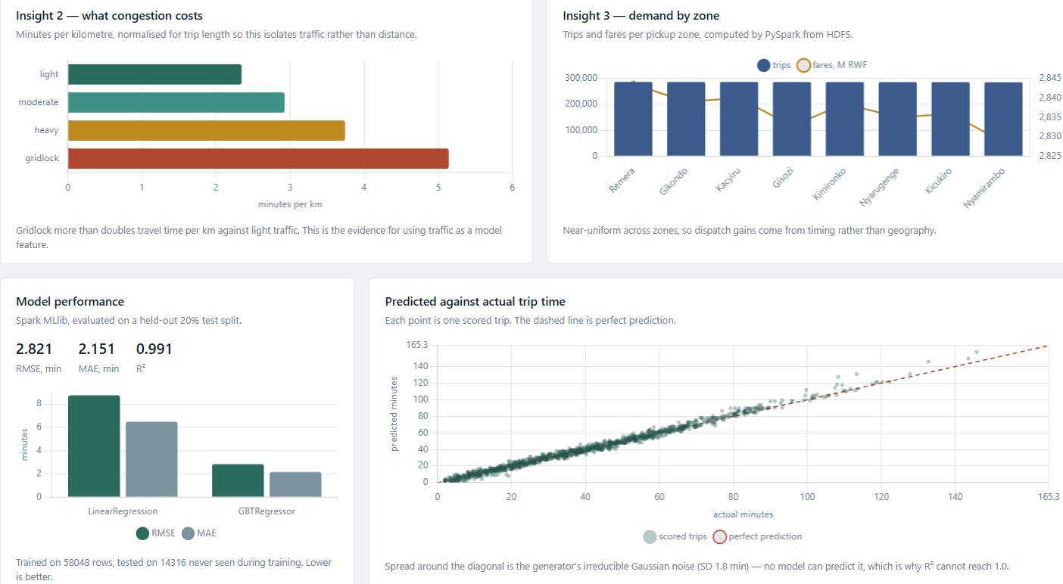
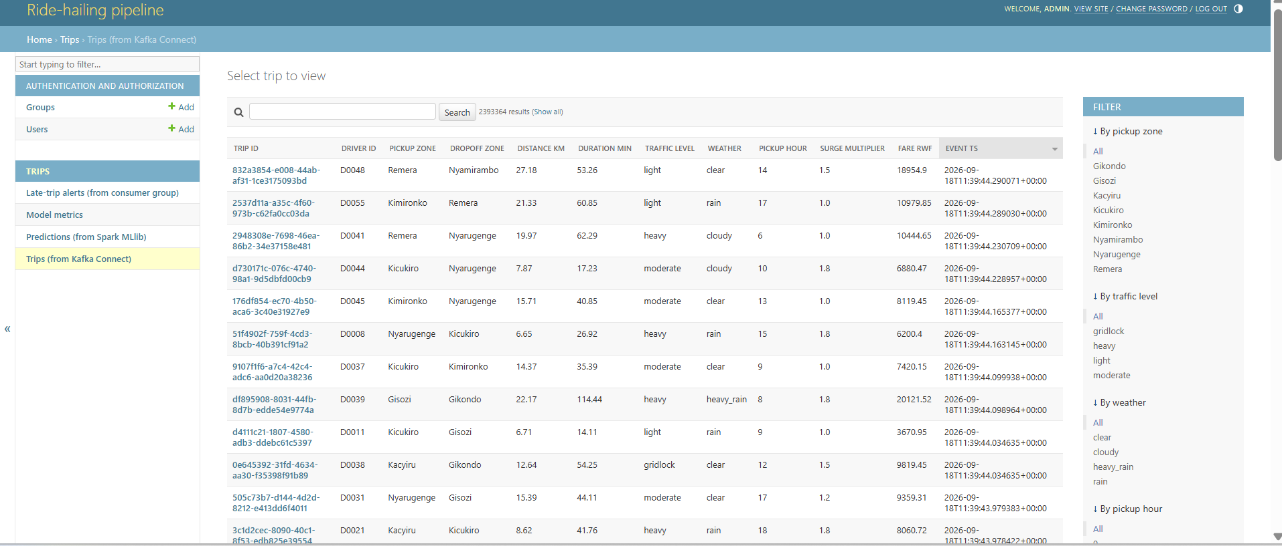
Dashboard and enhancements
Two Django applications over one schema, with four additions beyond the reference diagram
Django admin over the same tables, managed = False.
1
Alerts with stream provenance
each shows the Kafka partition and offset that produced it
2
Zone drill-down
PySpark insights and MLlib model performance on one screen. Seven charts, recomputed from query results on every request.
re-scopes operational panels, leaves HDFS insights global
3
Role-based access
Threshold tuned empirically:
raw records behind a login; aggregates open
at 1.5x expected duration, 60% of trips were flagged — gridlock alone is a 2.2x multiplier, so the rule was detecting ordinary congestion. At 3.0x the rate falls to a fraction of a percent, isolating genuine outliers.
Error analysis
4
largest errors and a bucketed distribution, not just successes
Notes:
Show the live board, then the admin at :8080. Explain managed = False - Django reads, Connect and Spark own the writes.

Slide 12
Conclusion
What the pipeline does, what it found, and what it cost us to learn
2.39M
Trip events end to end
through every stage of the pipeline
2
Stores fed automatically
MariaDB operational · HDFS historical
2.82 min
ETA prediction error
against a 1.8 min noise floor
0
Records lost in three failures
Kafka retained everything; consumers replayed from committed offsets
What the system does, in order
1 Ingests trip events continuously at a rate we can change while it runs.
2 Carries them through Kafka, keyed by driver so ordering holds where the domain needs it, with offsets committed by hand.
3 Lands them automatically in two stores one indexed for what is true now, one replicated and columnar for what happened.
4 Processes the full history at scale with PySpark, then trains a Spark MLlib model and redeploys it from HDFS to score unseen trips.
5 Surfaces all of it on a live Django dispatch board with seven charts recomputed on every request.
Three findings worth carrying away
Congestion more than doubles pace. 2.346 min/km in light traffic against 5.146 in gridlock monotonic, and stable as the dataset grew twenty-fold.
Boosting beat a linear baseline by 67.8%. Traffic and weather scale travel time rather than adding to it, and trees capture that interaction where an additive model cannot.
The accuracy sits against a floor we built in. Noise of 1.8 minutes per trip is irreducible which is the only reason we can call 2.82 good rather than merely low.
Stated limitations single broker at replication factor 1 · one DataNode, so blocks are under-replicated · small files by design for the demo · training on a 20% sample · synthetic data, so the pipeline is real but the domain conclusions are only as real as the generator
The most instructive parts of this project were not components. Three separate failures a database outage, an unclosed HDFS lease, and the complete loss of the operational store were each survived without data loss, because Kafka retained everything. And one bug produced a plausible-looking chart that was entirely wrong: finding it meant doubting our own output.
Notes:
CONCLUSION — what to say.
The system ingests ride-hailing trip events continuously, carries them through Kafka with a partitioning strategy we can justify and offsets we manage explicitly, lands them automatically in both an operational store and a replicated columnar historical store, processes that history at scale with PySpark, trains and deploys a Spark MLlib model that predicts trip duration to within roughly two minutes, and surfaces all of it on a live dashboard. Over 2.39 million events passed through it end to end.
Three findings. Congestion more than doubles travel time per kilometre, from 2.346 to 5.146 minutes per km. Gradient boosting cut prediction error by 67.8% against a linear baseline, because the underlying relationship is multiplicative and trees capture interactions additive models cannot. And the model's accuracy sits close to a theoretical floor set by noise we built into the data deliberately — which is the only reason we can say the result is good rather than merely low.
We state the limitations rather than hide them: one broker at replication factor 1, a single DataNode, deliberately small files, a 20% training sample, and synthetic data.
Close on the dark panel: the most instructive parts were the failures, and the one bug that produced a plausible chart that was entirely wrong.

