Slide 1
MIRAI
BOT * C flooding attacks
infects IoT with busybox …. for version < 1.16..
-target: have an army of BOTs to coordinate effective
ddos attacks against websites or dns servers (not intended to attack infected device or net.)
-net scan
-hijack telnet service
-passsword list to bruteforce<
-infects thru tftp (not verified)
-connects to cnc thru. dns resolved name, google dns hardcoded
-generates flooding packets, DdoS effective with many BOTs
-bot toolkit contains different ddos from Link layer to App layer
CNC * go
control 1 or many BOTs
exp port 23 and 101 tcp
conn to MysqlDB
ADMIN * go
user friendly client to CnC

Slide 2
BOT
CnC
CnC
Brazil
ADMIN
US
internet
China
TARGET
www.my.dk
DK
BOT
BOT
DK
China

Slide 3
BOT
wxrwxr-x 1 testuser testuser 6662728 May 26 15:56 cnc
-rwxrwxr-x 1 testuser testuser 59244 May 26 15:56 mirai.arm
-rwxrwxr-x 1 testuser testuser 58180 May 26 15:56 mirai.m68k
-rwxrwxr-x 1 testuser testuser 76204 May 26 15:56 mirai.mips
-rwxrwxr-x 1 testuser testuser 79804 May 26 15:56 mirai.mpsl
-rwxrwxr-x 1 testuser testuser 54088 May 26 15:56 miraint.arm
-rwxrwxr-x 1 testuser testuser 52496 May 26 15:56 miraint.m68k
-rwxrwxr-x 1 testuser testuser 68256 May 26 15:56 miraint.mips
-rwxrwxr-x 1 testuser testuser 71568 May 26 15:56 miraint.mpsl
-rwxrwxr-x 1 testuser testuser 50092 May 26 15:56 miraint.ppc
-rwxrwxr-x 1 testuser testuser 47556 May 26 15:56 miraint.sh4
-rwxrwxr-x 1 testuser testuser 54724 May 26 15:56 miraint.spc
-rwxrwxr-x 1 testuser testuser 56484 May 26 15:56 mirai.ppc
-rwxrwxr-x 1 testuser testuser 54084 May 26 15:56 mirai.sh4
-rwxrwxr-x 1 testuser testuser 60852 May 26 15:56 mirai.spc

Slide 4
LAB SETUP
CNC:10.11.11.101 debian (debian.labdomain)
  mysql, run cnc , tcp23, tcp101(api,debug+othersC2)
BOT:10.11.11.109 ubuntumirai
  mirai.dbg ,tcp 23, set CnC fqdn, some code modif.
ADMINCLIENT: 10.11.11.103
  Initiate telnet to cnc ip/fqdn

Slide 5
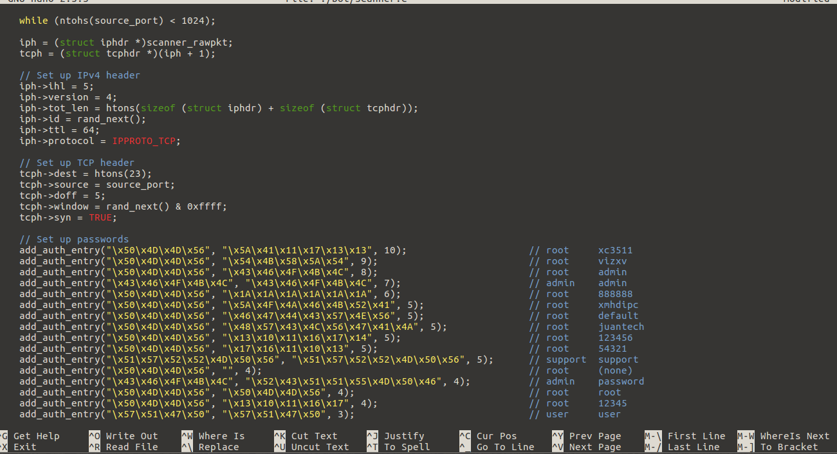
BOT

Slide 6
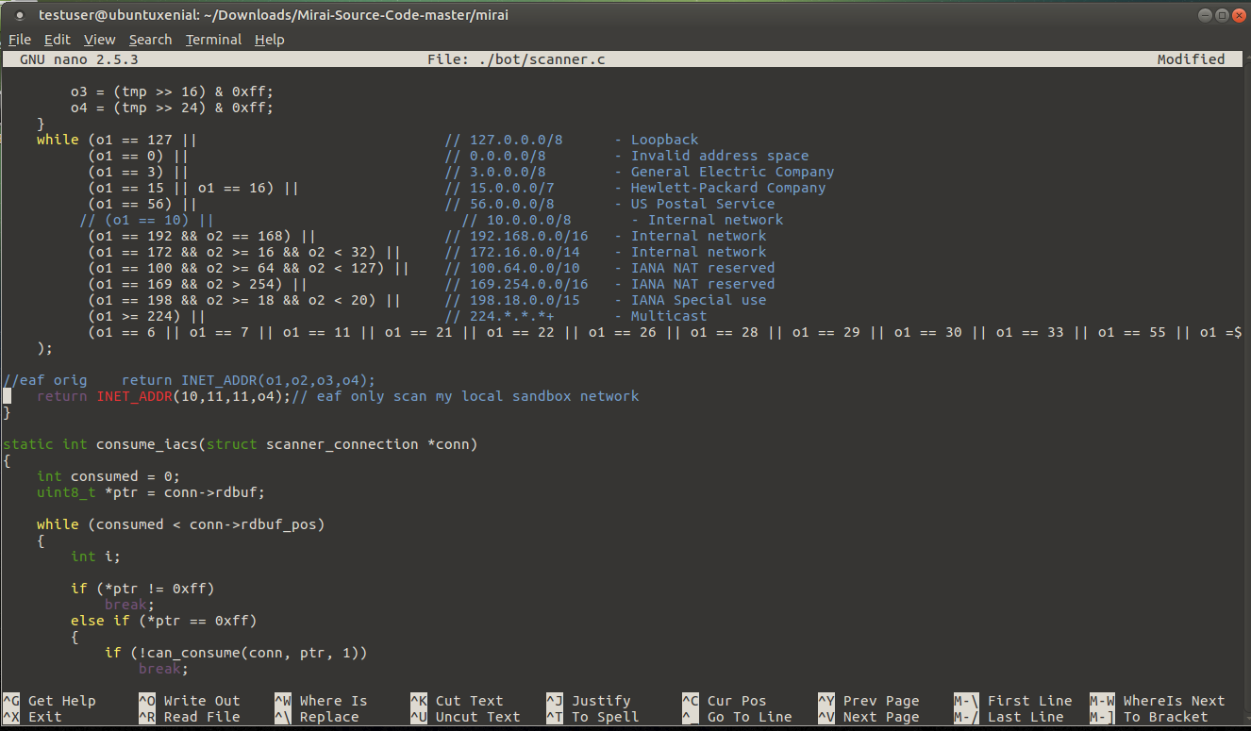

Slide 7
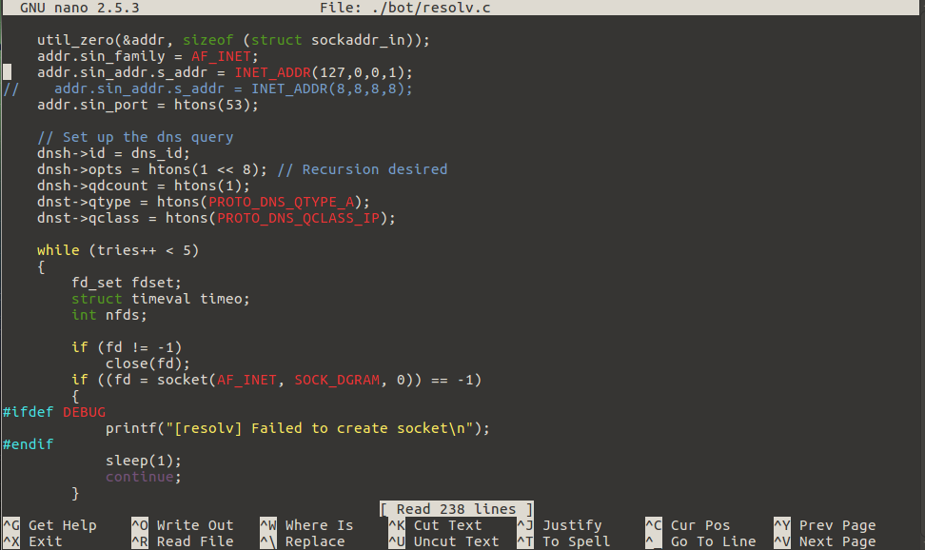

Slide 8
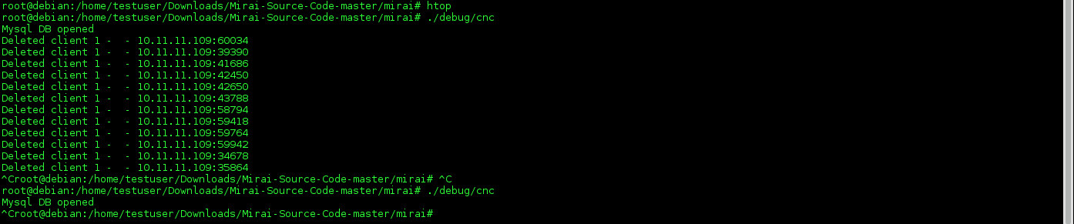
CnC

Slide 9
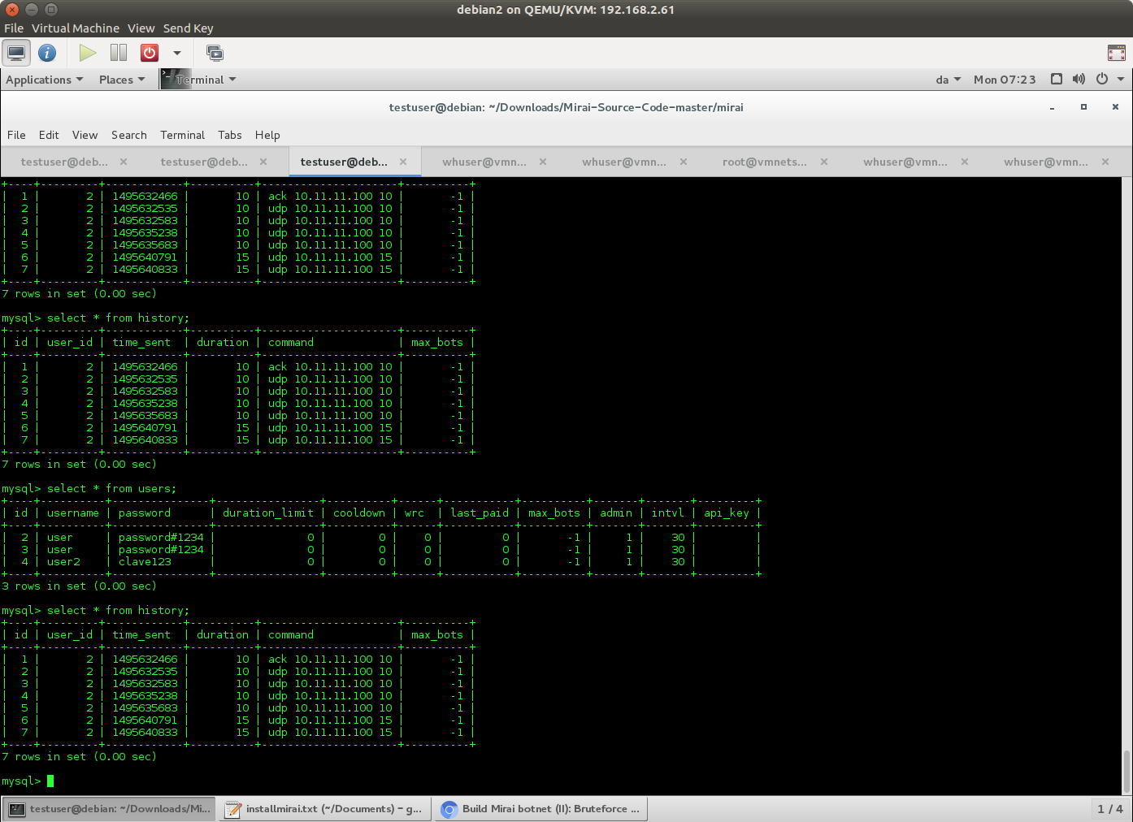

Slide 10
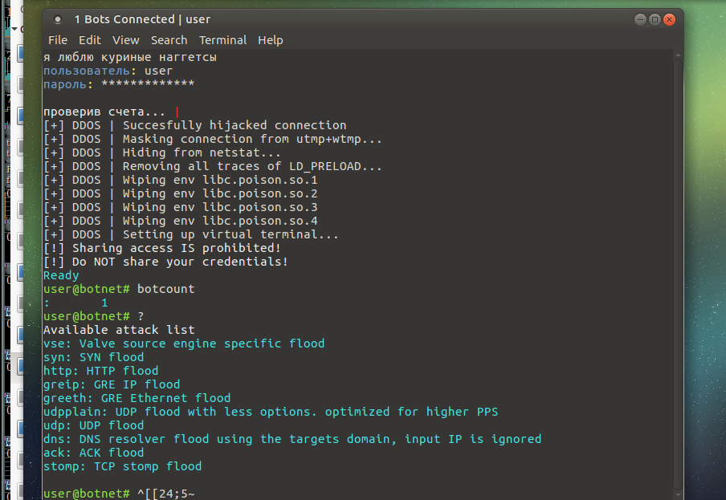
ADMIN CLIENT

Slide 11
DETECTION
Comm intelligent - By files hash
  Non detected over secure conn
  Mirai has low detection rate
  Mhr-detector.bro script , (modified)
    Mime types, MD5 SHA256, cymru DB
Behavior
BOT
  Icmp broadcast
  TCP port scan, 23 port detection
  DNS queries to blacklisted DNS CnC fqdn (intell)
  Protocol detection , TFTP
  ML
    Unusual DNS name, unusual port communication, unusual connection time, unusual pair (host/client) comm
Cnc
  Weird certificates sent
  Port 101, 48101 ,opened

Slide 12
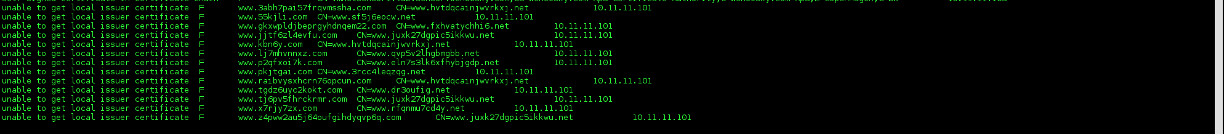
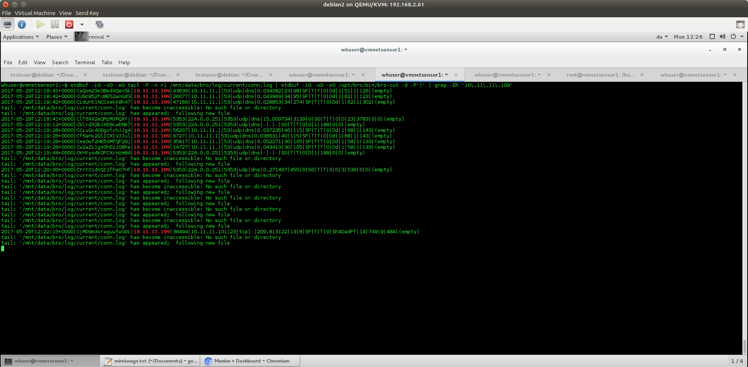
Cnc weird certs, receipt, (non modified code)
uid=CZqj4A3vknDz718fDa
https://virustotal.com/zh-tw/domain/r3---sn-gvbxgn-tt1s.gvt1.com/information/
BOT → CNC ANNOUNCEMENT

Slide 13
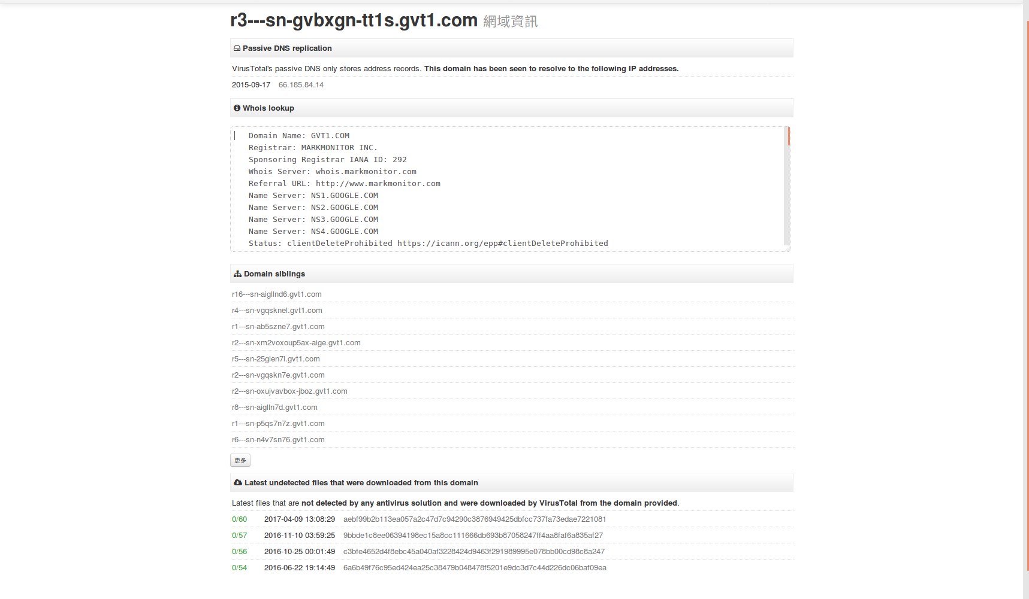

Slide 14
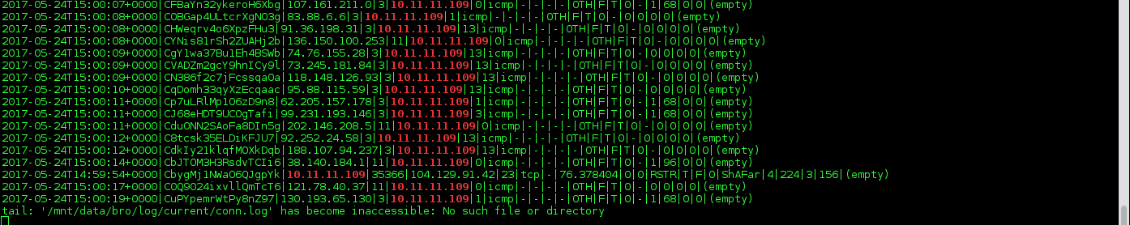
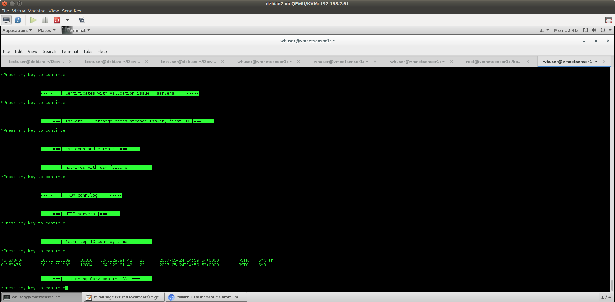
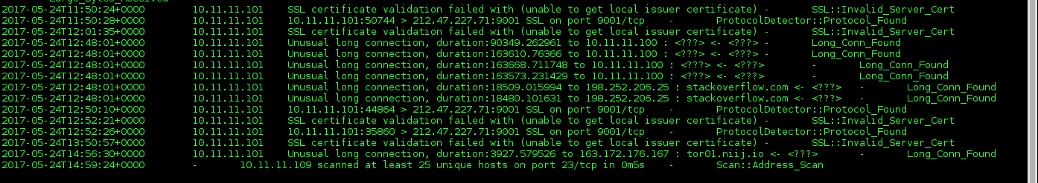
BRO Forensics
Port scan, they do it faster by using icmp, then syn
Seems like after icmp response , telnet conn is tried, and rejected by responder(why? Filtered or it doens’t have telnet services.)
Port scan detected, but only when heavy scan was done

Slide 15
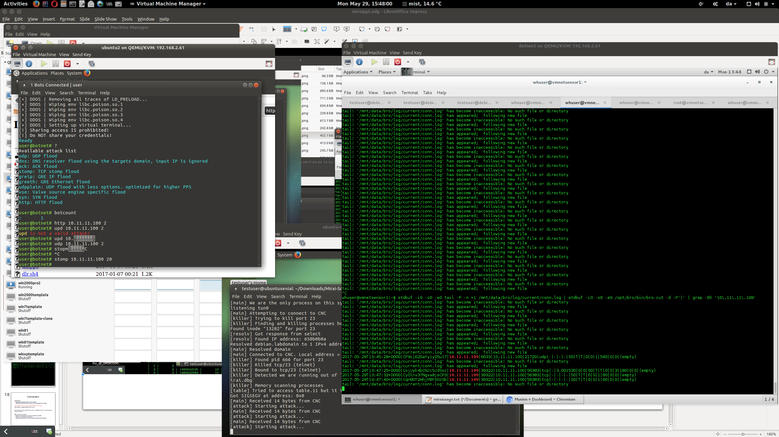
USAGE

Slide 16
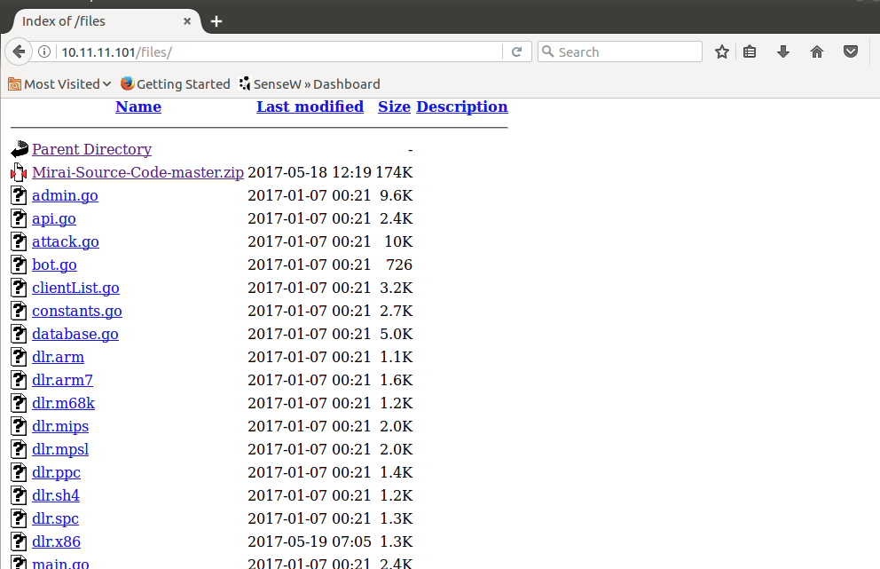

Slide 17
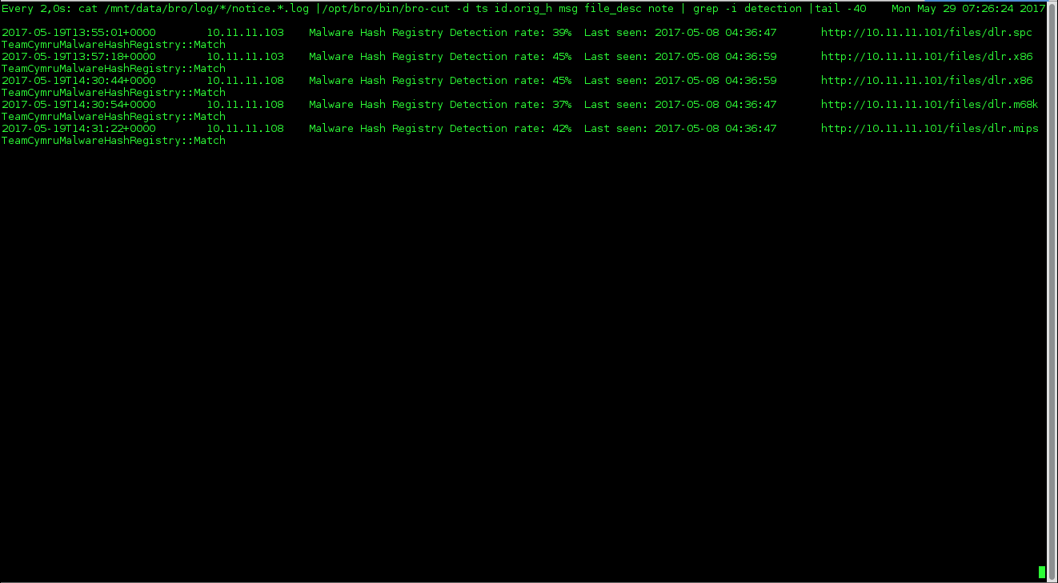

Slide 18
Conclusion
MITIGATION
  Hijacked: Networking best practices, detection, firewall
  Target Attacked: fast detection, fast response, LB infra, application layer firewalling
  https://github.com/jgamblin/Mirai-Source-Code
As code release many variants of mirai exists, using different ports , CnC and protocols, behavior detection

