Slide 1

Auto Prevention
IPS/IDS
Requirements
SDN Networks
OpenFlow, why
Devices
Sample network
Author: Ernest Farias - 2018

Slide 2
Auto Prevention - IPS
Intrusion prevention systems are basically extensions of intrusion detection systems. That are able to actively block or prevent intrusions that are detected.
An IPS can drop malicious packets by blocking the traffic an offending IP address.
Author: Ernest Farias - 2018

Slide 3
Auto Prevention - Requirements
SDN Networks
Openflow protocol
SDN Controller
Compatible Devices
Author: Ernest Farias - 2018

Slide 4
Auto Prevention – SDN/OF
SDN Networks and Open Flow Protocol
Facilitates network management and enables programmatically efficient network configuration
Centralize network intelligence in one network component by disassociating the forwarding process of network packets (data plane) from the routing process (control plane)
Openflow provides hardware abstraction providing the controller a method to communicate with
multiple vendor devices, multiple hardware types (routers, switches, load balancers and others), using a standard interface.
Most initial SDN devices are routers and switches
OF was released in 2006, most vendors supports OF V1.3
Author: Ernest Farias - 2018

Slide 5
Auto Prevention – Devices
SDN Controllers
Cisco Open SDN, OpenDaylight*, Floodlight.. etc.
Some OF Devices
HP Aruba 2920/30M Switch Series
HP Aruba 2540 Switch Series
HP Aruba 2930F Switch Series
Cisco Nexus® 3000 Series Switches
Cisco Nexus 3016Q, 3048, 3064X, 3064-32T, 3064T, 3132Q, 3132Q-X, 3172PQ, 3172TQ, 3524 and 3548
Cisco Catalyst 4500X Series Switches
Cisco Catalyst 4500X-40 SFP+, 4500X-32 SFP+,4500X-24 SFP+, 4500X-16 SFP+, 4500X-F-32 SFP+, 4500X-F-16 SFP
Cisco Catalyst 4500 Series Routers
Cisco Catalyst 4500 E Series with Supervisor cards SUP7E, SUP7LE and SUP8E
Author: Ernest Farias - 2018

Slide 6
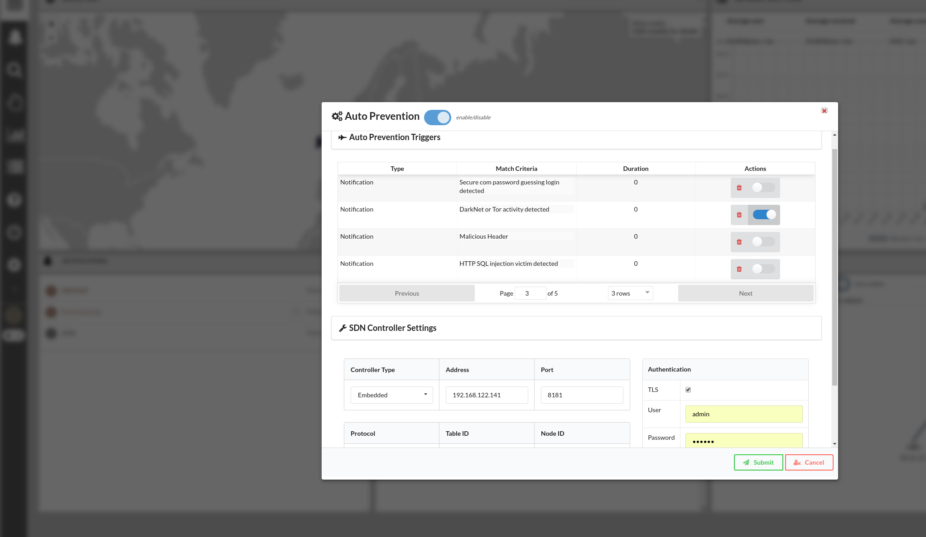
Auto Prevention – Muninn
Author: Ernest Farias - 2018

Slide 7
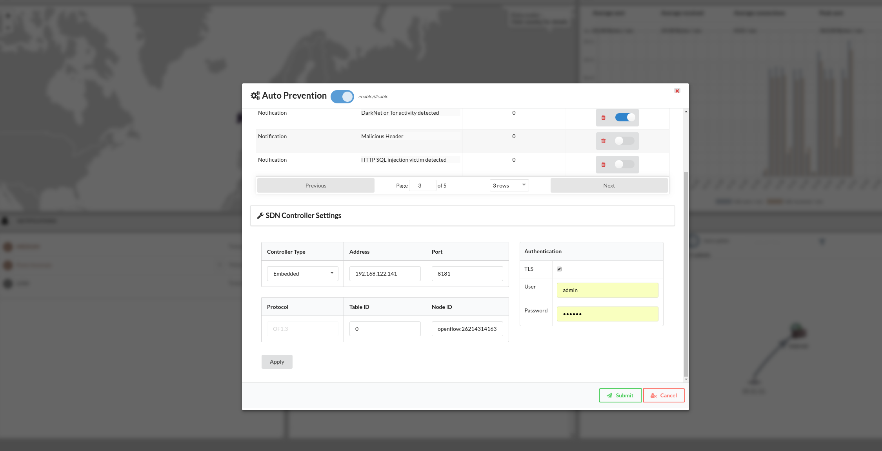
Auto Prevention – Muninn
Author: Ernest Farias - 2018

Slide 8
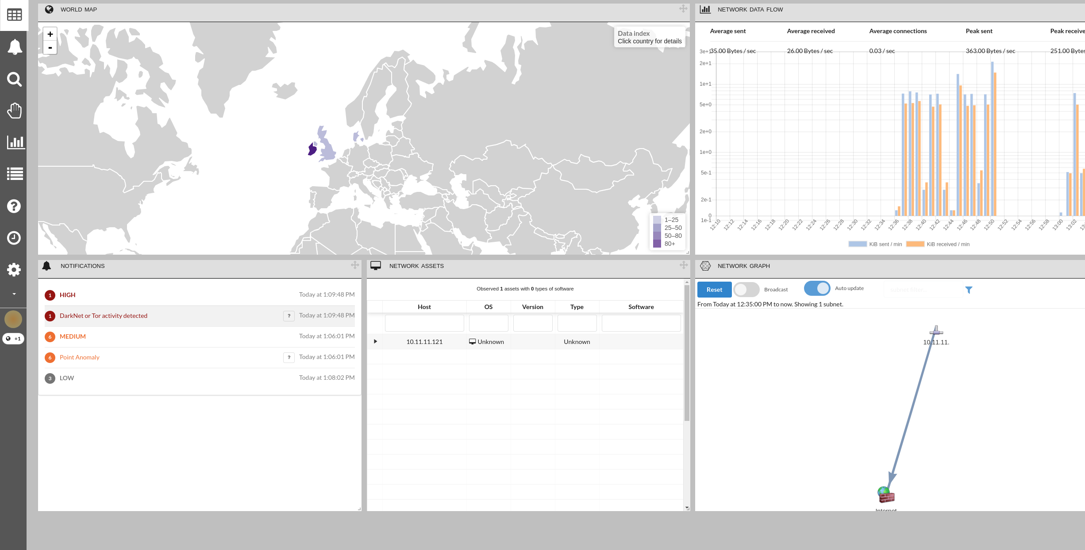
Auto Prevention
Author: Ernest Farias - 2018

Slide 9
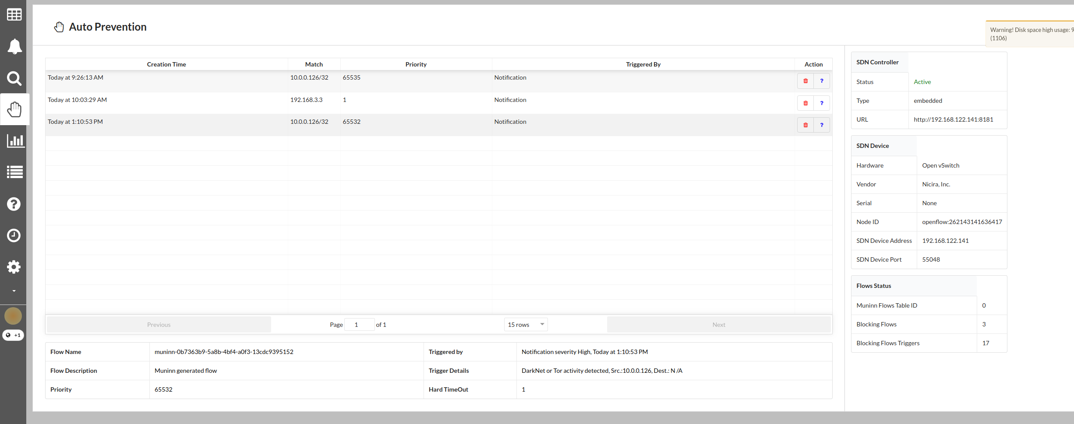
Auto Prevention
Author: Ernest Farias - 2018

Slide 10
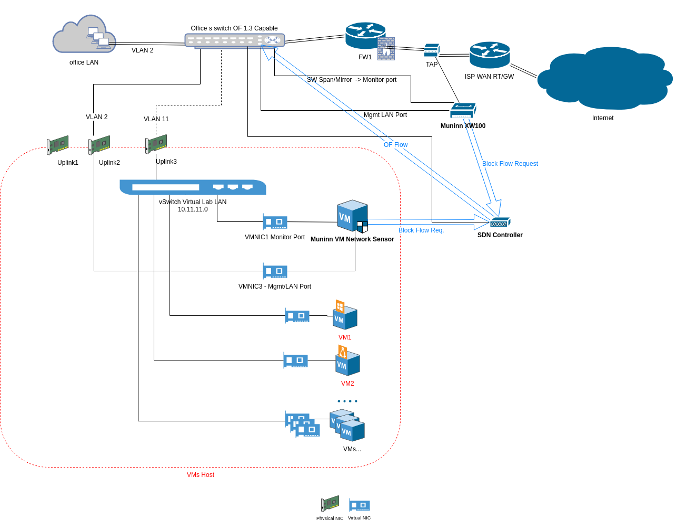
Sample Network
Author: Ernest Farias - 2018

