Slide 1

Reverse SSH
Reverse SSH specifies that the given port on the remote server host is to be forwarded to the given host and port on the local side. Reverse SSH is a technique through which you can access systems that are behind a firewall from the outside world.
Technique that could also be employed for Lateral Movevent tactics that pave the way for Data Exfiltration.
Author: Ernest Farias - 2018

Slide 2
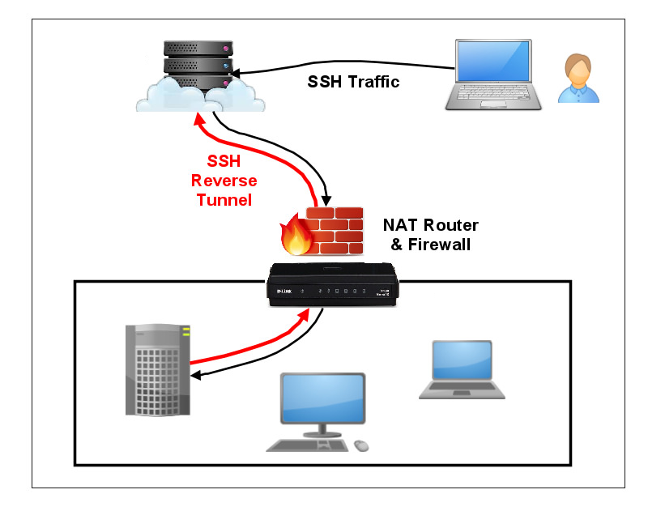

Reverse SSH
Computer with public access.
ie. an AWS instance
Attacker, in an unknown location
Office Network
Office Local computer
Author: Ernest Farias - 2018

Slide 3
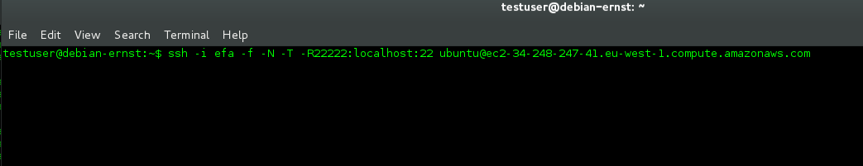
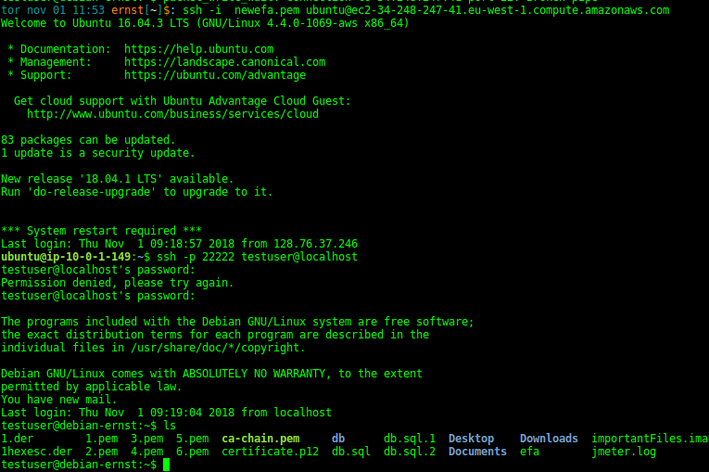
Reverse SSH – On the real world
ssh client command from the office local firewalled network, the initiator states that , it will connect to a public host that serves ssh at 22port , and it will allow remote ingoing connections to port 22222, it could be any port, ie 443 or 80 which are rarerly filtered.
Office local computer: start ssh client and indicates remote access port
The attacker has a computer with a ssh server listening at 22port, it could be hosted in a cloud provider, whose addresses normally are not part of abusive blacklisted addresses, it could also be a malicious software installed/infected a legitimate public sever, and the hijacked victim will inadvertently hide all attacker traces.
The attacker access to its cloud hosted computer/hijacked victim, it hides quite well its identity.
Then the attacker initiates the tunnel to access into the office local computer and run an list files command
As all the connections are being over secure encrypted channells, and passive victims could be involved, It’s quite hard to detect attacker’s indentity, traces nor location.
From Attacker laptop: ssh conn to public computer
Once in public computer: ssh conn to local office computer
Author: Ernest Farias - 2018

