Slide 1

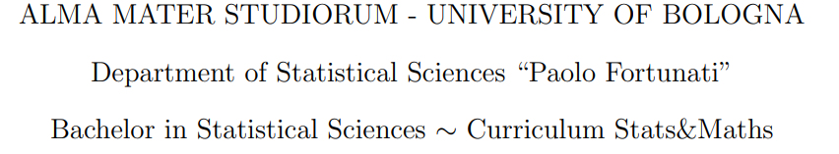
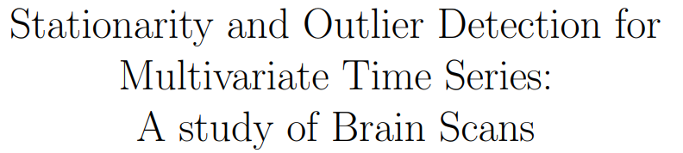
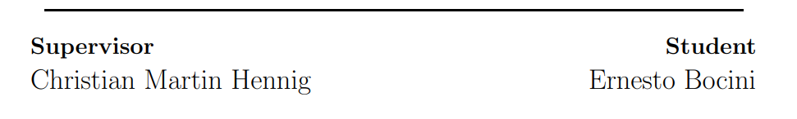

Slide 2
Background – Why important?
Brain studies focused on people engaged in an activity.
Several benefits from these kind of studies. Brain activity during tasks described in terms of properties of brain at rest.
Of particular interest is BOLD at rest for subjects with different traits.
Ernesto Bocini
Study of Brain Scans
1

Slide 3
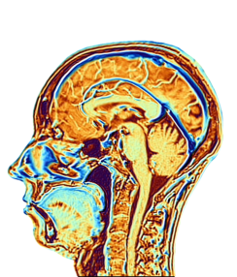
Presentation outline
1. Project overview.
2. Data.
3. Statistical Analysis.
4. Conclusions.

Slide 4
Project Overview
Aims
Methods
This project aims to study different behaviours of the brain at rest.
BOLD time series.
Define a statistic that is able to capture differences in BOLD among subjects based on their traits.
  ADF analysis.
  OUTLIER DETECTION procedure
Ernesto Bocini
Study of Brain Scans
3
Notes:
In order to study this, we need to prepare the data so that it can be used for later analysis, and this involves also a study of missing values. Then we also need to define a statistic that is able to capture differences in the BOLD for different subjects. In the thesis paper we proposed two different analysis, one based on the ADF tests, so on the strationarity of the BOLD serie, one based on an outrlier detection procedure. In this presentation we will only talk about this latter, which was the most succesfull analysis.
In this presentation however we are only going to focus on the process of bringing up a statistic

Slide 5
Data
The multimodal imaging dataset comes from a pilot study of the Enhanced Nathan Kline Institute-Rockland Sample project (NKI1). The pilot NKI1 study comprises multimodal imaging data and subject-specific covariates for n = 24 subjects. We focus on the following two datasets:
    1. Dynamic functional activity.
    2. Information on subjects.
Ernesto Bocini
Study of Brain Scans
4

Slide 6
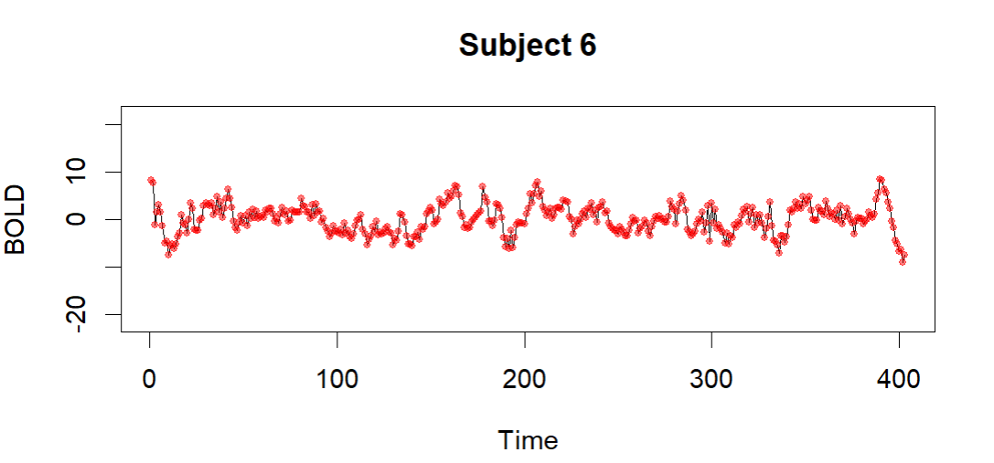
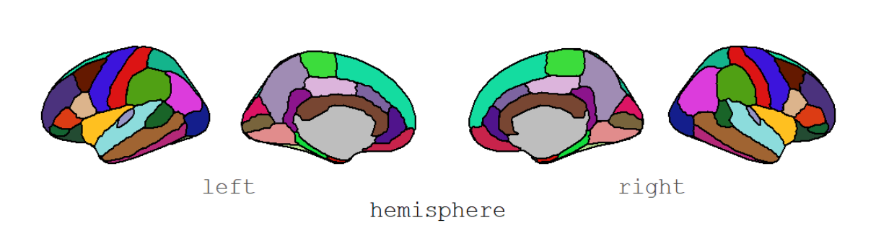
1. Dynamic functional activity.
70 × 404 × 24 × 2
70 × 404 × 24 × 2
70 × 404 × 24 × 2
70 × 404 × 24 × 2
Brain regions accordingly to Desikan atlas parcellation.
Time observations. Time lag between consecutive time observations is 1400 ms.
STUDY OF MISSING VALUES
BRAIN
REGIONS
TIME OBSERVATIONS
NUMBER OF SUBJECTS
NUMBER OF SCANS
70 × 403 × 22 × 1
https://surfer.nmr.mgh.harvard.edu/fswiki/CorticalParcellation
Ernesto Bocini
Study of Brain Scans
5

Slide 7
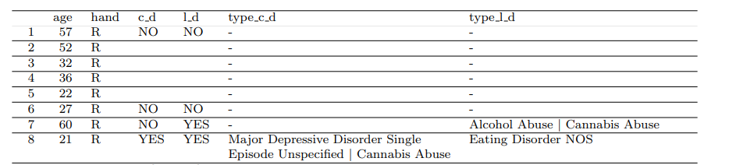
2. Information on subjects.
For each subject in the study we know:
1. ID
2. AGE at the first scan
3. HANDEDNESS
4. current and/or lifetime DIAGNOSIS
Ernesto Bocini
Study of Brain Scans
6

Slide 8







ADF Analysis Unit Root Test
DF test
ADF test
Ernesto Bocini
Study of Brain Scans
7

Slide 9
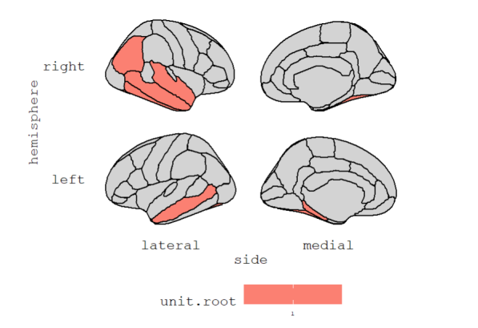
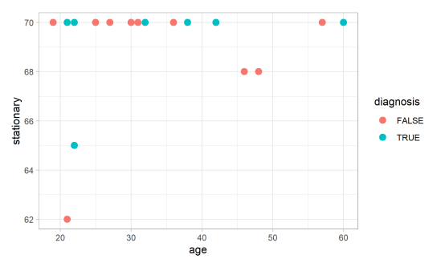
ADF Analysis
Scatterplot: stationary vs age
Stationary brain regions for Subject 9 accordingly to the Desikan atlas parcellation
Ernesto Bocini
Study of Brain Scans
8

Slide 10
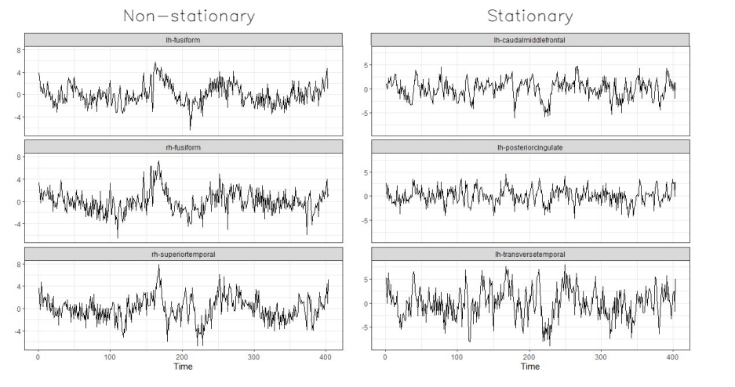
Subject 9. On the left: 3 randomly selected series that resulted non-stationary to the ADF test; on the right: three randomly selected series that resulted stationary to the ADF test.
Ernesto Bocini
Study of Brain Scans
9

Slide 11
OUTLIER DETECTION
Before discussing the results we need to introduce:
    4 types of TEMPORAL OUTLIERS
    Identification and estimation of the VARMA Model
    OUTLIER DETECTION PROCEDURE
Ernesto Bocini
Study of Brain Scans
10

Slide 12
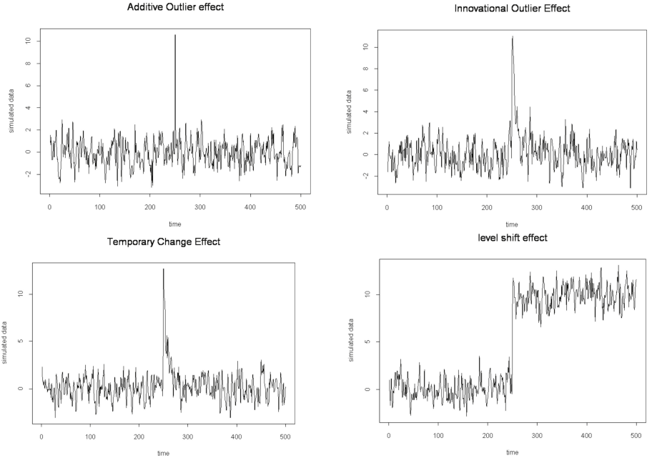
FOUR TYPES OF TEMPORAL OUTLIERS
F. Matarise (2012)
Ernesto Bocini
Study of Brain Scans
8/
11

Slide 13
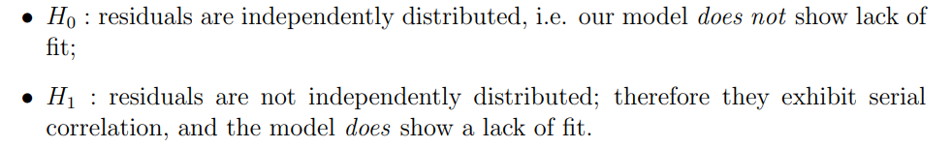





Identification of the VARMA Model
Ljung-Box statistics Q
The LB test is a way to test for the absence of serial autocorrelation up to a specified lag h:
sample autocorrelation, h number of lags.
Under , asymptotically follows a .
Estimation : Tiao & Box: Modeling multiple time series with applications
Ernesto Bocini
Study of Brain Scans
12

Slide 14







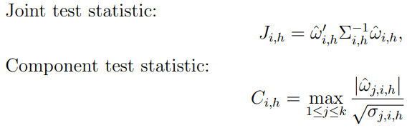
    OUTLIER DETECTION PROCEDURE
Build a VARIMA model, assuming no outliers and let be the estimated residuals and the estimated coefficients of the autoregressive representation of the time series.
Estimate the OUTLIER SIZE
TEST the null hypothesis vs To do so, two statistics are used.
Remove the outlier impact
The adjusted series is treated as the new dataset and the detecting procedure is iterated. We terminate the detection procedure when no significant outlier is detected.
Ernesto Bocini
Study of Brain Scans
13

Slide 15
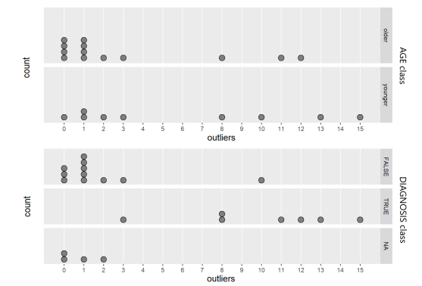
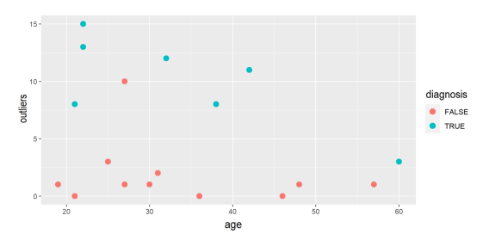
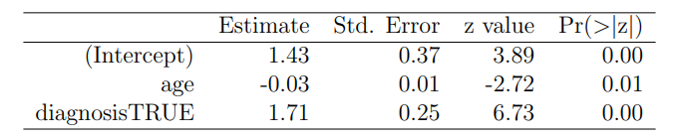
GLOBAL RESULTS:
Ernesto Bocini
Study of Brain Scans
14

Slide 16
Conclusions
Outlier detection performs better
There is still the possibility for future work:
    Enlarging our sample size
    Perform our own simulation study on the fitted models in order to create even more precise empirical critical values
    Obtain a more sensible spatio-temporal analysis.
Ernesto Bocini
Study of Brain Scans
15

