Slide 1
How to Mock it?
Open Source Examples of Unit Tests for a Jenkins Shared Library
Lisa Ranjbar, Emilio Reyes, Ernesto Ojeda
Notes:
This PowerPoint Template includes a series of slide masters with predefined layouts and color schemes for formatting slides
Slide Masters are displayed when you right click on a slide and select Layout from menu

Slide 2
Introduction

Slide 3


About EdgeX Foundry
An open source, vendor neutral project (and ecosystem)
A microservice, loosely coupled software framework for IoT edge computing
Hardware and OS agnostic
Started in 2017
https://www.edgexfoundry.org/

Slide 4
About edgex-global-pipelines
Opinionated Jenkins Shared Library for EdgeXFoundry
Backbone of the Jenkins pipelines for EdgeXFoundry
Open Source
Active Development
https://github.com/edgexfoundry/edgex-global-pipelines

Slide 5
Why Unit Test Your Jenkins Shared Library?
Jenkins Shared Libraries can have global scope
Functions should be reused in a large number of Jenkins jobs
Without automated tests you still have to regression test!
Having automated tests will help you find regressions faster.
Enables faster development of features for your Jenkins Shared Library

Slide 6
Pipeline Shared Library
EdgeX-Global-Pipelines Shared Library
Initial code base had limited test automation
Active development
Continuously adding new features
Delivering simple build pipeline API for developers
Improving pipeline build performance
Required regression testing to facilitate future iteration
In need of Building Continuous Confidence

Slide 7
Jenkins-Spock Framework
Extension of the Spock Framework for Jenkins Pipelines
Supports common testing flow: setup, expect, when, then, etc
Facilitates automatic mocking of core Jenkins steps and Jenkins Plugins steps
Supports Jenkins Global Libraries
Groovy based

Slide 8
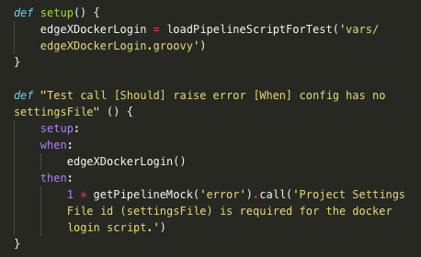
Jenkins-Spock Framework cont.
loadPipelineScriptForTest()
getPipelineMock()
Stub out interactions between functions
getBinding()
We use this to set environment variables
explicitlyMockPipelineVariable()
Mock another custom pipeline function in your library
explicitlyMockPipelineStep()
Mock Pipeline step from a Jenkins plugin
First level bullet, Arial 24pt
Line spacing 0.95, before paragraph 12pt
Left justified
Sentence case
First level bullet color is accent 1
Second level Arial 18pt
Line spacing 0.95, before paragraph 6pt

Slide 9
Mocking Best Practices

Slide 10
Mock Pipeline Plugins
Allow Jenkins-Spock to automatically mock Pipeline Steps
sshagent(credentials: [...])
Error: java.lang.IllegalStateException: There is no pipeline step mock for [sshagent]
Always add Jenkins Plugins as dependencies to Maven/Gradle project
Get Plugin ID for Step in Pipeline Steps: https://www.jenkins.io/doc/pipeline/steps/
Search for Plugin ID in Maven Repository: https://mvnrepository.com/
Add Plugin’s JAR as a project dependency
org.jenkins-ci.plugins:ssh-agent:1.17@jar
Eliminate the need of having to call explicitlyMockPipelineStep()
https://github.com/edgexfoundry/edgex-global-pipelines/blob/master/build.gradle

Slide 11
Mock Environment Variables
Enforce consistent pattern for getting and setting environment variables
Use env.VARIABLE to get value
Use env.VARIABLE = VALUE to set value - avoid using env.setProperty()
Always fully qualify using env.
Facilitate mocking by eliminating unnecessary mocks
Environment variables are script variables
Must be set using getBinding().setVariable()
Env variables should be specified as a Groovy map
https://github.com/edgexfoundry/edgex-global-pipelines/blob/master/vars/edgeXSemver.groovy

Slide 12
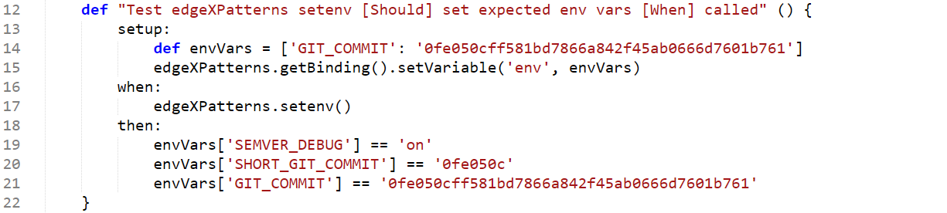
Mock Environment Variables - Example
Source
Unit Test

Slide 13
Mock Nested Objects
Nested objects require explicit mocking
docker.image(‘...’).inside()
Error: java.lang.NullPointerException: Cannot invoke method inside() on null object
Mock using explicitlyMockPipelineVariable()
Expect and stub interactions using getPipelineMock()
https://github.com/edgexfoundry/edgex-global-pipelines/blob/master/src/test/groovy/edgeXNexusPublishSpec.groovy

Slide 14
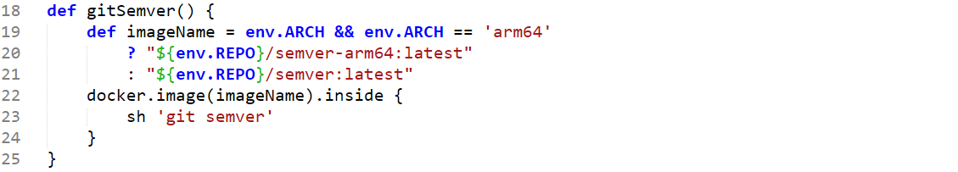
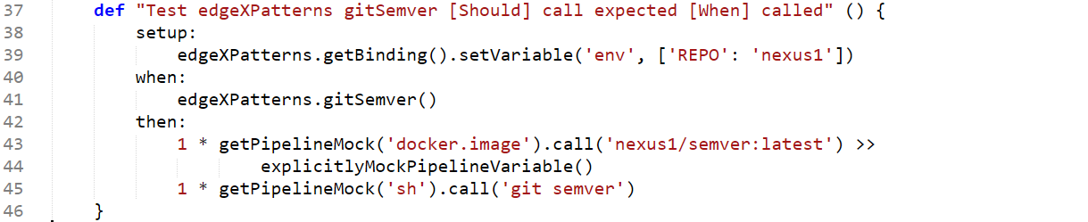
Mock Nested Objects - Example
Source
Unit Test

Slide 15

Mock External Method Calls
Method in scriptA calls method in scriptB
Shared Library may consist of multiple scripts
Helper methods can be centrally located in a utils groovy script for DRY reasons
Error: java.lang.IllegalStateException: There is no pipeline variable mock for [scriptB].
Pipeline libraries and scripts are also variables
Mock using explicitlyMockPipelineVariable()
Expect and stub interactions using getPipelineMock()
https://github.com/edgexfoundry/edgex-global-pipelines/blob/master/src/test/groovy/edgeXSwaggerPublishSpec.groovy

Slide 16
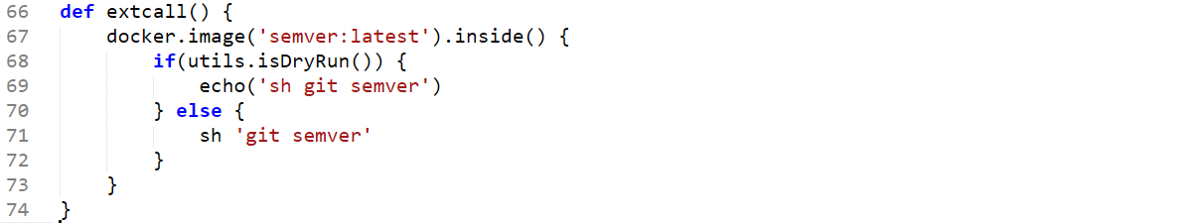
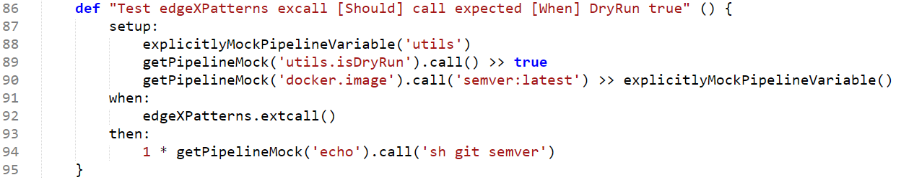
Mock External Methods - Example
Source
Unit Test

Slide 17
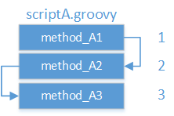
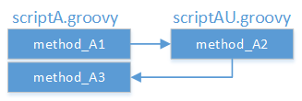
Mock Internal Method Calls
Method in scriptA calls another method in scriptA
Deliberate effort to develop small functionally cohesive methods
Isolate method under test
Mocking method call is complicated and doesn’t scale
Unable to mock method in same script
Workaround
Create call graph for all methods in scriptA
Create another script: scriptAU
Methods in odd-numbered layers stay in scriptA, even-numbered layers move to scriptAU
Use external method call mocking techniques
https://github.com/edgexfoundry/edgex-global-pipelines/blob/master/src/test/groovy/edgeXReleaseGitTagSpec.groovy

Slide 18
Unit Testing Setup
Jenkins-Spock, Gradle, etc...

Slide 19
Running the tests… Getting Started
Initial implementation was based off the jenkins-spock shared-library example
Tests originally run with Maven
pom.xml...so much xml
Issues with dockerized builds
Lacking features for fast local development

Slide 20
Running the tests… Migrating to Gradle
Overall speed improvements
Better developer experience
Gradle offers a lot of flexibility / extensibility
Plugin support to get code coverage (potentially build our own)
Unit test summary report
A good Maven vs Gradle comparison can be found here: https://gradle.org/maven-vs-gradle/

Slide 21
Running the tests… Speed improvements
Before and After Migration
Maven: mvn clean test.
103 tests, 5 minutes on average to run
Gradle: gradle clean test.
103 tests, 2 minutes on average to run
Today
188 total tests, 3 minutes on average to run
Use Gradle's --parallel. option with forking on Test tasks

Slide 22
CI/CD for the Pipeline Library
Best practices for running on Jenkins

Slide 23
Use of Docker for running unit tests
Docker is used for running Gradle tasks
Optimizations
Vanilla Gradle docker images can be used i.e. .gradle:6.5.
Recommended approach: Bundle dependencies in custom base docker image
Can save 1.5 - 2m downloading individual dependencies
docker pull takes about 16-20s for 602MB image
...
stage('Test') {
agent {
docker {
image "edgex-devops/egp-unit-test:gradle"
args ...
}
}
steps {
sh 'gradle clean test --parallel'
...
}
}
see Jenkinsfile...

Slide 24
Developer Experience
IDE Integration

Slide 25
IDE Integration
Nice integrations for IDE, Eclipse/IntelliJ, etc.
Run specific tests
Run only failed tests
Debug tests and step through code
https://www.jetbrains.com/idea/

Slide 26
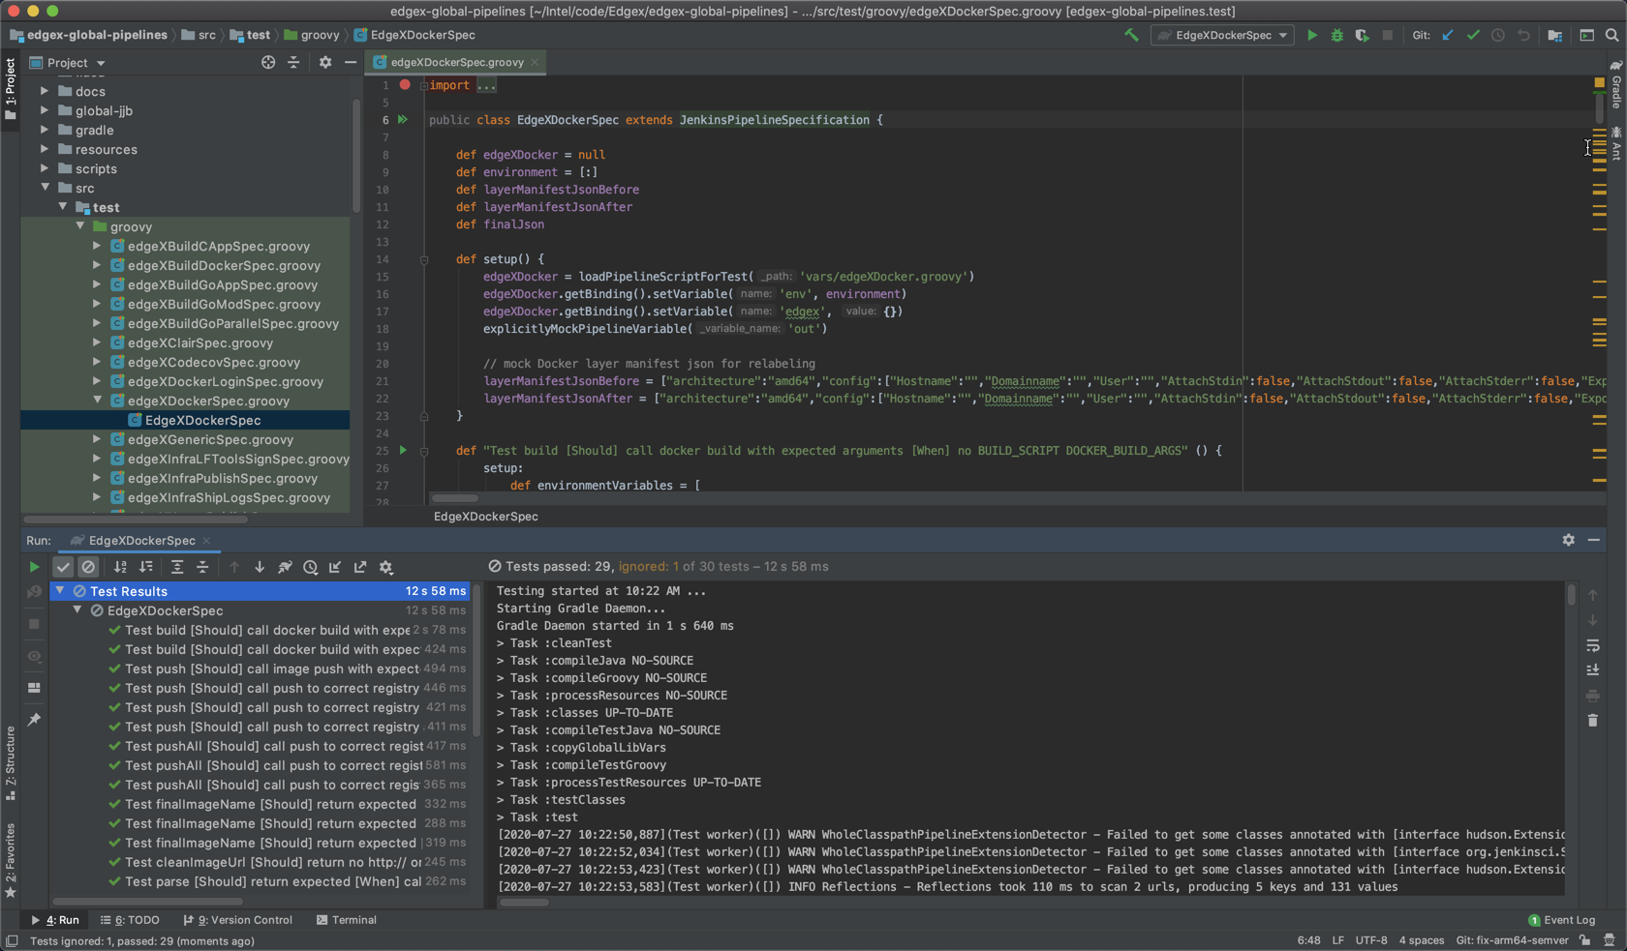
IntelliJ IDEA Integration

Slide 27
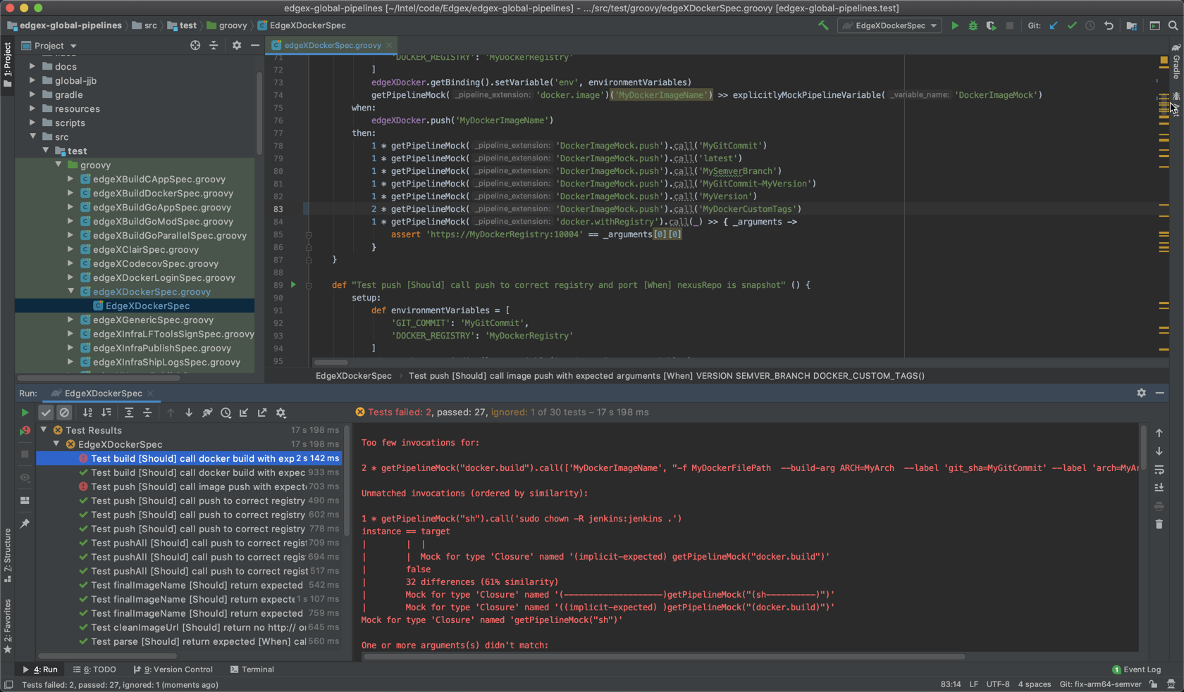
IntelliJ IDEA Integration

Slide 28
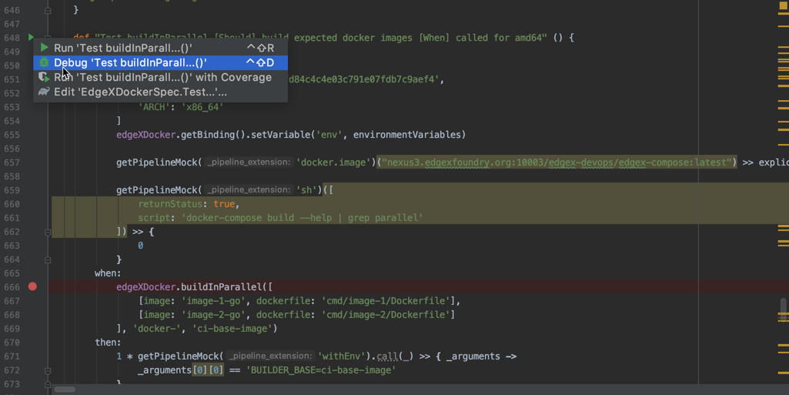
IntelliJ IDEA Integration

Slide 29
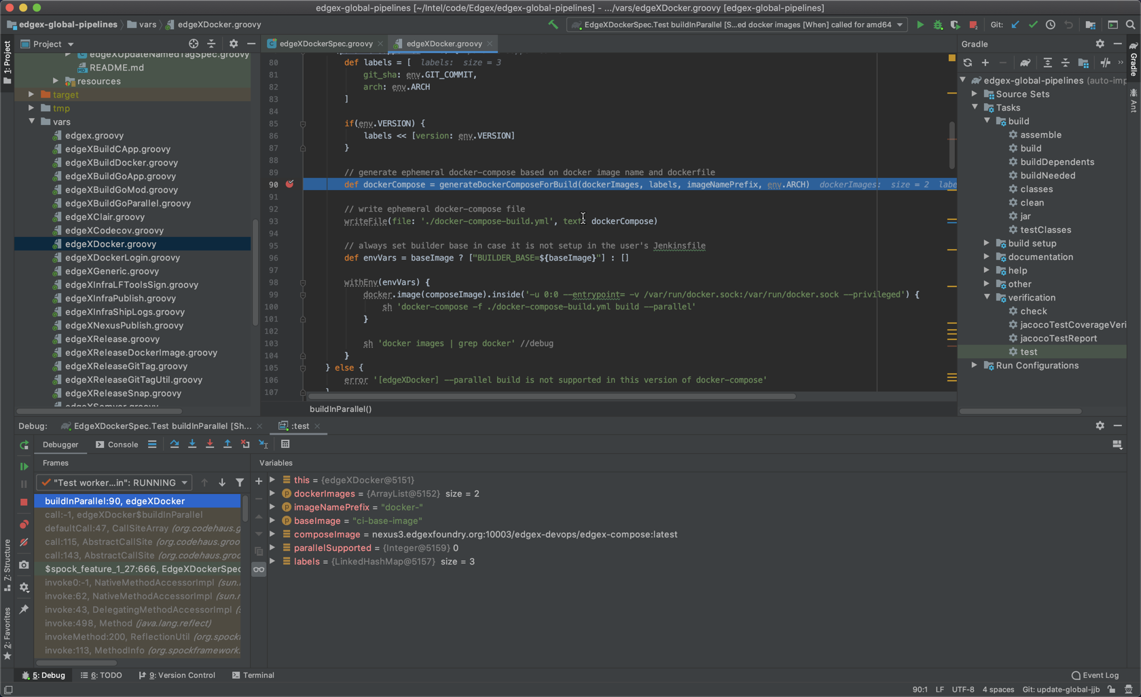
IntelliJ IDEA Integration

Slide 30
Conclusion

Slide 31
Conclusion
Jenkins-spock makes it easy to mock your pipeline steps
Build continuous confidence in your shared pipeline libraries
Ease of use and increased build velocity with Gradle
IDE integration makes for a great development experience

Slide 32
Title and Content Layout: Arial 32pt
First level bullet text, Arial 24pt
Line spacing 0.95, before paragraph 12pt
Left justified
Sentence case
First level bullet color is accent 1
Second level bullet Arial 18pt
Line spacing 0.95, before paragraph 6pt

Slide 33
Title and Content Layout: Arial 32pt
First level bullet text, Arial 24pt
Line spacing 0.95, before paragraph 12pt
Left justified
Sentence case
First level bullet color is accent 1
Second level bullet Arial 18pt
Line spacing 0.95, before paragraph 6pt

Slide 34
Two Content Layout
First level bullet, Arial 24pt
Line spacing 0.95, before paragraph 12pt
Left justified
Sentence case
First level bullet color is accent 1
Second level Arial 18pt
Line spacing 0.95, before paragraph 6pt
First level bullet, Arial 24pt
Line spacing 0.95, before paragraph 12pt
Left justified
Sentence case
First level bullet color is accent 1
Second level Arial 18pt
Line spacing 0.95, before paragraph 6pt

Slide 35
Theme Colors
White
R255 G255 B255
Accent 1
R244 G72 B60
Black
R0 G0 B0
Accent 2
R113 G82 B221
Light 2 –Background
R 192 G191 B200
Accent 3 R40 G156 B225
Dark 2 –Title
R33 G36 B60
Accent 4
R255 G191 B26
CHARTS WARNING: If you have both Office 2003 and 2007 installed on your system there may be a bug in chart colors. To ensure that accent colors 1-6 are used we recommend opening Excel 2007 prior to working with charts. We have discovered that if Excel 2007 is not open:
the charting could default back to MS graph app.
An error box may appear asking user to close excel dialog boxes
Accent 5 R89 G28 B89
Accent 6
R32 G82 B160

Slide 36
Default Settings
Theme Fonts:
Arial (heading)
Arial (body)
Drawing Style:
Sample
Sample
Sample
Text Box:
Default: Arial Bold 20pt
Center
Red, Accent 1
Line spacing [.9]
Space before [12pt]
For Alt Text Styles only – use layout placeholders for bulleted lists
Line Style:
Notes:
For Autotext : Wrap text is always ON (can not be changed)

Slide 37
Default Table Style
Heading 1 | Heading 2 | Heading 3 | Heading 4 | Heading 5
Content | Content | Content | Content | Content
Content | Content | Content | Content | Content
Content | Content | Content | Content | Content
Content | Content | Content | Content | Content

Slide 38
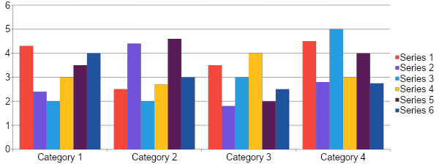
Content Layout: Column Chart Sample
Notes:
BEST PRACTICES:
Open Excel 2007 before creating/editing charts in PowerPoint
Duplicate this slide and edit data
Copy and paste this chart/slide to desired location
With the chart selected, go to the Chart Design tab and select Edit Data (this should open the data sheet in Excel)
Edit the data cells on the data sheet in Excel and Save
If this chart contains custom formatting:
These charts and any others you create can be saved as chart templates.
With the chart selected, go to the Chart Design tab and select Save as Template [Note: MAC users click Change Chart Type and select Save as Template from the dropdown]
Name the style as desired and Save
To apply the template, first select desired chart, then go to the Chart Design tab, select Change Chart Type
Select the Template folder at the top of the list and choose the custom saved style you wish to apply, then click OK
Note: you will need to do this for each type of chart (column, line, pie). Name your Template styles accordingly for efficiency.

Slide 39
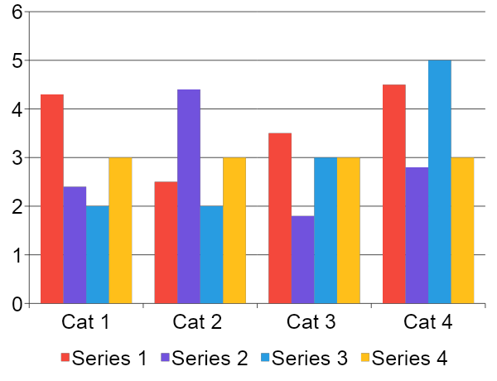
Two Content Layout: Column Chart Sample
First level bullet text
Line spacing 0.95, before paragraph 12pt
Left justified
Sentence case
First level bullet
Second bullet level
Second bullet level
Notes:
BEST PRACTICES:
Open Excel 2007 before creating/editing charts in PowerPoint
Duplicate this slide and edit data
Copy and paste this chart/slide to desired location
With the chart selected, go to the Chart Design tab and select Edit Data (this should open the data sheet in Excel)
Edit the data cells on the data sheet in Excel and Save
If this chart contains custom formatting:
These charts and any others you create can be saved as chart templates.
With the chart selected, go to the Chart Design tab and select Save as Template [Note: MAC users click Change Chart Type and select Save as Template from the dropdown]
Name the style as desired and Save
To apply the template, first select desired chart, then go to the Chart Design tab, select Change Chart Type
Select the Template folder at the top of the list and choose the custom saved style you wish to apply, then click OK
Note: you will need to do this for each type of chart (column, line, pie). Name your Template styles accordingly for efficiency.

Slide 40
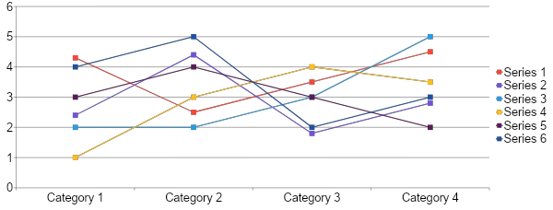
Content Layout: Line Chart Sample
Notes:
BEST PRACTICES:
Open Excel 2007 before creating/editing charts in PowerPoint
Duplicate this slide and edit data
Copy and paste this chart/slide to desired location
With the chart selected, go to the Chart Design tab and select Edit Data (this should open the data sheet in Excel)
Edit the data cells on the data sheet in Excel and Save
If this chart contains custom formatting:
These charts and any others you create can be saved as chart templates.
With the chart selected, go to the Chart Design tab and select Save as Template [Note: MAC users click Change Chart Type and select Save as Template from the dropdown]
Name the style as desired and Save
To apply the template, first select desired chart, then go to the Chart Design tab, select Change Chart Type
Select the Template folder at the top of the list and choose the custom saved style you wish to apply, then click OK
Note: you will need to do this for each type of chart (column, line, pie). Name your Template styles accordingly for efficiency.

Slide 41
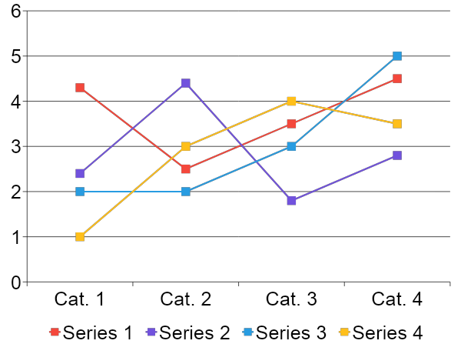
Two Content Layout: Line Chart Sample
First level bullet text
Line spacing 0.95, before paragraph 12pt
Left justified
Sentence case
First level bullet
Second bullet level
Second bullet level
Notes:
BEST PRACTICES:
Open Excel 2007 before creating/editing charts in PowerPoint
Duplicate this slide and edit data
Copy and paste this chart/slide to desired location
With the chart selected, go to the Chart Design tab and select Edit Data (this should open the data sheet in Excel)
Edit the data cells on the data sheet in Excel and Save
If this chart contains custom formatting:
These charts and any others you create can be saved as chart templates.
With the chart selected, go to the Chart Design tab and select Save as Template [Note: MAC users click Change Chart Type and select Save as Template from the dropdown]
Name the style as desired and Save
To apply the template, first select desired chart, then go to the Chart Design tab, select Change Chart Type
Select the Template folder at the top of the list and choose the custom saved style you wish to apply, then click OK
Note: you will need to do this for each type of chart (column, line, pie). Name your Template styles accordingly for efficiency.

Slide 42
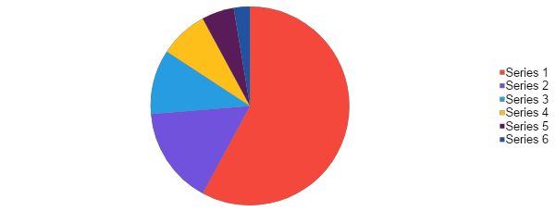
Content Layout: Pie Chart Sample
Notes:
BEST PRACTICES:
Open Excel 2007 before creating/editing charts in PowerPoint
Duplicate this slide and edit data
Copy and paste this chart/slide to desired location
With the chart selected, go to the Chart Design tab and select Edit Data (this should open the data sheet in Excel)
Edit the data cells on the data sheet in Excel and Save
If this chart contains custom formatting:
These charts and any others you create can be saved as chart templates.
With the chart selected, go to the Chart Design tab and select Save as Template [Note: MAC users click Change Chart Type and select Save as Template from the dropdown]
Name the style as desired and Save
To apply the template, first select desired chart, then go to the Chart Design tab, select Change Chart Type
Select the Template folder at the top of the list and choose the custom saved style you wish to apply, then click OK
Note: you will need to do this for each type of chart (column, line, pie). Name your Template styles accordingly for efficiency.

Slide 43
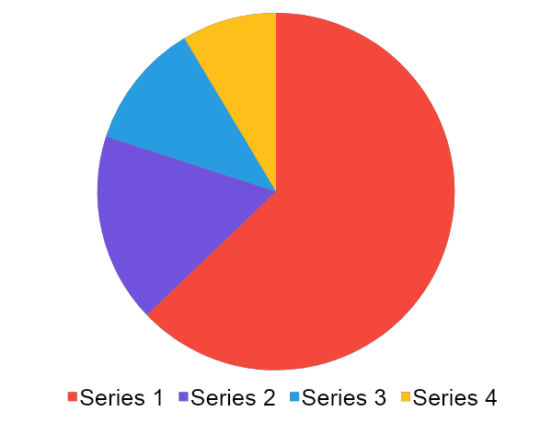
Two Content Layout: Pie Chart Sample
First level bullet text
Line spacing 0.95, before paragraph 12pt
Left justified
Sentence case
First level bullet
Second bullet level
Second bullet level
Notes:
BEST PRACTICES:
Open Excel 2007 before creating/editing charts in PowerPoint
Duplicate this slide and edit data
Copy and paste this chart/slide to desired location
With the chart selected, go to the Chart Design tab and select Edit Data (this should open the data sheet in Excel)
Edit the data cells on the data sheet in Excel and Save
If this chart contains custom formatting:
These charts and any others you create can be saved as chart templates.
With the chart selected, go to the Chart Design tab and select Save as Template [Note: MAC users click Change Chart Type and select Save as Template from the dropdown]
Name the style as desired and Save
To apply the template, first select desired chart, then go to the Chart Design tab, select Change Chart Type
Select the Template folder at the top of the list and choose the custom saved style you wish to apply, then click OK
Note: you will need to do this for each type of chart (column, line, pie). Name your Template styles accordingly for efficiency.

Slide 44
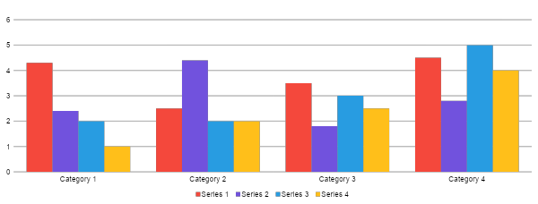
Custom Column Chart
Notes:
THIS CHART USES CUSTOM FORMATTING. To retain custom formatting, do one of the following options:
Duplicate and Edit Data
Copy and paste this chart/slide to desired location
With the chart selected, go to the Chart Design tab and select Edit Data (this should open the data sheet in Excel)
Update the data cells on the data sheet in Excel and Save
Save this custom chart style as a template
With the chart selected, go to the Chart Design tab and select Save as Template
[Note: MAC users click Change Chart Type and select Save as Template from the dropdown]
Name the style as desired and Save
To apply the template, first select desired chart, then go to the Chart Design tab, select Change Chart Type
Select the Template folder at the top of the list and choose the custom saved style you wish to apply, then click OK
Note: you will need to do this for each type of chart (column, line, pie). Name your Template styles accordingly for efficiency.
BEST PRACTICES:
PC users should open Excel before creating charts in PowerPoint

