Slide 1
Zoo Class
Brain Box Group
30th june 2012

Slide 2
Hierarchy of the Zoo
ZOO Attribute:Zoo_Name,Location
LIVING BEIGNS Attribute(s):(Name,Age,Gender)
INFRASTRUCTURE
ANIMALS
HUMAN BEIGNS
we created the parent class (Zoo)
We went ahead and created 2 child classes (living beings and Infrastructure)

Slide 3
Hierarchy of Human Beigns
HUMAN BEIGNS
EMPLOYEES
VISITORS
ID
DEPARTMENT
POSITION
SALARY
TICKET NUMBER
Under Human Beings we created we created 2 child classes (Employee and Visitors)

Slide 4
Hierarchy of Animals
ANIMALS
AMPHIBIANS
MAMMALS
BIRDS
FISH
REPTILES
Under Animals we created 5 child classes (animals, Amphibians, Fish, Mammals, Birds)

Slide 5
Hierarchy of Infrastructure
INFRASTRUCTURE
Offices
Cages
Under infrastructure we had two child classes (Cages and Offices)

Slide 6
Attributes
We had the following attributes for the zoo (name,location)
Living beings(age, gender name)
Humans(status)
Visitor(ticket_number)
Employee Class(position, department, salary)
Animals(Population)
Infrastructure(type, location)
Cages(security_Level)
Offices(Room_Number)

Slide 7
Methods
Zoo:Print_Details() - This will be a method that will be referenced by all the child classes
Search()-This will be a method that will be referenced by all the child classes
Employee: Add_Employee()
Visitors: Take_Photo()
Animal: Make_Noise()

Slide 8
Sample Code
class Zoo:
def __init__(self,name,location):
self.name = name
self.zoo_location = location
def print_detail(self):
print self.name,self.zoo_location
def search(self,place):
print place.zoo_location

Slide 9
class Infrustructure(Zoo):
def __init__(self,zoo,buildtype,location):
Zoo.__init__(self,zoo.name,zoo.zoo_location)
self.buildtype= buildtype
self.location = location
self.zoo = zoo
def search(self,place):
print place.buildtype,'at',place.location,'in',place.name,'at',self.zoo.search(self.zoo)
cage = Infrustructure(accrazoo,'cages','north gate')
office = Infrustructure(accrazoo,'office flat','south gate')
#cage.search(cage)

Slide 10
class Cages(Infrustructure):
def __init__(self,infustructure,security_level,cage_no):
Infrustructure.__init__(self,infustructure.zoo,infustructure.buildtype,infustructure.location)
self.security_level= security_level
self.cage_no = cage_no
self.infustructure = infustructure
def search(self,cage):
print 'cage no.',cage.cage_no,'at',self.infustructure.search(cage)

Slide 11
class Offices(Infrustructure):
def __init__(self,infustructure,Dept,room_no):
Infrustructure.__init__(self,infustructure.zoo,infustructure.buildtype,infustructure.location)
self.infustructure = infustructure
self.Dept = Dept
self.room_no = room_no
def search(self,office):
print 'Office is in room',office.room_no,'at',self.infustructure.search(office)
den = Cages(cage,'high',24)
den.search(den)
manager_office = Offices(office,'Administration','AD201')
manager_office.search(manager_office)

Slide 12
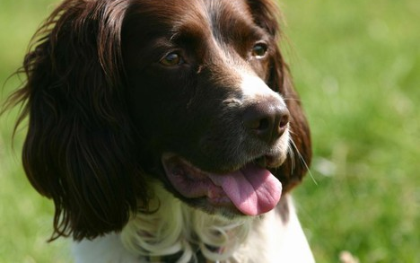
Thank You
  Group Members
  Selom Nyaku
  Kwadwo Debrah
  Anthonio Desmond
  Michael Asare
  Ernest Pobee

