Slide 1

Project for CS2704
By: Ernest Vovk - 3697928

Slide 2
Hypothesis
Original
States with more electric vehicle charging stations will experience higher growth in EV adoption.
Final Hypothesis
States with more electric vehicle (EV) charging stations will experience higher growth in EV adoption. – we investigated whether EV infrastructure influences year-over-year EV growth across the USA by states.
Result Summary
The hypothesis was not supported by the data and its results. EV growth had no significant correlation with charging station count.

Slide 3
Datasets used
EV Registrations 2022 - https://afdc.energy.gov/vehicle-registration?year=2022
EV Registrations 2023 - https://afdc.energy.gov/vehicle-registration?year=2023
EV Charging Stations - https://afdc.energy.gov/stations#/analyze?country=US&tab=fuel&fuel=ELEC&ev_levels=all&show_map=true (You can extract an excel table from it)

Slide 4
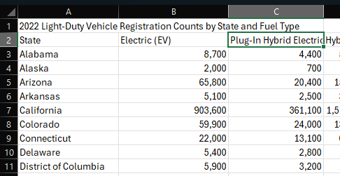
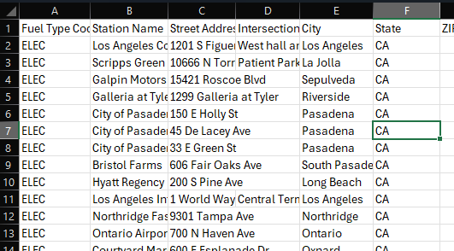
Metadata
EV_2022 and EV_2023
Number of EVs registered per state in 2022 and 2023 (Integer)
Charger_Stations
Count of public EV charging stations (Integer)
EV_Growth (%)
Calculated: ((EV_2023 - EV_2022) / EV_2022) * 100
Measures adoption growth by percentage

Slide 5
Descriptive Analytics
Average EV growth across states – 47.2%
Highest growth – 66.7% in North Dakota
Lowest growth – 29% in Hawaii
Charger station average per state – 1415 (highly skewed by California)

Slide 6
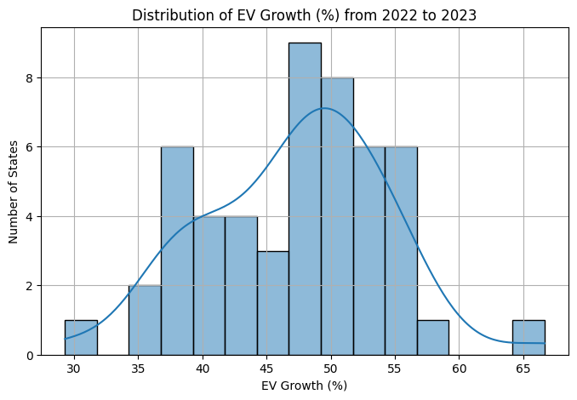
Visualization
Histogram is showing to us that most states experienced EV growth between 40% and 55% from 2022 to 2023, with an average of 47,2%. The distribution is slightly left-skewed, so we could assume that some states are rapidly catching up in EV adoption.

Slide 7
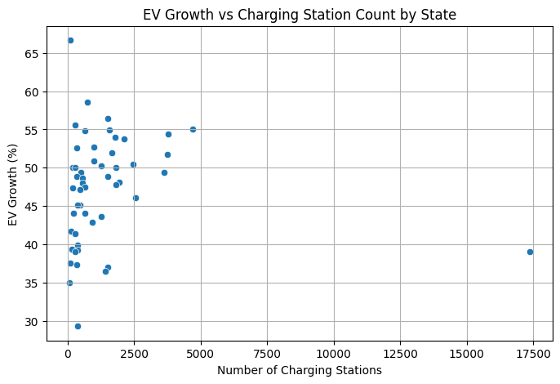
visualization
Scatter plot shows no clear correlation between the number of EV charging stations and EV growth by state, because we can clearly see that states with both high and low station counts had similar growth rates. This implicates that other factors must be the reason for rising adoption.

Slide 8
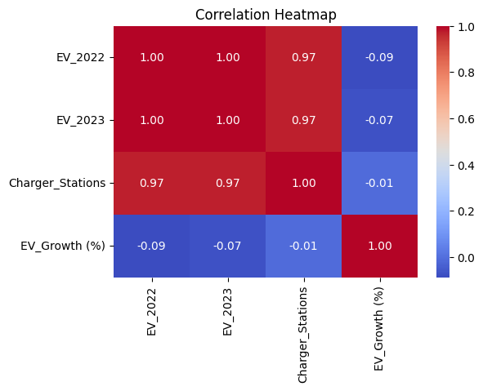
visualization
Correlation heatmap shows that the number of charging stations is strongly correlated with the total number of EVs in both years.
However, EV growth rate has almost no correlation with charging stations or total EV count.
From this we could derive that infrastructure is associated with current EV presence, but it doesn’t predict growth.

Slide 9
Predictive analytics
Response Variable – EV_Growth (%) - growth in EV registrations (target)
Predictor Variable – Charger_Stations - number of public EV charging ports per state
Method used – Linear Regression with statsmodels
Results:
Coefficient: -0.0000282% (The effect of charging stations on growth is extremely weak)
p-value: 0.944 > 0.05, so we cannot say that the number of chargers affects EV growth.
R² = 0.000 (No predictive power)

Slide 10
Conclusion
In this analysis, I explored whether the number of EV charging stations in each U.S. state could predict the percentage growth in electric vehicle registrations from 2022 to 2023. The hypothesis was tested using linear predictive model and the results showed a very weak and statistically insignificant relationship. The findings implicate that while infrastructure is important, it does not directly drive short-term EV growth, and that other factors such as policy incentives, consumer behaviour and prior adoption levels likely to have a much bigger role.

