Slide 1
購物清單產生器
B01505025
工科三張育維

Slide 2
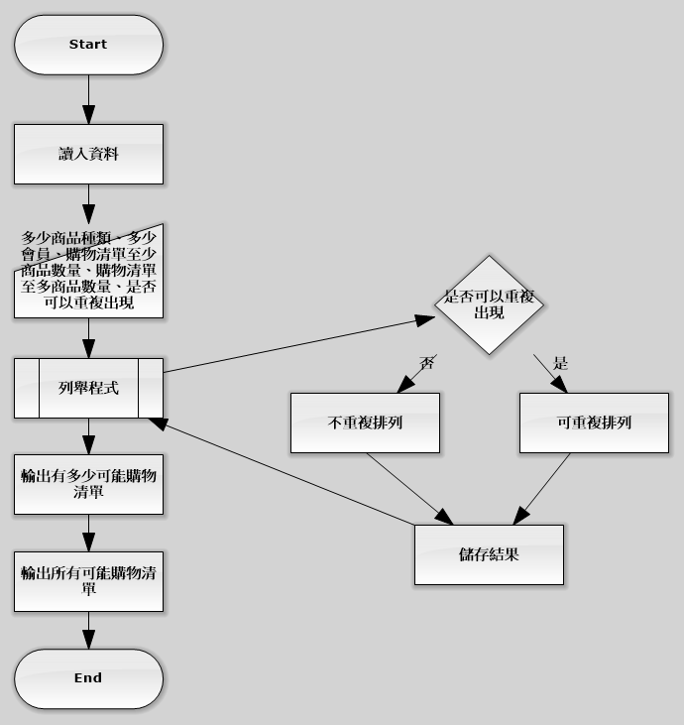
Flow diagram

Slide 3
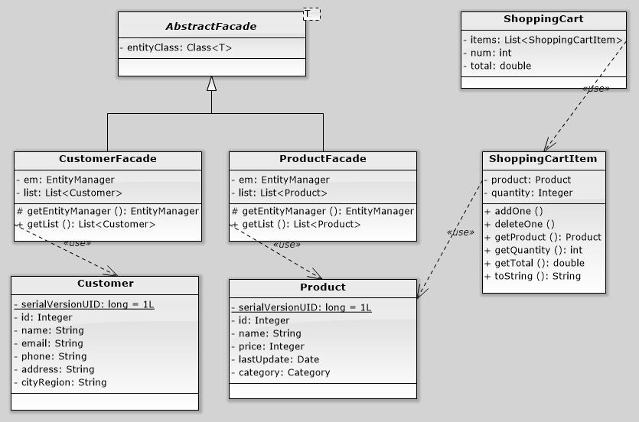
Entity and shopping cart

Slide 4
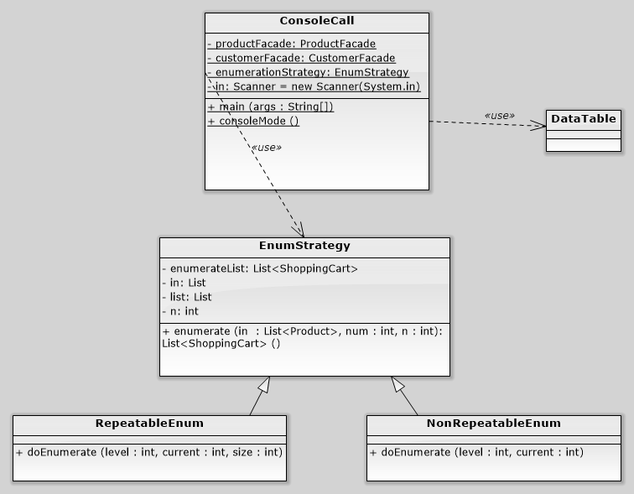
Console

Slide 5
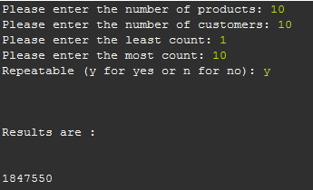
Why 10 will be dead?
In fact, the enumeration of 10, 10, 1, 10 is complete. Because the numbers of enumeration is calculated by the size of the result list. The console output is too slow. To show only the number of result is fast (after all enumerations has been done).

