Slide 1
購物之條件機率
B01505025
工科三張育維

Slide 2
Outline
Requirement
Flow
Architecture
Coverage
Refactor
Terminology
Question
Add E-mail
In time suggestion on facebook

Slide 3
Requirement
Store the shopping cart list as a csv file
Read in the csv file and generate a related shopping rules and corresponding probability
品j被客i買
客i買品j，推薦三件
{客x,品y}，品z被客x買
{客x,品y}，客x買品z，推薦三件

Slide 4
Requirement (additionally)
Set the different probability of different customer, and generate the shopping list
Set the profit of all products, and maximum the profit probability
Consider time
Grouping
{品p,品q,品r}

Slide 5
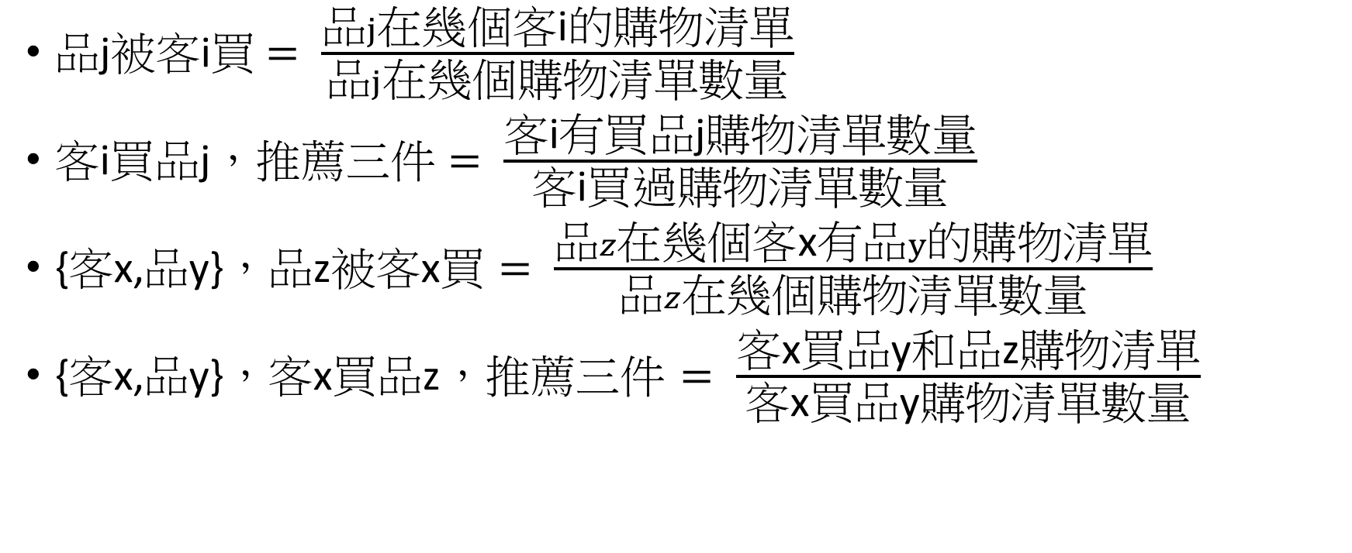
Flow
品j被客i買$= \frac{品j在幾個\text{客}\text{i}的購物清單}{品j在幾個購物清單數量}$
客i買品j，推薦三件 $= \frac{\text{客}\text{i}有\text{買品}\text{j}購物清單數量}{\text{客}\text{i}買過購物清單數量}$
{客x,品y}，品z被客x買 $= \frac{品z在幾個\text{客}\text{x}有品y的購物清單}{品z在幾個購物清單數量}$
{客x,品y}，客x買品z，推薦三件 $= \frac{\text{客}\text{x}\text{買品}\text{y}和\text{品}\text{z}購物清單}{\text{客}\text{x}\text{買品}\text{y}購物清單數量}$

Slide 6
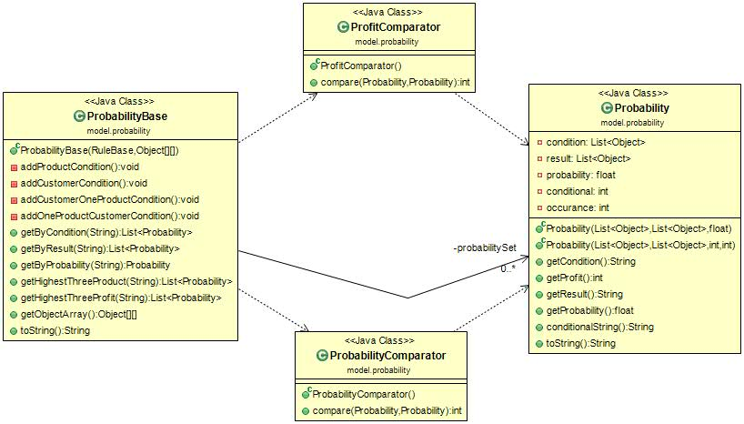
Architecture

Slide 7
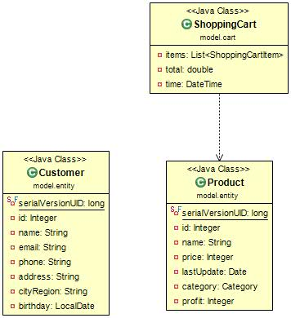
Architecture

Slide 8
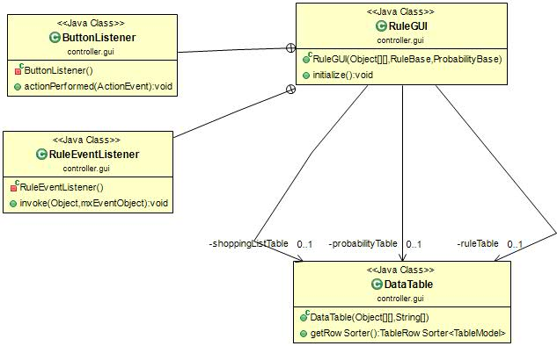
Architecture

Slide 9
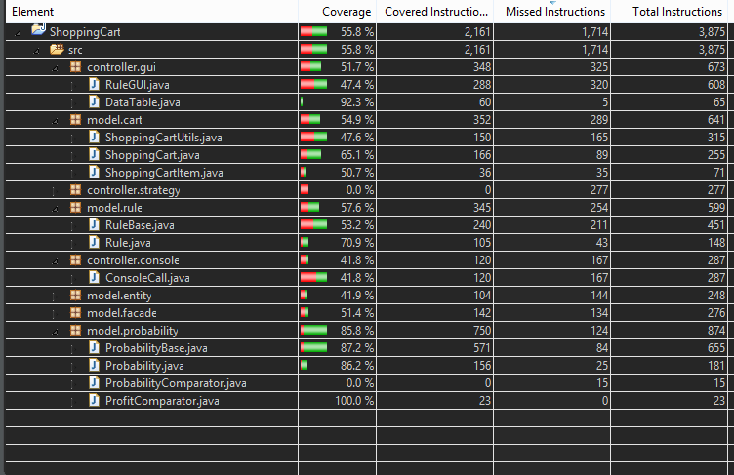
Coverage

Slide 10
Refactor
Code coverage only 55%
RuleBase and RuleGUI below 50%

Slide 11
Terminology
Joda-Time http://www.joda.org/joda-time/
Javax.mail
JAF (JavaBeans Activation Framework)
Guava
restfb
Notes:
he standard date and time classes prior to Java SE 8 are poor. By tackling this problem head-on, Joda-Time has become the de facto standard date and time library for Java. Note that from Java SE 8 onwards, users are asked to migrate to java.time (JSR-310).

Slide 12
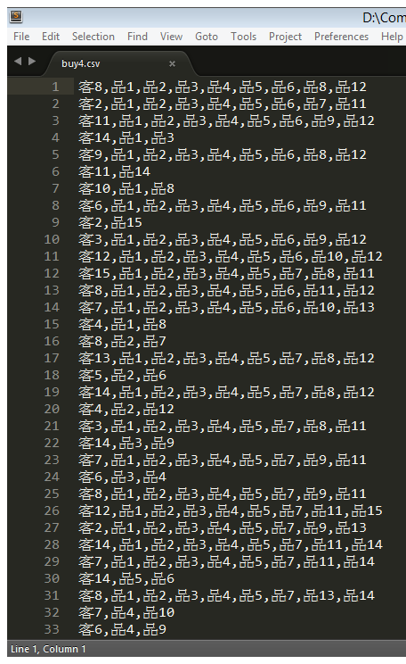
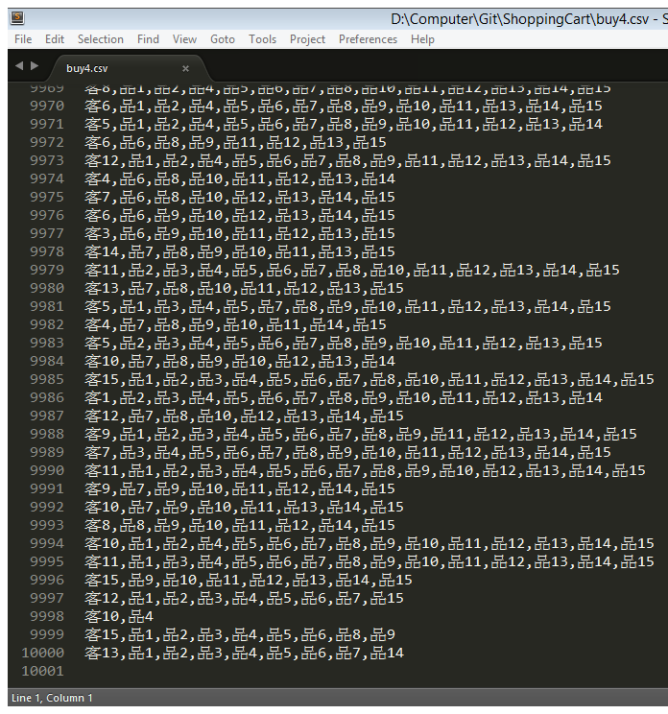
Question
How about generate a list over 10000?

Slide 13
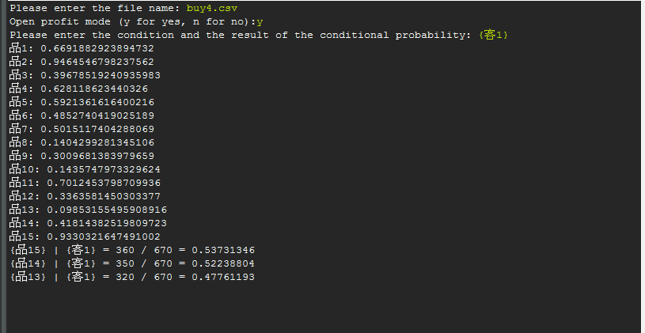
Question

Slide 14
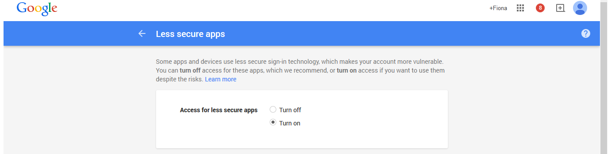
Add E-mail
To use g-mail, you have to configure secure options

Slide 15
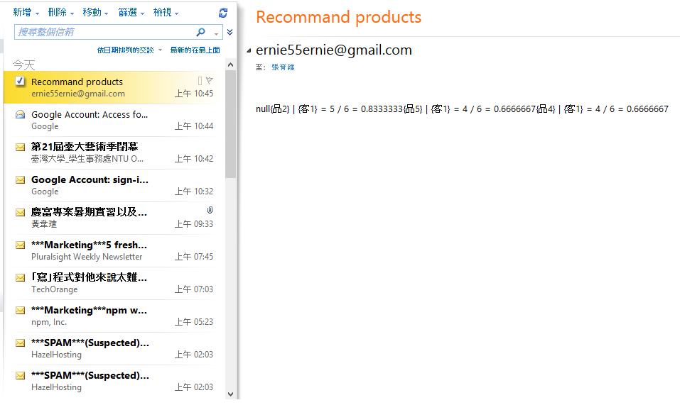
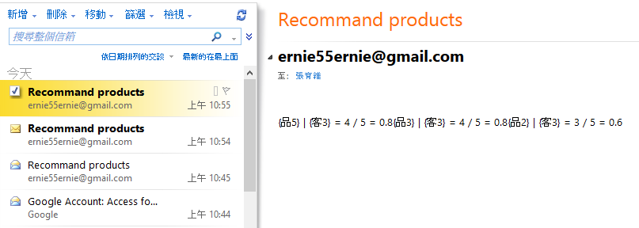
Add E-mail

Slide 16
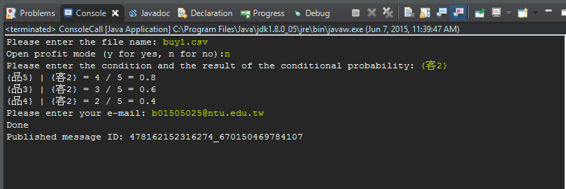
In time suggestion on facebook

Slide 17
In time suggestion on facebook
Using multithread
/**
* Using multithread to cope with big data
*/
LoadProbability loadProbability = new LoadProbability();
loadProbability.start();
// new RuleGUI(ShoppingCartUtils.addShoppingListTime(sl), rb, pb);
InputProbability inputProbability = new InputProbability();
inputProbability.start();
Thread.yield();

Slide 18
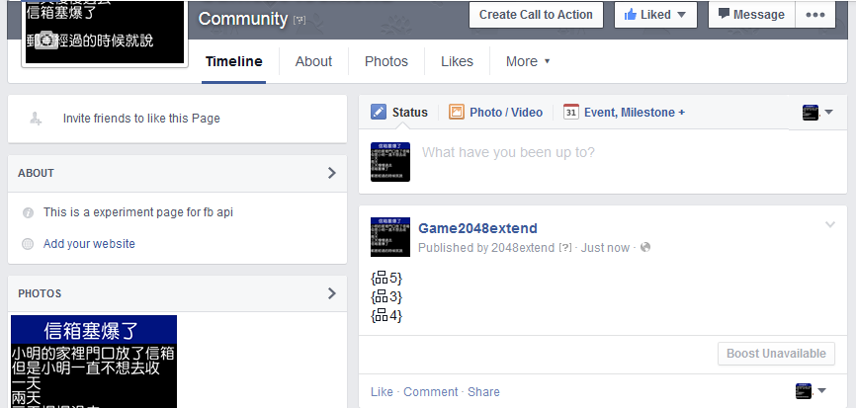
In time suggestion on facebook

