Slide 1
購物清單產生器
B01505025
工科三張育維

Slide 2
Outline
Architecture
Robustness
Extensibility
Teaching assistance question

Slide 3
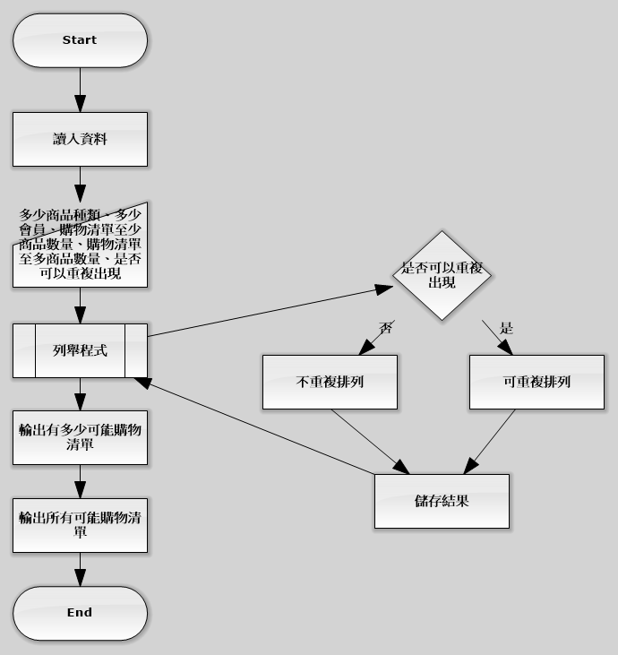
Architecture Flow diagram

Slide 4
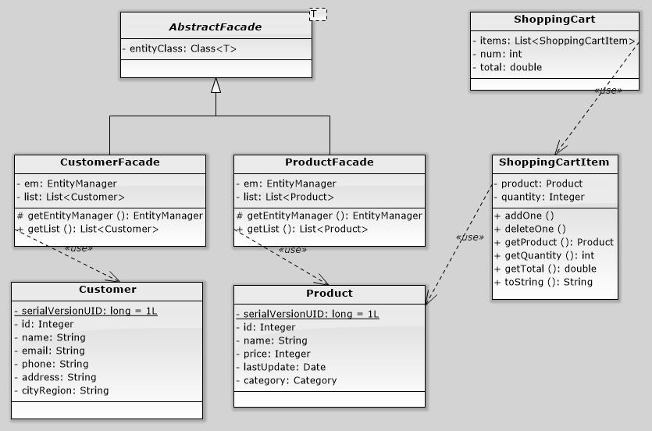
Architecture Entity and shopping cart

Slide 5
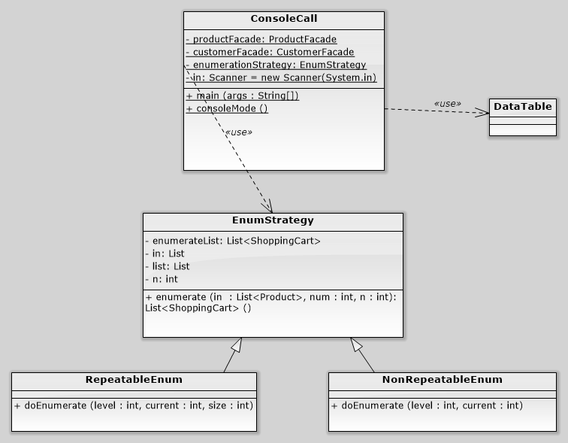
Architecture Console

Slide 6
Robustness
The validation of user input is done by checking if the numbers of product, customer, least count , and maximum count is valid.
The system may be dead due to too great input, ex: product = 10, customer = 10, least count = 0, maximum = 10. This will cause the eclipse console to dead. But the result enumeration is finished.

Slide 7
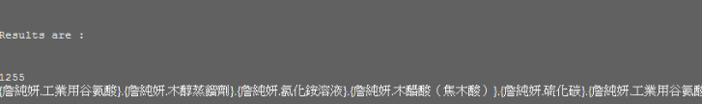
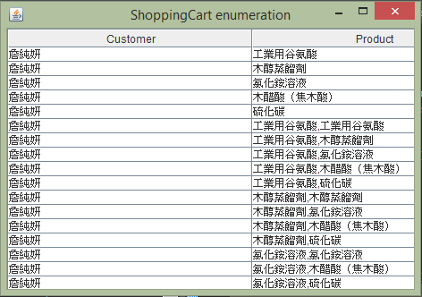
Extensibility
While the entity is initial by real data such as:
customer:詹純妍、孫惠祥、賴剛萍、錢巧馨
product:工業用谷氨酸 、木醇蒸餾劑、氯化銨溶液
In which resource can be found in the package of model.resource
Future connecting to a database is possible because of the entitymanager design

Slide 8
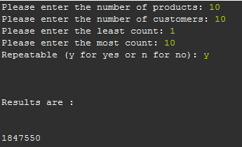
Why 10 will be dead?
In fact, the enumeration of 10, 10, 1, 10 is complete. Because the numbers of enumeration is calculated by the size of the result list. The console output is too slow. To show only the number of result is fast (after all enumerations has been done).

