Slide 1
PyQt GUI API
2019-11-05
何柏勳

Slide 2
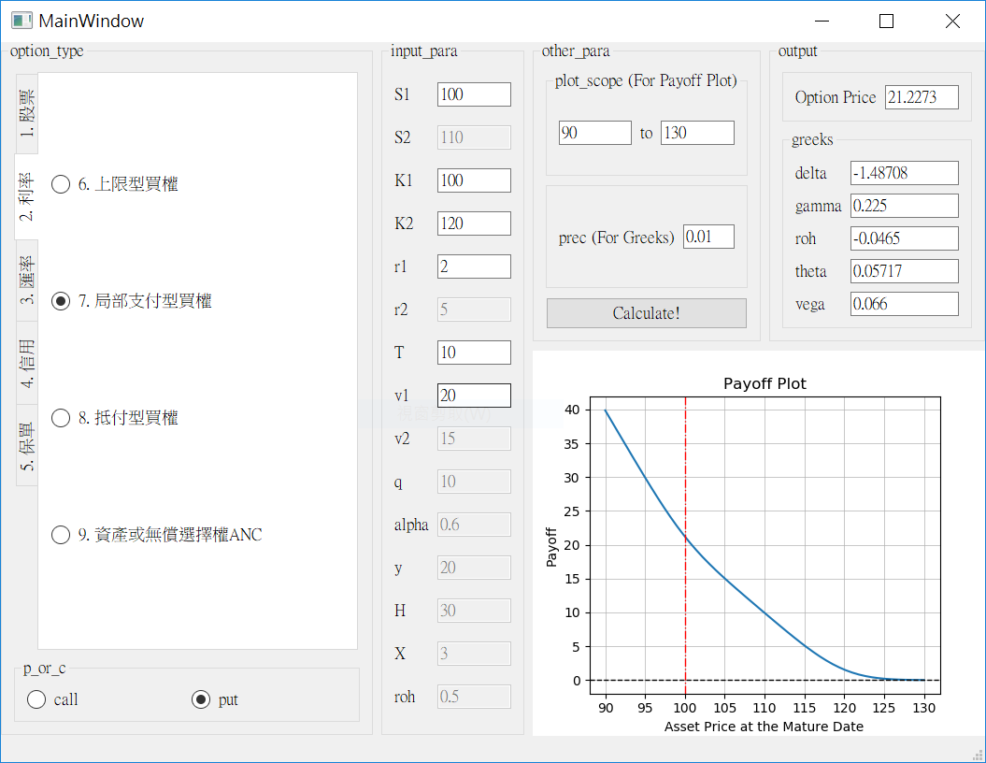
Outlook

Slide 3
Outlook
Left:
Inputs
Right:
Outputs

Slide 4
Schematic

Slide 5
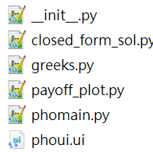


File System

Slide 6
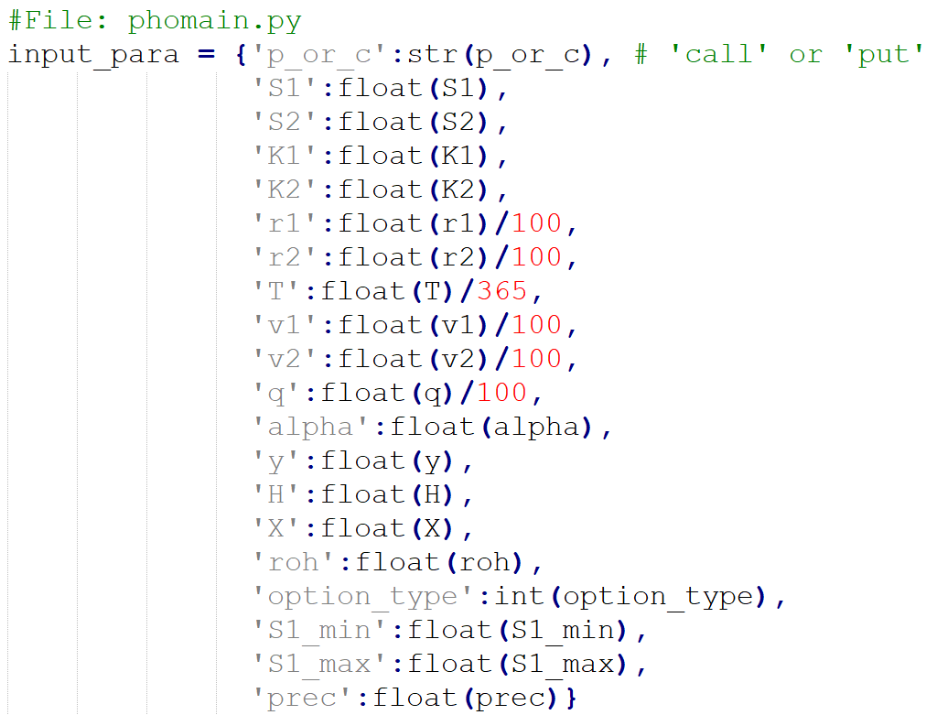
Input parameters as a dictionary

Slide 7
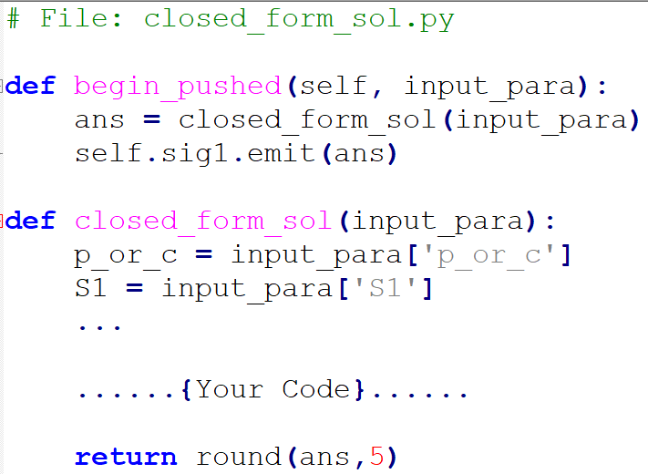
A simple module
(負責模組的不用管)
(模組本身code)

Slide 8
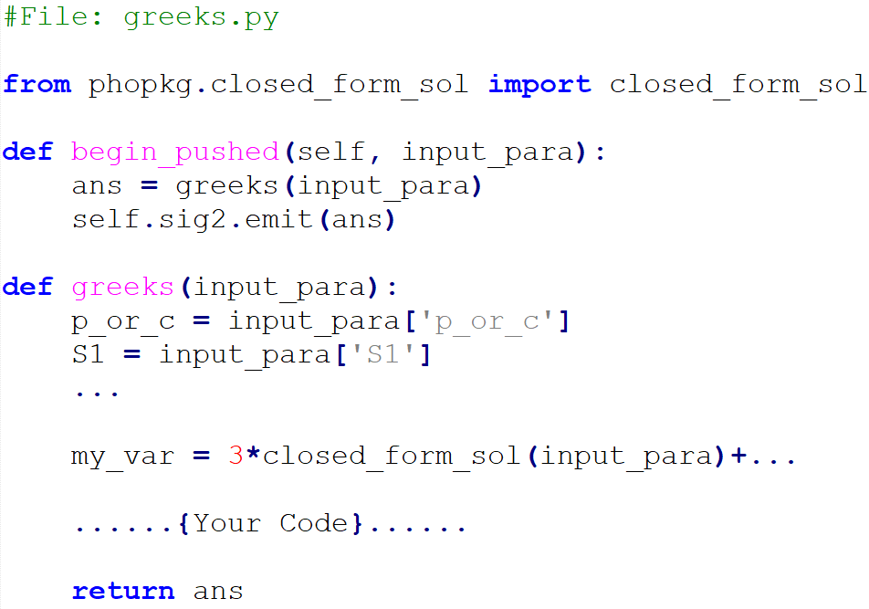
A module refer the other module
(負責模組的
不用管)
(模組本身code)

Slide 9
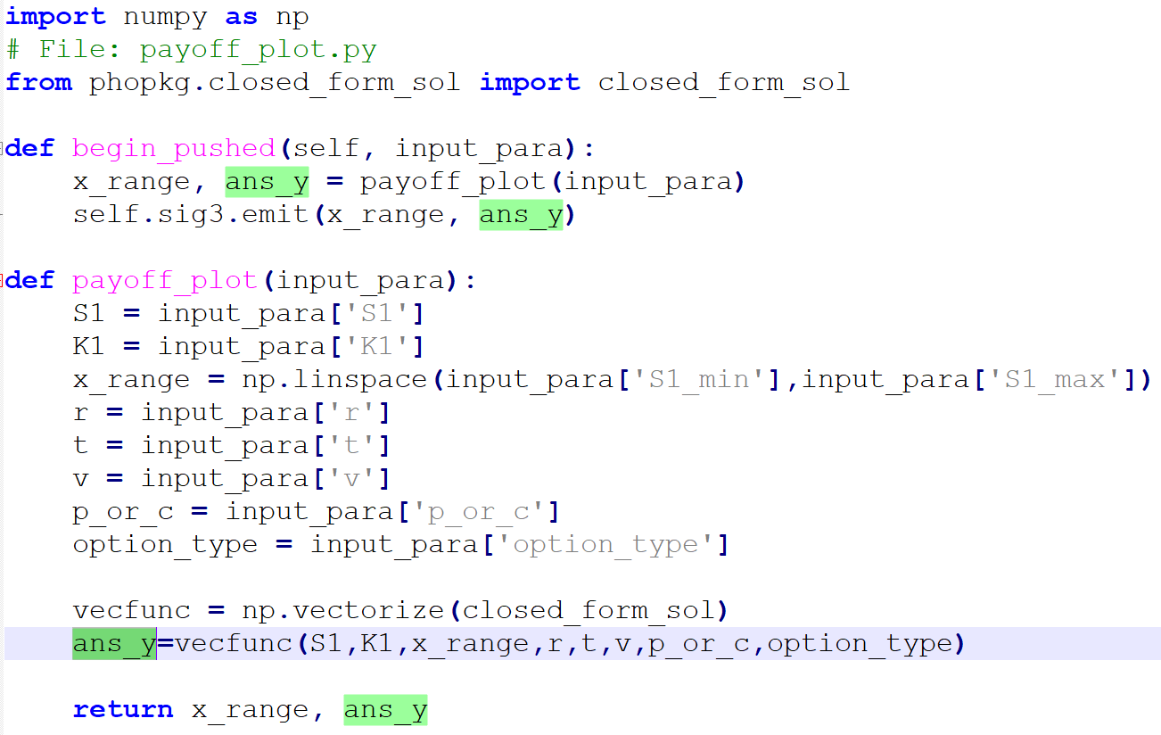
A module output a plot
(負責模組的不用管)
(模組本身code)

Slide 10
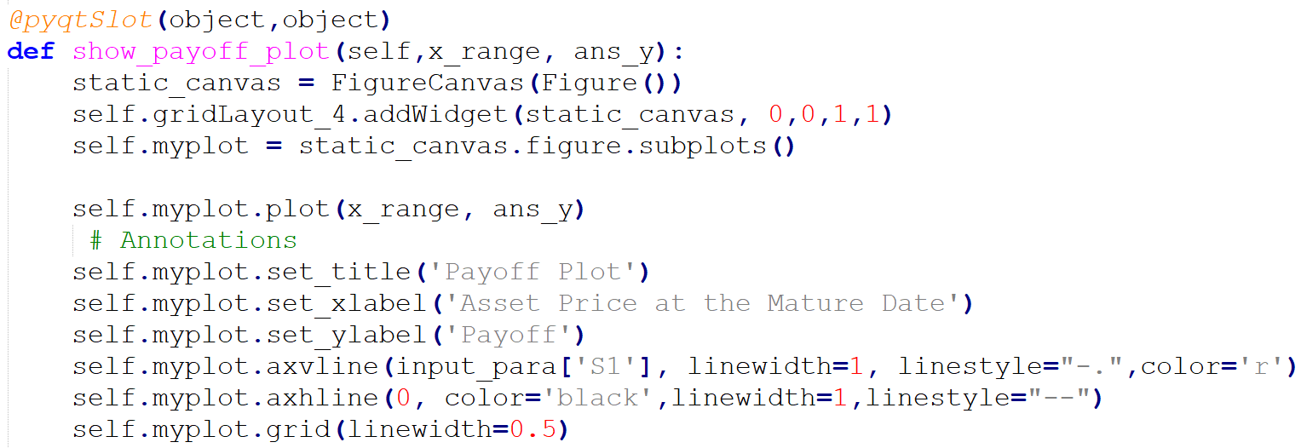
A module output a plot (File:phomain.py)
(要手動加入圖)
(Annotation of the plot)

Slide 11
Final look

Slide 12
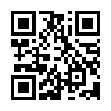
Demo project: https://bit.ly/2r9fw3L

