Slide 1

2022.07.01
Data Analysis Exercise
Chen Yi- Ju (Ernie)

Slide 2

Table of contents
Overview
Pattern Discovery
Proposed Rule
Metrics and results
Conclusions and remarks

Slide 3

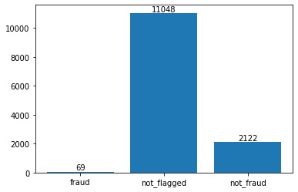
Overview
The data
With a total of 13239 data points, there were 2191 flagged data points ~4/27, with the rest unflagged

Slide 4
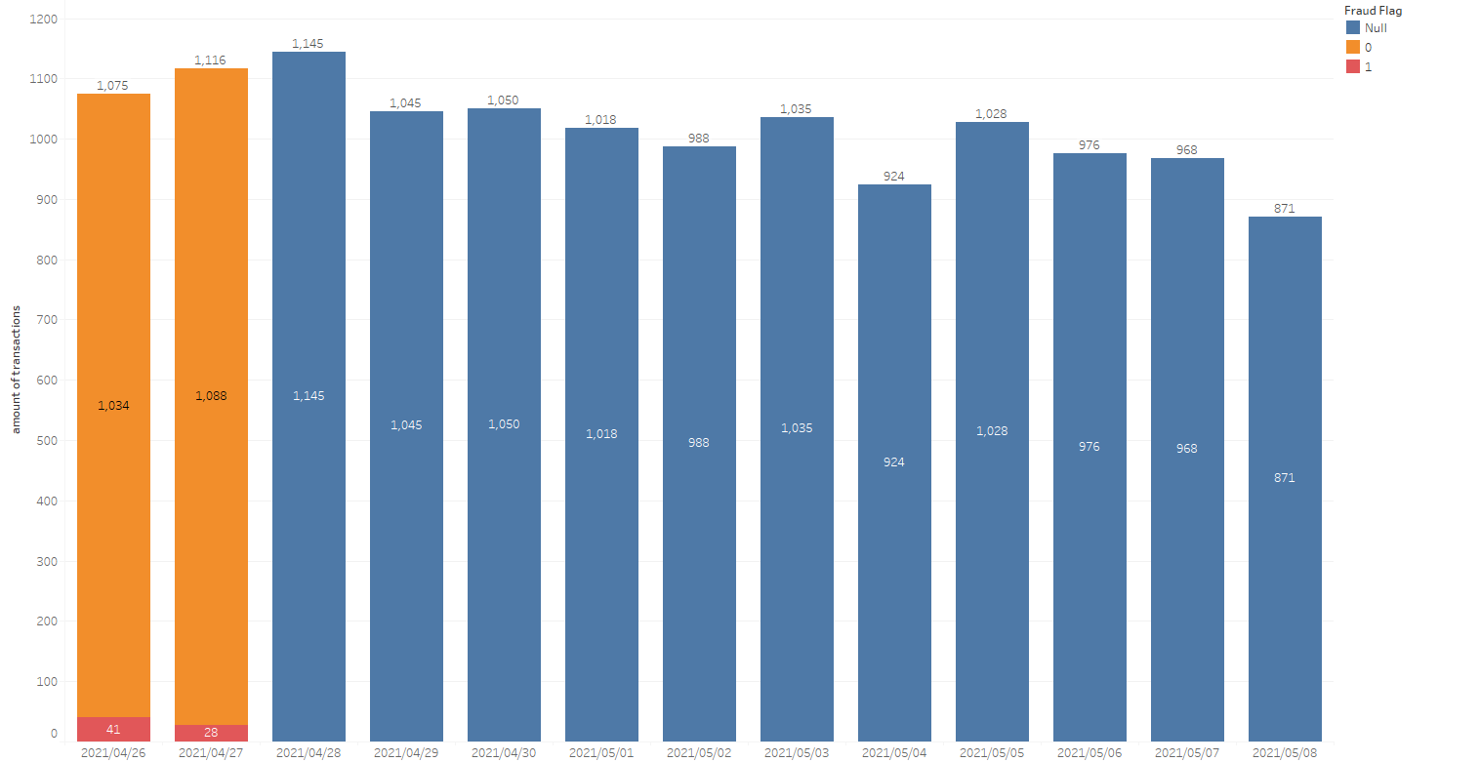
Overview
The data

Slide 5
Overview
The Goal: answering the questions
Discovering "why this happened” and “how to prevent it”

Slide 6
Overview
The Goal: answering the questions
What is the suspicious pattern?
Flag the payments that look suspicious from 4/28
Propose some rules to block the suspicious payments
What additional data points could help?

Slide 7
Pattern Discovery
Key Findings from data flagged as fraud
All fraud happened in the blues store
All fraud had payment time happening just before or right after account creation(in less than 2 minutes) -> 0 ltv
There are three kinds of email domain used, of which includes “gomen-da.com”, a disposable temporary domain
All the transactions happened in new stores (0 days of age)
A relatively low percentage (less than 1/3 ) of the users had same phone numbers for Paidy and marketplace

Slide 8
Proposed Rule
"if the user account is created within 3 minutes
after the payment/transaction, identify it as fraud"

Slide 9
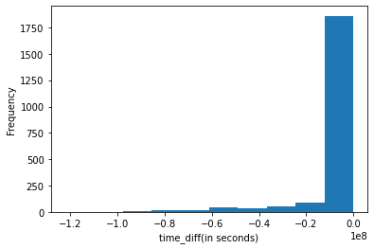
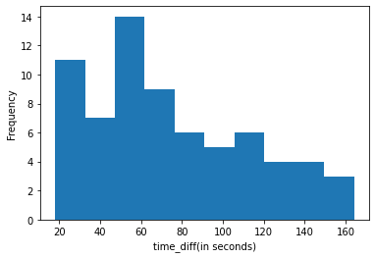
Proposed Rule
Reasoning
A clear distribution difference between fraud and non-fraud data

Slide 10
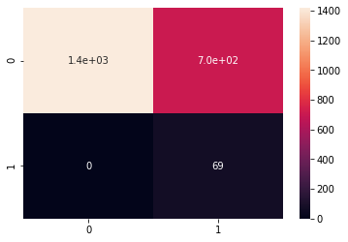
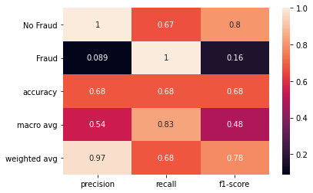
Metrics and results
Using the original data to evaluate
Below is the classification results using the original labeled data.

Slide 11
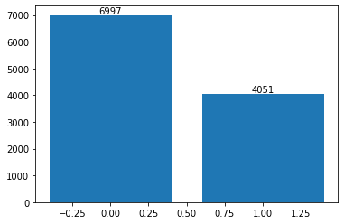
Metrics and results
The classification on the unlabeled data
Below is the classification results by imposing the rule.

Slide 12
Conclusions and remarks
The conflict between “making rules” and “correct classification”
The results of using the proposed rules were not satisfactory.
The problem of “imbalanced data”
Relatively complex models(logistic/trees/k-nearest) imposed were able to produce better classification results
However, they could not impose “rules” to execute that makes business sense
Choosing “interpretability” over “precision” in this case

Slide 13
Conclusions and remarks
Additional suggestions & personal thoughts
email domains whitelists could be provided to weed out domains that fall prey to easy abuse
Needs more data and research to create the whitelist
There could be potential security risks in the blue market and particular versions of OS systems
“Analytics is art”
Focus on solving “the actual question” over using particular methods

Slide 14
Thank you!

