Slide 1

Kart Attack Final Report
Brian Chase
Ernie Gillard
Noah Judson
December 10th, 2010
Technical Communications 497

Slide 2
Project Requirements
  Create a computer game
    can't use existing engine
      e.g. Torque, Ogre
    grading focuses on complexity
      secondary focus: gameplay "fun"

Slide 3
Proposal
  2D competitive multiplayer kart arena game
    team-based options
  Collect coins, bring back to base
    coins used to upgrade and customize karts
  Destroy each other
    prevent others from getting coins
    collect their coins plus some
  Hand-drawn theme
  Plethora of map and kart options
  AI to compete against
  Various additional game modes

Slide 4
Objectives
  Fun gameplay
    risk
    reward/feedback
  Intuitive
    simple, accurate controls
  Polished
    week or more

Slide 5
Agenda
  Process
  Work done so far
  Obstacles
  Major successes
  Demo
  Meeting requirements
  Tasks to finish
  Lessons learned

Slide 6
Process
  Brainstorm ideas
  Choose one and get specifics
  Design class structure
  Divide work
  Create detailed schedule
    multiple hard deadlines
    priority levels for features
  Code game/draw art
  Test/polish

Slide 7
Work Done So Far
  Fully-functional beta
    collisions
    movement
    controls
    maps
    animations
    menus

Slide 8
Obstacles
  Spec'd out too much
    however, we prioritized things in the beginning
    cut low priority items
      AI
      game modes
      weapons/ abilities
      themes
      kart customization
  Not enough time spent on design

Slide 9
Major Successes
  Art
    animation engine
  Solid gameplay
    collision engine
    controls
  Feature-heavy
  Beta playtesting with non-group members
  Done early enough for extensive testing and polishing
    stuck to demanding timeline
  Map editor

Slide 10
Demo

Slide 11
How well do we meet requirements?
  Made own engines
    collisions
    movement
    animations
    maps
  Fun and easy to pick up and play
    tested by others
    positive responses
  Didn't use complex technologies

Slide 12
Finishing Tasks
  Add a few more weapons/abilities
  Testing and balancing
  Polishing art
  Update design document

Slide 13
Areas of Improvement
  Spend more time on design
    initial design
    updating design
    menu design
  Iterative testing outside our group
  More research into complex systems
  Code review?
Notes:
Ernie: I think we need to beef up the Lessons Learned slides.
The guidelines say 3-5 pages for lessons learned. Should we spread some of this info out?

Slide 14
New skills/Tools
  C# language
  XNA framework
  Subversion control (Tortoise SVN)
  Class diagram creation
  How to create a development schedule

Slide 15
Team management
  Regular meetings
  Backlog of needed items/features
  Iterative/concurrent development
  Delegation of work
  Successful schedule and priorities

Slide 16
Notes:
This is the questions slide

Slide 17
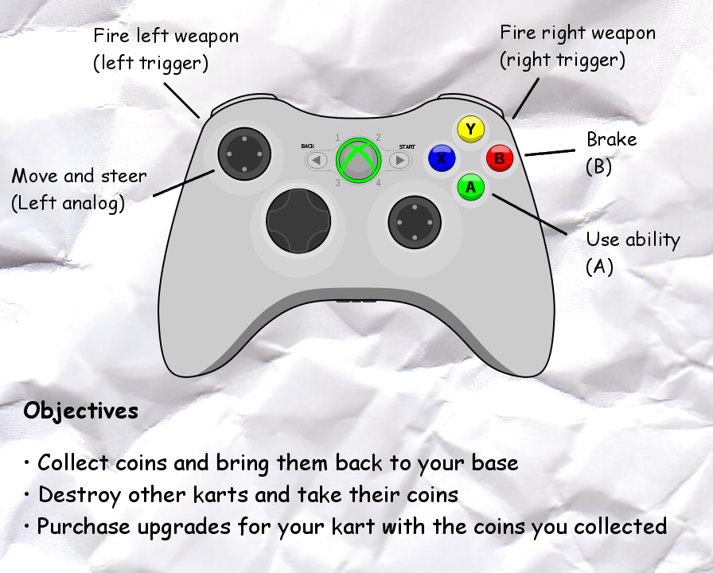
Help screen

