Slide 1

Queensland New Youth Program Implementation
Transition Guide for Venturer Scouts

Slide 2
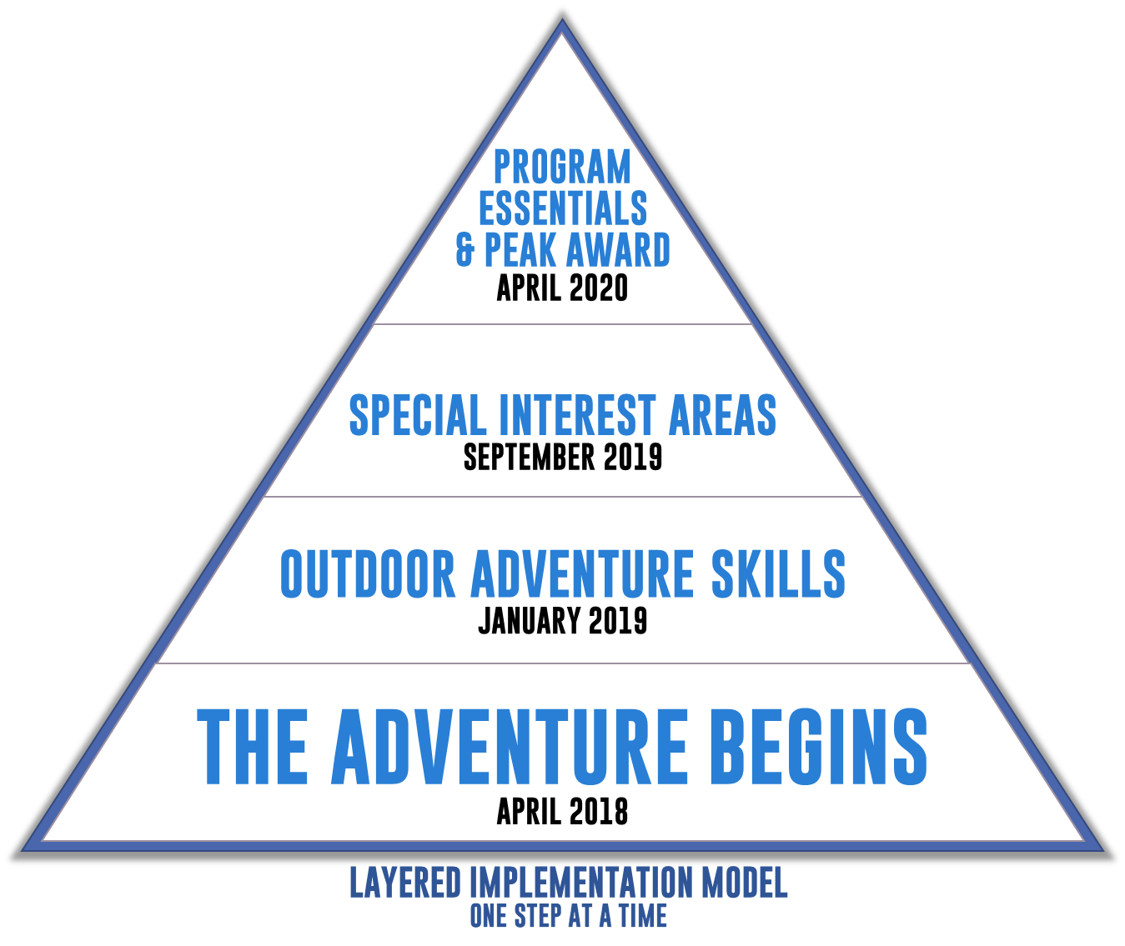
Queensland New Youth Program Implementation (QYIP)
April 2018 | The Adventure Begins
January 2019 | Outdoor Adventure Skills Areas introduced - Benchmarking of skills
September 2019 | Special Interest Areas introduced
April 2020 | Milestone & Challenge Areas (Program Essentials) introduced
December 2022 | No further peak awards issued on current Award scheme

Slide 3
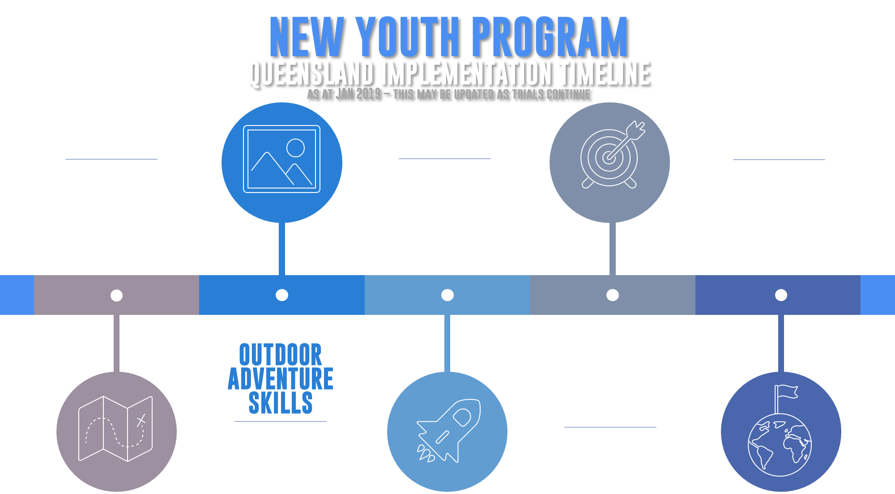
QYIP Timeline

Slide 4
What Does QYIP Mean For Me?
Queen’s Scout Award stays as the peak award name
This can be achieved under current scheme until Dec 2022
You may choose to transition to the new program from Sep 2019, or remain in the current program
If you choose to transition, you will be given credit for your current badgework
Fundamental principle is:
NO YOUTH MEMBER WILL BE DISADVANTAGED

Slide 5

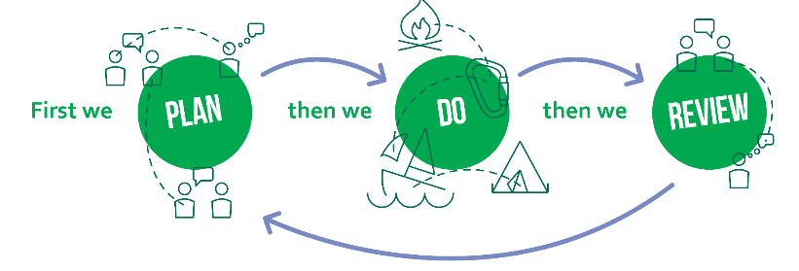
Transitioning to New Youth Program
You have already started with The Adventure Begins
Law and Promise
Youth Leading / Adult Supporting
Unit Councils
Plan>Do>Review>
The Adventure Begins
Apr 2018

Slide 6
Outdoor Adventure Skills
Introduced in January 2019
Being pioneered in Queensland
Benchmarking through September 2019
  This will qualify you for OAS badges, when they become available
  Runs in parallel with current Award scheme
Nine skill areas
  Three CORE – these are focus of current benchmarking
  Six NON-CORE – more specialist outdoor activities
Nine Stages in each skill area
  Stage 1 is starting point for everyone
  Stage 5 is expected minimum for Queen’s Scout Award
  Higher stages may qualify for VET achievements
The Adventure Begins
Outdoor Adventure Skills
Apr 2018
Jan 2019

Slide 7
OAS Benchmarking
This is a GROUP exercise
Requires a Mentor, Peer and one or more Participants
  Mentor would usually be a Leader, with suitable skills for the OAS Area
  Peer is anyone, preferably another youth member, who has completed a stage at least two higher than stage being assessed
  Participants are those being assessed
  Current badges can be recognized as competency (but still peer-assessed)
Two up / two down
  Look to engage other Sections, Groups, Districts, Regions etc…
  Higher stages may require Guides or even Instructors
The Adventure Begins
PEER
MENTOR
Outdoor Adventure Skills
PARTICIPANT
Apr 2018
Jan 2019

Slide 8
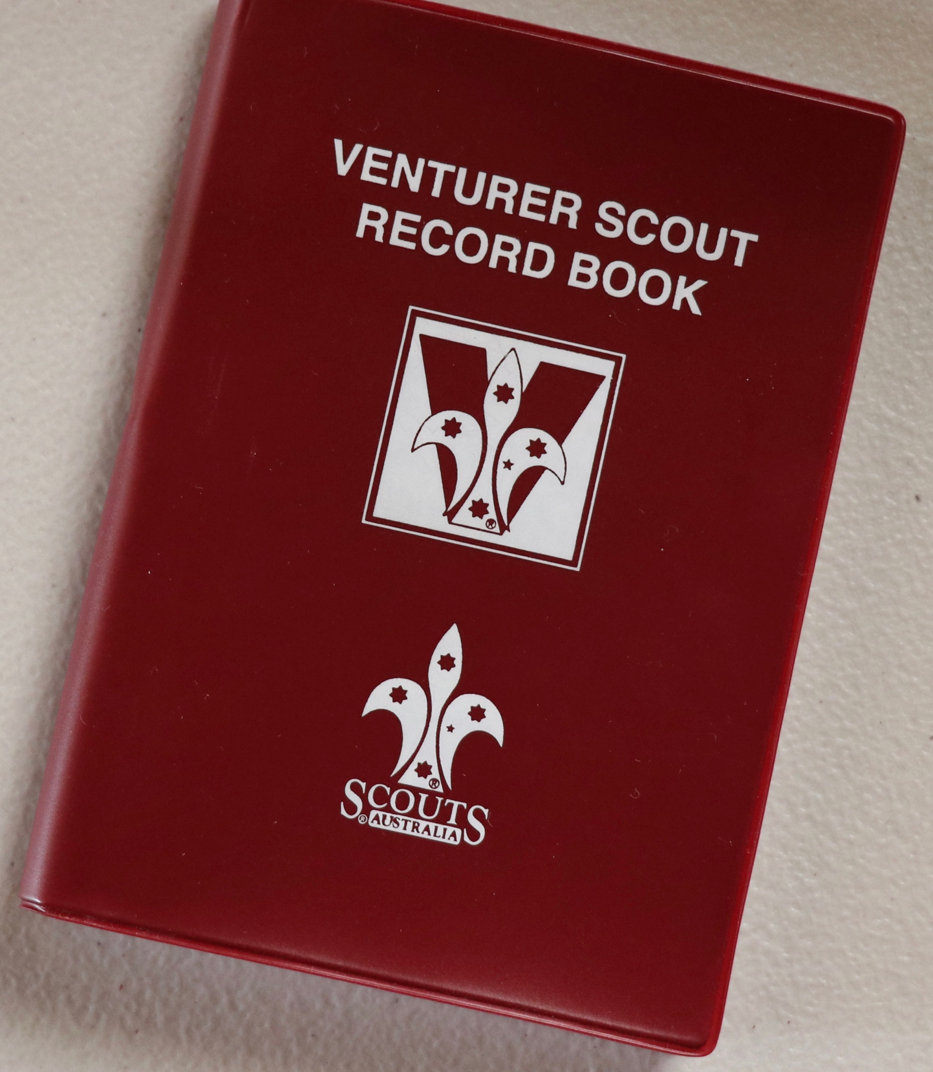

OAS Implementation
All members continue with current Award Scheme
Benchmarking
Badges can be earned but not part of current Award scheme – until September!
The Adventure Begins
Outdoor Adventure Skills
Expected Completion
BENCHMARKING
PEER
MENTOR
PARTICIPANT
Apr 2018
Jan 2019
Sep 2019

Slide 9
Special Interest Badges
Special Interest Areas
  Adventure & Sport
  Arts & Literature
  Creating a Better World
  Environment
  Growth & Development
  Innovation & STEM (Science, Technology, Engineering, Mathematics)
Planned to be introduced in Sep 2019
  Timing subject to current trials of NYP elements across Australia
Formal beginning of New Youth Program
  From this time onwards, youth members may choose to begin with, or switch to, NYP
The Adventure Begins
Special Interest Badges
Outdoor Adventure Skills
Apr 2018
Jan 2019
Sep 2019

Slide 10
After Sep 2019: Stay or Switch?
START or CONTINUE WITH CURRENT SCHEME
or TRANSITION
NO DISADVANTAGE
TO NEW
The Adventure Begins
Special Interest Badges
Milestone & Challenge Areas
Outdoor Adventure Skills
SCHEME
Apr 2018
Jan 2019
Sep 2019
Apr 2020

Slide 11
Milestones & Challenge Areas (Program Essentials)
MILESTONES
For an activity in one of the Challenge Areas:
  ONE: Participate, partial Assist, some Lead
  TWO: Significantly Assist and partial Lead
  THREE: Lead
CHALLENGE Areas
  Community
  Creative
  Outdoor
  Personal
Planned to be introduced in April 2020
The Adventure Begins
Special Interest Badges
Milestone & Challenge Areas
Outdoor Adventure Skills
Apr 2018
Jan 2019
Sep 2019
Apr 2020

Slide 12

Queen’s Scout Award in NYP
You will have achieved:
Milestone 3
Up to Stage 5 in the Core Areas of the Outdoor Adventure Skills
Twelve progressions (or level-ups) across all OAS. Four of these progressions must be at Stage 4 or above.
Four Special Interest Badges
Adventurous Journey
Leadership or Personal Development Course
Personal Reflection
The Adventure Begins
Special Interest Badges
Outdoor Adventure Skills
Milestone & Challenge Areas
Apr 2018
Jan 2019
Sep 2019
Apr 2020

Slide 13
After April 2020
Final QSA in current Award scheme
CONTINUATION ONLY
NO DISADVANTAGE
The Adventure Begins
Queen’s Scout Award
Outdoor Adventure Skills
Milestone & Challenge Areas
Special Interest Badges
Apr 2018
Jan 2019
Sep 2019
Apr 2020
Dec 2020
Dec 2022

Slide 14
Which pathway should I choose?
This is an individual choice, and remember the fundamental principle
NO YOUTH MEMBER WILL BE DISADVANTAGED
Notwithstanding, here are some recommendations
BEFORE Sep 2019
Start with the current award scheme
  Even if you are currently linking up from Scouts or joining Venturer Scouts
AFTER Sep 2019
Stick to the current award scheme if:
  You’re close to completing your Queen’s Scout Award
  You believe the current award scheme can completely satisfy your Scouting journey requirements
  You are convinced you will complete your QSA prior to Dec 2022
  You can continue to also earn OAS Stages in addition to the current award scheme, but they will not contribute to your peak award.
Transition to the new youth program if:
  You have particular interests outside of the current award scheme
  You want flexibility to achieve your Queen’s Scout Award beyond Dec 2022
  Your current view is that you do not want to achieve your Queen’s Scout Award
The New Youth Program will provide you with lots of new exciting Scouting opportunities

Slide 15
Questions?
QYIP Website
http://nypqld.scoutsqld.com.au

