Slide 1
JSON APIs
An Intro to JSON APIs

Slide 2
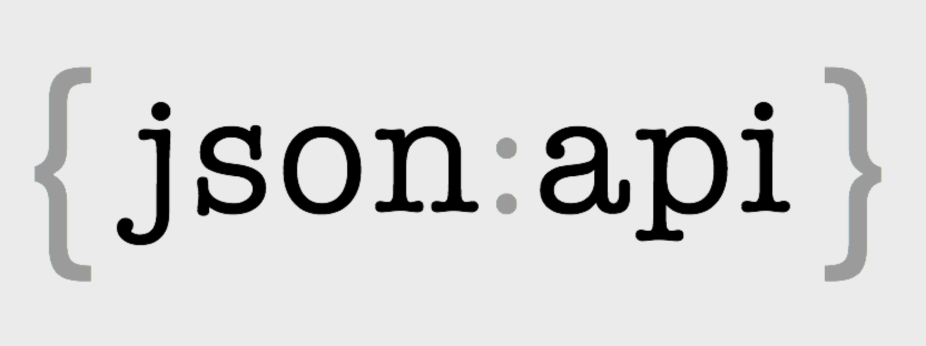
What is JSON API?
JSON or JavaScript Object Notation is an encoding scheme that is designed to eliminate the need for an ad-hoc code for each application to communicate with servers that communicate in a defined way
JSON is an independent component, which can be used by any framework or technology
JSON API module exposes an implementation for data stores and data structures, such as entity types, bundles, and fields
JSON:API has been properly registered with the IANA. Its media type designation is application/vnd.api+json
IANA (Internet Assignment Numbers Authority)
JSON:API has a collection of extensions that APIs can use to provide clients with information

Slide 3
JSON API Cont’d
JSON is completely language-agnostic, so it can be used with any programming language
SOAP is XML based only which can cause heavy transfer of data flow
JSON is light weight allowing more data transference at faster rates than XML
JSON files consist of collections of name/value pairs and ordered lists of values that are universal data structures used by most programming languages
JSON API has no official standard because it is an architectural style
JSON API makes use of HTTP verbs

Slide 4
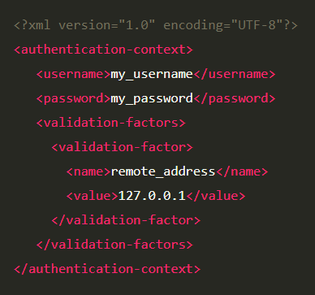
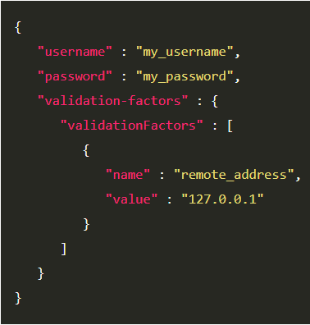
JSON API Cont’d
SOAP vs JSON API
JSON is a more lightweight and less verbose format, and it’s easier to read and write as well
XML still has advantages that allow for placement of metadata into tags’ forms attributes
SOAP (Simple Object Access Protocol)
can work with any application layer protocol, such as HTTP, SMTP, TCP, or UDP
Security, authorization, and error-handling are built into the protocol

Slide 5
JSON API Cont’d
SOAP vs JSON API cont’d
SOAP follows a formal and standardized approach that specifies how to encode XML files returned by the API
SOAP messages consist of
Envelope (required) – This is the starting and ending tags of the message.
Header (optional) – It contains the optional attributes of the message. It allows you to extend a SOAP message in a modular and decentralized way.
Body (required) – It contains the XML data that the server transmits to the receiver.
Fault (optional) – It carries information about errors occurring during processing the message.
JSON and REST play together very nicely, which means formatting data has never been more accessible

Slide 6
JSON API Cont’d
Headers and request & response body
To make a request with JSON, the appropriate HTTP headers are
Content-Type: application/json Accept: application/json
To create a request, an action verb of some sort must be used against a URL
When sending data, a JSON object can be created and POSTed to an API call
That data can then be parsed and stored in the database by chosen language
The payload must contain valid JSON if it will work
Much like a request body, the response body can also store representations of objects in JSON format
The client code can then parse through the JSON response object and manipulate the code accordingly

Slide 7
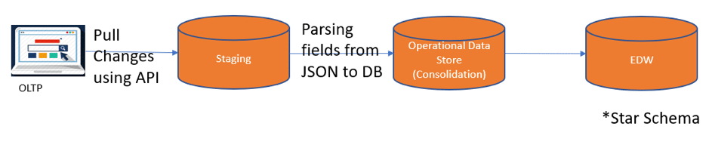
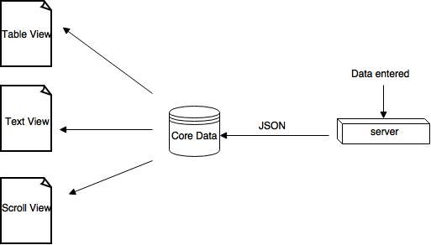
JSON API Cont’d

Slide 8
JSON API Cont’d
Advantages of JSON API:
Reduces both the number of requests and the amount of data transmitted between clients and servers
Enabling the JSON API module, allows for immediate gain of a full REST API
JSON API inspects entity type and bundle to provide URLs to access each one of them using the standard HTTP methods, GET, POST, PATCH, and DELETE
Unlike core REST module, JSON API is Zero configuration
Controls which HTTP methods should be used, what HTTP response codes should be returned under specific request, the format of the response body, and the link between resources
JSON allows for schema support

Slide 9
SOAP Cont’d
Disadvantages of JSON API:
JSON has no error handling for JSON calls
If no insert happens, JSON will fail silently
The request can not be canceled or restarted
JSON can be quite dangerous if used with untrusted services or untrusted browsers
JSON service returns a JSON response wrapped in a function call, which will be executed by the browser
if it will be used with untrusted browser it can be hacked
JSON only has limited supported tools which we can use during JSON development

Slide 10
References
jsonapi. (2013, May 3). A SPECIFICATION FOR BUILDING APIS IN JSON. Retrieved November 5, 2013, from jsonapi
website: https://jsonapi.org/
Prakash, N. (2017, October 6). An overview of JSON API: A text-based data exchange format. Retrieved
November 5, 2019, from valuebound website: https://www.valuebound.com/resources/blog/
overview-of-json-api
Monus, A. (2018, August 2). SOAP vs REST vs JSON comparison [2019]. Retrieved November 5, 2019, from
raygun website: https://raygun.com/blog/soap-vs-rest-vs-json/
STRASSNER, T. (n.d.). XML vs JSON. Retrieved November 5, 2019, from cs.tufts.edu website:
https://www.cs.tufts.edu/comp/150IDS/final_papers/tstras01.1/FinalReport/FinalReport.html
RapidAPI Staff. (2019, February 13). SOAP vs REST (vs JSON). Retrieved November 5, 2019, from
rapidapi website: https://rapidapi.com/blog/soap-vs-rest-api/
Atlassian. (n.d.). JSON requests and responses. Retrieved November 5, 2019, from Atlassian website:
https://developer.atlassian.com/server/crowd/json-requests-and-responses/
ezeelive. (n.d.). JSON – its advantages and disadvantages. Retrieved November 5, 2019, from
ezeelive website: https://ezeelive.com/json-advantages-disadvantages/
Notes:
In Slide Show mode, select the arrows to visit links.

