Slide 1
Pager Rotation Duties
An Intro

Slide 2
Pager Rotation Duties
What are pager rotation duties?
- Duties consist of everyone in a value stream sharing the downstream responsibilities of handling operational incidents (Willis, Debois, Humble, & Kim, 2016).
- This happens by putting developers, development managers, and architects on pager rotation (Willis, Debois, Humble, & Kim, 2016).

Slide 3
Pager Rotation Duties
What causes a need for pager rotation?
-There is no such thing as a perfect deployment, in any complex service there will still be unexpected problems such as (Willis, Debois, Humble, & Kim, 2016):
Incidents
Outages
Network issues
Code issues

Slide 4
Pager Rotation Duties
If issues remain unfixed, they can cause recurring problems and suffering for Ops engineers downstream (Willis, Debois, Humble, & Kim, 2016)
Sometimes the problems are not made visible to the upstream engineers responsible for creating the problem (Willis, Debois, Humble, & Kim, 2016)
Even if the problem results in a defect being assigned to the feature team, it may be prioritized below the delivery of new features (Willis, Debois, Humble, & Kim, 2016).

Slide 5
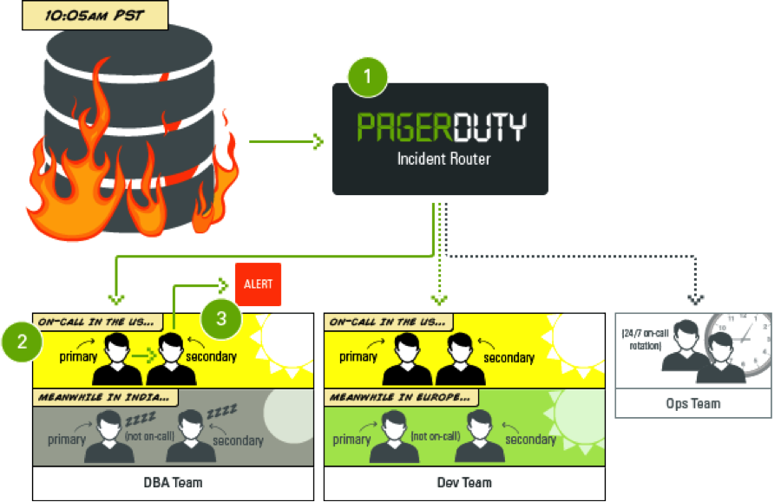
Pager Rotation Duties
(Au, 2014)

Slide 6
Pager Rotation Duties
The problem may keep recurring for weeks, months, or even years, causing continual chaos and disruption in Operations (Willis, Debois, Humble, & Kim, 2016).
Upstream work centers can locally optimize for themselves but actually degrade performance for the entire value stream (Willis, Debois, Humble, & Kim, 2016).
- Use of pager rotation duties ensures that Operations doesn’t struggle and are (Willis, Debois, Humble, & Kim, 2016):
1) no longer isolated
2) no longer alone with code-related production issues
3) has everyone help find proper balance with fixes and dev

Slide 7
Pager Rotation Duties
Pager rotation duties help Development management see that business goals are not achieved b/c features have been marked as done (Willis, Debois, Humble, & Kim, 2016).
Instead, the feature is only done when it is performing as designed in production, without causing excessive escalations or unplanned work for either Development or Operations (Willis, Debois, Humble, & Kim, 2016).

Slide 8
Pager Rotation Duties
Pager rotation duties are applicable for market-oriented teams, responsible for both developing a feature and running it in prod, as well as for functionality-oriented teams. (Willis, Debois, Humble, & Kim, 2016)
It is much more common that people no longer have on-call teams, rather have individuals that are reachable if they have knowledge of production code and environments (Willis, Debois, Humble, & Kim, 2016).

Slide 9
Pager Rotation Duties
Developers get feedback on how their applications perform in production (Willis, Debois, Humble, & Kim, 2016):
Fixes
Breaks
Developers become closer to the customer and a buy-in is created that everyone in the value stream benefits from (Willis, Debois, Humble, & Kim, 2016).

Slide 10
References
Willis, J., Debois, P., Humble, J., & Kim, G. (2016, October). The DevOps Handbook [EPUB]. Retrieved
from https://learning.oreilly.com/library/view/the-devops-handbook/9781457191381/
Au, V. (2014, February 10). [Pager Duty]. Retrieved from
https://iqm7l1pa7bn3d42rc278rat5-wpengine.netdna-ssl.com/assets/blog/PagerDuty_On_call_schedule_alert_routing.png
Notes:
In Slide Show mode, select the arrows to visit links.

