Slide 1
SOAP
An Intro to Simple Open Access Protocol

Slide 2

What is a RESTful API?
Last week we learned about resource state and application state
Application state is kept on the client, but the server can manipulate it by sending representations that describe the possible state transitions
Resource state is kept and recorded on the server, the client state does not know about resource state
Resource state is affected when the page state has changed by having data POSTed
Although a resource can be anything at all, a client can’t do whatever it wants to a resource.
In a RESTful system, clients and servers interact only by sending each other messages that follow a predefined protocol.
The protocol used is called HTTP
The HTTP standard defines eight different kinds of messages. These four are the most commonly used

Slide 3
RESTful APIs Cont’d
A REST API should be entered with:
no prior knowledge beyond the initial URI (bookmark)
set of standardized media types that are appropriate for the intended audience
All application state transitions must be driven by client selection of server-provided choices that are:
present in the received representations
implied by the user’s manipulation of those representations
The transitions may be determined (or limited by) the client’s knowledge of media types and resource communication mechanisms, both of which may be improved on-the-fly

Slide 4
RESTful APIs Cont’d
GET - Get a representation of this resource
DELETE – Destroy this resource
POST - Create a new resource underneath this one, based on the given representation
PUT - Replace this state of this resource with the one described in the given representation
HEAD - Get the headers that would be sent along with a representation of this resource, but not the representation itself
OPTIONS - Discover which HTTP methods this resource responds to
PATCH - Modify part of the state of this resource based on the given representation. If some bit of resource state is not mentioned in the given representation, leave it alone. PATCH is like PUT, but allows for fine-grained changes to resource state
LINK- Connect some other resource to this one

Slide 5
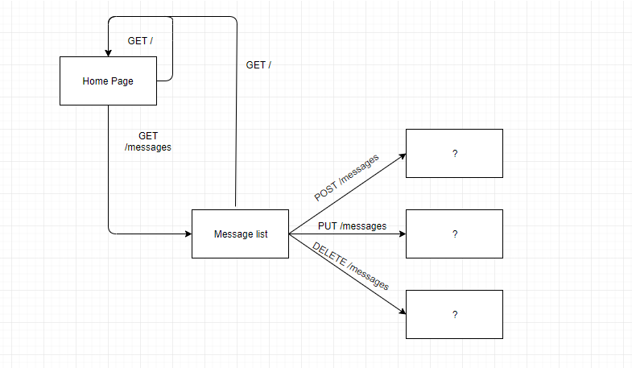
RESTful APIs Cont’d
Website communications
Issue a GET to the home page
Issue a GET to the messages list
The message list page state can be changed by
Inserting data
Updating data
Deleting data

Slide 6
RESTful APIs Cont’d
In terms of web services, there are not many options. In fact I have only come across two:
SOAP (Simple Object Access Protocol)
SOAP is known as a transport-independent messaging protocol. SOAP is based on transferring XML data as SOAP Messages. Each message has something which is known as an XML document. Only the structure of the XML document follows a specific pattern, but not the content. The best part of Web services and SOAP is that its all sent via HTTP, which is the standard web protocol.
REST (Representational State Transfer)
Designed specifically for working with components such as media components, files, or even objects on a particular hardware device. Any web service that is defined on the principles of REST can be called a RestFul web service. A Restful service would use the normal HTTP verbs of GET, POST, PUT and DELETE for working with the required components.
Which one is right for you depends entirely on your application needs

Slide 7
RESTful APIs Cont’d
Some advantages of using REST over SOAP are
Client-Server - This constraint operates on the concept that the client and the server should be separate from each other and allowed to evolve individually.
Limited resources and bandwidth – Since SOAP messages are heavier in content and consume a far greater bandwidth, REST should be used in instances where network bandwidth is a constraint. This low use of resources is beneficial to a low latency server.
Statelessness – If there is no need to maintain a state of information from one request to another then REST should be used.
Caching – If there is a need to cache a lot of requests then REST is the perfect solution. At times, clients could request for the same resource multiple times. This can increase the number of requests which are sent to the server. By implementing a cache, the most frequent queries results can be stored in an intermediate location.
Ease of coding – Coding REST Services and subsequent implementation is far easier than SOAP. So if a quick win solution is required for web services, then REST is the way to go.
Layered System - REST APIs have different layers of their architecture working together to build a hierarchy that helps create a more scalable and modular application.

Slide 8
RESTful APIs Cont’d
Some disadvantages to REST are:
Client/Server – This can be a double edged sword. Since the business logic is decoupled from the presentation, one can be changed without impacting the other, which can impose negligible latency
Asynchronous processing and subsequent invocation – if there is a requirement that the client needs a guaranteed level of reliability and security then the new SOAP standard of SOAP 1.2 provides a lot of additional features, especially when it comes to security. REST struggles to provide this.
Formal means of communication – if both the client and server have an agreement on the exchange format then SOAP 1.2 gives the rigid specifications for this type of interaction where REST does not have this definition.
Reference files make it easier for clients & developers to know what services they are consuming. SOAP offers the WSDL file.
Stateful operations – if the application has a requirement that state needs to be maintained from one request to another, then the SOAP 1.2 standard provides the WS* structure to support such requirements.
Lack of Security – REST does not impose any sort of security like SOAP. This is why REST is very appropriate for public available URL's, but when it comes down to confidential data being passed between the client and the server, REST is the worst mechanism to be used for web services

Slide 9
RESTful APIs Cont’d
What are the differences between a URI and URL
URI stands for uniform resource identifier
URL stands for uniform resource locator
Not all URIs are URLs. URIs identify the network location of a resource by defining a protocol for the web resource. The URL defines where the resource can be obtained.
Representations cannot be retrieved without a URL
A resource that’s not identified by a URL cannot fulfill many of the Fielding constraints

Slide 10
References
Richardson, L., & Amundsen, M. (2013). RESTful Web APIs. Sebastopol, CA: O'REILLY.
Guru99. (n.d.). SOAP Vs. REST: Difference between Web API Services. Retrieved October 22, 2019, from
Guru99 website: https://www.guru99.com/comparison-between-web-services.html
chakray. (2017, February 9). REST API? Retrieved October 22, 2019, from chakray website:
https://www.chakray.com/advantages-of-rest-api/
mulesoft. (n.d.). What is a RESTful API? Retrieved October 22, 2019, from mulesoft website:
https://www.mulesoft.com/resources/api/restful-api
restfulapi. (n.d.). What is REST. Retrieved October 22, 2019, from restfulapi website:
https://restfulapi.net/
Notes:
In Slide Show mode, select the arrows to visit links.

