Slide 1
Microservices
An Intro

Slide 2
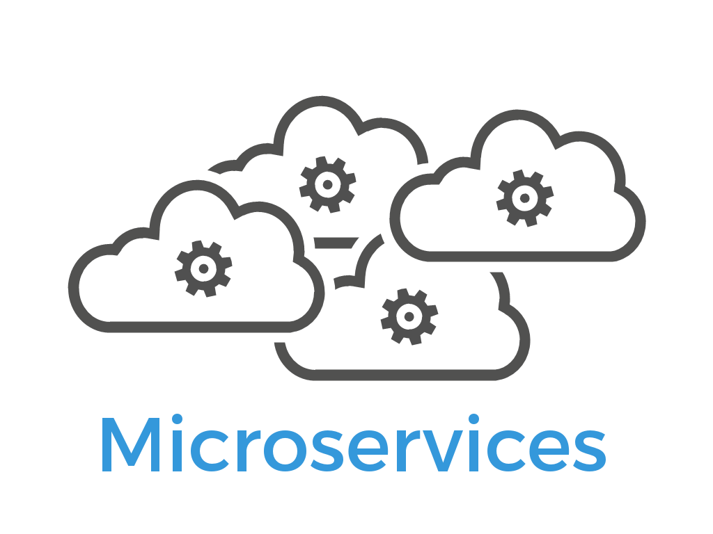
Microservices
What are Microservices?
A self contained process that provides a unique business capability
Different Microservices act as one larger system
In example:
An application may appear to be one large serve all function
But behind the scenes there may be many different services for
Employees
Orders
Processing
Work Orders

Slide 3
Microservices
What is an API gateway?
An API gateway is a server that is the single entry point into the system
The API Gateway encapsulates the internal system architecture and provides an API that is tailored to each client.
Has responsibilities such as authentication, monitoring, load balancing, caching, request shaping and management, and static response handling.
API Gateway is responsible for request routing, composition, and protocol translation.
All requests from clients first go through the API Gateway, then are routed to the appropriate micro service.

Slide 4
Microservices
What are the advantages of Microservices?
Improved Productivity and Speed - microservices architecture tackles the problem of productivity and speed by decomposing applications into manageable services that are faster to develop
Flexibility in Using Technologies and Scalability – having the ability to write each service in a different tech simplifies the selection of the most appropriate tech stack for the specific needs of your service.
Autonomous, Cross-functional Teams - carrying out the development of a massive monolith system can be complicated and messy if you’re working with divisions around the globe or extended teams.
Easier to Build and Maintain Apps - Applications become easier to build and maintain when they’re split into a set of smaller, composable fragments. Managing the code also becomes less painful because each microservice is, in fact, a separate chunk of code.
Organized Around Business Capabilities - microservice architectures invite teams to focus on building business functionality instead of writing glue code.

Slide 5
Microservices
What are the disadvantages of Microservices?
Microservices are more complex – this can cause delay for developers unfamiliar to the process
Microservices require cultural changes – everybody must get on board and be on the same page which can be difficult in some companies
Microservices are more expensive – since services need to communicate with each other, this will result in many remote calls
Microservices pose security challenges – due to the several remote calls, each opens an opportunity for outsiders to gain access to the system
Microservices create more testing – due to the amount of services, more testing will need to be conducted
Microservices create an increased need for team management & communication

Slide 6
Microservices
How are Microservices deployed in a production environment?
Microservices can be deployed through a pattern known as Multiple Service Instances per Host
The pattern states one or more physical or virtual hosts are provisioned and run multiple service instances on each one
Multiple service instances share the server and its operating system
Deploying a service instance is relatively fast
Another pattern: Service Instance per Host Pattern
Run each service instance in isolation on its own host
Service Instance per Virtual Machine and Service Instance per Container
Service Instance per Container Pattern

Slide 7
Microservices
How are Microservices managed in a production environment?
Using the ‘Keep it Simple Stupid’ method
Put a management plan into place early on by developing best practices in deployments, security, and operations
Tap into an orchestration platform – each microservice needs to share its status with a management application. From there, decisions can be made about the lifecycle of Microservices
Develop a minimum set of operational capabilities - ensure that each containerized microservice adheres to a “minimum set of operational capabilities” so that it works well within such an environment.
Implement continuous integration and continuous delivery
Without CI/CD, the maintenance of microservices will become overburdened with manual processes, will fail to scale as intended, and will ultimately cost more than a monolith application in both infrastructure and human resources
Over time, CI/CD will help your team unlock the potential of an orchestration or management tool, especially when it comes to managing how CPUs, memory, and storage are allocated across a pool of hosts

Slide 8
Microservices
How are Microservices scaled?
Microservices usually communicate through well defined interfaces like REST
Communications are almost always stateless
Microservice data is responsible for it’s own data model and data
Breaking the system into small parts allows each micro service to focus on a single business capability
Simple interfaces allow for different languages and tools
Proper built Microservices will be able to continue if another fails

Slide 9
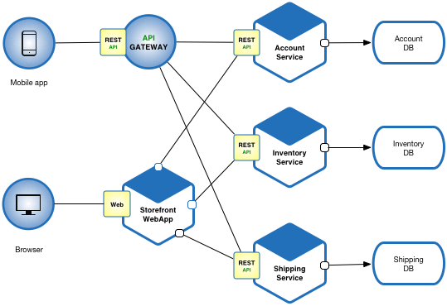
Microservices
The database is at the base
Databases are accessed by API calls
An API gateway is defined to communicate with APIs
The application or mobile app communicates with the API gateway to retrieve information
Here a series of HTTP protocols take place
Data is received and modified accordingly

Slide 10
References
skelia. (2018, March 2). 5 MAJOR BENEFITS OF MICROSERVICE ARCHITECTURE. Retrieved November 26, 2019,
from skelia website: https://skelia.com/articles/5-major-benefits-microservice-architecture/
Wittmer, P. (2019, July 4). Advantages and Disadvantages of Microservices. Retrieved November 26,
2019, from tiempodev website: https://www.tiempodev.com/blog/
disadvantages-of-a-microservices-architecture/
Torre, J. L. (2018, April 11). Microservices: The Good, the Bad, and the Ugly. Retrieved November
26, 2019, from dzone website: https://dzone.com/articles/
microservices-the-good-the-bad-and-the-ugly
Richardson, C. (2015, June 15). Building Microservices: Using an API Gateway. Retrieved November 26,
2019, from nginx website: https://www.nginx.com/blog/
building-microservices-using-an-api-gateway/
U, D. (2015, August 8). What are microservices? [Video file]. Retrieved from https://youtu.be/
PY9xSykods4
Notes:
In Slide Show mode, select the arrows to visit links.

